Slide 1
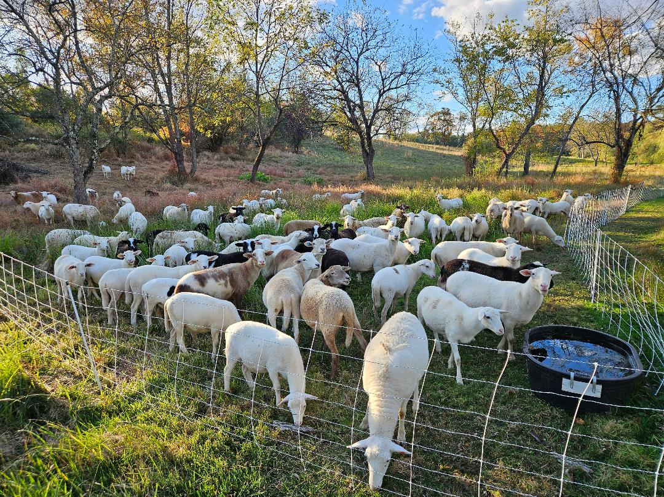
Sheep Management for Small to Mid-sized Producers

Slide 2
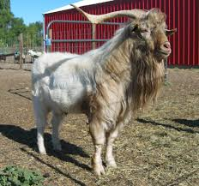
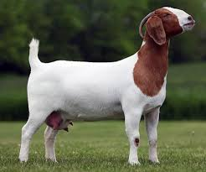
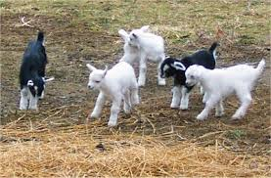
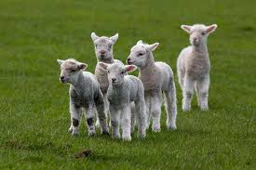
Sheep/Goat Facts
Ram/Buck- male of breeding age
Ewe/Doe- female of breeding age
Lamb/Kid-newborn

Slide 3
Types of Sheep/Goats
Fine Wool- High end wool for textiles
Long Wool- coarse, strong, luster
(English breeds)
Carpet Wool- low quality
Hair- Straight, non elastic shed out every year
**Goats- the vast majority of goats have hair (example of wool goat ➔ Angora)

Slide 4
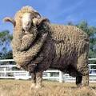
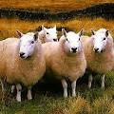
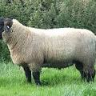
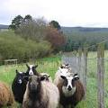
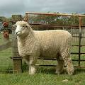
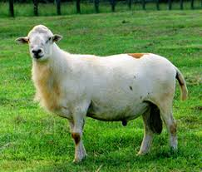
Popular Breeds of Sheep
Cheviot
Long wool
Shetland
Long wool
Katahdin
Hair
Merino
Fine wool
Suffolk
Carpet wool
Romney
Fine Wool

Slide 5
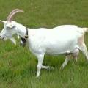
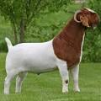
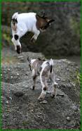
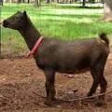
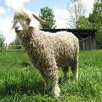
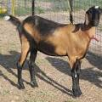
Popular Breeds of Goats
Boer
Meat
Nigerian Dwarf
Milk
Angora
Wool
Saanen
Milk
Pygmy
Pet or
companion
Nubian
Milk

Slide 6
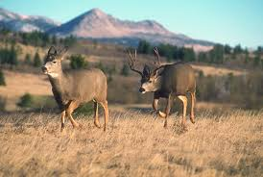
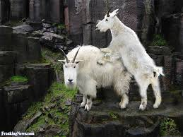
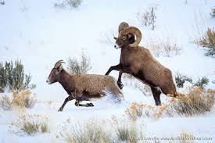
Wild cousins are similar

Slide 7
Sheep Nutrition
Sheep do very well on pure grass pasture or pastures that are not at hay quality
  A mix of grasses and legumes will provide 100% of the forage requirements if managed properly
Free choice minerals should be made available to sheep at all times
Notes:
Feeding the Flock
Keeping feed costs low while still supplying the necessary nutrients to keep the flock healthy should be the goal of every shepherd.
Save For Later Print
ARTICLES
UPDATED: AUGUST 8, 2017
Listed below are some guidelines on feeding the flock. Because a ewe's feed requirements change as her reproductive status changes, there are several distinct feeding periods. The rations below are designed to keep feed costs at a minimum, while supplying all the necessary nutrients required by the ewe. Keep in mind these are guidelines and may need to be adjusted for your operation.
In drawing up these guidelines there were several assumptions made that you should be aware of. The flock should always have access to a loose trace mineral salt formulated for sheep. They should always have access to plenty of clean, fresh water. Always change feeds gradually.
Pasture refers to a well managed grazing system containing improved grasses and some legumes. There should be several small pastures so that rotational grazing can be practiced. With a good pasture system, sheep should be able to eat all the fresh herbage they want every day. A good pasture has lime applied as needed and is fertilized every year. Over 90% of all sheep pastures in this area do not qualify as good pasture, so be honest with yourself.
The amount of hay in each ration is the amount the ewe must eat, not necessarily the amount you put in the feeder. You must take into account any wasted feed and adjust accordingly.
Alfalfa hay refers to average alfalfa with a crude protein content of 17%, while clover hay was assumed to have 15% crude protein. Mixed hay assumes a 50:50 grass:legume mix (timothy/clover, etc.) with 13% crude protein and grass hay assumes 10% crude protein. In this area, grass hay is usually either timothy or orchardgrass. "Meadow hay" of unknown grass species and weeds should not be fed to sheep.
Corn refers to coarsely cracked corn, and commercial feed refers to complete feeds prepared at a feed mill. The % is the amount of crude protein in the feed. All rations are the amount to be fed daily.
Rations are shown for 130 pound and 150 pound mature ewes. If your ewes are smaller or larger, you will need to make the appropriate adjustments. Past research has shown that the ideal size ewe for commercial production is about 135 pounds. Ewes much larger than this do not wean off any more pounds of lamb and cost more to feed.
Purebred producers who are trying to sell breeding stock and compete on the show circuit will need to maintain a ewe which meets the breed standards for size and weight. For many breeds, that is well above 175 pounds.
Nonlactating and First 15 Weeks of Gestation
During these two periods, a ewe's nutritional needs do not change a great deal, and her feed requirements are fairly low. Therefore, her needs can be met with any of the following forage rations. Because legume hay is generally more expensive than grass hay, it would be economically sound to feed the cheaper grass hay during these periods. You will note that commercial feeds are not recommended because they cost more and are not necessary during these periods. Choose one:
130 pound ewe; Choose one:
Pasture, if adequate
3 lbs. of alfalfa or clover hay
3.5 lbs. of grass or mixed hay
150 pound ewe; Choose one:
Pasture, if adequate
3.5 lbs. of alfalfa, clover, mixed or grass hay
Flushing
Flushing simply means providing a little extra feed for your brood ewes prior to the breeding season. Research has shown that ewes on an increasing plane of nutrition during the breeding season are more likely to have twins. Two weeks prior to the breeding season start giving the ewes 1/4 to 1/2 pound of corn or other feed each day. Lush pasture can also be used but avoid pasture with a high percentage of red clover - it adversely affects reproduction. Continue flushing 2 to 3 weeks into the breeding season and then discontinue. Do not flush fat ewes, as you will only be compounding reproductive problems.
Last 6 weeks of Gestation and Last 8 Weeks of Nursing Single Lamb
A ewe's nutritional requirements during the last 6 weeks of pregnancy and the last 8 weeks of nursing a single lamb are about the same and are treated as one feeding period for ration formulation. The ewe's energy and protein requirements are higher during this period and the ration must be adjusted accordingly. You will note that some of the rations are completely hay. Many ewes in late pregnancy cannot consume that much forage because their digestive system is squeezed by the lambs in the uterus. Therefore, you may find that you have to use a combination of hay and grain during this period.
130 pound ewe; Choose one:
Pasture, if adequate
4.25 lbs alfalfa, clover or mixed hay
2.75 lbs alfalfa, clover or mixed hay and 1 lb. corn
2 lbs. alfalfa, clover or mixed hay and 2 lbs. corn
3.75 lbs. grass hay and. 5 lb. 14% commercial feed
3 lbs. grass hay and 1 lb. 14% commercial feed
2 lb. grass hay and 2 lbs. 14% feed
150 pound ewe; Choose one:
Pasture, if adequate
4.5 lb. alfalfa, clover or mixed hay
3 lb. alfalfa, clover or mixed hay and 1 lb. corn
2 lb. alfalfa, clover or mixed hay and 2 lb. corn
4 lb. grass hay and. 5 lb 14% commercial feed
3 lb. grass hay and 1.5 lbs. 14% commercial feed
2 lb. grass hay and 2 lbs. 14% commercial feed
As with the first feeding period, the ewe's needs can be met with the cheaper mixed hay and that is the most economical feed for this period. However, many ewes cannot eat large amounts of hay in this stage of pregnancy, because the lambs take up most of the space in her abdomen. Therefore, most shepherds cut back on the amount of hay and increase grain. This also helps avoid Pregnancy Toxemia. Several rations with reduced hay and some grain are listed. Good pasture will still meet the ewe's needs during these periods if it is available, and if she can consume enough with the limited gut capacity during pregnancy. By the time the lambs are eight weeks old, the ewe's milk production has dropped off and her nutritional needs can usually be met with good pasture.
First 8 Weeks Nursing Singles and Last 8 Weeks Nursing Twins
During these two periods a ewe's daily requirements are very high and she requires a considerable amount of feed per day. As you can see from the rations below, these periods are the time to use good legume hay. Once the ewe has lambed, grass hay needs to be supplemented with high protein commercial feeds in order to balance the ration. Commercial feeds are generally a good deal more expensive than legume hay.
130 pound ewe; Choose one:
Pasture, if adequate
4 lbs. alfalfa or clover hay and 1.75 lbs. of corn
4.25 lbs. alfalfa or clover hay and 1.5 lbs. of corn
4 lbs. mixed hay and 1.75 lbs. 16% commercial feed
2 lbs. grass hay and 3.75 lbs. 16% commercial feed
150 pound ewe; Choose one:
Pasture, if adequate
4 lbs. alfalfa hay and 2 lbs. corn
5 lbs. alfalfa hay and 1.25 lbs. corn
4.25 lbs. clover hay and 2 lbs. corn
4 lbs. mixed hay and 2.25 lbs. 16% commercial feed
2 lbs. grass hay and 4 lbs. 16% commercial feed
Do not feed the full amount the first few days after lambing. Provide the ewe with hay and plenty of clean fresh water. Gradually increase the feed to the desired level during the first week after lambing.
First 8 Weeks of Nursing Twins
There is no other time in a ewe's life when her nutrient requirements are higher than when she is nursing twins. This period requires a great deal of high quality feed. As in the previous examples pasture is included in the event you are on a lambing system where the lambs are born during warm weather. Pure grass pastures will be a little short on protein, but not critically short. A grass pasture with a small amount of clover will meet all energy and protein requirements.
130 pound ewe: Choose one:
Pasture, if adequate
4.5 lbs. alfalfa or clover hay and 2 lbs. of corn
3 lbs. mixed hay and 3.5 lbs. 18% commercial feed
2.5 lbs. grass hay and 4 lbs. 18% commercial feed
150 pound ewe; Choose one:
Pasture, if adequate
5 lbs. alfalfa hay and 2 lbs. corn
6 lbs. alfalfa hay and 1 lb. corn
5 lbs. clover hay and 2 lbs. 16% commercial feed
5 lbs. mixed hay and 2 lbs. 18% commercial feed
3 lbs. grass hay and 4 lbs. 18% commercial feed
Replacement ewes and lambs being fattened for slaughter have their own special requirements. A couple of example rations are listed below.
90 pound Replacement Ewe gaining. 4 pounds/day
Pasture, if adequate
3.5 lbs. alfalfa, clover or mixed hay
2.5 lbs. grass hay and 1 lb. 18% commercial feed
90 pound Lamb being fattened, gaining. 6 pound/day
Pasture and 1/2 pound corn
2 lbs. alfalfa hay and 2 lbs. corn
1 lbs. alfalfa hay and 3 lbs. corn
. 5 lb. clover, mixed or grass hay and 3.5 lbs. 14% commercial feed
Mature rams can get by on pasture or hay through the entire year, except during breeding season. Depending on the number of ewes he is breeding and his size, a ram may need a little corn or 14% feed to keep him in shape during the breeding season.
Prepared by Michael Fournier, former Penn State Extension Educator

Slide 8
Reproductive Traits (sheep)
Mature Weight- 90 – 300 lbs. (ewes)
150 -450 lbs. (rams)
Mature Age – 5-8 months (ewes)
6-8 months (rams)
**1 Ram can service 30 -35 ewes in 60 day breeding season
** Semen is freezable

Slide 9
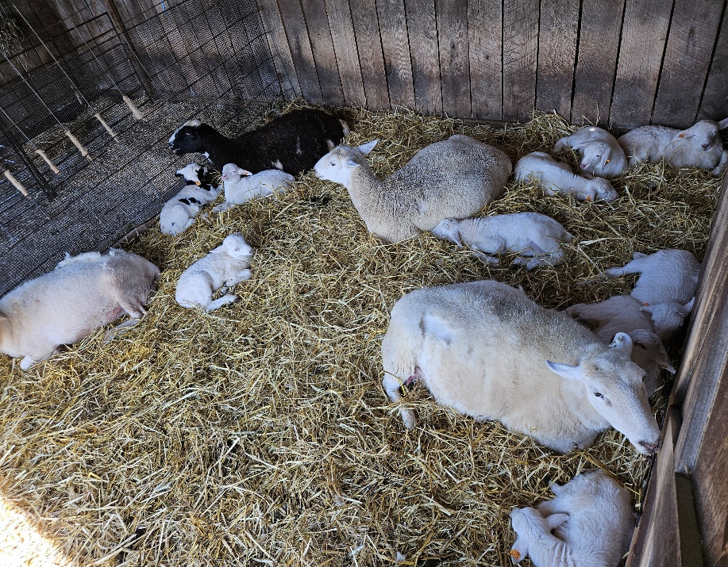
Reproductive Traits (Continued)
Ewes- most sheep are seasonal breeders
  Early fall to late winter but some are
  Poly-estrous- able to be bread year round
Estrous Cycle- 14-19 days (17days)
Duration of estrus- 24-36hrs. (standing heat)
Gestation Period145-155 days
  Artificial Insemination- Yes (cervical/vaginal)

Slide 10
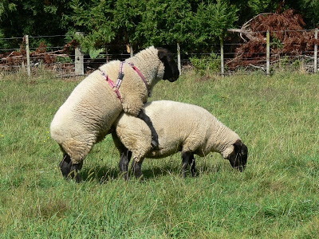
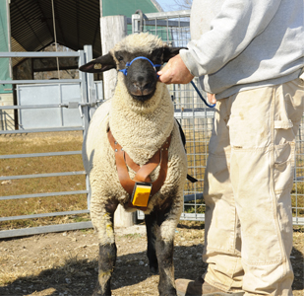
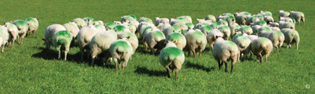
Keep track of rams progress
Marking harness-
Switch colors after 20 days

Slide 11
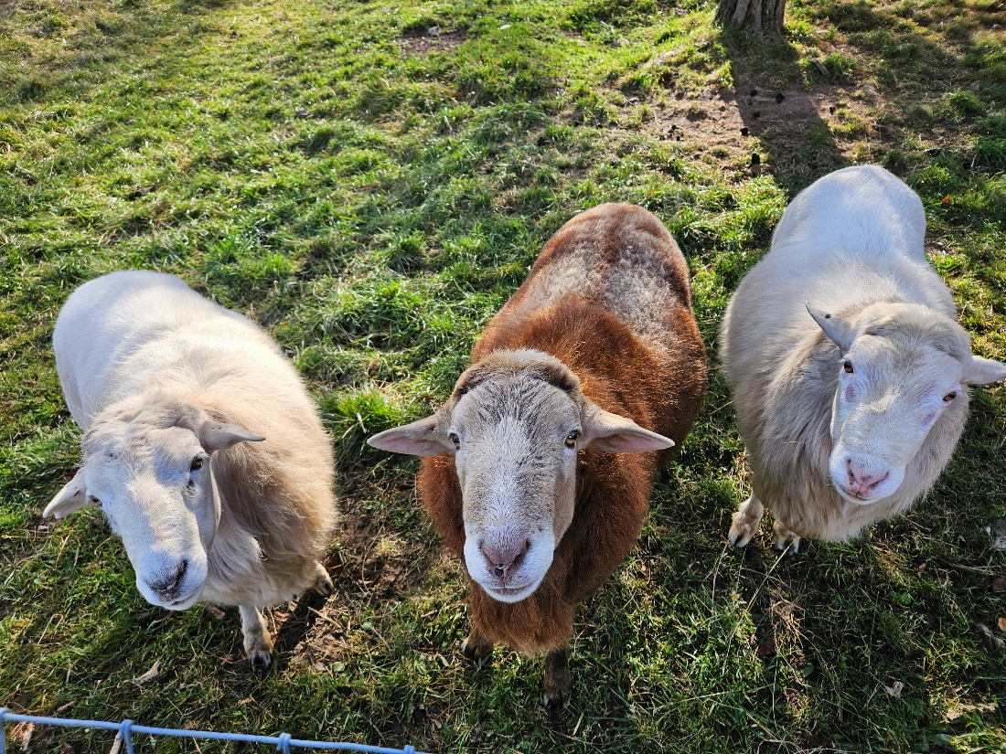
Feeding Rams
Be sure to keep rams in good body condition prior to ewe exposure
  Trim hooves
  Breeding soundness exam 30 days prior
Rams will lose weight during breeding
  Check harness and observe ram activity
Return to good quality forage when breeding is complete

Slide 12
Feeding Ewes during Pregnancy
1st Trimester
  Ewes should be in good body condition
  Quality pasture or stockpiled pasture or decent 1st cutting hay
    Top feed quality is not essential and should not be too rich in protein to avoid rapid fetal growth
  Always provide free choice minerals
  Mineral intake, especially calcium and selenium very important
    Consider adding kelp meal for additional iodine

Slide 13
Feeding Ewes during Pregnancy
2nd Trimester
  Transition ewes to higher quality forage
  Quality pasture or stockpile pasture
Transition to 2nd cut hay
  Be sure to get a hay forage test prior to feeding
  Vitamin, mineral, protein, energy content
Pregnancy check at this point
  Blood or ultrasound

Slide 14
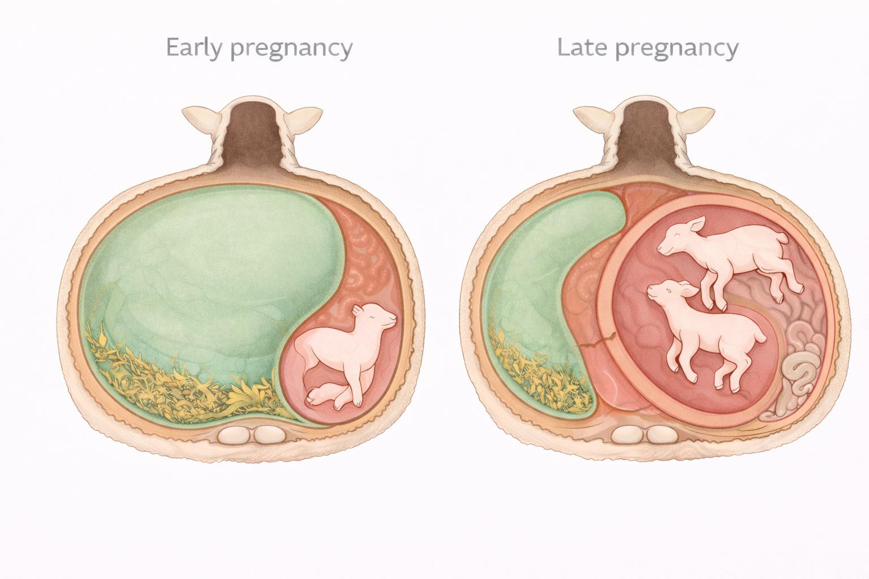
Lambs Growth

Slide 15

Feeding Ewes in 3rd Trimester
Space is limited
  Roughly two-thirds of fetal growth occurs during the final four to six weeks of gestation.
Nutrient demand rising Feed capacity shrinking
  Energy vs Protein
  Ewes require energy dense forage
  Balance energy and protein
    Pregnancy toxemia (ketosis) or milk fever (calcium deficiency)
Notes:
Spend enough time around sheep and goats and you’ll hear a lot of simple advice about late pregnancy.
“Just feed more protein.”
“Give them more hay.”
“Add some grain the last couple weeks.”
The problem is that biology rarely works in simple one-line rules. Sheep and goats aren’t machines where one dial controls everything.
Late gestation is not about one nutrient.
It’s about how the entire system changes during the last weeks of pregnancy.
And one of the most important changes has nothing to do with feed ingredients.
It has to do with space.
⸻
The Rumen Is Enormous
To understand what happens late in pregnancy, we first need to understand just how big the rumen really is.
In an adult sheep or goat, the rumen is massive.
In many animals it can hold roughly the volume of a five-gallon bucket of feed and fluid. In fact, the rumen alone can account for 60–70% of the entire digestive tract volume.
That large fermentation vat is what allows sheep and goats to live on forage. Inside the rumen, billions of microbes break down plant fiber and convert it into usable energy for the animal.
Under normal conditions, this system works extremely well.
But pregnancy changes the physical layout inside the abdomen.
⸻
Two Organs Competing for the Same Space
As lambs or kids grow during the final weeks of pregnancy, the uterus expands rapidly.
In sheep and goats, roughly two-thirds of fetal growth occurs during the final four to six weeks of gestation.
That means the uterus is increasing in size very quickly during the same time period when the developing lambs or kids are demanding the most nutrients.
But the abdomen is a fixed space.
When the uterus expands, something else has to move.
And what gets pushed out of the way is the rumen.
⸻
A Simple Way to Picture It
One way to visualize this is to imagine two balloons inside a box.
As one balloon grows larger, the other balloon has less room to expand.
The abdomen works in a similar way. As the uterus enlarges during late pregnancy, the rumen has less room to expand after a meal.
The rumen doesn’t disappear.
It simply has less space to work with.
⸻
The System Starts to Tighten
As the uterus enlarges, it begins compressing the rumen.
This creates an important shift in the system:
The same animal that needs more nutrients is also losing some of her ability to consume large volumes of feed.
In other words:
• Nutrient demand is rising.
• Feed capacity is shrinking.
Late gestation is where those two curves begin to cross.
⸻
Why “Just Feed More Hay” Doesn’t Always Work
A common piece of advice is to simply offer more hay during late pregnancy.
While forage remains extremely important, this advice misses a key biological reality.
As abdominal space becomes limited, the animal often cannot physically consume the same large volumes of bulky forage she could earlier in pregnancy.
This is especially true when animals are carrying twins or triplets.
It’s not that the animal suddenly refuses to eat.
It’s that the system is becoming physically constrained.
Understanding this mechanical pressure is one of the keys to understanding late gestation nutrition.
⸻
Bigger Babies Are Not the Goal
Another misconception that sometimes appears in late-gestation discussions is the idea that larger birth weights should always be the goal.
Birth weight can certainly be useful data when tracking flock performance, but it should not be confused with future growth potential.
Just as in humans, a larger newborn does not necessarily mean the animal will become larger later in life.
The goal of late gestation feeding is not to create the biggest possible lambs or kids.
The goal is to maintain metabolic balance in the ewe or doe while supporting healthy fetal development.
Those are not always the same thing.
⸻
Why Understanding the System Matters
Many sheep and goat producers do very well with simple feeding systems.
Pasture-based animals may raise healthy lambs every year.
Others feed round bales free-choice with few obvious problems.
But understanding how the system actually works allows producers to recognize when things begin to drift out of balance.
Late gestation is a period where several forces are all changing at the same time:
• fetal growth accelerates
• energy demand rises
• rumen capacity decreases
• abdominal pressure increases
When these changes line up poorly, metabolic problems can begin to appear.
⸻
In the Next Article
Now that we understand the space problem, the next step is to look at the metabolic side of the equation.
Because once rumen intake begins to fall while fetal demand continues to rise, the ewe or doe must begin drawing energy from somewhere else.
And that’s where some of the most important late-gestation challenges begin.

Slide 16
Lambing Time
Preparing ewes for lambing
  Provide a warm dry place to allow ewe to lamb
  After lambs hit the ground separate to from flock and place ewe and lambs together in quiet place
Claiming- this will help mothers accept newborns
  Sheep very rarely will share
  Colostrum is needed within 10 hours of birth
  https://youtu.be/APnR9m6PWFw?si=DILx_K9D4CAZu4cS

Slide 17
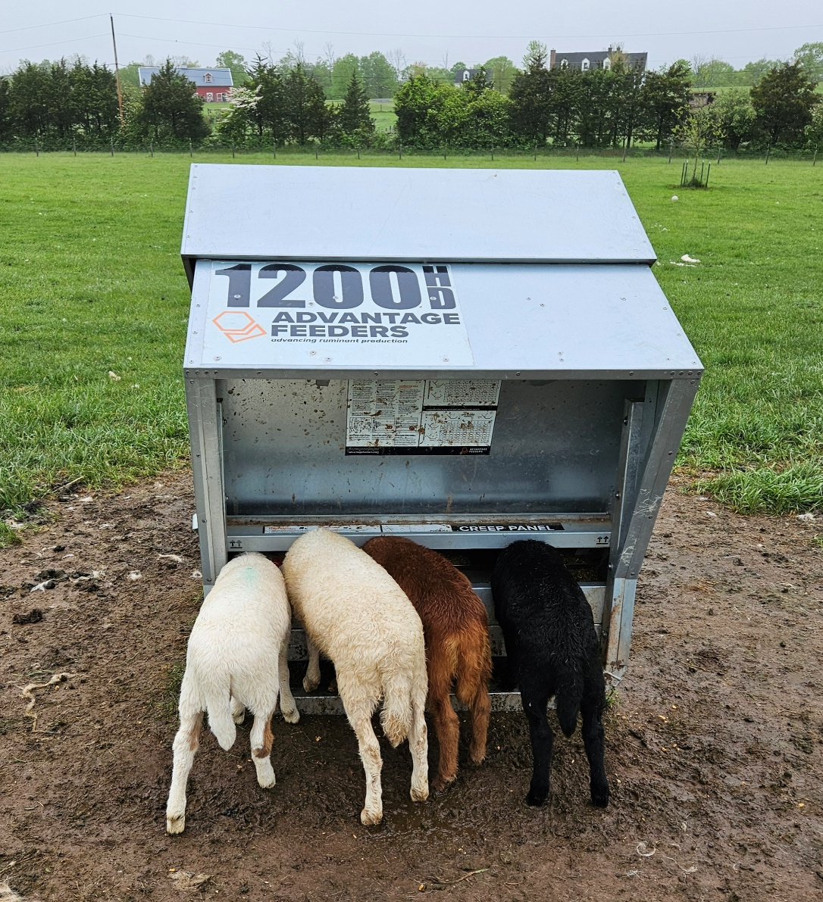
Lamb Management
Observe lambs often
Look for bright active lambs
  Respond to mom tails wag when nursing
  The “pinky trick”
    Tubing lambs might be needed
    https://youtu.be/9ayeyHXDk_M?si=pncShkPAvhhqB2Kk
Teaching and Growing
  Fence train ASAP
  Allow access to 19-22% creep feed at 2 weeks
    Consumption picks up after week 4

Slide 18
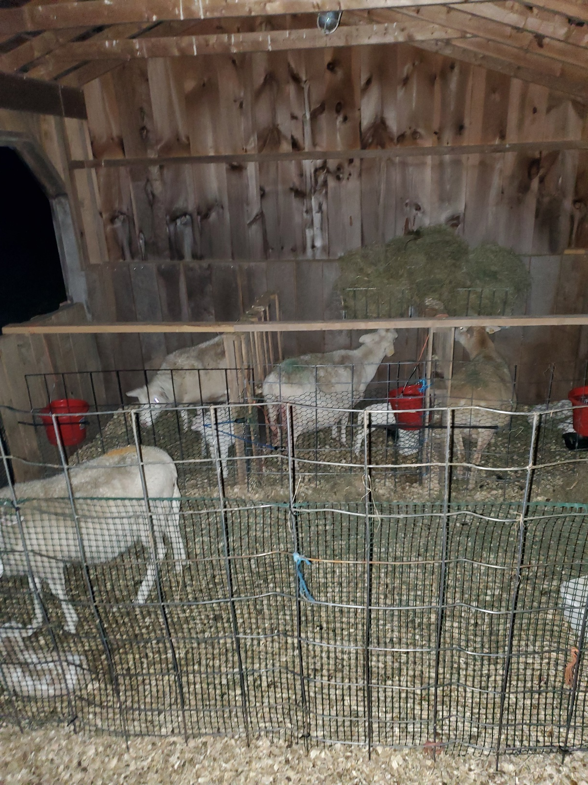
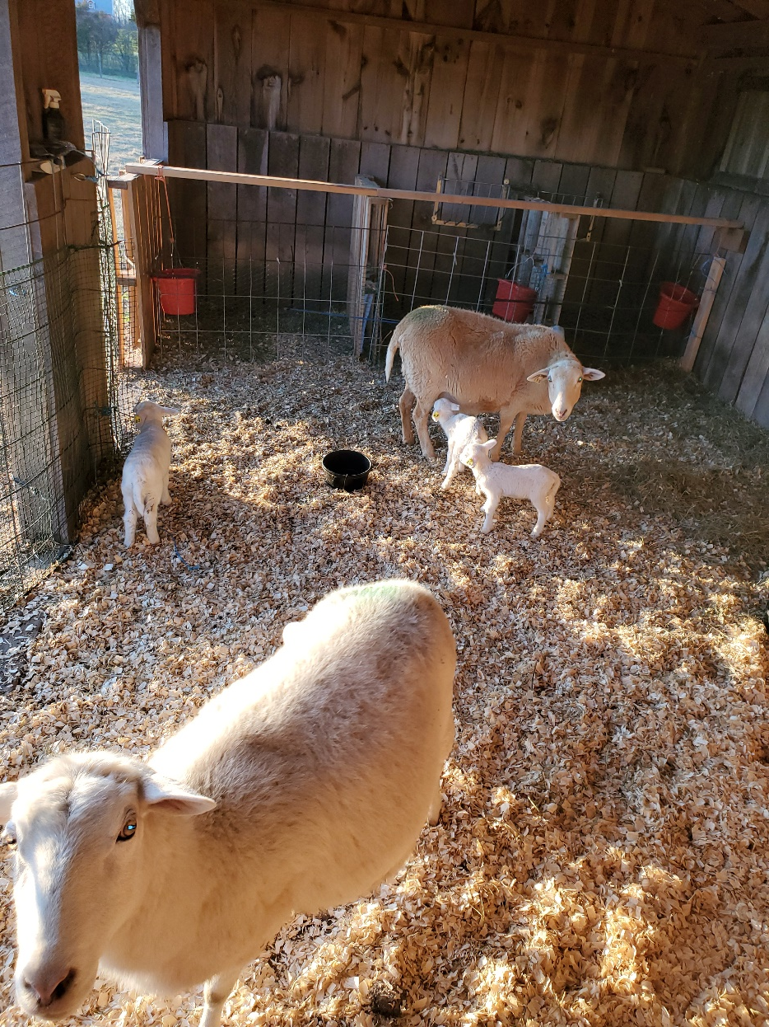

Slide 19
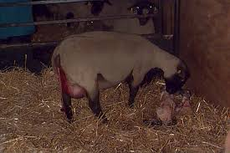
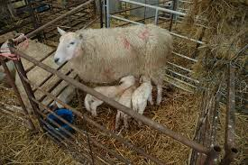
Sheep Like Privacy at Lambing

Slide 20
Sheep Health
Sheep do get sick but many problems can be prevented with good observation and quality living conditions
The biggest challenge to all sheep production systems (organic or conventional) are internal parasites

Slide 21
Internal Parasites
Passed onto pasture through manure
  Best to deworm new flock members before bringing to your farm or set up area to dump worms away from active pastures
Eggs hatch and develop in soil and manure
  Larvae climb grass to gain access to host
Ingested through grazing
  Adult larvae lay eggs in digestive system of host
Notes:
https://www.extension.purdue.edu/extmedia/as/as-573-w.pdf

Slide 22
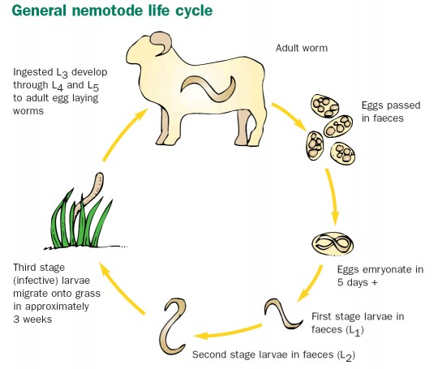
Parasite
Life
Cycle https://youtu.be/Ly8jwhLF9yU?si=R6wmTXnz3XI-kG8t
Notes:
https://attra.ncat.org/attra-pub/viewhtml.php?id=215

Slide 23
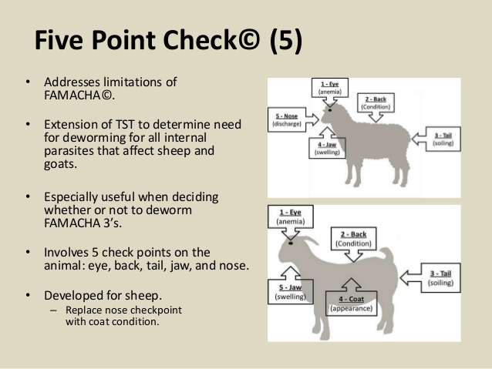

Slide 24
Sheep Disease (common)
White Muscle Disease-
  Lack of selenium and/or vitamin E
Foot-rot-
  Two bacteria present in soil also carried by members of the flock (can affect cows, horses)
  https://youtu.be/xSVYILBs7Lw?si=oYuBNMua0anrAw1y
Pinkeye-
  Bacteria carried by flies (can affect other species including humans)

Slide 25
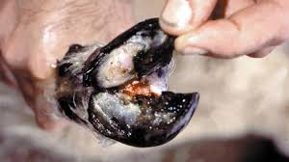
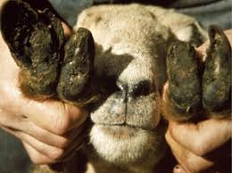
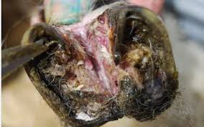
Foot- Rot
Treatment
-Zinc or copper sulfate foot bath
-Routine hoof trimming
-Clean stock yard or dry pasture

Slide 26
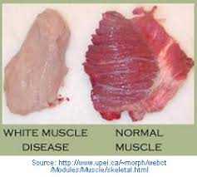
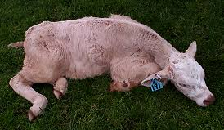
White Muscle Disease

Slide 27
Digestive System
Ruminant- multiple compartment stomach containing microbes (bugs) that are able to digest forages
Daily consumption- Food- 2-5 lbs
Water- .5 – 1.5 quarts
Daily Waste- Fecal- 2 – 6.5lbs
Urine- 20-80 ml per lb body weight

Slide 28
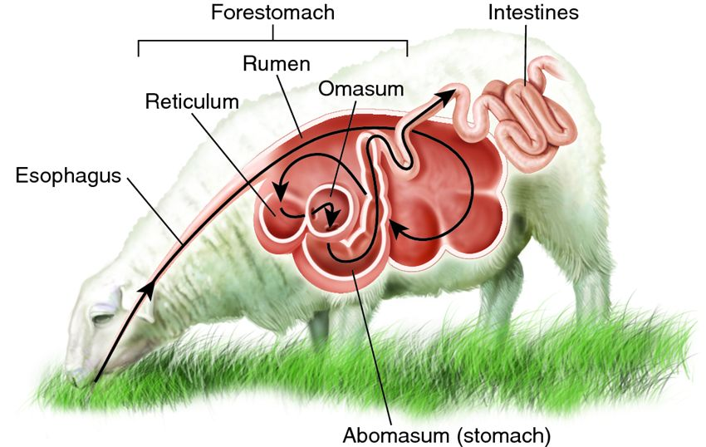
Rumen in Sheep

Slide 29
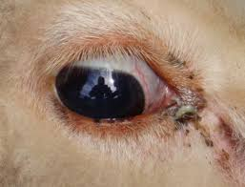
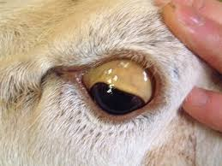
Copper Toxicity
Normal
Minerals should not contain Copper!
  Copper toxicity can kill sheep
  Be sure to read the ingredient labels
  Excess copper is usually not the main issue
  Poor nutritional management allows for copper to be dangerous
Copper Toxic
Notes:
Information by
Treasure Valley Sheep Producers
by Larry L. Berger, Ph.D.
Professor, Animal Sciences
University of Illinois
Importance of Copper
Copper toxicity in sheep is more often a problem of nutritional management than it is excess copper intake. The purpose of this paper is to look at such factors as nutrient interactions, animal management, and environmental conditions that may increase the risk of copper toxicity and how the sheep producer can minimize these risks.
The importance of copper as an essential nutrient has been known since the 1920's. Copper is required for normal iron metabolism, elastin and collagen synthesis, melanin production and integrity of the central nervous system. There are numerous metalloprotein enzymes, metalloporphyrin enzymes and non-enzyme metalloproteins in animals that require copper to be biologically active. More recently it has been shown that copper is one of the key trace minerals required for an effective immune response. The bottom line is that copper is essential for life. Consequently, most trace mineralized salt products contain 0.03 to 0.04% (300 to 400 ppm) of copper to prevent copper deficiency.
Sensitivity of Sheep
Like most nutrients, excessive concentrations can cause toxicity. However, sheep tend to be much more sensitive than other farm animals. For example, growing swine are often fed copper concentrations as high as 250 ppm in the diet to improve performance. Cattle can consume diets containing 100 ppm copper with no problem, while toxicities have occurred in sheep with concentrations as low as 10 ppm (Church and Pond 1988).
Copper toxicity in sheep usually results from the accumulation of copper in the liver over a period of a few weeks to more than a year with no clinical signs followed by a sudden release of liver copper stores to cause toxicity. In these situations, chronic copper poisoning may result from excessive copper intakes or from low intakes of molybdenum, sulfur, zinc, calcium or following liver damage (Kimberling, 1988). Sheep accumulate copper in the liver more readily than other farm animals and over a period of time, 1000 - 3000 ppm on a dry weight basis may be achieved. During the accumulation phase, blood copper levels are normal in the 0.10 to 0.20 mg/dl. Toxicity results when stress conditions cause the liver cells to die and release the stored copper into the blood. Plasma copper levels then increase 10 to 20 fold. These elevated blood copper levels (500-2000 mg/dl) usually precede clinical signs by 24 to 48 hours (Kimberling 1988). The most common symptoms are anorexia, excessive thirst and depression. These are accompanied by severe hemoglobinemia, anemia, icterus and methemoglobinemia. Most sheep will die within 1 to 2 days of the onset of these signs (Merck Veterinary Manual 1979).
Molybdenum Ratio
The ratio of copper to molybdenum is the most important dietary factor affecting copper toxicity in sheep. Ratios of 10:1 or less will prevent toxicity in most cases. The exact mechanism by which molybdenum prevents copper toxicity is poorly understood. However, it is known that an insoluble complex, CuMo04, can be formed in the gastrointestinal tract thus reducing copper absorption. This theory is substantiated by the fact that increasing dietary copper is an effective treatment of molybdenum toxicity.
Molybdenum concentrations in most feeds are in the range of 1 to 3 ppm in the total diet. If molybdenum concentrations are low (less than 1 ppm), diets containing copper in the range of the normal requirement (8 - 11 ppm) have been known to produce toxicity(NRC 1975). Sheep producers who live in or buy feed from molybdenum deficient areas should pay close attention to dietary copper levels. Such feeds as distillers dried grains and soybean meal which are normally high in copper should be limited in the diet. Trace mineralized salt should not be removed from the diet because it contains zinc which also reduces copper absorption. Diets containing high concentrations (100 ppm) of zinc have been shown to reduce liver copper stores. In addition, eliminating all trace mineral supplementation may actually worsen the situation by creating an even greater mineral imbalance.
Although prevention is much preferred, there are times when mass treatment is indicated. The most common treatment is to give a drench daily containing 50 to 100 mg of ammonium molybdate and 0.5 to 1.0g of sodium sulfate per animal for three weeks. To reduce labor, an aqueous solution of the two salts can be sprayed onto the feed. This approach is recommended as a treatment procedure only if all animals are eating regularly.
Unusual Animal Behavior, Check Veterinary Recalls: Feed, Medicine, Equipment and etc.
Animal Management and Environment
Besides nutrition, animal management factors can affect the incidence of copper toxicity in sheep. For example, although this disease can occur in both sexes of all breeds, mature ewes of British breeds seem to be the most susceptible. In the United States this disease is most common in the western states of the intermountain region. Although the disease can occur anytime, peak incidence usually is in the fall and winter.
Environmental factors and stress can also affect the susceptibility of sheep to this disease. For example, grazing sheep in areas containing certain potentially toxic plants may predispose them to copper toxicity. Plants such as lupines, which contain toxic alkaloids, produce copper toxicity by impairing the liver's ability to metabolize ingested copper. Chronic toxicity is also common in sheep grazing subterranean clover and is associated with normal levels of copper, low levels of molybdenum and no apparent liver damage. The stress associated with shipping ewes from mountain ranges to pastures some distance away appears to make ewes more susceptible.
Summary
In summary, sheep producers should become familiar with copper and molybdenum levels of feeds grown in their area. If the area is deficient in molybdenum or high in copper, feed samples should be analyzed routinely to monitor the copper: molybdenum ratio in the diet. Supplemental feeds which are known to be low in copper should be used whenever possible. Feeding a properly fortified trace mineralized salt is essential to the health and production of the sheep flock.
Literature Cited
Church, D.C. and W.G. Pond, 1988. Basic Animal Nutrition and Feeding, 3rd Edition. Published by John Wiley and Sons, New York. pp. 196-199.
Kimberling, C.V. 1988., Jensen and Swift's Disease of Sheep, 3rd Edition. Published by Lea and Febiger, Philadelphia, PA. pp. 372-374.
Merck Veterinary Manual, 1979. 5th Edition. Published by Merck and Company. Rahway NJ. pp. 977-978.
NRC., 1975. Nutrient Requirements of Sheep. 5th Edition, National Academy Press. Washington DC.

Slide 30
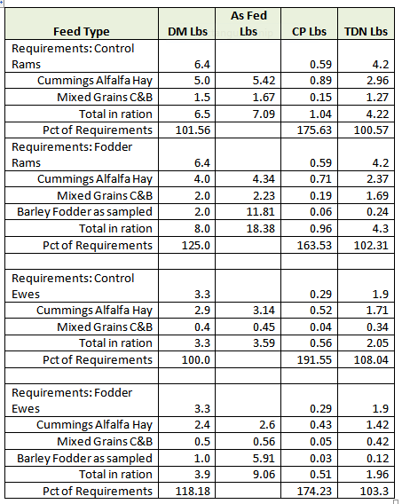
Feed Ration For Sheep

Slide 31
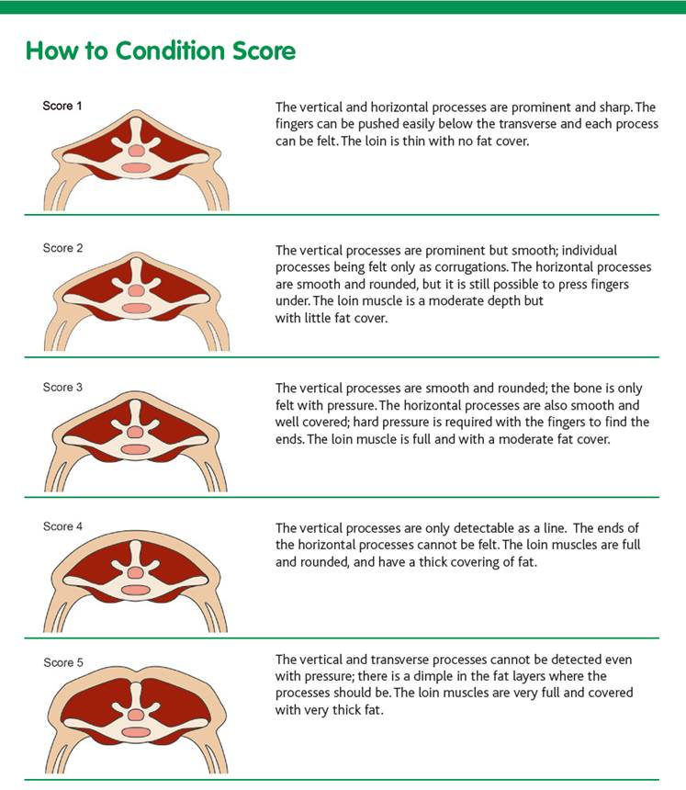
Body Condition Scoring

Slide 32
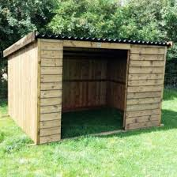
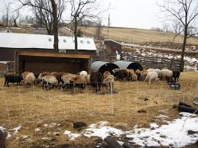
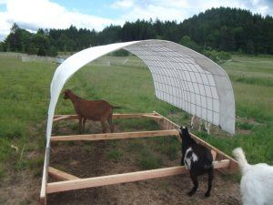
Sheep Shelter
https://youtu.be/NZNjWAxqLDI?si=RnDrCu3Sbs0JMrpz

Slide 33
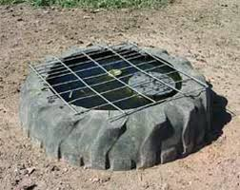
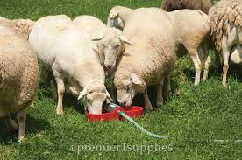
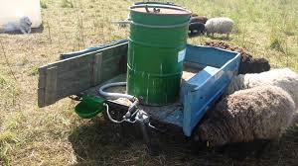
Watering

Slide 34
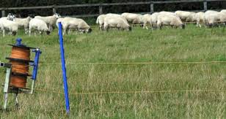


Fencing

Slide 35
Custom Grazing
Working with nearby property owners to benefit your flock and their land
  Develop relationships with neighbors
  Invasive weed control and animal impact
How to evaluate the right fit?
  What types of forage
  Size of the property/amount of animals
  Clear expectations for all parties involved
What to charge?
  Remember, you are putting time in but your animals are gaining weight

