Slide 1
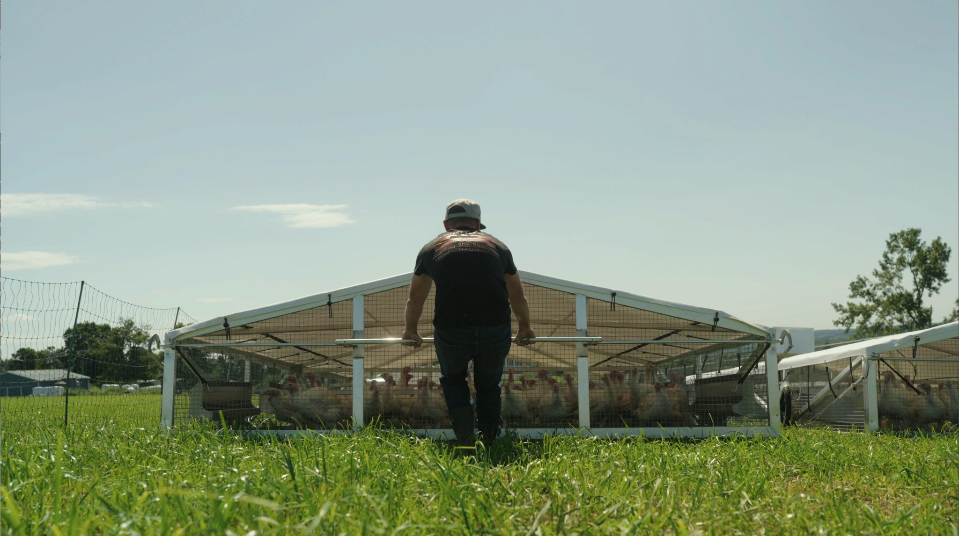

Rooted in Resilience:
Will Your Pastured Poultry Plan Hold Up in the Real Market or Get Put Out to Pasture?

Slide 2
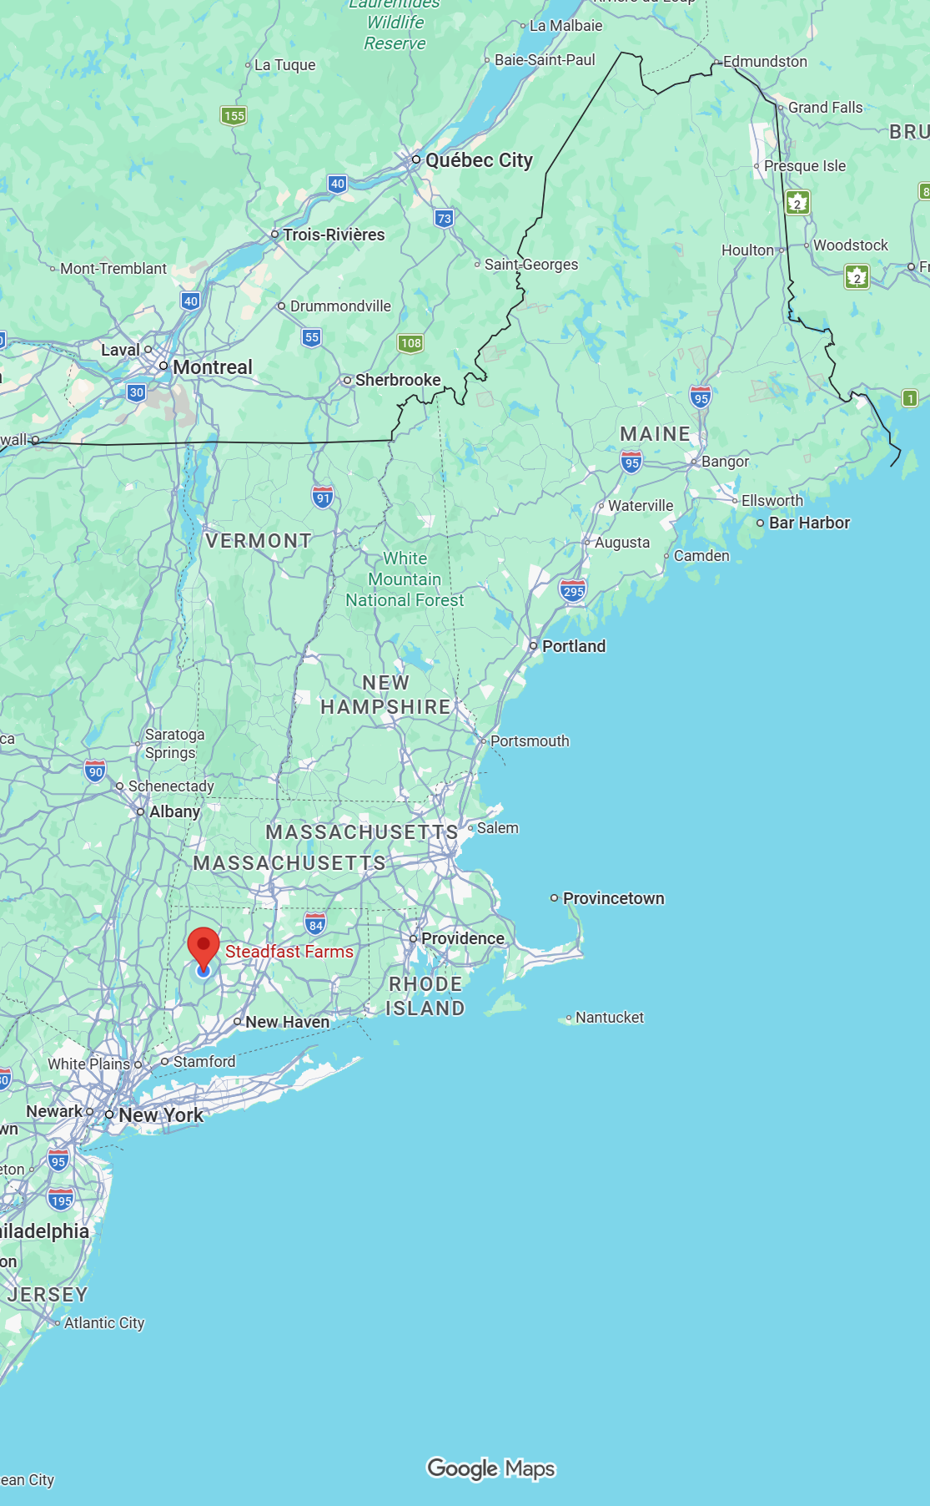


Why Our Perspective Matters
Steadfast Farms - Bethlehem, CT
10 years Raising Pastured Poultry
CT’s Only USDA-inspected Poultry Slaughter & Processing Facility
USDA Certified Organic
Animal Welfare Approved
Serving 180 Farms across the Northeast

Slide 3
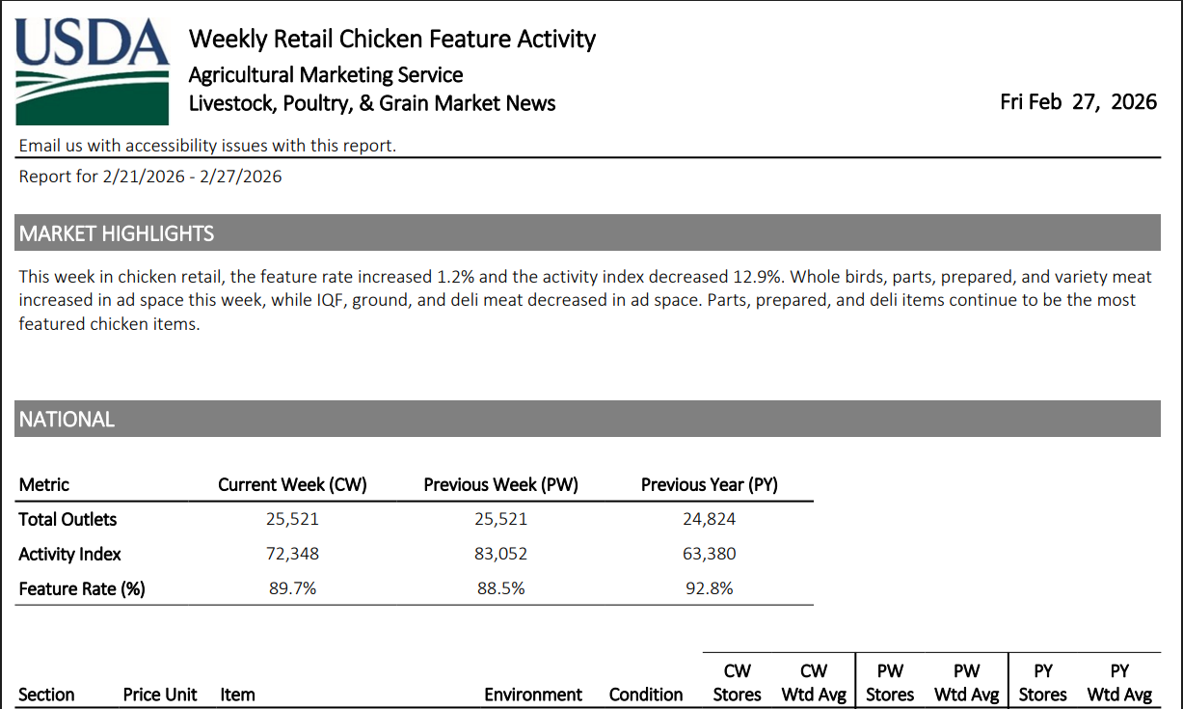
The Market Is Real
Source: USDA AMS Market News (2026)

Slide 4
The Market Is Real
47 Billion lbs U.S. annual chicken production
Source: USDA AMS Market News (2026)

Slide 5
The Market Is Real
47 Billion lbs U.S. annual chicken production
$2.9 Billion Organic livestock & poultry sales
Source: USDA AMS Market News (2026)

Slide 6
The Market Is Real
47 Billion lbs U.S. annual chicken production
$2.9 Billion Organic livestock & poultry sales
Demand is not the bottleneck.
Source: USDA AMS Market News (2026)

Slide 7
Retail Pricing Reality
$3.70
$4.49
Grocery Organic Whole Fryers
$4.50
$10.96
Farmer’s Market Organic Whole Fryers, Free Range
$9.00
$24.00
Boneless Skinless Breasts
$3.70
$24.00
What are you getting per pound right now?

Slide 8
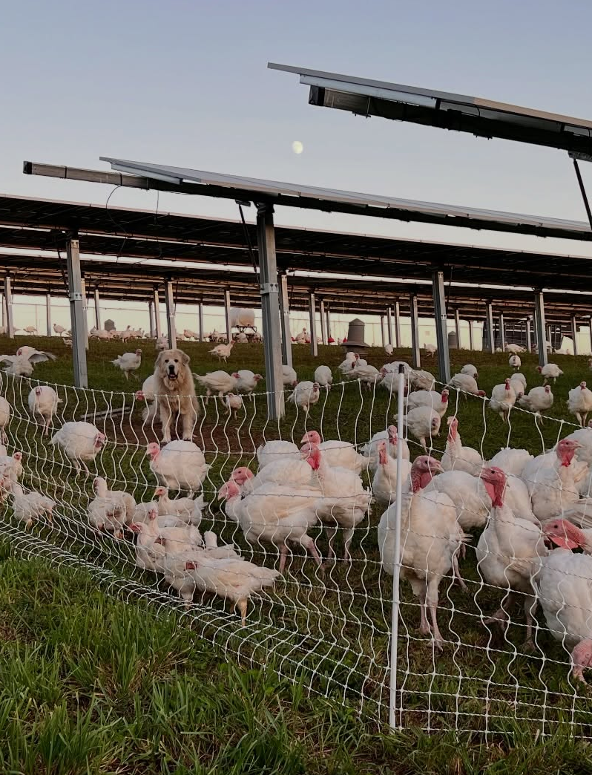
Raising Poultry Works — If
Processing secured
True cost per bird calculated
Labor capacity proven
Market defined before chicks arrive
Numbers work on paper first
Market first. Birds second.

Slide 9
Capacity Determines Scale
Birds per Acre ≠ Birds per Season
Rotation × Labor × Processing
ACRES AVAILABLE
DAILY MOVEMENT CAPACITY
BIRDS
PER
BATCH
BATCHES PER SEASON
ANNUAL
BIRD CAPACITY

Slide 10
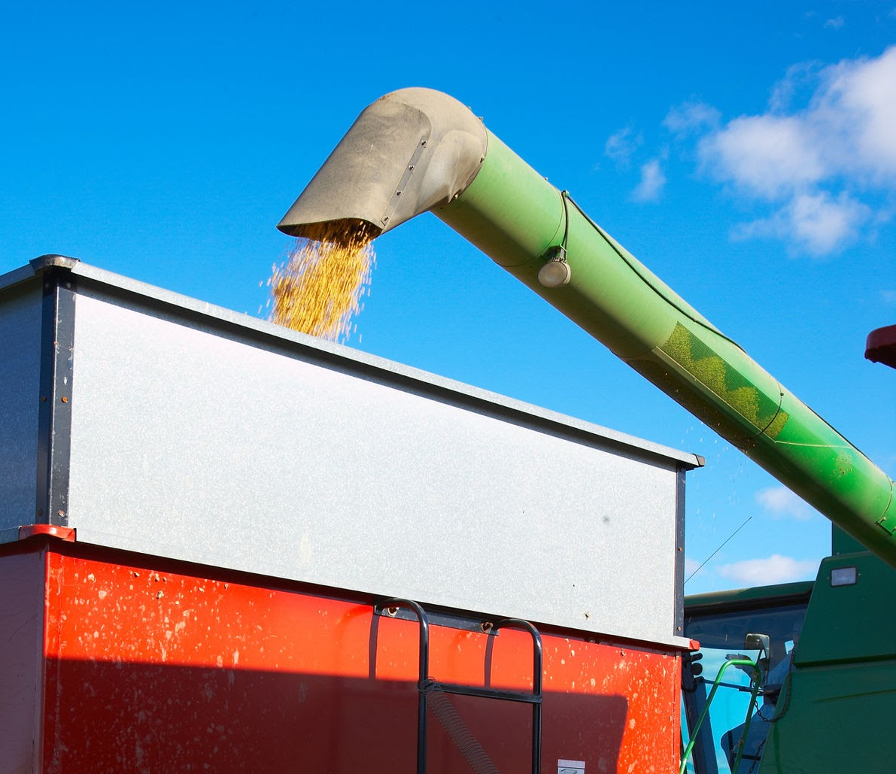
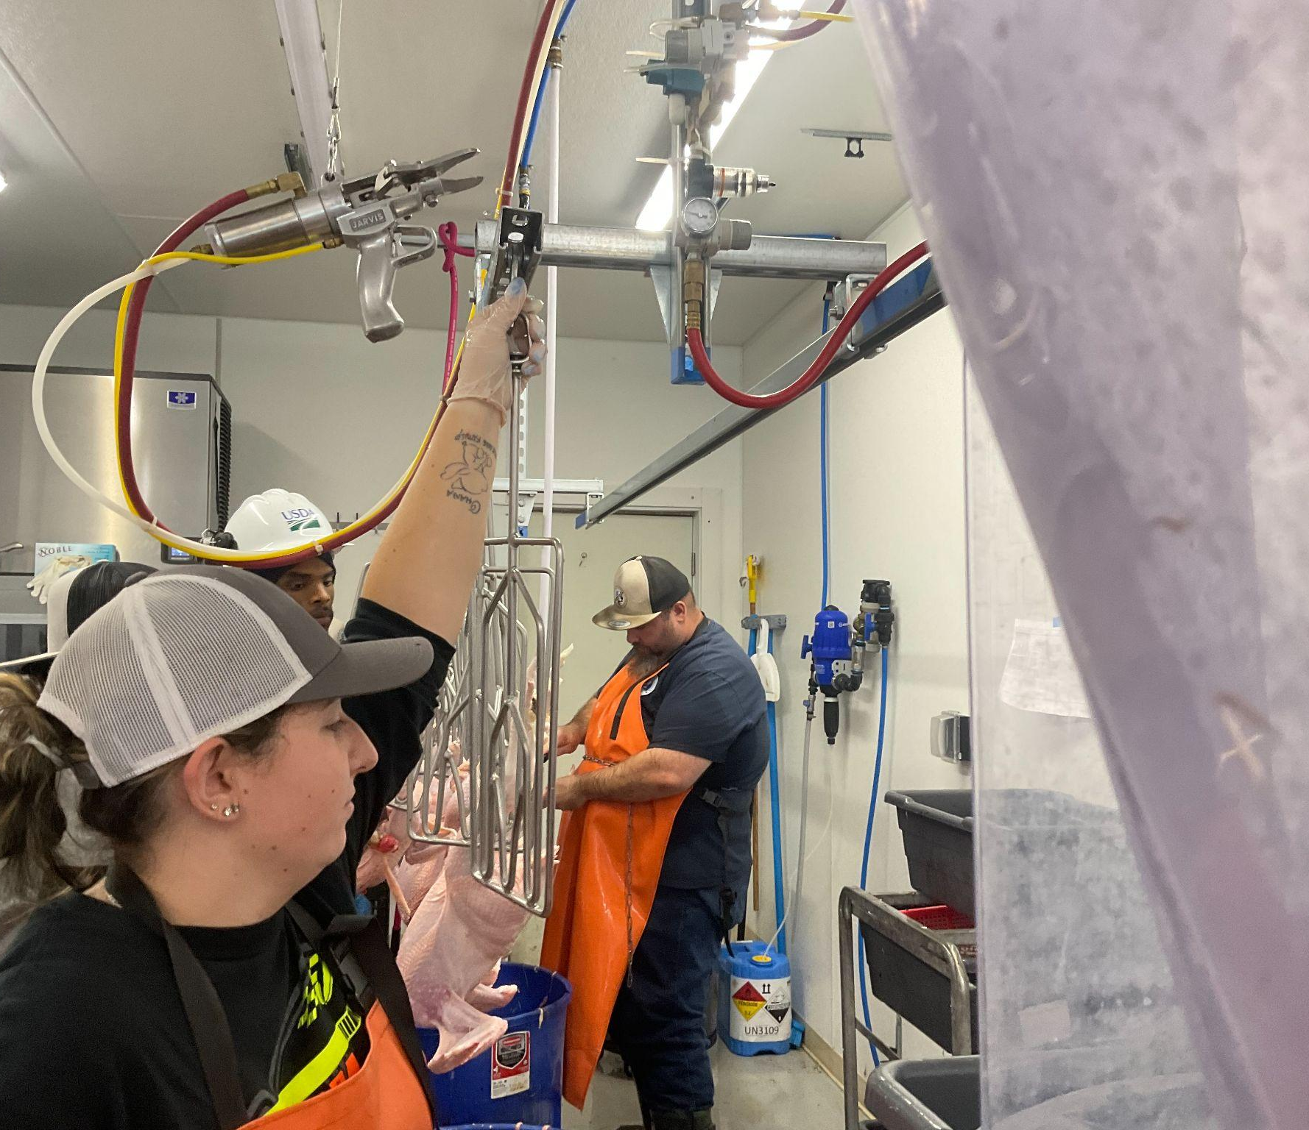
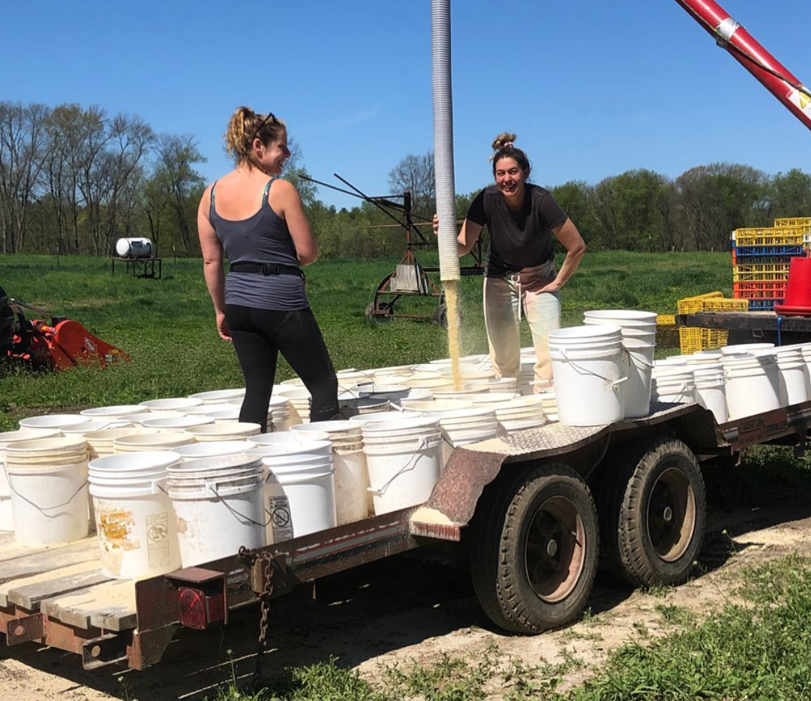
Cost Determines Margin
The Silent Costs
Feed
Slaughter
Labor
Shrink
Mortality
Fuel
Travel Time
50% - 60% of total cost
Bagged vs Bulk
Second Largest Expense
Almost Always Underestimated

Slide 11
Cost Determines Margin
The Silent Costs
Feed
Slaughter
Labor
Shrink
Mortality
Fuel
Travel Time
Marketing
50% - 60% of total cost
Bagged vs Bulk
Second Largest Expense
Almost Always Underestimated
Are you counting yourself?

Slide 12
1,000 Bird Projection
Per Bird
Chicks $2 - $4
Feed $6 - $8
Processing $6 - $8
Labor $2 - $4
Silent Costs $1 - $5

Slide 13
1,000 Bird Projection
Per Bird
Chicks $2 - $4
$6.50/lb × 4.5 lb = $29.25
gross revenue
Feed $6 - $8
Processing $6 - $8
Labor $2 - $4
Silent Costs $1 - $5
Total: $17 - $29+

Slide 14
1,000 Bird Projection
Per Bird
Chicks $2 - $4
$6.50/lb × 4.5 lb = $29.25
gross revenue
Feed $6 - $8
Processing $6 - $8
Revenue - Cost = Margin
Labor $2 - $4
Silent Costs $1 - $5
Total: $17 - $29+
Margin per Bird x 1000 Birds = Profit

Slide 15
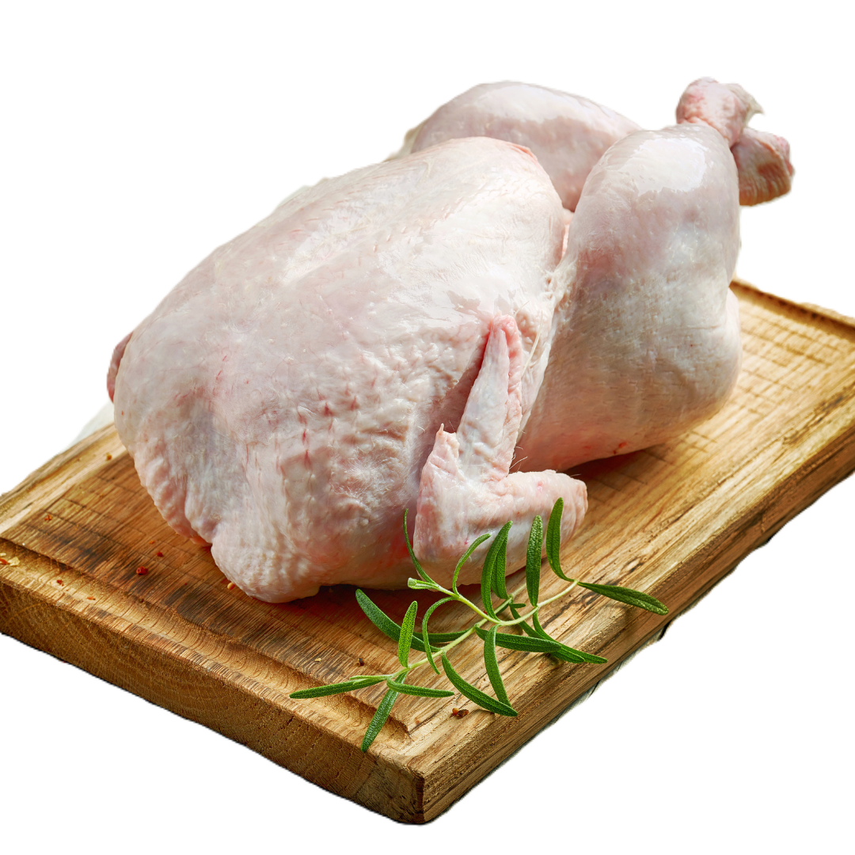
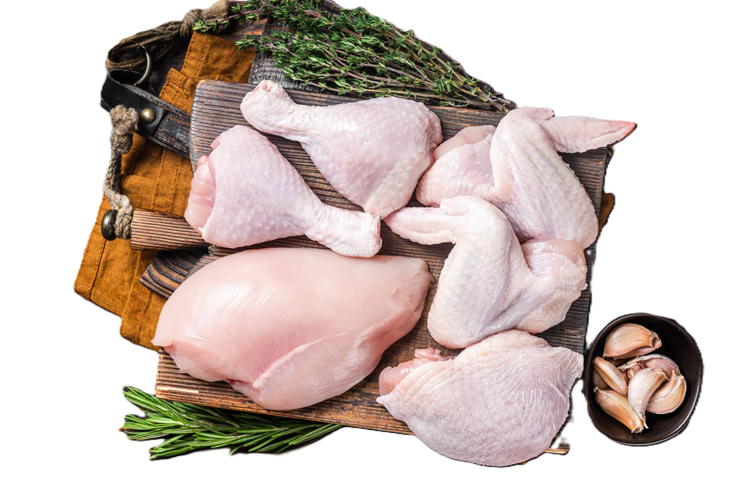
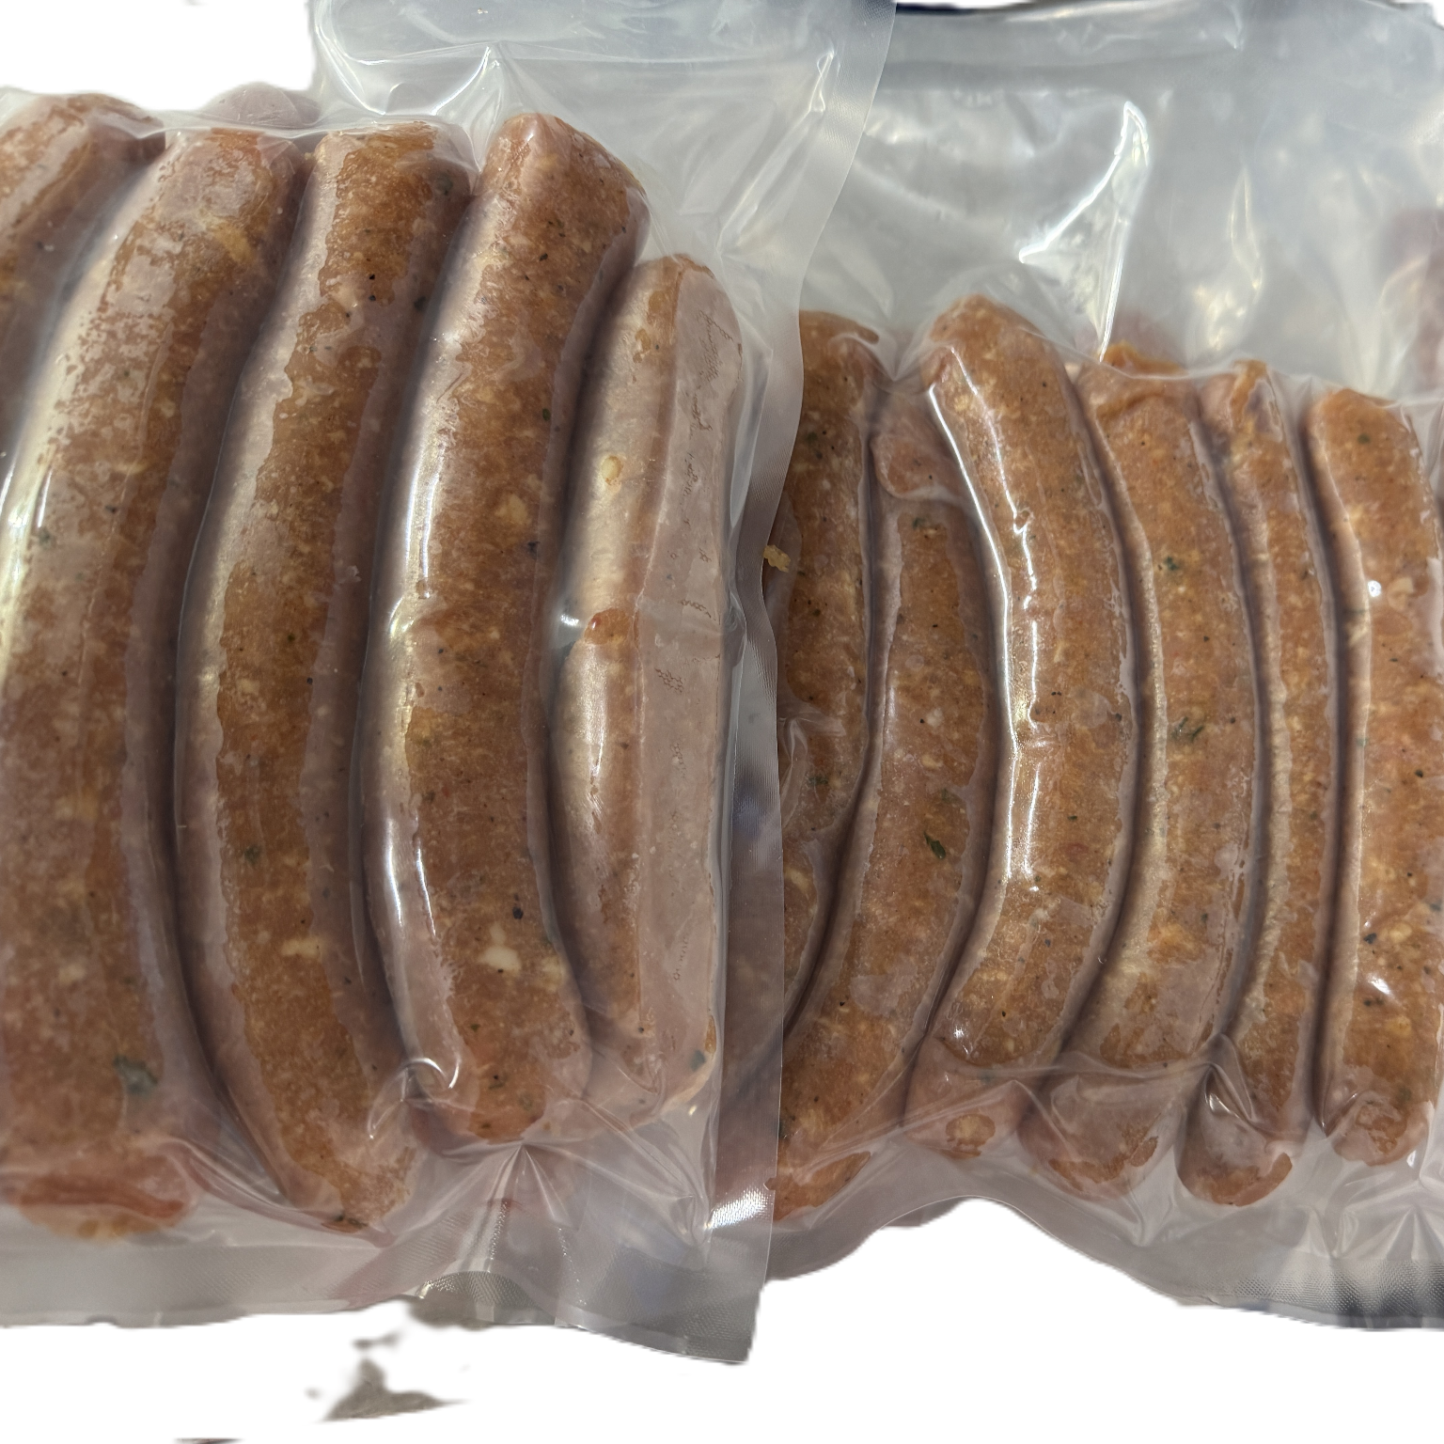
Where Margin Lives
Whole Bird
Cut-Up / Value Added
Breast
Thighs
Wings
Drumsticks
Ground
Sausage
Stock / Broth
4.5 lb × $6.50/lb.
$29.25 revenue
Lowest labor
Simplest packaging
Fastest processing
Limited Margin
More revenue per bird
Higher Margin
$40 – $60+ potential revenue

Slide 16
Break-Even Logic
Scenario 1 Tight Operation
Scenario 2 Avg Operation
Scenario 3 Poor Cost Control
Revenue per bird: $29.25 Cost per bird: $17
Margin per bird: $12.25
1,000 birds = $12,250
Revenue per bird: $29.25 Cost per bird: $23
Margin per bird: $6.25
1,000 birds = $6,250
Revenue per bird: $29.25 Cost per bird: $29
Margin per bird: $0.25
1,000 birds = $250
Small changes in cost swing annual income dramatically.

Slide 17

Proforma for a $100,000 Salary
Target Owner Salary $100,000
Margin Per Bird | Annual Birds
$5 | 20,000
$10 | 10,000
$20 | 5,000
$40 | 2,500
Margin determines scale.

Slide 18
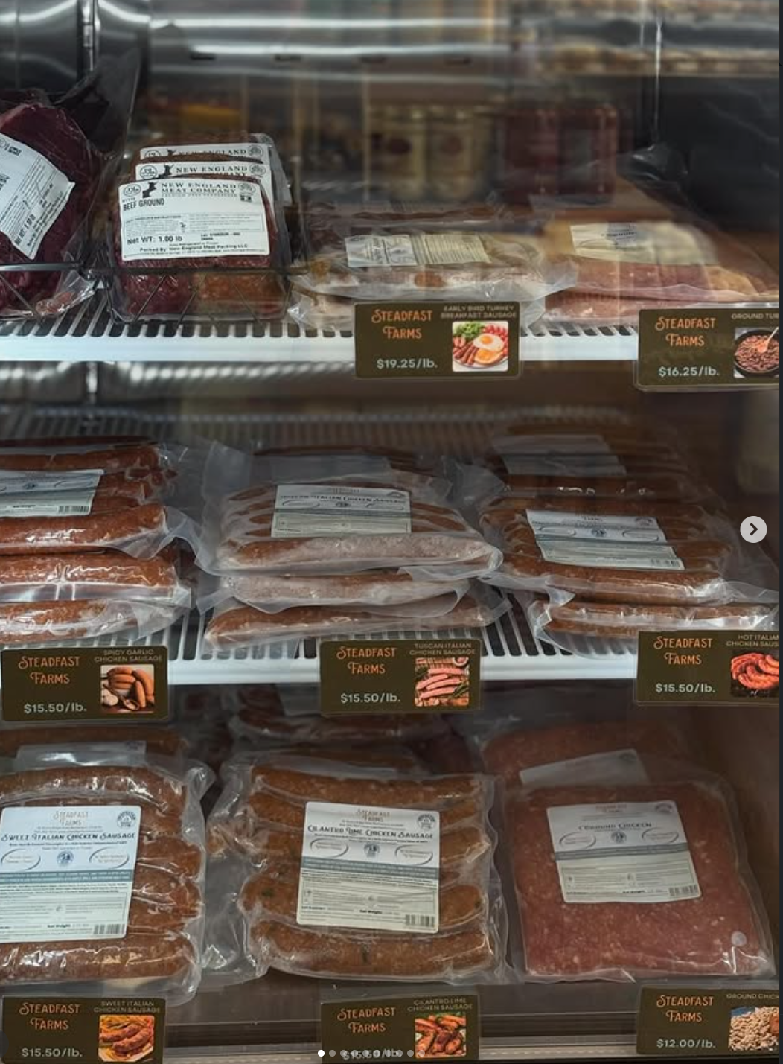
Design to Market First
Start with the market. Then design production.
Who is buying
What they want
What they will pay for
Then build the system
Retail-ready product

Slide 19
Operational Reality
Let’s Stress Test
Feed ↑ 15%
Mortality = 8%
Processing delayed 7–10 days
What breaks first?

Slide 20
Operational Reality
Let’s Stress Test
Feed ↑ 15%
Mortality = 8%
Processing delayed 7–10 days
What breaks first?
Feed bill; another week of feed changes your cost per bird.

Slide 21
Operational Reality
Let’s Stress Test
Feed ↑ 15%
Mortality = 8%
Processing delayed 7–10 days
What breaks first?
Feed bill; another week of feed changes your cost per bird.
Labor burnout; those birds are still getting moved every day.

Slide 22
Operational Reality
Let’s Stress Test
Feed ↑ 15%
Mortality = 8%
Processing delayed 7–10 days
What breaks first?
Feed bill; another week of feed changes your cost per bird.
Labor burnout; those birds are still getting moved every day.
Customer delivery timing; now your market schedule shifts.

Slide 23
Operational Reality
Let’s Stress Test
Feed ↑ 15%
Mortality = 8%
Processing delayed 7–10 days
What breaks first?
Feed bill; another week of feed changes your cost per bird.
Labor burnout; those birds are still getting moved every day.
Customer delivery timing; now your market schedule shifts.
Cash flow; suddenly, your cost goes up and margin shrinks

Slide 24
Operational Reality
Let’s Stress Test
Feed ↑ 15%
Mortality = 8%
Processing delayed 7–10 days
What breaks first?
Feed bill; another week of feed changes your cost per bird.
Labor burnout; those birds are still getting moved every day.
Customer delivery timing; now your market schedule shifts.
Cash flow; suddenly, your cost goes up and margin shrinks
Resilient farms design systems that absorb stress

Slide 25
Resilient System Design
Multiple Sales Channels
Reliable
Slaughter & Processing
A Resilient Poultry System
Cash Flow Awareness
Labor Discipline
Flexible Flock Size
Seasonal Production

Slide 26
Rooted in Resilience
Pastured poultry works.
But the question is:
Does YOUR system work
on your land, with your labor, for your market?
Design it intentionally

Slide 27
Rooted in Resilience:
Will Your Pastured Poultry Plan Hold Up in the Real Market or Get Put Out to Pasture?

