Slide 1
Organic Approach to Plant Disease Management
Yonghao Li, Ph.D.
The Connecticut Agricultural Experiment Station
Plant disease information office
123 Huntington St
New Haven, CT 06511
Phone: (203)974-8601
Email: Yonghao.Li@ct.gov

Slide 2
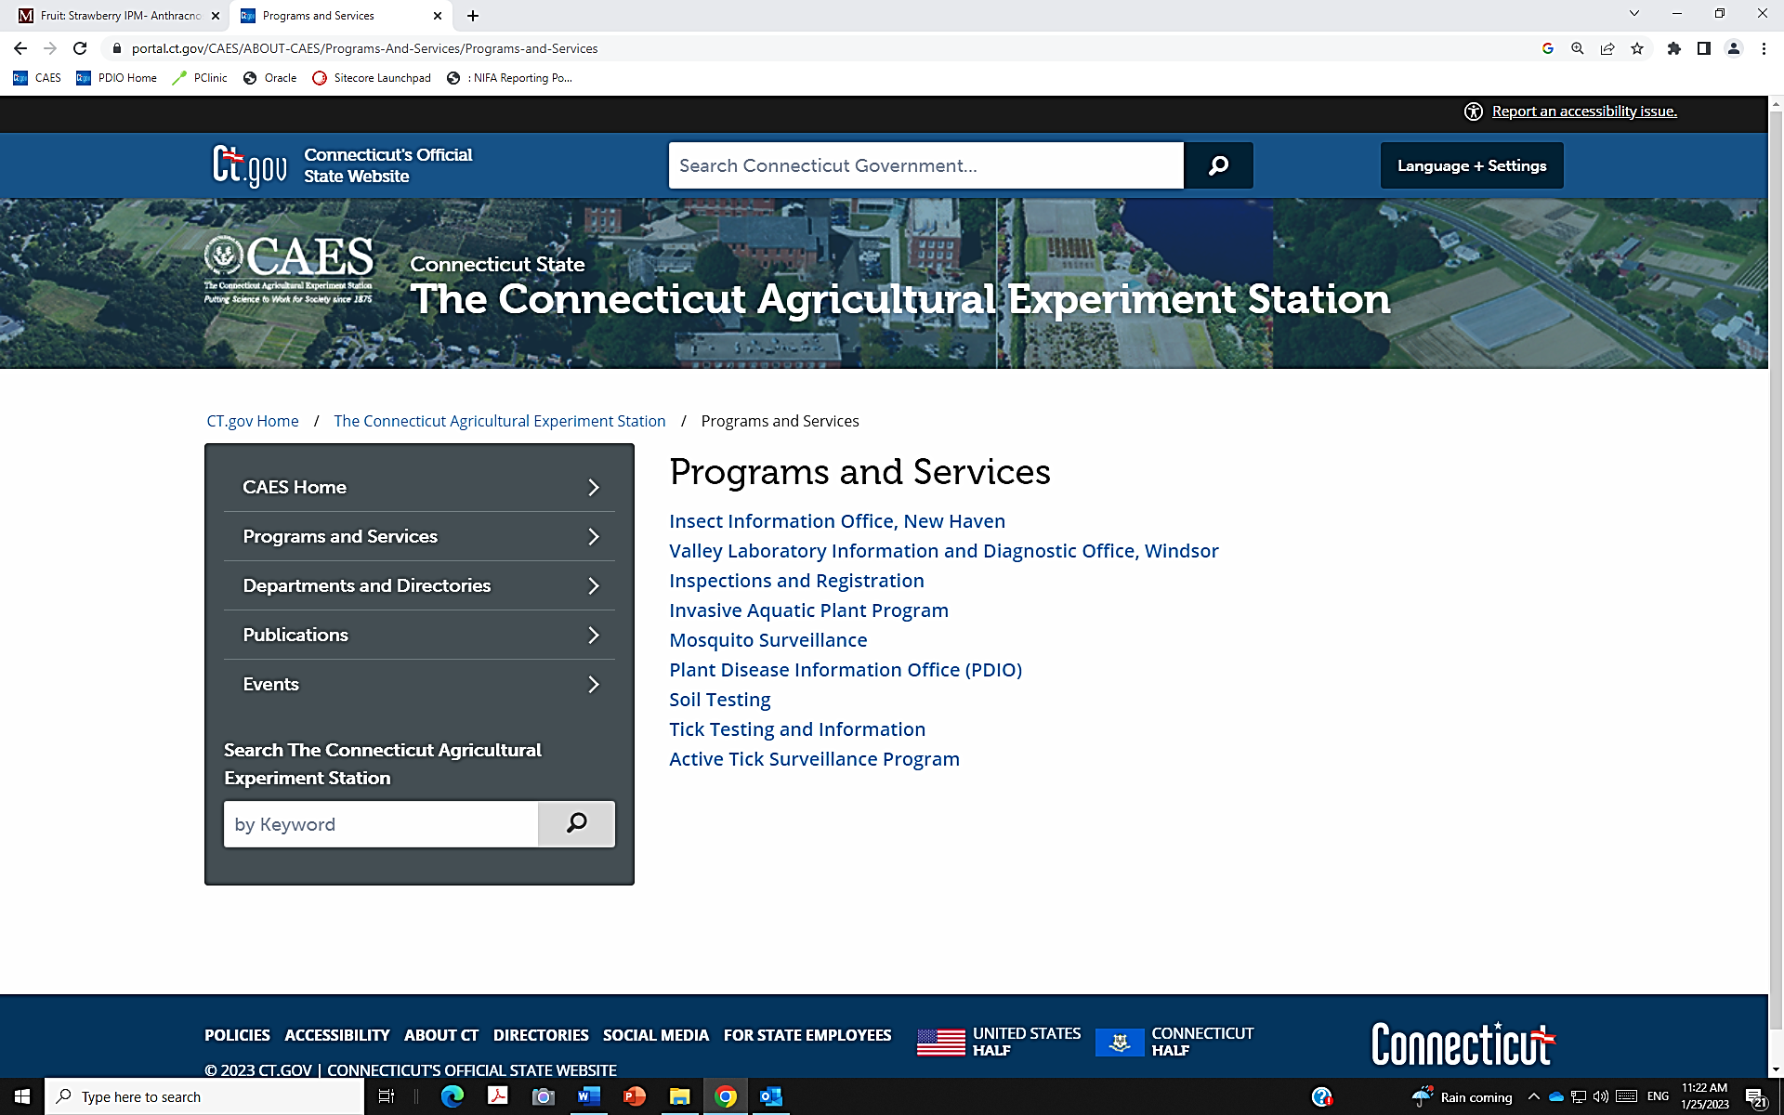


Slide 3
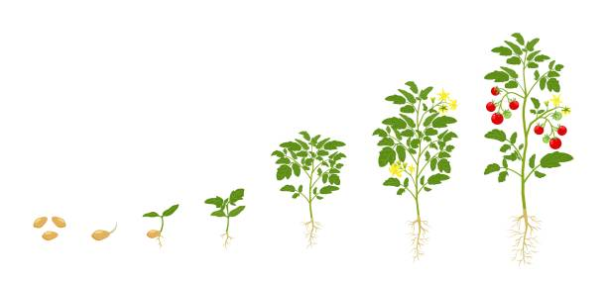
Requirement for Plant Growth
Insects
Diseases
Light
Temperature
Air
Soil
Water
Nutrients
Microorganisms

Slide 4

Plant Disease
Plant disease
Biotic/
Infectious
Abiotic/
Non-infectious
Pathogens
Environment
Fungi
Viruses
Bacteria
Nematodes
Phytoplasmas
Water
Soil pH
Nutrition
Chemicals
Temperature

Slide 5

Disease Triangle
Susceptible host
The existence of a biotic disease requires the interaction of these three components.
If any one of the three factors is missing, no disease will occur.
Disease
Virulent Pathogen
Favorable Environments

Slide 6
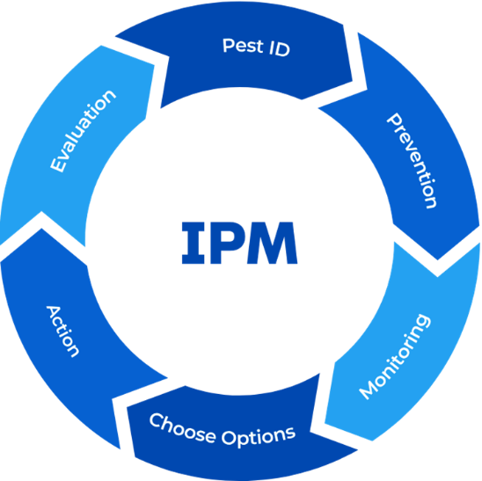
Integrated Pest Management (IPM)
A sustainable decision-making process
Identify the disease and its biology
Survival, disposal, favorable conditions,
Prevention
General cultural practice
Monitor
History, scouting
Set action thresholds
Based on potential damage, stage of disease development, weather forecast
Action
Mechanical, biological, chemical
Evaluation
Keep records, reviewing, improving

Slide 7
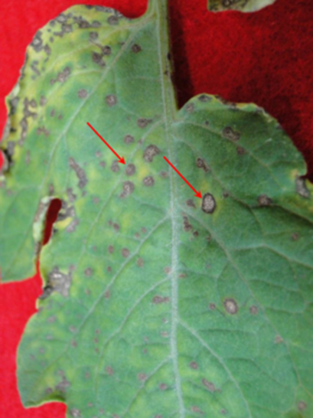
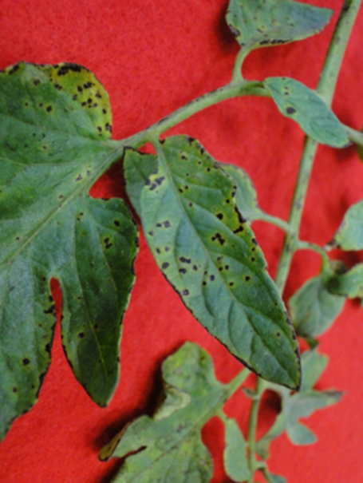
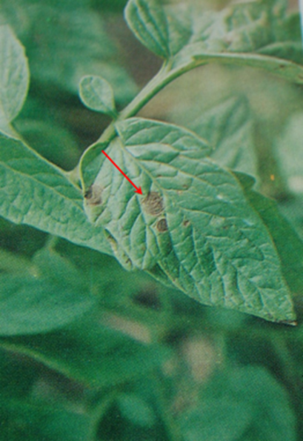
Plant Disease Diagnosis
Symptom: changes of plant appearance
Spots, blight, wilting, chlorosis, stunted growth

Slide 8
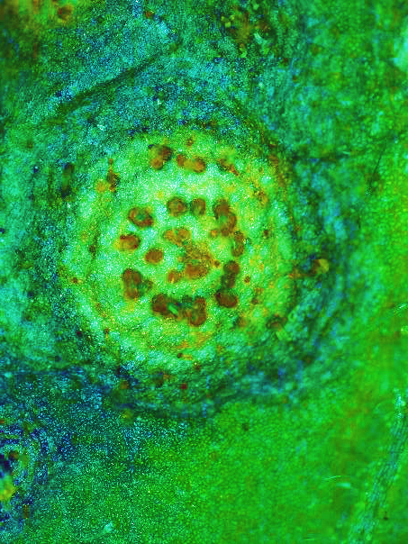
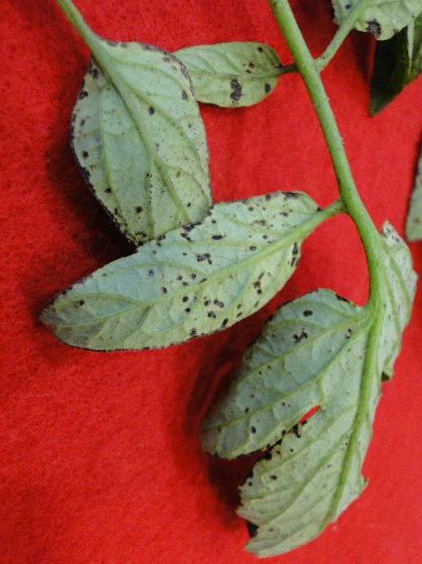
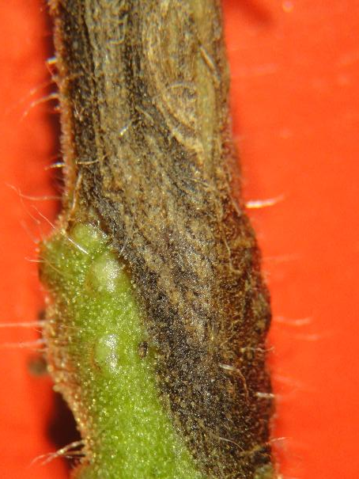
Plant Disease Diagnosis
Sign: visible structures of pathogens
Mildew, mold, fungal fruiting bodies,

Slide 9
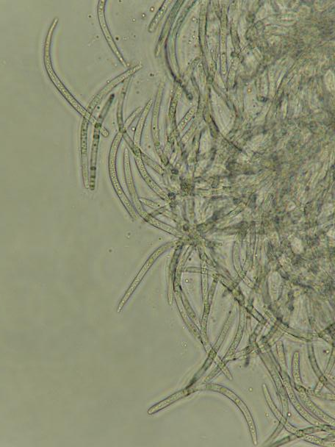
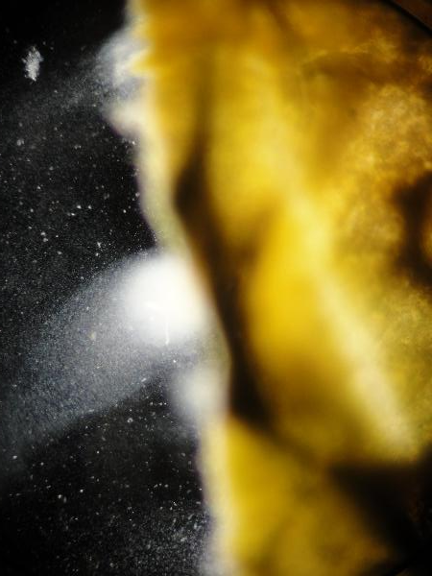
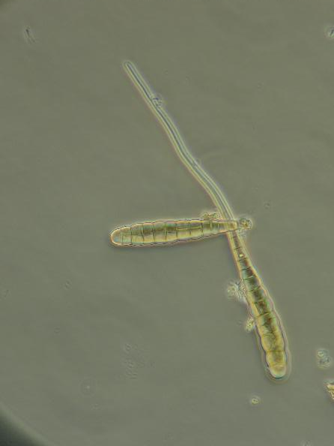
Plant Disease Diagnosis
Sign: visible structures of pathogens
Mildew, mold, fungal fruiting bodies,

Slide 10

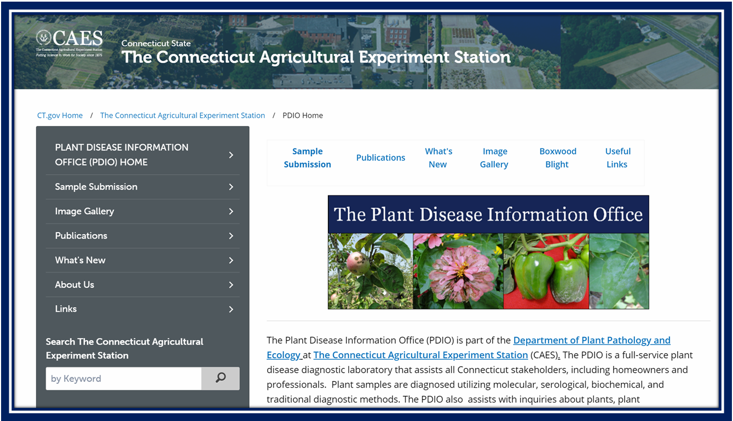
Plant Disease Diagnosis

Slide 11
Plant Disease Prevention
Site selection
Sunny location with over 8 hours sunlight/day
Open areas
Good air circulation (prevent foliar diseases)
Good soil drainage
Strong root development
Prevent soilborne diseases

Slide 12
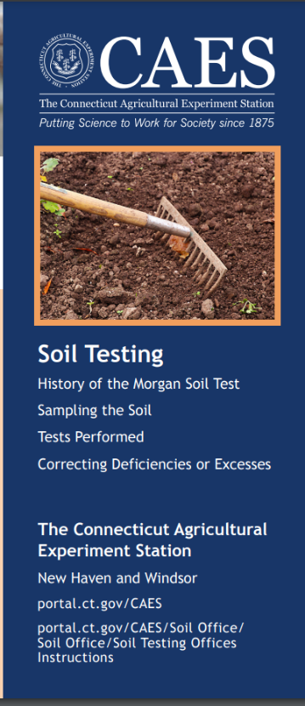
Plant Disease Prevention
Healy soil
Soil texture
Soil pH
Major nutrients
Fertilizer recommendation
Organic matter (3-5%)

Slide 13
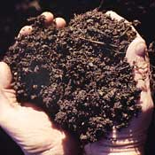
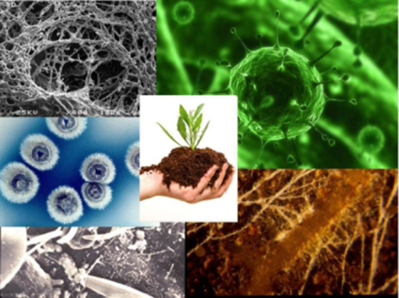
Plant Disease Prevention
Organic matter (Manure and compost)
Provide a favorable condition for beneficial microorganisms
Improve soil structure
Add nutrients

Slide 14

Plant Disease Prevention
Material | N (%) | P²O⁵ (%) | K (%) | Other Nutrients (%)
Rock phosphate | 0 | 25 | 0 | 25 Ca
Greensand | 0 | 0 | 9
Alfalfa pellets | 3 | 0.5 | 3
Bone meal (raw) | 2 | 15 | 0 | 20 Ca
Fish emulsion | 4 | 2 | 2 | 1 Ca
Blood meal | 13 | 0 | 0
Wood ashes | 0 | 2 | 5 | 20 Ca
Soybean meal | 7 | 2 | 2
Cottonseed meal | 7 | 2 | 2
Compost | 1.5 | 1 | 1.5 | 2 Ca
Epsom salts | 0 | 0 | 0 | 10 Mg
Gypsum | 0 | 0 | 0 | 22 Ca; 16 S
Corn gluten | 9.5 | 0.5 | 0.5

Slide 15
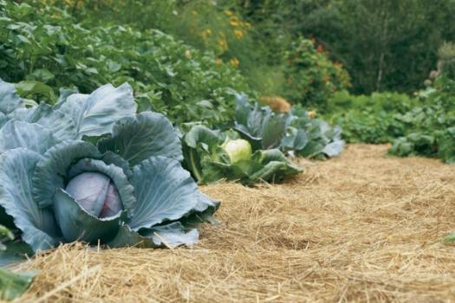
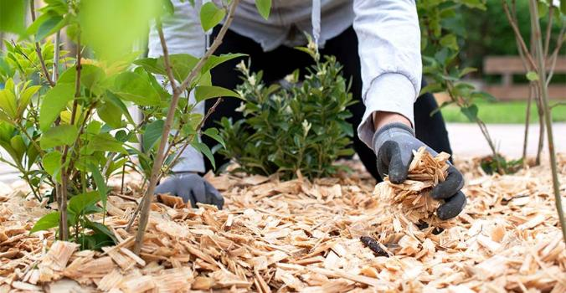
Plant Disease Prevention
Mulching
Add organic matters
Retain soil moisture
Reduce spread pathogens from the soil
Reduce relative humidity
Control weed
What kinds
Leaves
Hay/Straw
Woodchips
Newspaper and cardboard
Compost

Slide 16
Plant Disease Prevention
Cover crops
Winter (Annual rye, oats, radish, hairy vetch)
Summer (Sweet clover, buckwheat)
Increase soil organic matter
Increase soil biodiversity
Suppress soilborne diseases
Nitrogen cycling in the soil
Control weeds

Slide 17
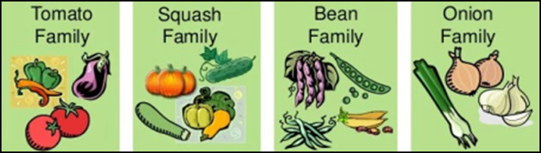
Plant Disease Prevention
Crop rotation
Host range of pathogen
The plant species that a pathogen can infect
Host vs. nonhost (tomato is nonhost of cucurbit powdery mildew fugus)
Narrow or broad (clubroot of cabbage or Verticillium wilt)
Reduce population of soilborne pathogens
Some pathogens survive in the soil
Balance available nutrients in the soil
Different plants have different nutrition needs

Slide 18

Plant Disease Prevention
Use resistant cultivars if available
A cost-effective components in IPM
Suppress disease development
Hybrids
cross between two parents
conventional breeding
Heirlooms
open-pollinated varieties from generation to generation
No variety is resistant to all pathogens

Slide 19
Plant Disease Prevention
Grafting desirable cions to resistant root stock
Soilborne diseases
Fusarium wilt in tomato or watermelon
Verticillium wilt in eggplant
Phytophthora root rot in pepper
High cost and more labor
Greenhouse production

Slide 20
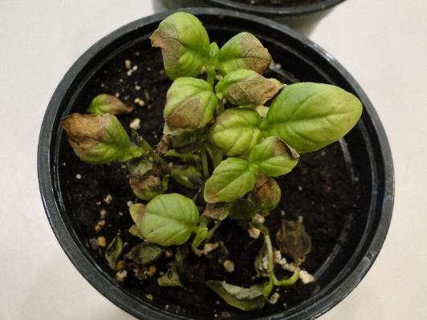
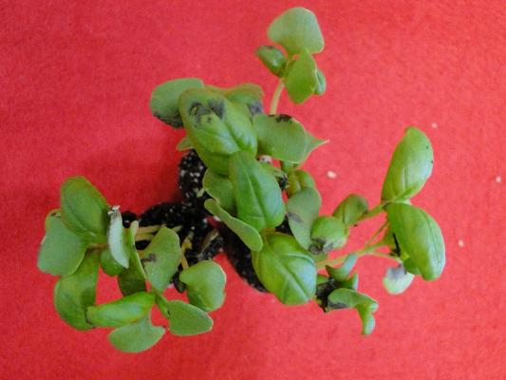
Plant Disease Prevention
Use disease-free plant materials
Seed, tubers, bulbs, transplants
Source of long-distance dissemination and entry of pathogens into new areas

Slide 21
Plant Disease Prevention
Sanitation
Remove and destroy diseased plants or materials
Greenhouse benches and floors (hydrogen peroxide)
Clean tools and equipment frequently
Wash and disinfect reused pots

Slide 22
Plant Disease Prevention
Space and support plants
Improve air circulation
Reduce humidity
Slow disease development
Sunlight penetration

Slide 23
Plant Disease Prevention
Water plants properly
Prevent drought stress
Avoid excessive watering
Avoid overhead irrigation when possible
Use drip irrigation
Water plants in the morning
Water deeply, less frequently

Slide 24
Monitor Plant Diseases
Regularly scout plants (seedling, transplant, field)
Normal or abnormal
Spots, wilt, stunting, chlorosis, injury
Weather and environmental conditions (rain, humidity, temperature, soil, and irrigation)
Identify the problem
Distribution of the problem
Number of plants affected
Recordkeeping (disease history)
Notebook
Mapping
Photos

Slide 25
Threshold and Action
Action threshold
The point above which specific pests cannot be tolerated
Developed over the long-term monitoring, recordkeeping, and evaluation
Action
The disease and its life cycle
Environmental conditions
Total cost of the action
The value of the crop
The impact on the environment

Slide 26

Fungicide Treatment
Most fungicides are preventative, but not curative
Apply fungicides before infection, or upon detected
Rotate fungicides to prevent fungicide resistance
Read and follow the product label when using any pesticides

Slide 27
Pathogen - Fungicides
Active Ingredient | Trade Name | Control
Bacillus subtilis GB03 | Companion | Pythium, Rhizoctonia
B. subtilis QST 713 | Cease, Serenade | Botrytis, powdery mildew, Pythium, Rhizoctonia
B. amyloliquefaciens D747 | Triathlon, Double Nickel, Stargus | Powdery mildew, botrytis, bacterial leaf spot, Pythium
Streptomyces spp. | Mycostop, Actinovate | Leaf spot, Botrytis, powdery mildew, downy mildew, summer patch, dollar spot, Pythium, Rhizoctonia
Trichoderma harzianum strain T-22 | RootShield | Pythium, Rhizoctonia, Thielaviopsis
T. harizanum strain KRL-AG2 | RootShield | Pythium, Rhizoctonia, Thielaviopsis
T. harzianum T-22 + T. virens G-41 | RootShield Plus | Pythium, Rhizoctonia, Thielaviopsis
T. asperellum strain T34 | Asperello | Pythium, Rhizoctonia
T. asperellum + T, gamsii | BioTam | Pythium, Rhizoctonia, Thielaviopsis
Gliocladium catenulatum J1446 | Prestop, PVent | Pythium, Rhizoctonia,

Slide 28
Fungicides
Active Ingredient | Trade Name | Diseases
copper sulfate | Phyton 27, Phyton 35 | Leaf spot, Botrytis, powdery mildew, Pythium, Rhizoctonia
hydrogen peroxide and peroxyacetic acid | TerraClean 5.0, OxiDate, | Pythium, Rhizoctonia, Thielaviopsis
quaternary ammonium chloride | KleenGrow | Pythium, Rhizoctonia, Thielaviopsis
extract of giant knotweed | Regalia | Pythium, Rhizoctonia
potassium bicarbonate | MilStop | Leaf spot, Botrytis, rust, downy mildew, powdery mildew,
hydrogen dioxide | OxiDate | Leaf spot, Botrytis, rust, downy mildew, powdery mildew, Pythium, Thielaviopsis
neem oil | Triact 70 | Leaf spot, Botrytis, rust, powdery mildew
horticultural oil | SuffOil-X | Rust, powdery mildew

Slide 29
Evaluation
Efficacy of the treatment
Reduced disease level?
Cost-benefit
Better yields?
Reduced pesticide use?
Environmental and social benefits
Health impacts from reduced pesticide use
Biodiversity increased?

Slide 30
Common Diseases of Vegetables and Ornamental Plants

Slide 31
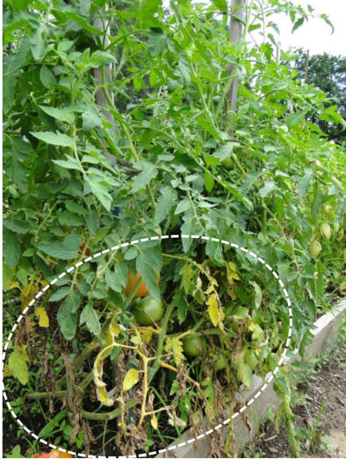

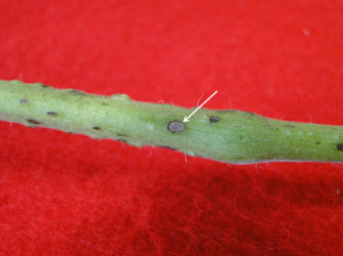
Leaf Spot
Septoria leaf spot of tomato

Slide 32
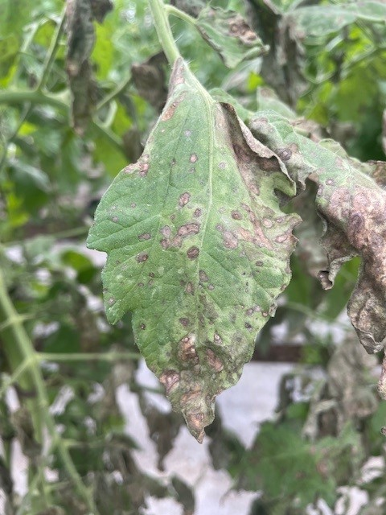
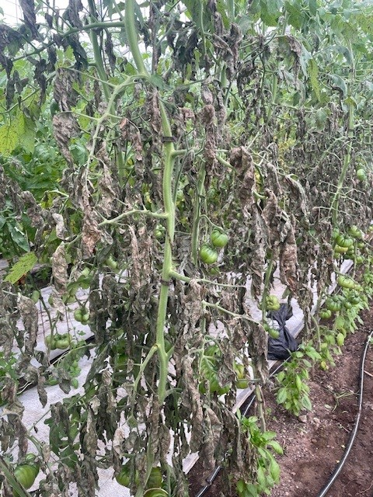
Leaf Spot
Gray leaf spot of tomato

Slide 33
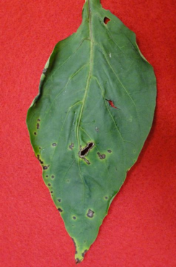
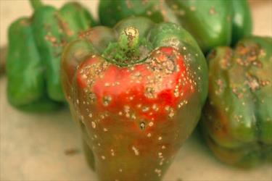
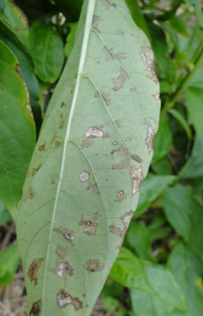
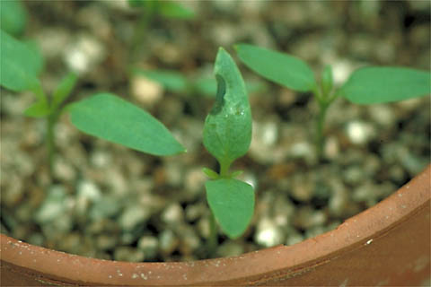
Leaf Spot (cont.)
http://www.apsnet.org/edcenter/intropp/lessons/prokaryotes/Pages/Bacterialspot.aspx
Bacterial leaf spot of pepper

Slide 34
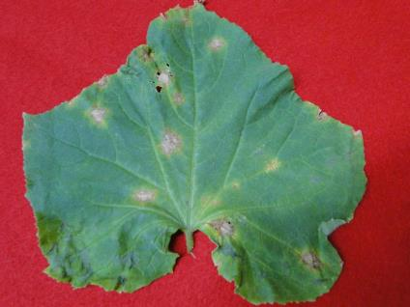
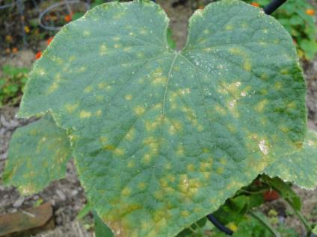
Leaf Spot (cont.)
Anthracnose
Bacterial leaf spot
Cucumber

Slide 35
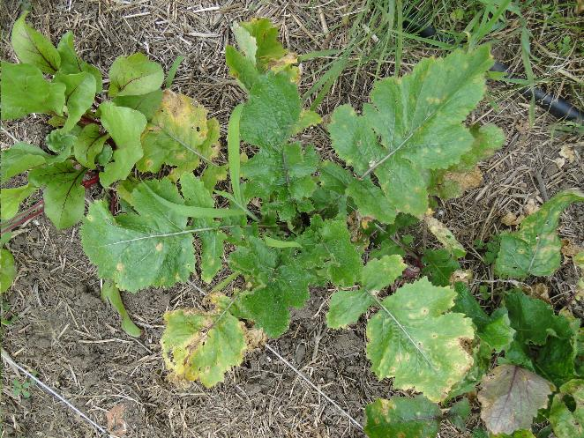
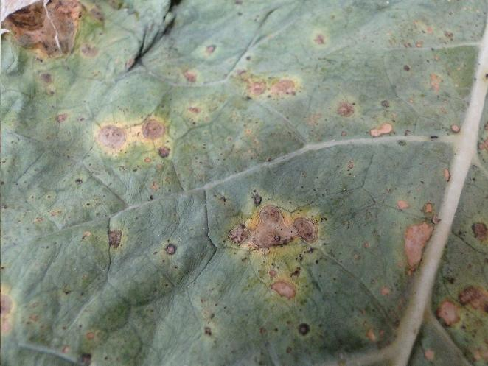
Leaf Spot (cont.)
Radish
Broccoli
Alternaria leaf spot

Slide 36
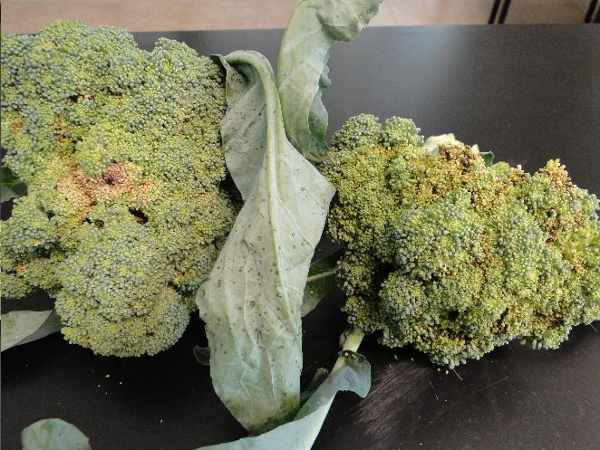
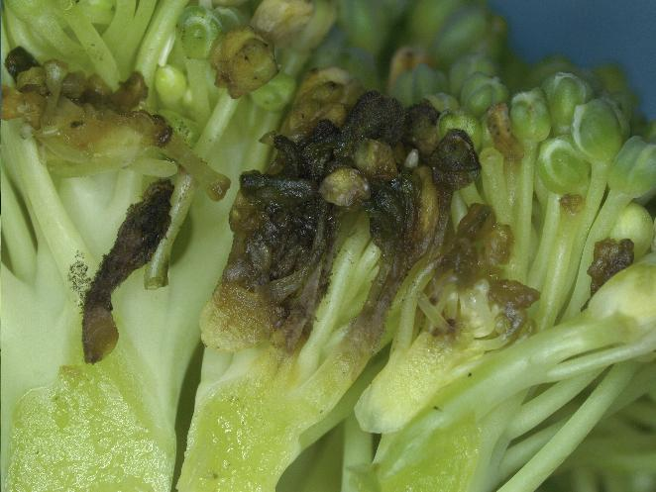
Leaf Spot (cont.)
Alternaria leaf spot of broccoli

Slide 37
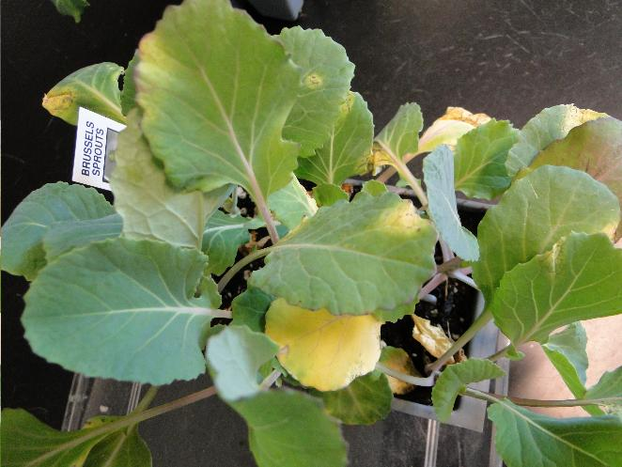
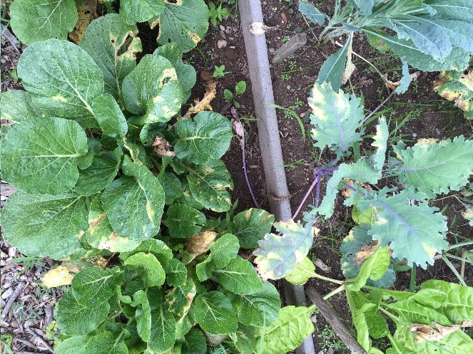
Leaf Spot (cont.)
Brussels sprouts
Brassica crops
Bacterial black rot

Slide 38
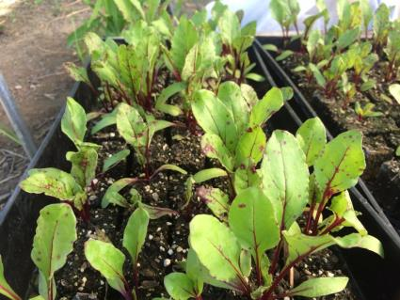
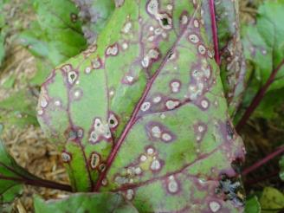
Leaf Spot (cont.)
Cercospora leaf spot of beet

Slide 39
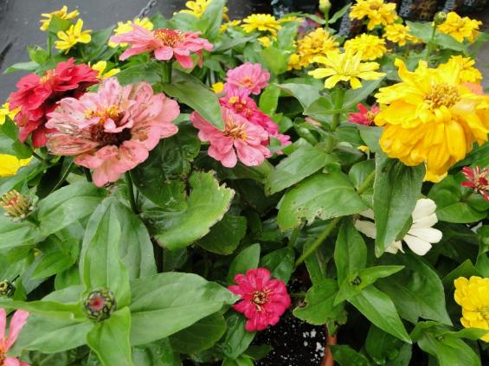
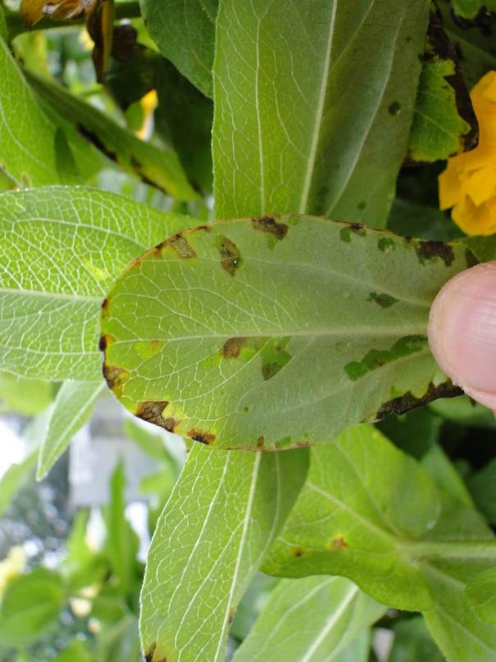
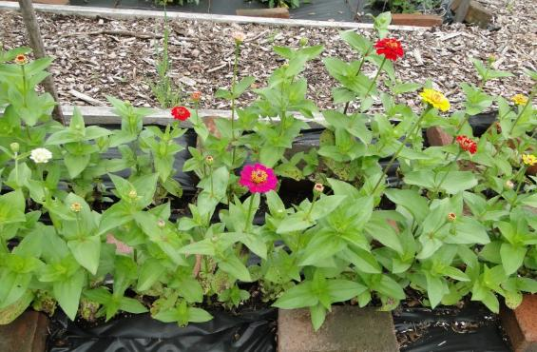
Leaf Spots (cont.)
Leanne Pundt
Bacterial leaf spot of zinnia

Slide 40
Management of Leaf Spot
Use disease-free seed or transplants
Sanitation
Remove and destroy infected plant materials
Cultural practice
Avoid overhead irrigation whenever possible
Avoid handling plants when they are wet
Space plants
Reduce relative humidity in greenhouses/hoophouses
Scouting for diseases
Fungicides – preventative

Slide 41
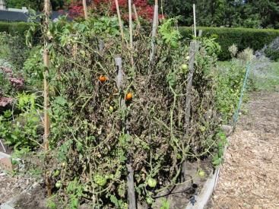
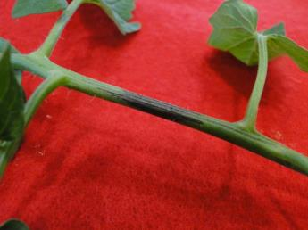
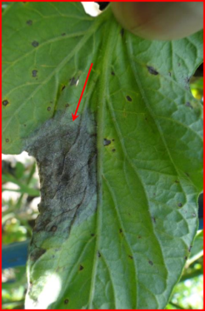
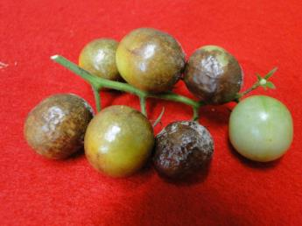
Blight
Late blight of tomato

Slide 42
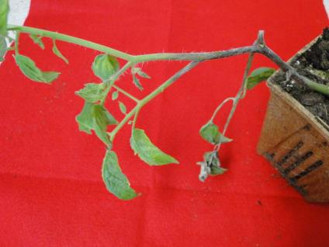
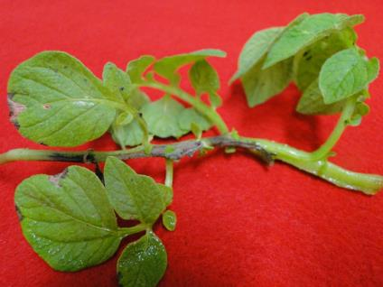
Blight (cont.)
Tomato
Potato
Late blight of tomato and potato

Slide 43
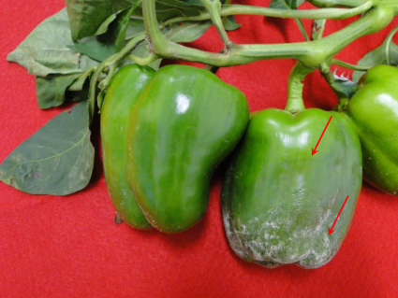
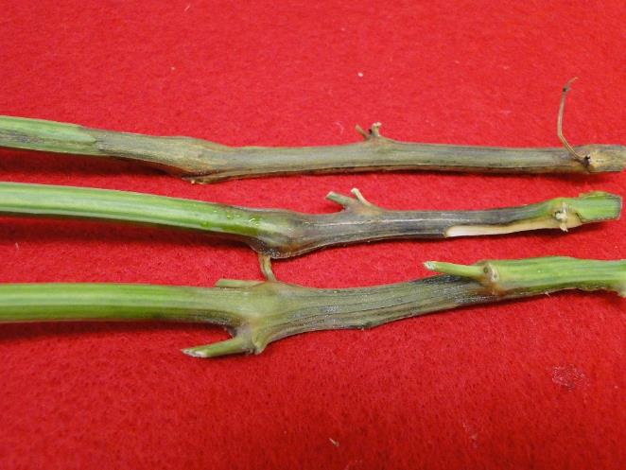
Blight (cont.)
Phytophthora blight of pepper

Slide 44



Blight (cont.)
Volutella blight of pachysandra

Slide 45

Blight (cont.)
Botrytis blight of tulip

Slide 46


Blight (cont.)
Courtesy of Leanne Pundt
Geranium
Lily
Botrytis blight

Slide 47

Management of Blights
Use disease-free seed/transplants
Late blight
Volutella blight of pachysandra
Cultural practices
Space plants
Good air circulation
Avoid overhead irrigation
Crop rotation (Phytophthora blight on cucurbits and pepper)
Remove faded flowers and diseased leaves
Fungicide
Early detection
Preventative fungicides

Slide 48



Downy Mildew (cont.)
Basil

Slide 49


Downy Mildew (cont.)
Cucumber

Slide 50


Downy Mildew
Courtesy of Leanne Pundt
Courtesy of Leanne Pundt
Upper surface
Rudbeckia
Lower surface

Slide 51


Downy Mildew (cont.)
Impatiens

Slide 52
Management of Downy Mildew
Purchase disease-free seed/transplants
basil downy mildew
Cultural practices
Adequate spacing
Avoid overhead irrigation
Container-grown – moved indoor when raining or high humidity
Fungicide
Scout for diseases
Apply fungicides preventatively

Slide 53


Powdery Mildew (cont.)
Begonia
Dahlia

Slide 54


Powdery Mildew (cont.)
Rosemary
Chervil

Slide 55


Powdery Mildew (cont.)
Cucurbit
Tomato

Slide 56

Management of Powdery Mildew
Air borne diseases
High humidity, but not free water
Space plants and maintain a good air circulation
Reduce humidity (<RH 85%)
Scout crops for diseases
Apply fungicides as soon as the disease appears

Slide 57


Virus Diseases
Begonia
Cineraria
Impatiens necrotic spot virus (INSV)

Slide 58


Virus Diseases (cont.)
Tomato
Pepper
Impatiens necrotic spot virus (INSV)

Slide 59


Virus Diseases (cont.)
Tomato spotted wilt virus (TSWV) on pepper

Slide 60


Virus Diseases (cont.)
Tomato spotted wilt virus (TSWV) on tomato

Slide 61


Virus Diseases (cont.)
Begomoviruses on tomato
Herbicide injury

Slide 62
Management of Virus Diseases
Exclusion
Use clean, disease-free plant materials
Separate greenhouses for vegetables and ornamentals
Sanitation
Remove and destroy infected plants
Handle healthy plants first, then diseased plants
Insect control
Most plant viruses were transmitted by insects (thrips, aphids, white fly)
Weed control
Wide host ranges of viruses

Slide 63




Vascular Diseases
Fusarium wilt of tomato
Verticillium wilt of eggplant

Slide 64
Management of Vascular Diseases
Persist in the soil for many years
Systemic infection
Dispersed via soil movement, running water, farm equipment, transplants, tubers
Resistant cultivars
Grafting
Cultural practice
Rotation with non-susceptible crops (cereals, legumes, leafy vegetables)
Do not compost diseased plant materials

Slide 65


Root Rot - Pythium
Pythium damping-off of lupine
Pythium root rot of pepper

Slide 66


Root Rot - Rhizoctonia
Rhizoctonia damping-off of kale
Rhizoctonia damping-off of tomato

Slide 67


Root Rot - Thielaviopsis
Black root rot of calibrachoa

Slide 68
Management of Root Rots
Cultural practice
Start with disease-free plants
Use pathogen-free potting mix
Avoid over-watering and over-fertilizing
Sanitation
Clean and sanitize greenhouse surfaces and containers
Remove and destroy heavily infected plants
Apply fungicides preventatively
in greenhouses or nurseries

Slide 69


Questions?

