Slide 1



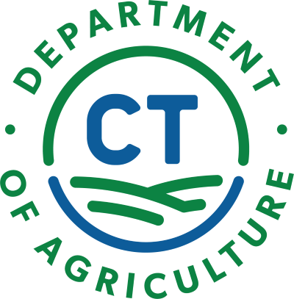
The Basics of Finding Land to Farm
CT NOFA Winter Conference
March 2026
Kip Kolesinskas, Robert Chang, Freedom Gerardo, Cyrena Thibodeau

Slide 2

Overview
Introductions- speakers & in chat
Land Tenure + Land Assessment
CT FarmLink
Technical Assistance & Available Services
Leasing & Acquisition

Slide 3
What Is Land Tenure?
Land Tenure is the way people hold their land, usually owning or leasing it
It includes legal, political and business considerations
For landowners, responsibilities and rights are defined by land use laws.
For tenants, responsibilities and rights are spelled out in lease agreements.

Slide 4
Secure tenure is necessary for a farm or ranch to be sustainable
Secure land tenure includes:
Affordability and availability
Findability and security
Equity and housing
Compatibility with land use laws and/or lease and deed terms

Slide 5
Why Does it Matter?
Access to land is a serious challenge faced by most beginning farmers and ranchers
It’s often hard for beginners to:
Find suitable, available and affordable land to purchase and/or lease
Secure loans to buy it
Negotiate appropriate lease arrangements
Especially with non- family members

Slide 6
Factors Affecting Land Tenure Decision
Personal and business goals
Your current financial position
Capital needs of your business
Earning potential of your business

Slide 7
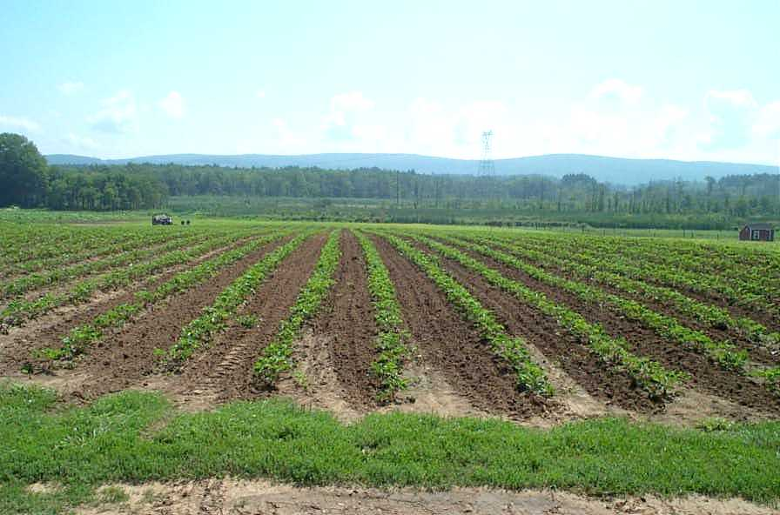
Let’s make a plan and find some land!
Notes:
Connect to some of these sites and provide a demonstration
Ask students to create a list to include any local or regional possibilities
A written down search plan or strategy is helpful. Build a network and team to help you!

Slide 8
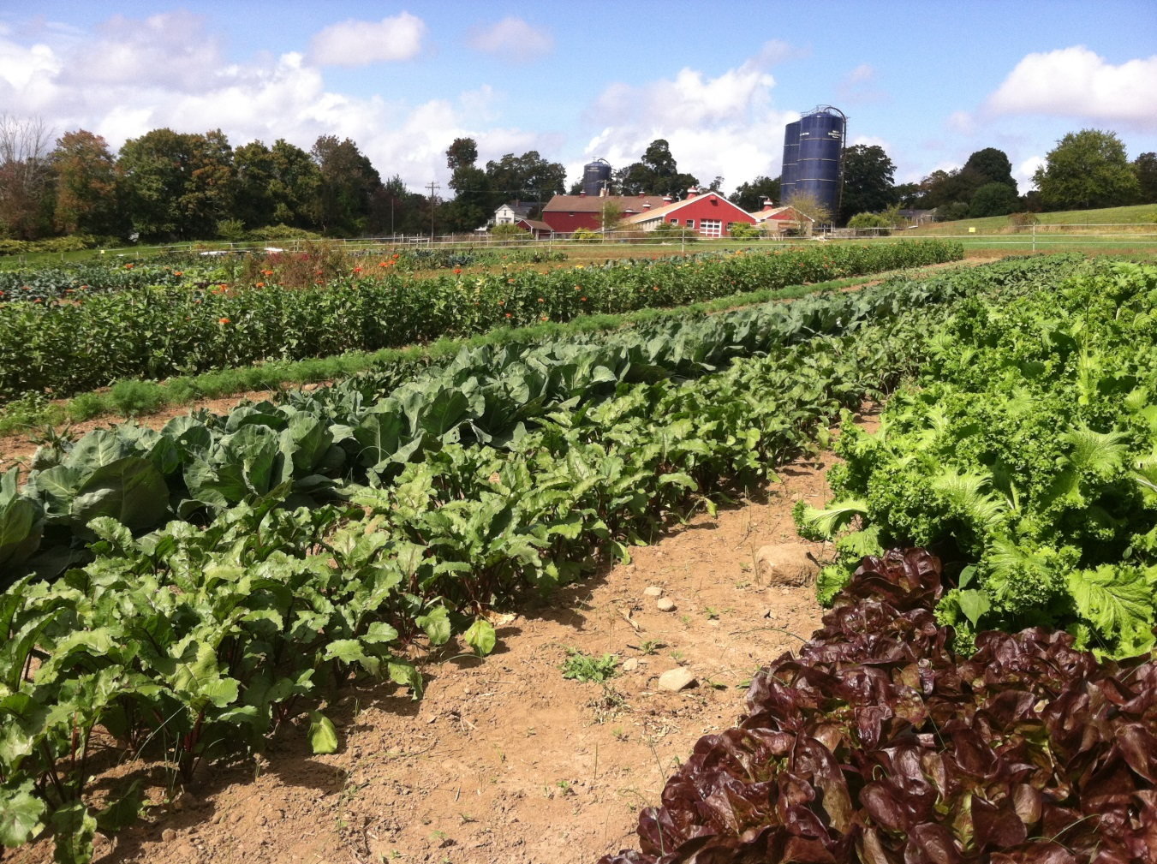
Reading the Land
How and Why we do a land assessment
BEGINNING FARMER AND RANCHER DEVELOPMENT PROGRAM AWARD: 2015-70017-23901
Presenter Name
Title
Affiliation
Date
Notes:
Learning Objectives
1.a. Summarize key components of a land assessment
1.b. Identify tools, resources and contacts for conducting a parcel evaluation
1.c. Assess land use policies and community factors specific to the selected site
1.d. Describe the relationship between property features and conservation, business and personal goals
Most agricultural enterprises are different from other businesses due to the reliance on a land base with specific natural resource attributes.
New and beginning farmers often have requirements that are different then past agriculture in the area, or are relegated to parcels with more limitations due to cost or competition. It is critical to carefully examine the features of a parcel being considered through a land assessment.

Slide 9
What is a Land Assessment?
A land assessment is a way to evaluate a property in the context of its neighbors and community
It inventories natural resources, physical characteristics and existing infrastructure.
It documents historic and current land use.
It evaluates a specific site and setting including owner, property and community considerations.
It analyzes carrying costs.
Why Conduct a Land Assessment?
To compare properties to find the one that’s best for you: does it meet your personal, financial and business goals?

Slide 10
How to Assess a Specific Site
Collect information like maps and photos
Visit the site and community setting - talk to people!
Identify experts to consult with on specific issues/concerns
Document what you find: use a checklist
Perform due diligence

Slide 11
Key Features to Assess
Location and configuration
Natural resources
Infrastructure and improvements, including housing
Land use and management
Property rights and limitations
Carrying costs, including taxes
Community support for agriculture

Slide 12
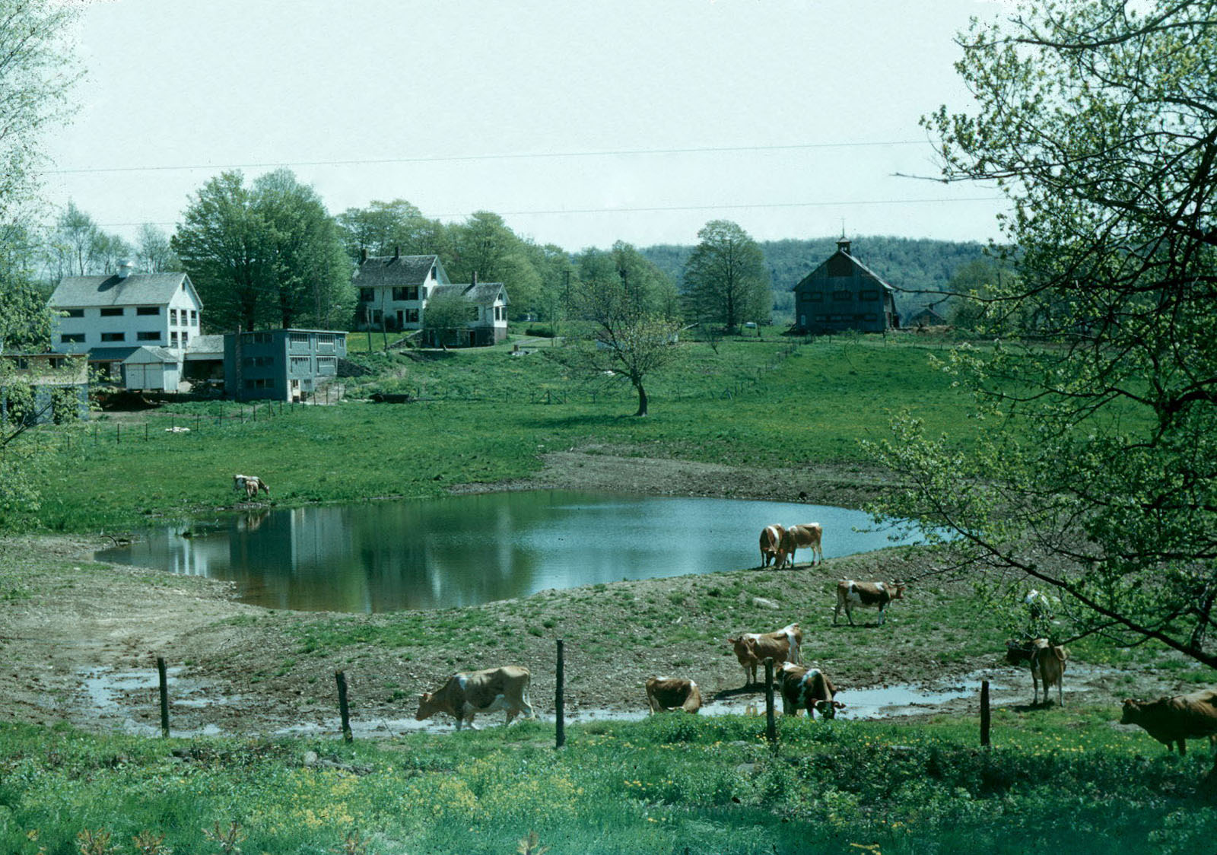
Notes:
Lots of infrastructure, lots of challenges. Degraded water quality in pond from livestock

Slide 13
Location and Configuration
Location, location, location
Where is the property located?
What are local weather patterns and growing seasons?
How is road and highway access?
Are services readily available?
Is housing affordable?
Are neighbors friendly toward agriculture?
Configuration
Size, shape and orientation of fields and parcel
Neighboring land use and cover

Slide 14
Natural Resources
Soil suitability
Water sources: quality and quantity
Topography
Local weather patterns, growing season
Other natural resources: forests, wetlands, habitat
Scenic vistas
Wildlife patterns
Find out about the health and conditions
of these resources

Slide 15
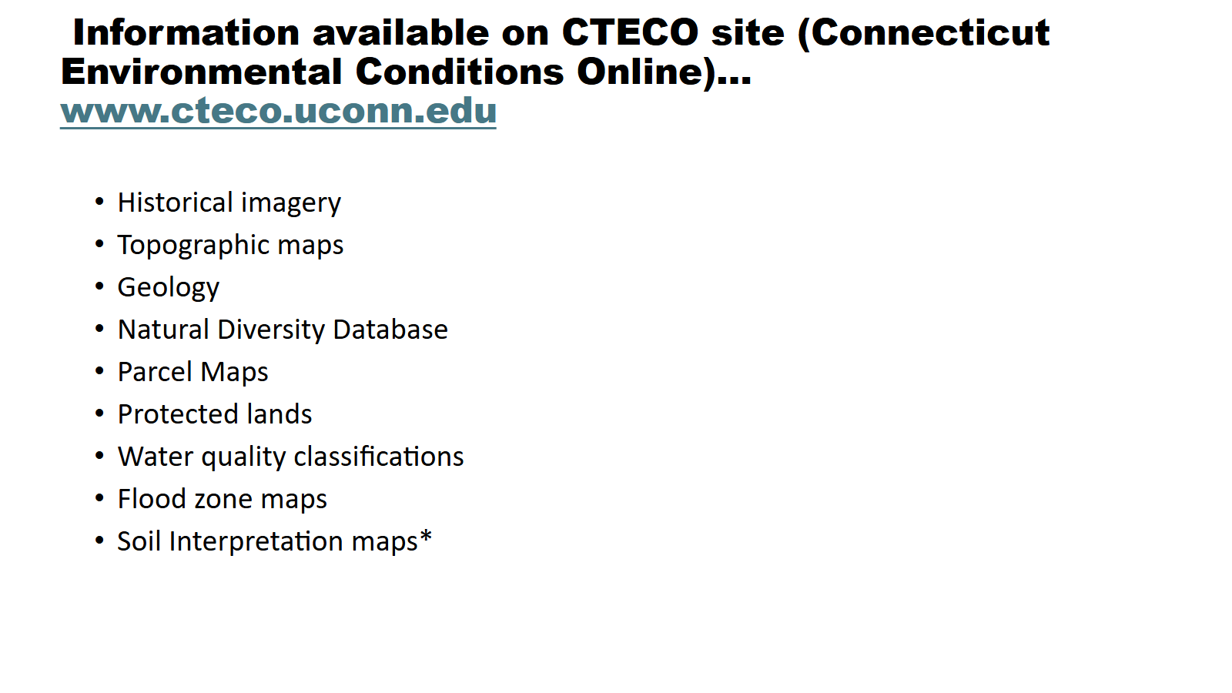

Slide 16
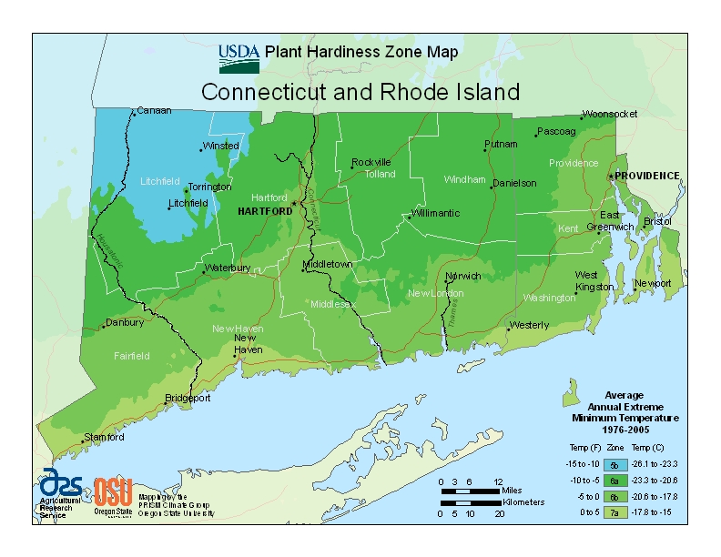

Slide 17
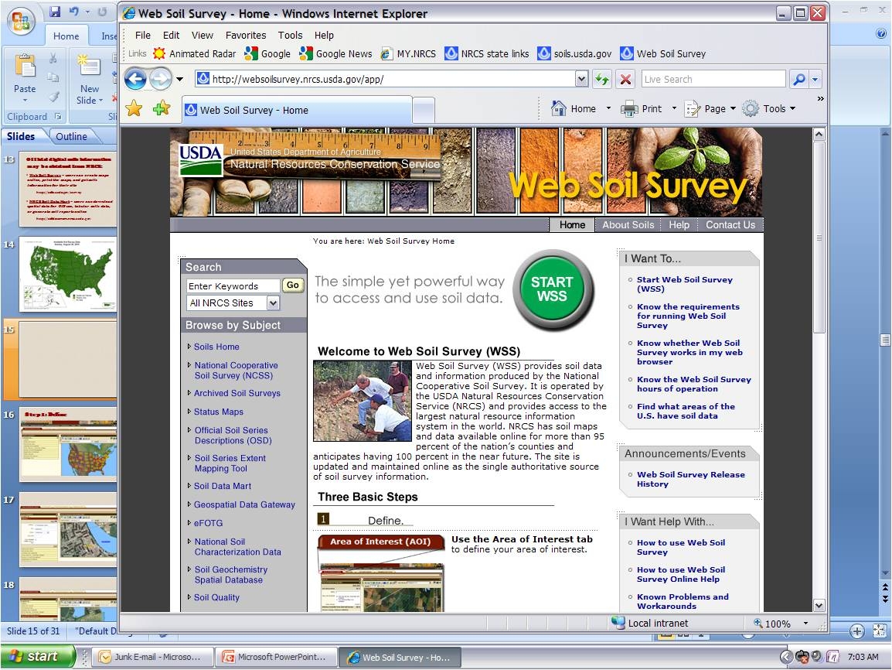
WSS homepage - click on Start button http://websoilsurvey.nrcs.usda.gov

Slide 18
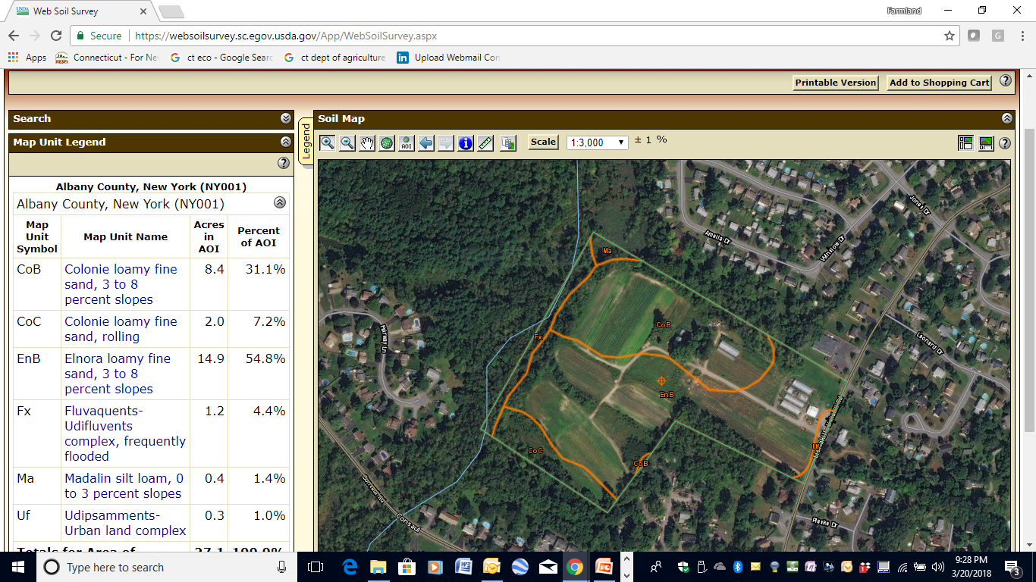

Slide 19
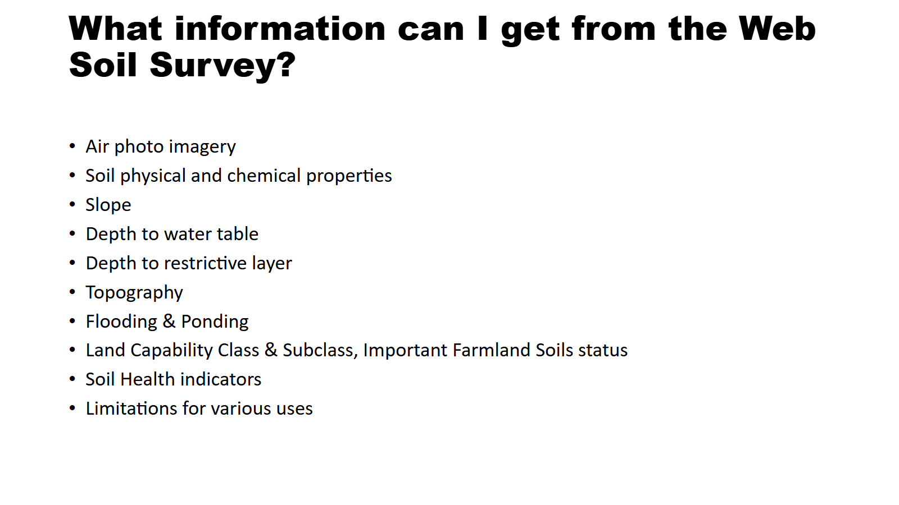

Slide 20
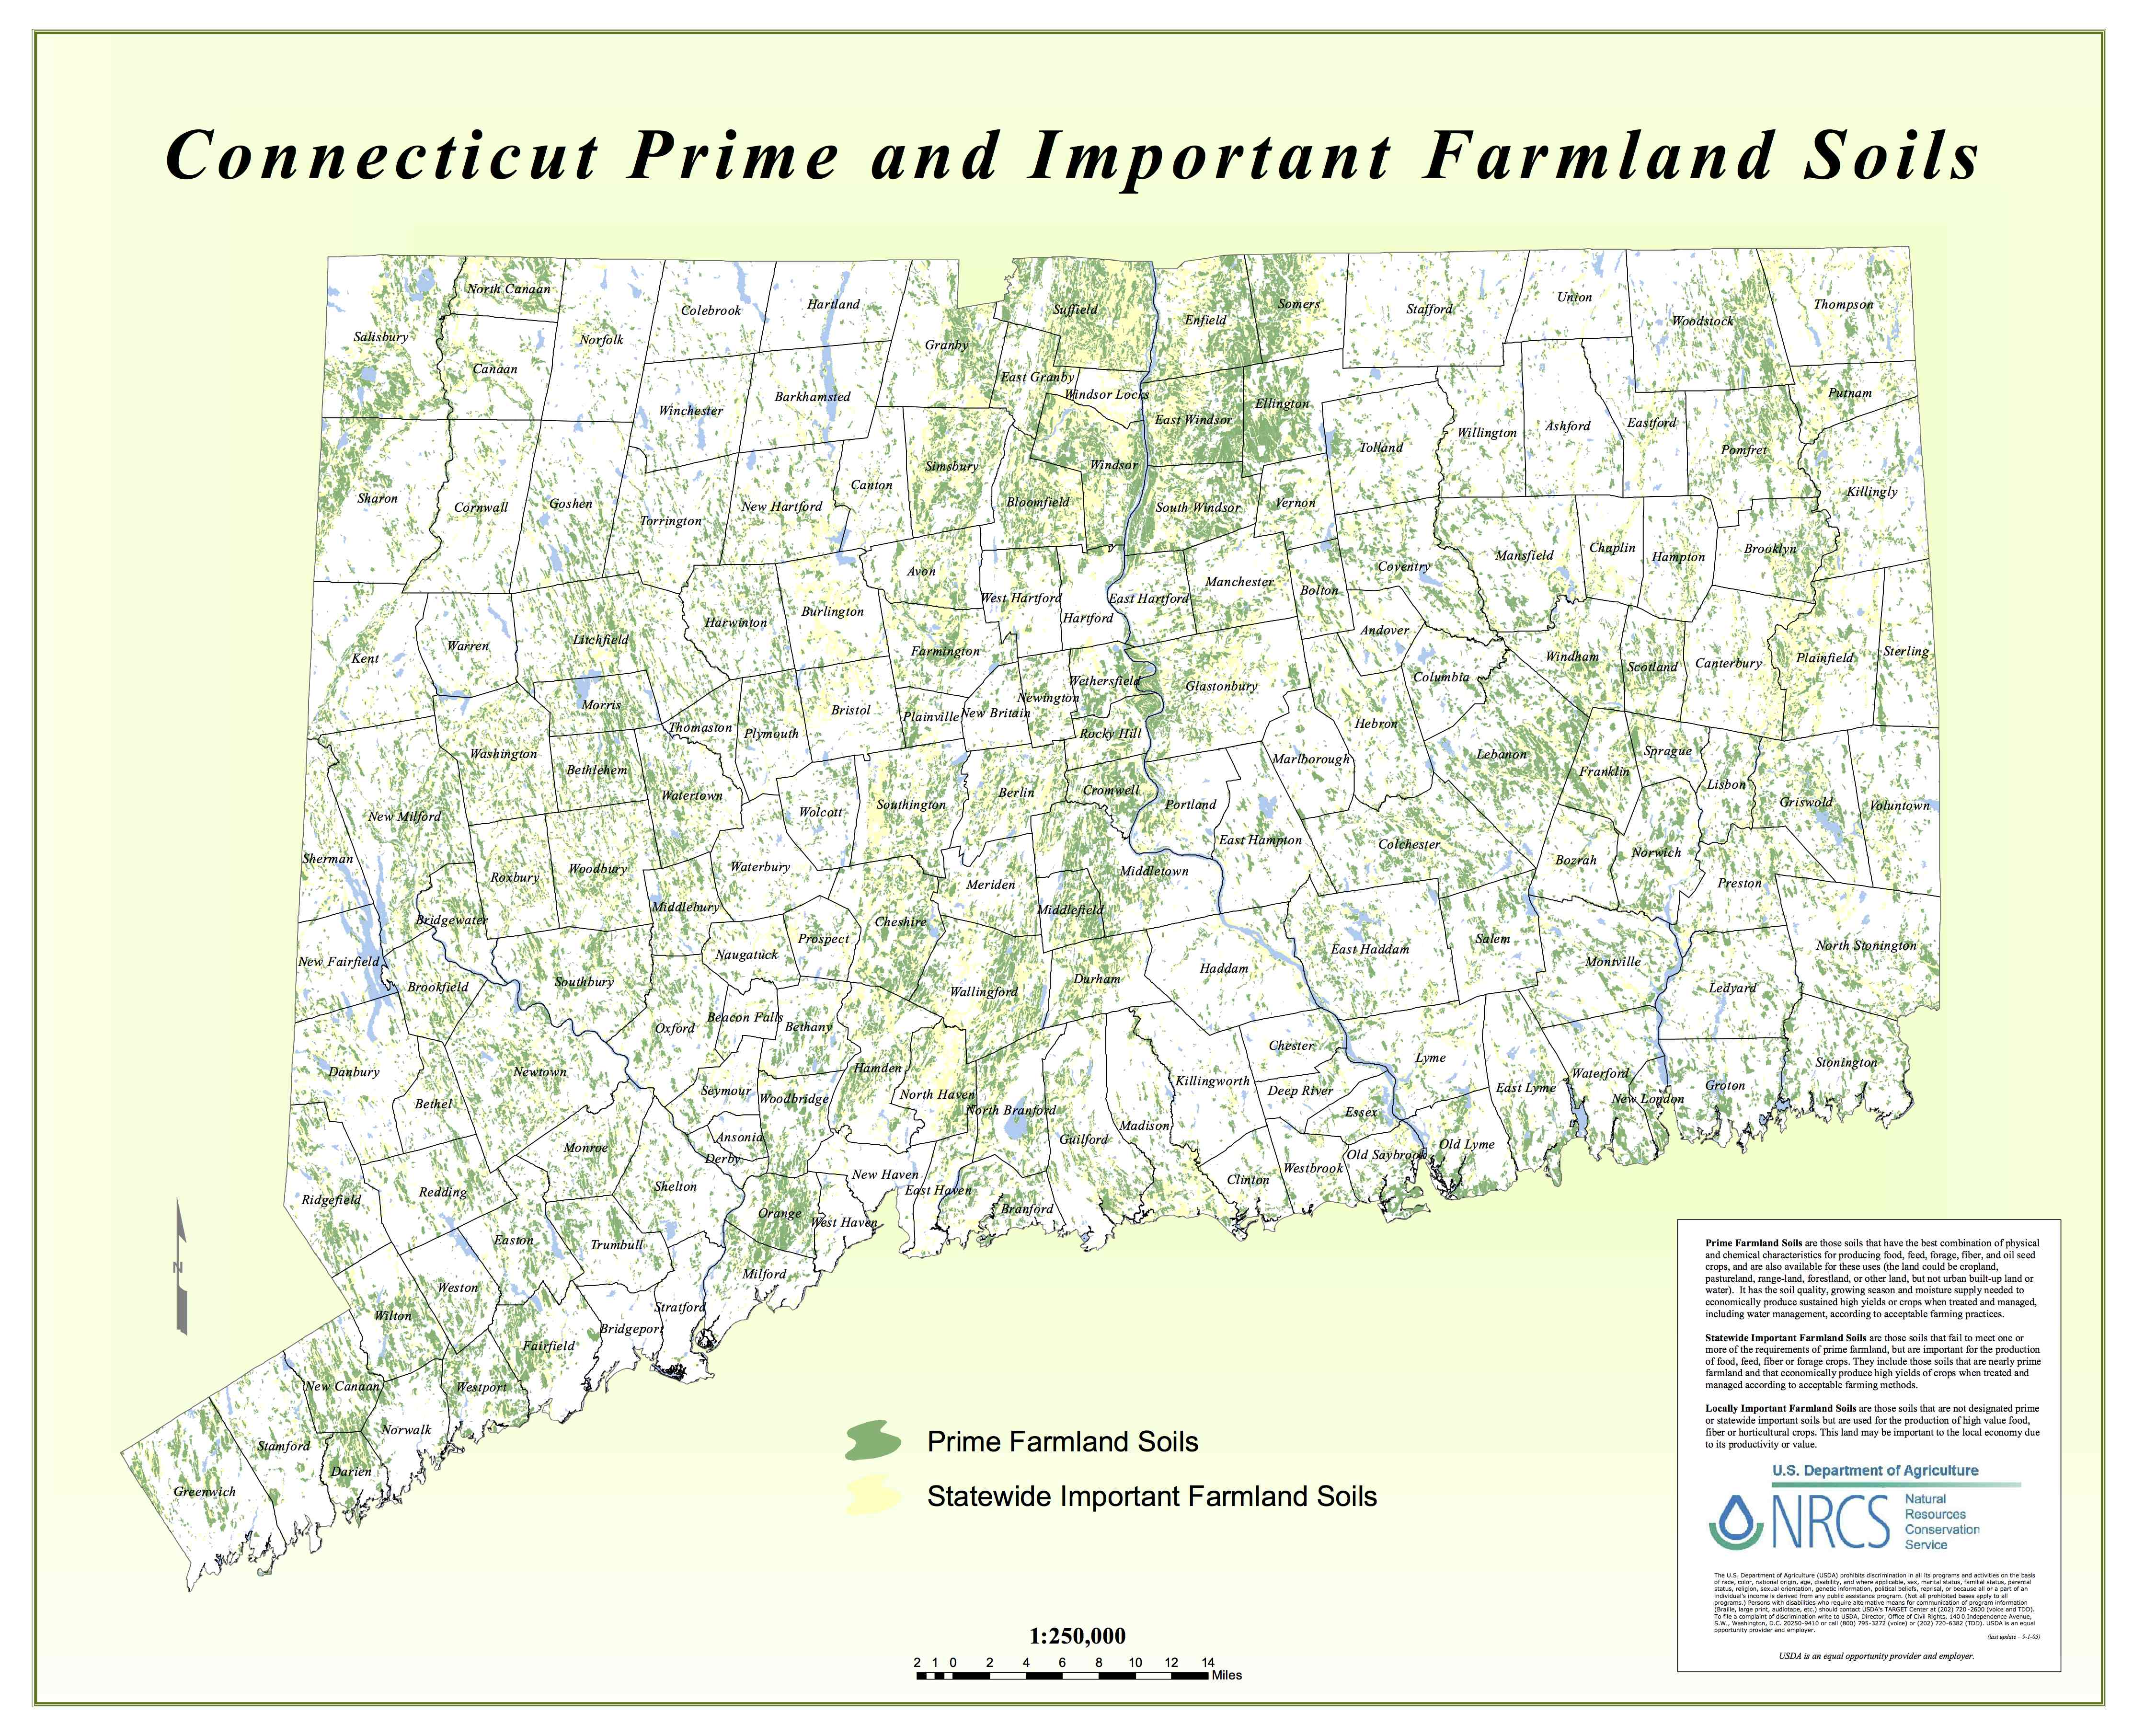
Where are our best soils?

Slide 21
Infrastructure and Improvements
Look at the location, suitability and condition of:
Housing
Buildings, barns, sheds and hoop houses
Farm roads/driveways
Fencing
Conservation practices
Water systems: e.g., irrigation, wells, filtering, etc.
Septic systems and other utilities
Other facilities which may affect your farm

Slide 22
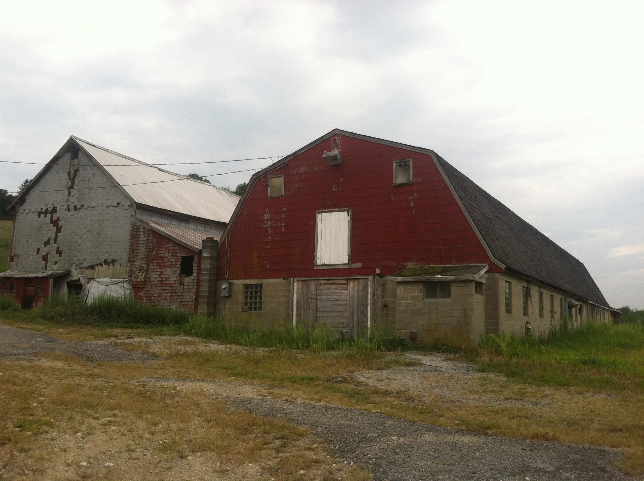
Notes:
Barns of size and nature for what you need?

Slide 23
Land Use and Management
What is the current land cover and use?
What has the site been used for in the past?
Is it in active management now?
Are there areas needing restoration?
Is the land being managed in accordance with a conservation plan?

Slide 24
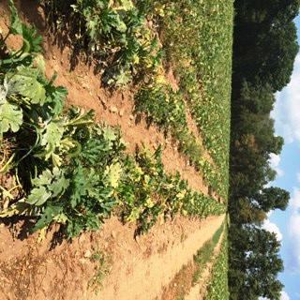
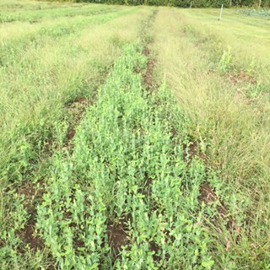
Notes:
Low organic matter, compaction on left. Squash is struggling. Field on right has a nice cover crop

Slide 25
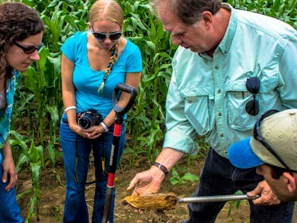
Nothing Beats an onsite investigation!

Slide 26
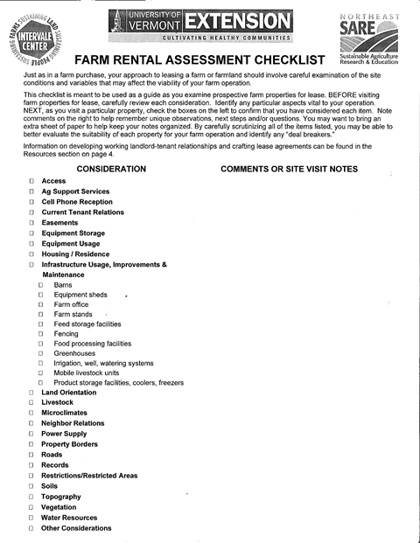

Slide 27
Property Rights and Potential Limitations
Are any property rights owned or leased by others?
E.g., water, timber, energy, hunting, etc.
Are there any limitations on the use of the land?
Conservation easements or other deed restrictions, utility easements or right of ways
Public access
Compliance with federal/state laws
Local laws, including zoning and health codes

Slide 28
Carrying Costs
Property taxes
Water and other utilities
Conservation practices
Needed improvements/restoration
Special assessments

Slide 29
Analyzing Results from Reading the Land
Does the property meet your needs and goals?
Do you need another site visit or professional help to decide?
Does the price reflect the value of the property for your operation?
If this site doesn’t completely meet your needs, visit other properties and compare the features/advantages.

Slide 30
Analyzing Results from Reading the Land
Does the property meet your needs and goals?
Do you need another site visit or professional help to decide?
Does the price reflect the value of the property for your operation?
If this site doesn’t completely meet your needs, visit other properties and compare the features/advantages.

Slide 31
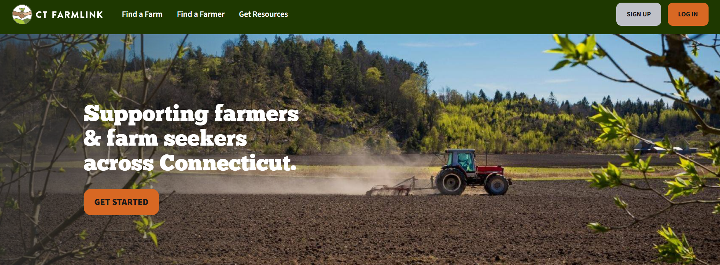

Slide 32
About CT Farmlink
Who is this website for:
Beginning farmers starting their own operation
Current farmers looking to expand
Landowners seeking a farmer to sell or lease their land to
Farmers and landowners looking for agricultural business partners
Farm parcels of all sizes (1 acre to 300+ acres) with map feature
Agricultural diversity: orchards, vegetables, beef, hops, dairy, vineyards, backyard farming
Numerous resources for classes/workshops, loans and grant programs, permits and regulations, estate planning & transfer, marketing an ag business, and more!
Technical assistance:
Evaluating the suitability of the property
Reviewing and developing leases
Determining lease rates
Restoring farmland
Protecting farmland with an agricultural easement

Slide 33


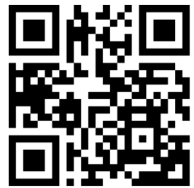
Program Updates
Primary Partners:
DoAg
UConn Extension
Land for Good
Expanded Technical Assistance Services
Technical Assistance Services are available at no cost to anyone with an active FarmLink Profile (landseeker or landowner)
Optional in-take session for new seekers/owners and continued resource navigation with Farmer Resource Navigator (Robert)
Access to other professional consultants previously only available to participants in the LCMA program
Assistances evaluating properties and help reviewing/drafting leases, navigating town regs.
Potential Properties: Help us crowd source potential properties that you see for us to reach out to, vet, and get listed!
Expanded Learning Opportunities:
Land Access Readiness Course through UConn
Quarterly Intro to Farming webinars (coming soon!)
Reimagined FarmLink mixers
If you have any comments about how to make FarmLink more effective or any questions, please email Cyrena.Thibodeau@ct.gov
Visit: https://ctfarmlink.org/

Slide 34
CT Business Technical Assistance
CT Small Business Development Center
Business advising and planning. Grant writing assistance prior to application submissions, focused on DoAg programs. Supporting farm/food system businesses more broadly by providing access to all appropriate CTSBDC services.
Learn more. To get started, complete the CT SBDC Agricultural intake form.
Carrot Project
Business Advising & Coaching: The Carrot Project provides personalized, one-on-one advising to help clients meet their business goals and improve long-term viability. Their services have a proven record of increasing farm profitability.
Learn more. To get started, email jcole@thecarrotproject.org
Tierra Viva Collective
Their assistance helps farmers and producers clarify goals, grow their enterprises, and build sustainable food distribution networks rooted in equity and shared ownership. Through tailored mentorship, collaborative research, and capacity-building workshops, they support the long-term vision of community-owned land and food systems across the region.
Learn more. To get started email hello@tierravivacollective.org
Agricultural producers or agribusinesses interested in working with any of the above organizations are welcome to contact them directly or reach out to Cyrena.Thibodeau@ct.gov.

Slide 35
Frequently Asked Questions:
How do I apply/participate/submit a posting?
For those who own and are selling farmland to farmers, go to the I want someone to farm my land page For those who own and want to lease farmland to farmers, go to the I want someone to farm my land page For farmland seekers, go to the I want land to farm page
How long are postings on the website?
Does it cost anything to have a posting?
How do I get information on a Owner or Seeker posting?

Slide 36
Programs and Assistance
USDA Natural Resources Conservation Service: conservation planning, EQIP Program, web soil survey, some onsite assistance
USDA Farm Service Agency- maps, financing
CT Department of Agriculture- Farmland Preservation Programs, Farmland Restoration & Resiliency Program, Farm Transition Grant
Connecticut Farmland Trust- Farmland Preservation Programs
Land for Good- Leasing, Succession planning
UConn Extension- Business planning, onsite technical assistance from specialists
CT NOFA , CT Farm Bureau, NCTFA , CT RC&D
Soil & Water Conservation Districts- maps, local conditions

Slide 37
New Farmer Business Navigator at UConn Extension
Robert Chang – robert.chang@uconn.edu
Connect new/beginning farmers to technical assistance and other resources in CT
Land Access
Farm Business start up
Resources include:
Training
One on one consultation with, navigator, experts and technical assistance providers
Agencies to share costs of implementing certain farm practices

Slide 38
Land Access - Training
UConn Extension Land Access Readiness course
Finding and evaluating farmland
Urban Farming
Leasing
Real Estate transactions
Conservation Easements
Local Regulations
Financing
Alternative ownership models
UConn Extension [web site URL]

Slide 39
Business Start Up -Business Planning
Fail to Plan = Plan to Fail
Business Plan is living document describing:
Who you are and who are your customers
What you grow and how you grow it
How you sell your products
How you manage your business and finances
Plan guides you, partners, collaborators and staff
Plan helps funders, service providers understand the viability of farm business

Slide 40
Business Start Up - Training
UConn Extension Business of Farming Course
Legal issues for Farmers
Financial management, taxes and insurance
Marketing, branding and sales opportunities
UConn Extension Solid Ground Beginning Farmer Training
Farm Manager's Summit
Farmland Mixer
Agriculture Mechanics Trainings
Field Days
Accessing Grants

Slide 41
One on One Consultations
Initial Meeting with New Farmer Business Navigator
Questions for farmers
Prior farm experience
Prior farm training
Business plan
Farmland requirements
Finance options
Support network

Slide 42
One on One Consultations
Referrals to Technical Assistance Providers for individual consultations
Legal guidance
Marketing and branding
Taxes and accounting
Business coaching and financial management
Business planning
Financing
Town regulations

Slide 43
One on One Consultations
Additional Technical Assistance Providers
Land Evaluation
Leasing land
Soil Health
Crop production specialists
Conservation planning
Conservation easements

Slide 44
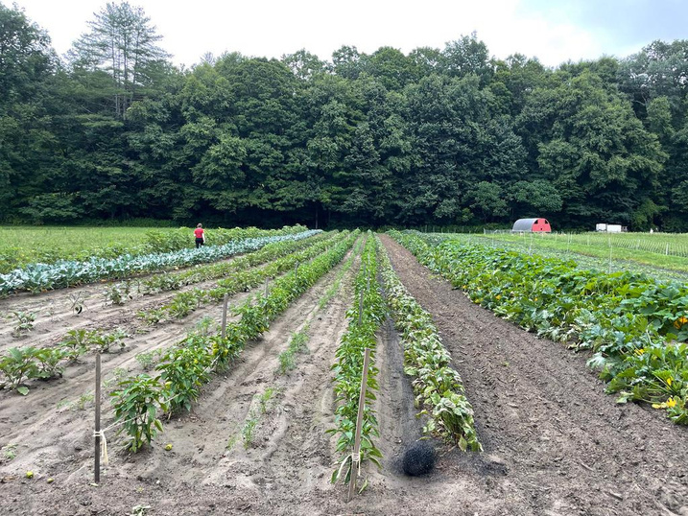
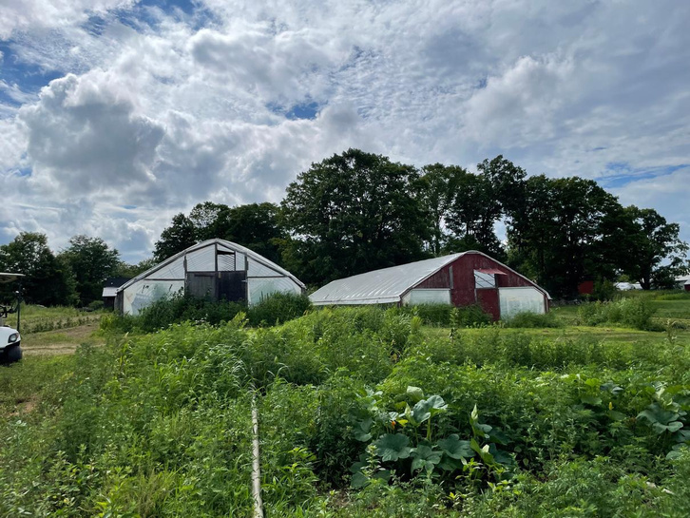

Land Access: Leasing and Acquisition
PRESENTATION
Finding Farmland in Connecticut
Presented by: Freedom Gerardo

Slide 45
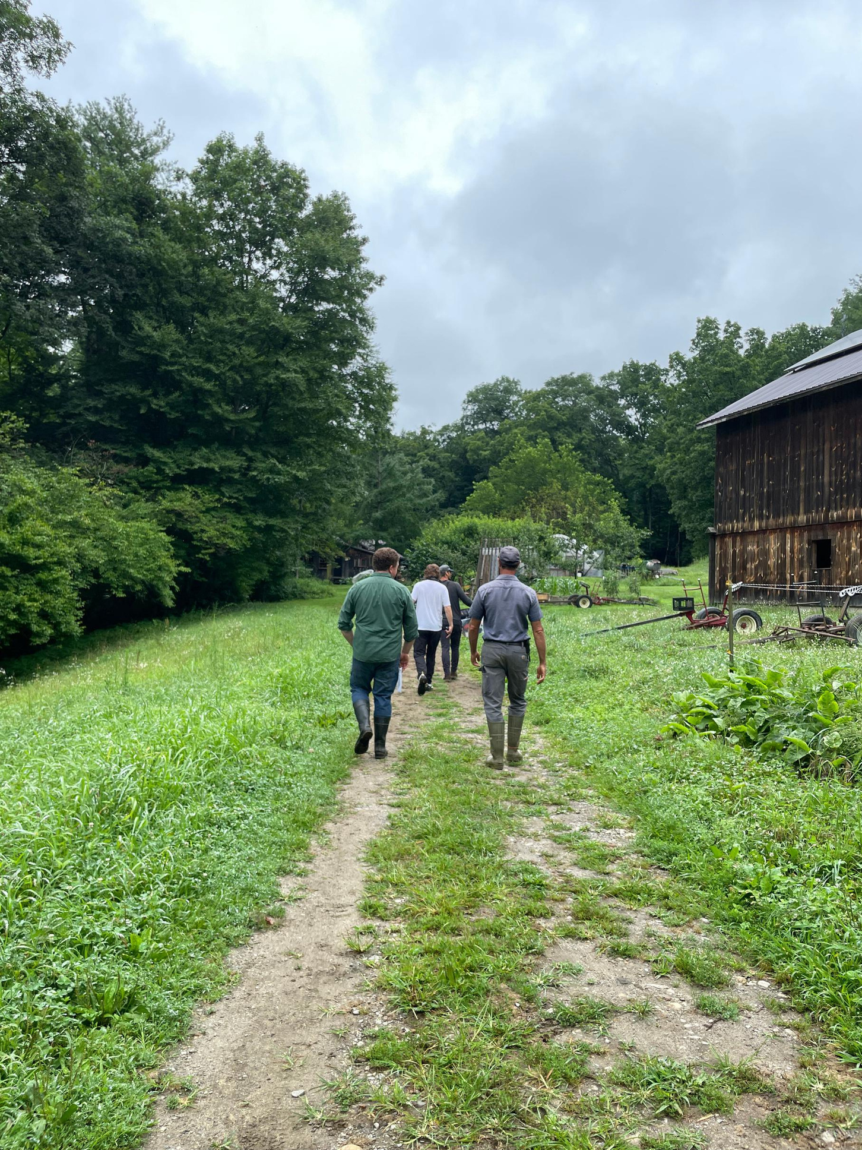
ABOUT US
Land For Good’s mission is to expand secure farmland access, tenure, and transfer.
Since 2004, Land For Good has been providing support and expert guidance to help farmers, landowners, and communities navigate the complex challenges of
land access, tenure, and transfer.

Slide 46
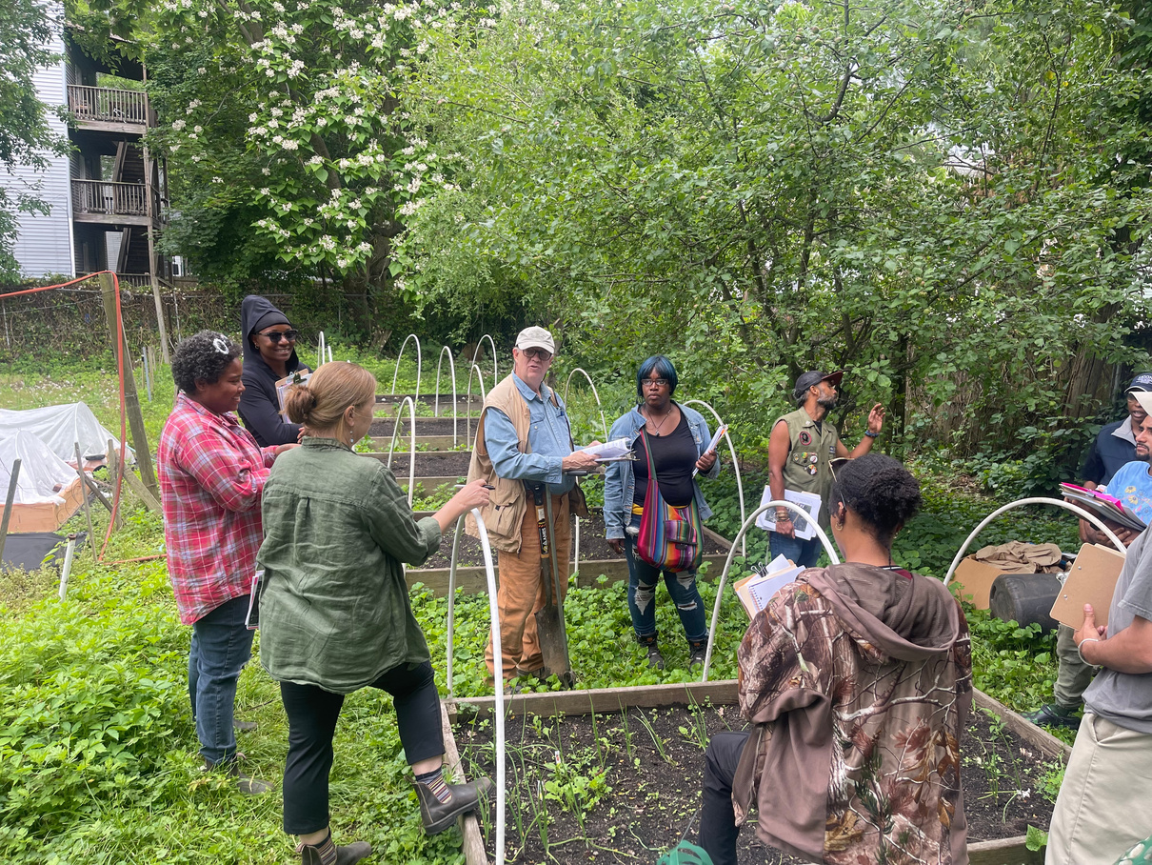
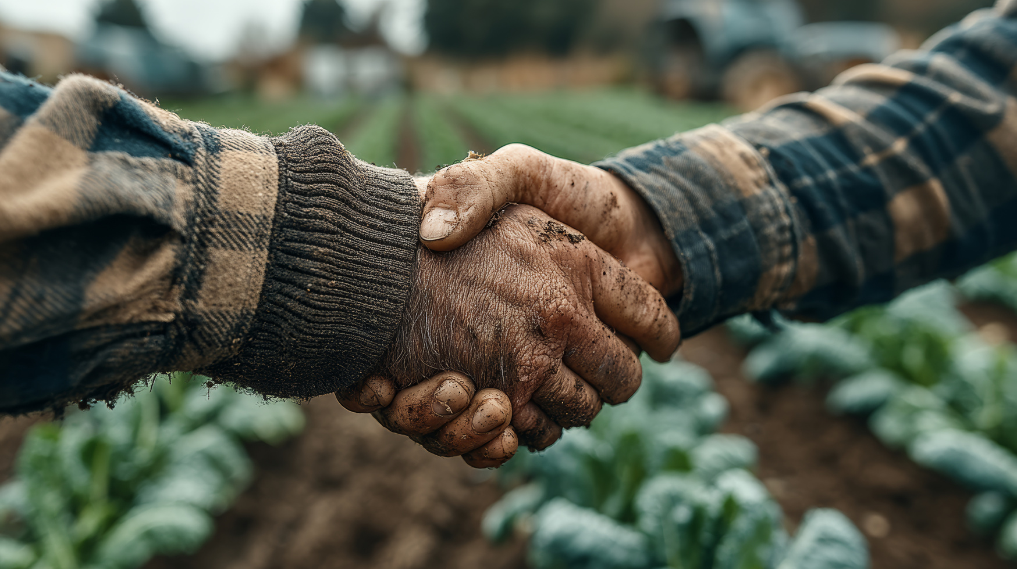
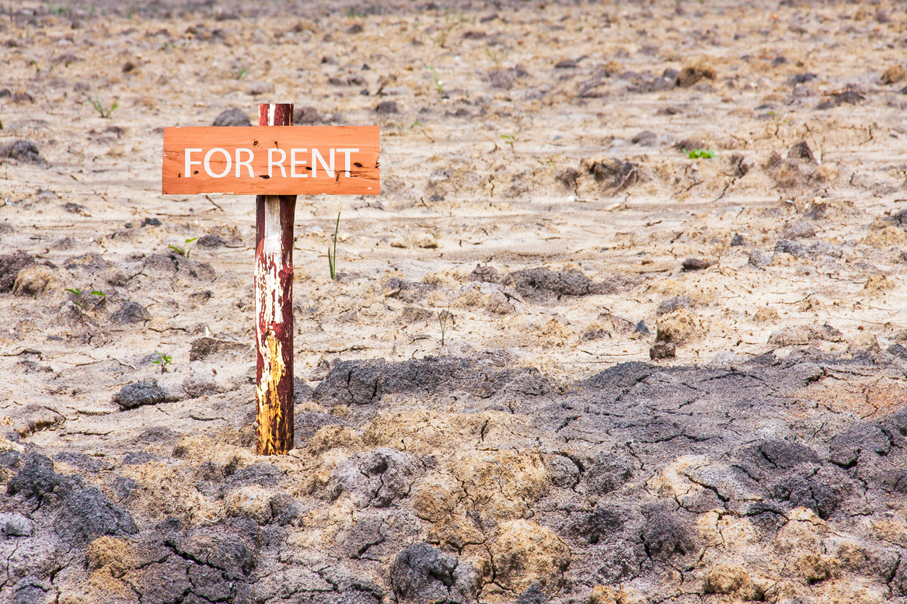
HOW WE HELP
FARM SEEKERS
TRANSITIONING FARMLAND
LANDOWNERS
Access land to start or expand a farm business
Making land available
for agriculture or find the
right farmer for a property
Transfer their farm or identify a successor

Slide 47
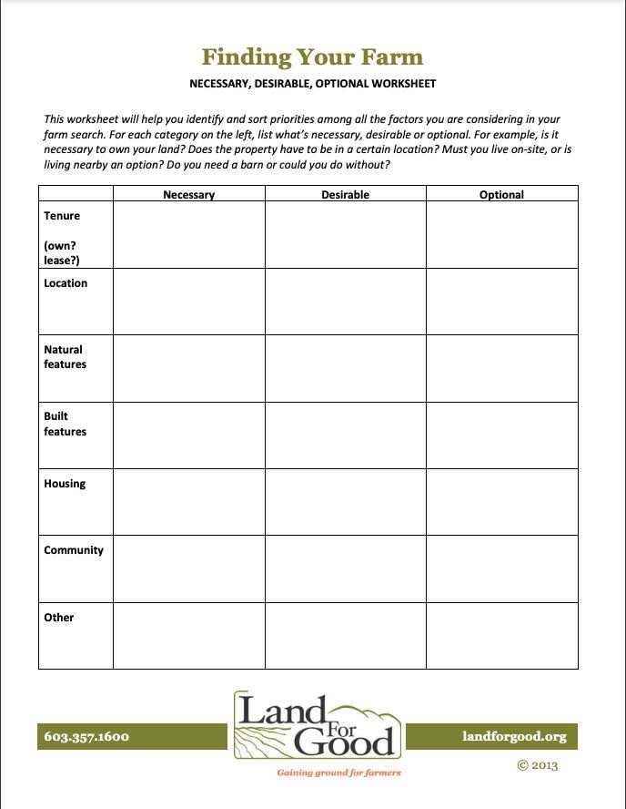
Finding Your Land
Use Land For Good’s worksheet, or create your own
Consider a spreadsheet to keep track of multiple properties
Add your own categories as needed

Slide 48
Three Basic Paths to Land Access
Leasing land
Buying land
Accepting gifts/inheriting land
Notes:
Review the Land Tenure Options Information Sheet for more detailed information. Find out about specific conditions, e.g., if your state limits the length of a lease term.
Remind participants that there are two basic forms of land tenure: leasing and owning but there are three paths to access: leasing, purchasing and inheriting/accepting gifts of land.
Explain that while traditionally farms and ranches have passed from one generation to the next by “cradle, altar or grave” – often with the farm or ranch business intact – this is less and less true. But it is often harder to gain access to land and takes more creativity than if it is passed down within the family.
Many beginners lease some if not all of their land. Others inherit or receive a gift of land usually from relatives. Beginners with enough net worth may be able to buy land. The right path for you will combine your goals and the realities of what you need and can afford. But it’s not fixed, you might start out leasing and move on to ownership. You might purchase or lease land that you inherit from your family or receive a small gift of land and expand your operation by buying or leasing more in the future.
It is important to weigh different considerations: how long a commitment you want to make, your financial position, how much security you need and whether you want to build equity (wealth).

Slide 49
How to Decide Which Land Tenure Options Are Right for You?
What can you afford?
Do you want to build equity?
How much security do you need?
Notes:
At the end of the presentation and discussion, ask participants to update their LP3 Land Requirements Checklist.

Slide 50
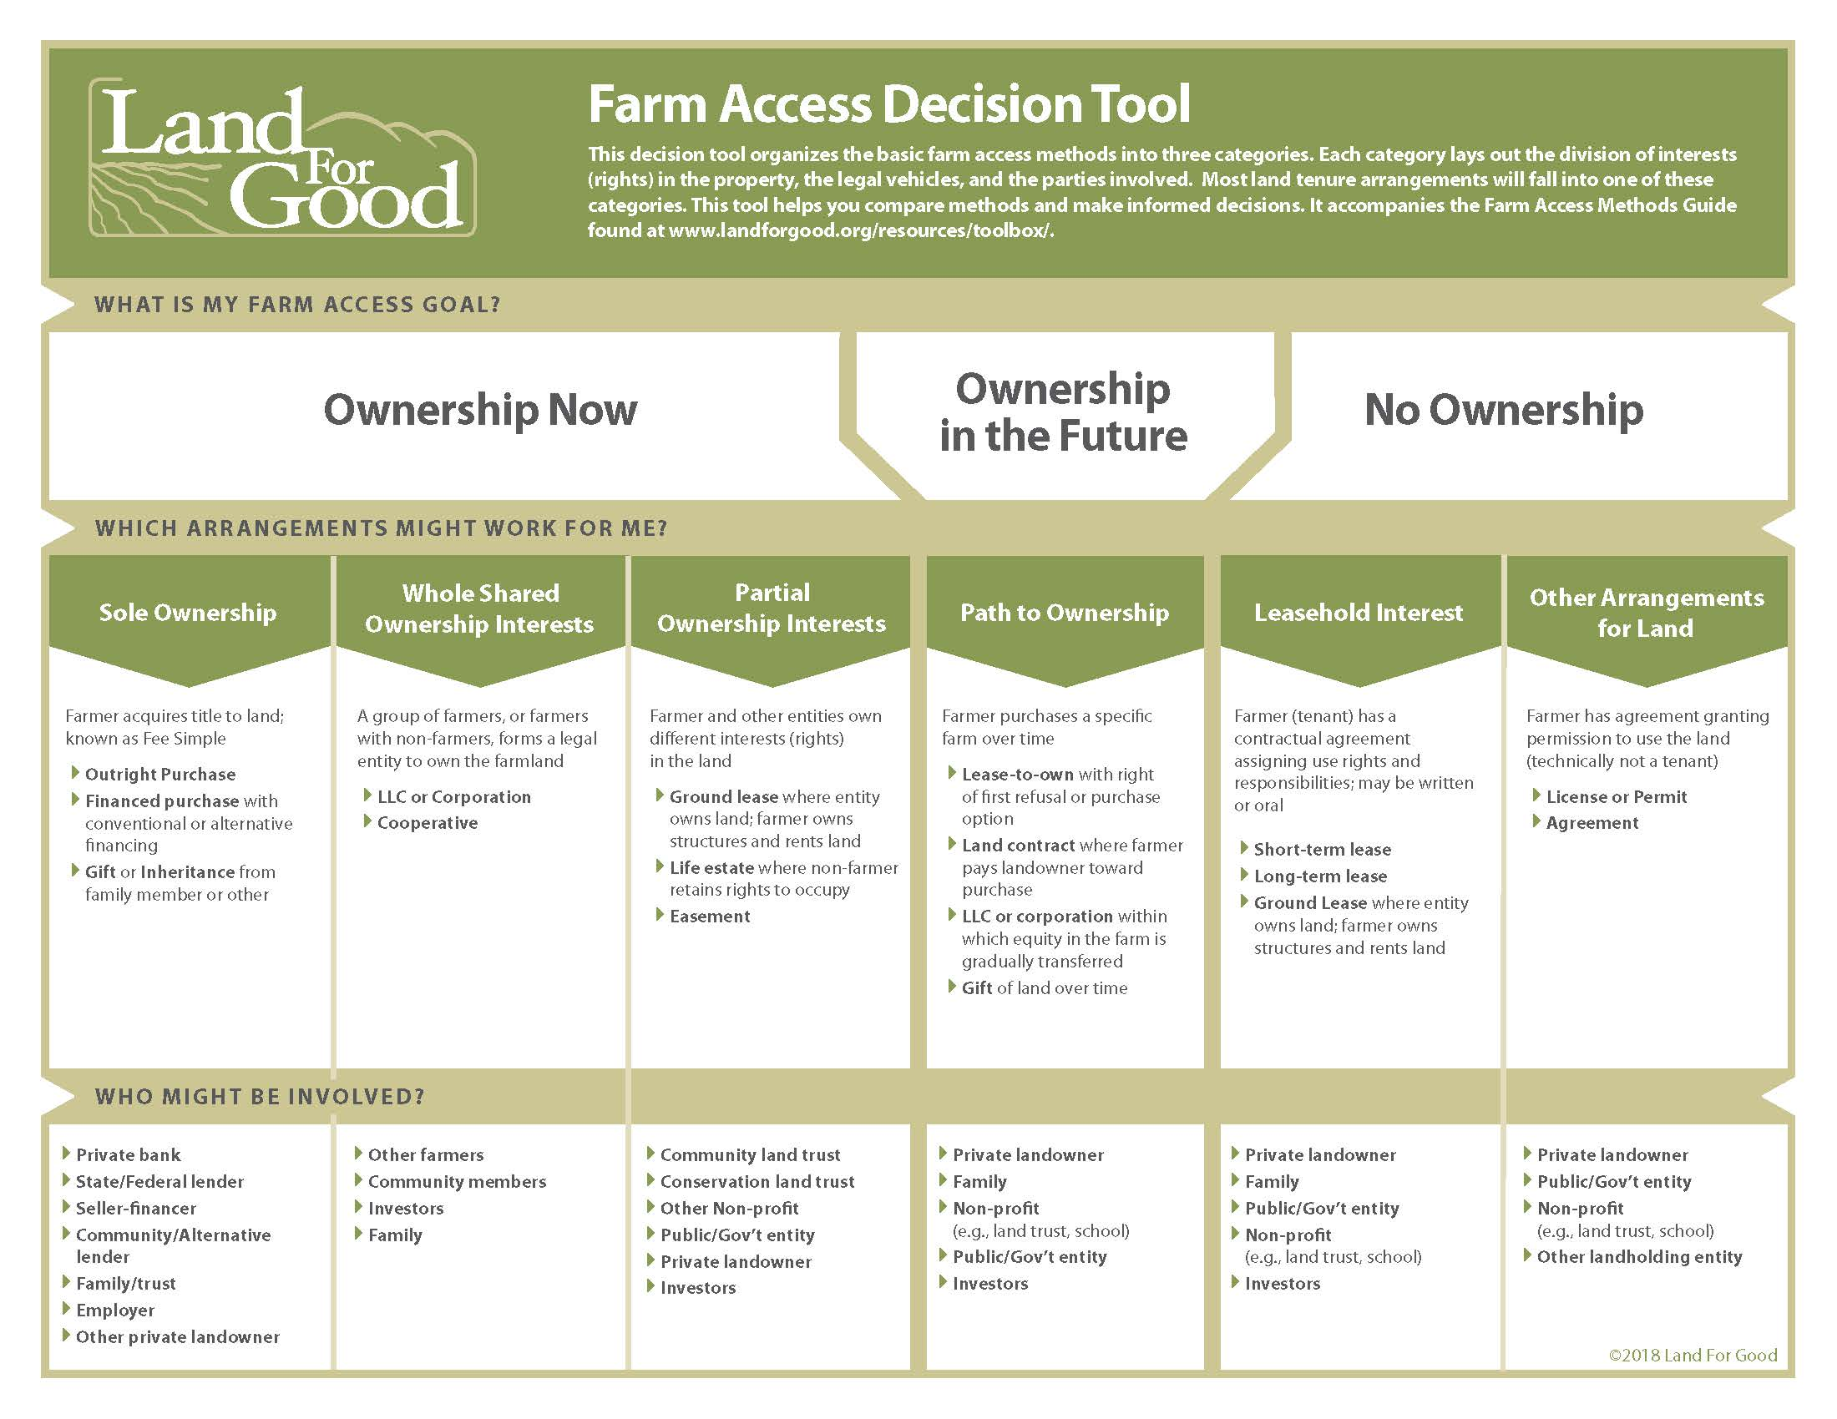

Slide 51
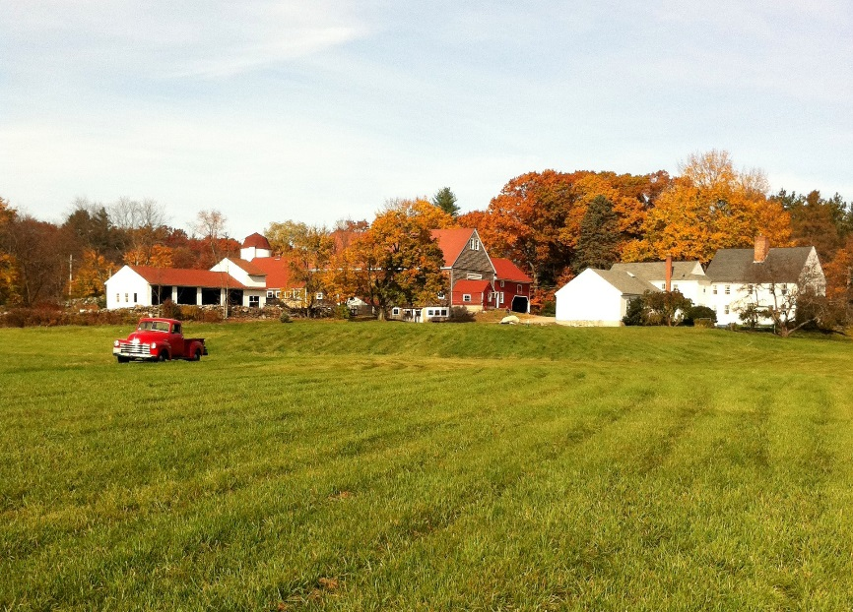
If You’re Leasing…
What’s in a good lease?
The parties
Premises
The term
The “consideration”
Signatures
= a lease contract … but there can be more!

Slide 52
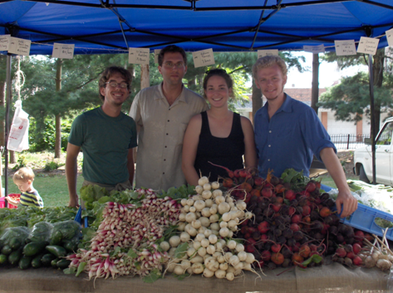
How can I find land to rent or buy?
Word of mouth – e.g. from family and friends
Real estate market (MLS, Find a Realtor)
Place ads in Ag & community media
Community networks
Review classified ads in local papers or farm/ranch publications
Online resources
Notes:
Lots of possibilities – maybe some that you have not considered. For example, many states have land trusts and farmland protection programs that have permanently protected land for agriculture and may be looking for new owners or tenants to keep that land in production.
NYFC guide on working with land trusts: http://www.youngfarmers.org/wp-content/uploads/2015/01/NYFC-Finding-Affordable-Farmland.pdf
Public sector landowners may make land available – from federal grazing land to state and local governments, park departments, military bases

Slide 53
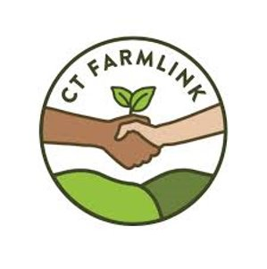
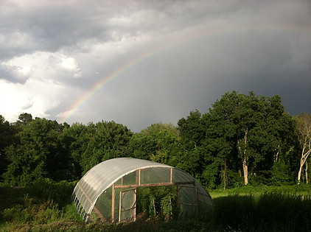
Questions?
Cyrena Thibodeau, CT DOAG
Cyrena.Thibodeau@ct.gov
Solid Ground Farmer Trainings
Strengthening Our Farms Across Connecticut
Notes:
5 minutes – Partner Org Rep or PC

