Slide 1
How to Create and Operate a Successful On-Farm Airbnb
Robert Maddox – Sun One Organic Farm, Bethlehem, CT

Slide 2
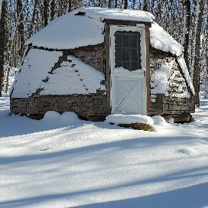
What This session will cover
Is an Airbnb on your farm right for you
Quick review of Airbnb
Tips for success
Overview Sun One Organic Farm
Overview of June Farms
Q & A
Closing remarks

Slide 3

Is an Airbnb right for you and your farm?

Slide 4
Things to consider
Do you mind having people around?
How will this affect your farming operation?
Zoning?
Where will they stay?
What is the rest rooms situation?
Cleaning?
Allow people to bring their Pets?
Who will manage the operation?
What can they do in the area?
Kitchen/cooking/Refrigerator
Internet?

Slide 5

What is Airbnb
https://www.airbnb.com/
The world largest On-line platform allowing people to book rooms & experiences.
They collect a fee from both host and guest and handle all taxes.
Provide some insurance protection.
You receive ratings and reviews from guests as well as rate guests.
Easy to use

Slide 6
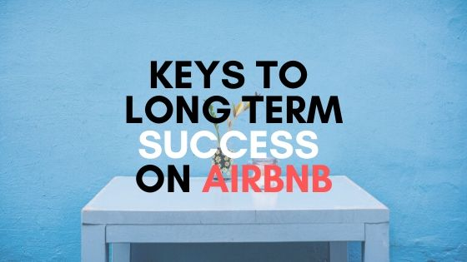
Tips for success
Set a fair price
Good pictures that accurately represent your place
Communication and (always do it through Airbnb app)
Under promise and over deliver
Set right expectations
Vet your guests
Recommendations for things to do, places to eat.
Know when to offer a refund

Slide 7
Our stay at the dome in the woods was amazing ! Even in the 20 degree weather we were able to make the most of our stay. Everything about this stay exceeded our expectations, whether it was walking around the farm with our dogs or sitting by the greenhouse wood stove or even just bundling up in the dome. The hospitality was exceptional also. Our host was very friendly and even walked the farm with us while giving us a quick history lesson on the farm origins, so cool! We would recommend this to anyone and will be coming back again!

Slide 8
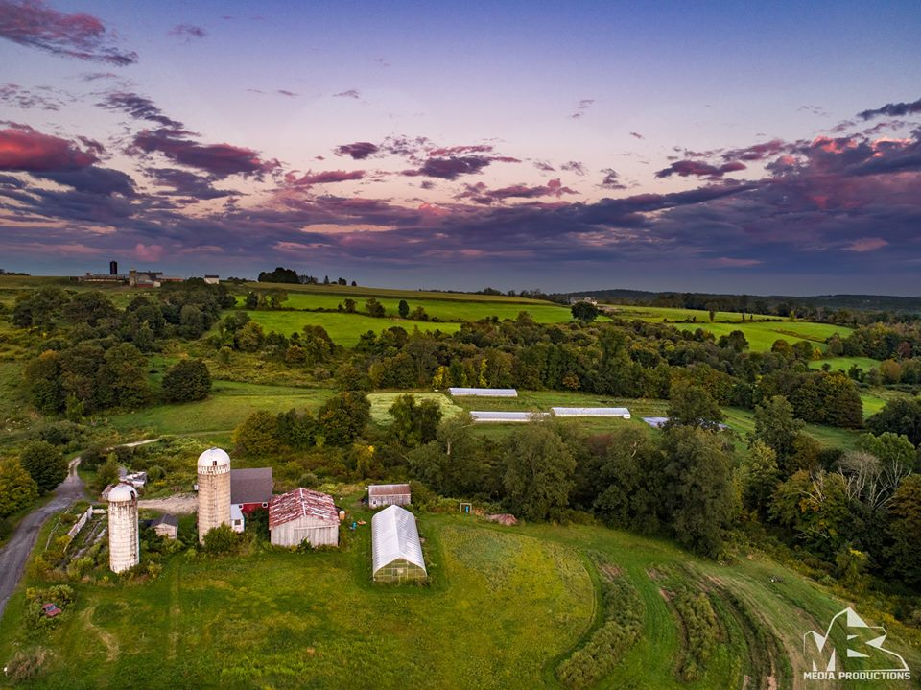
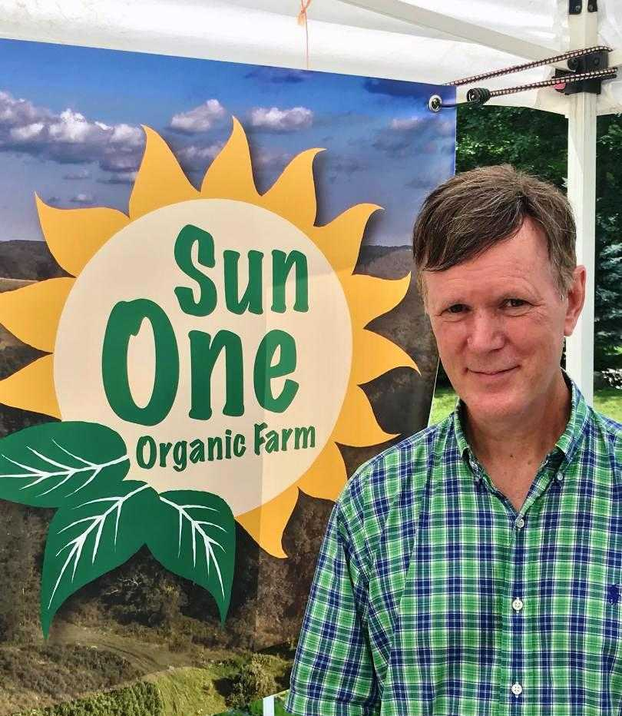
Sun One Organic Farm – Bethlehem, CT

Slide 9
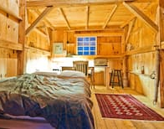
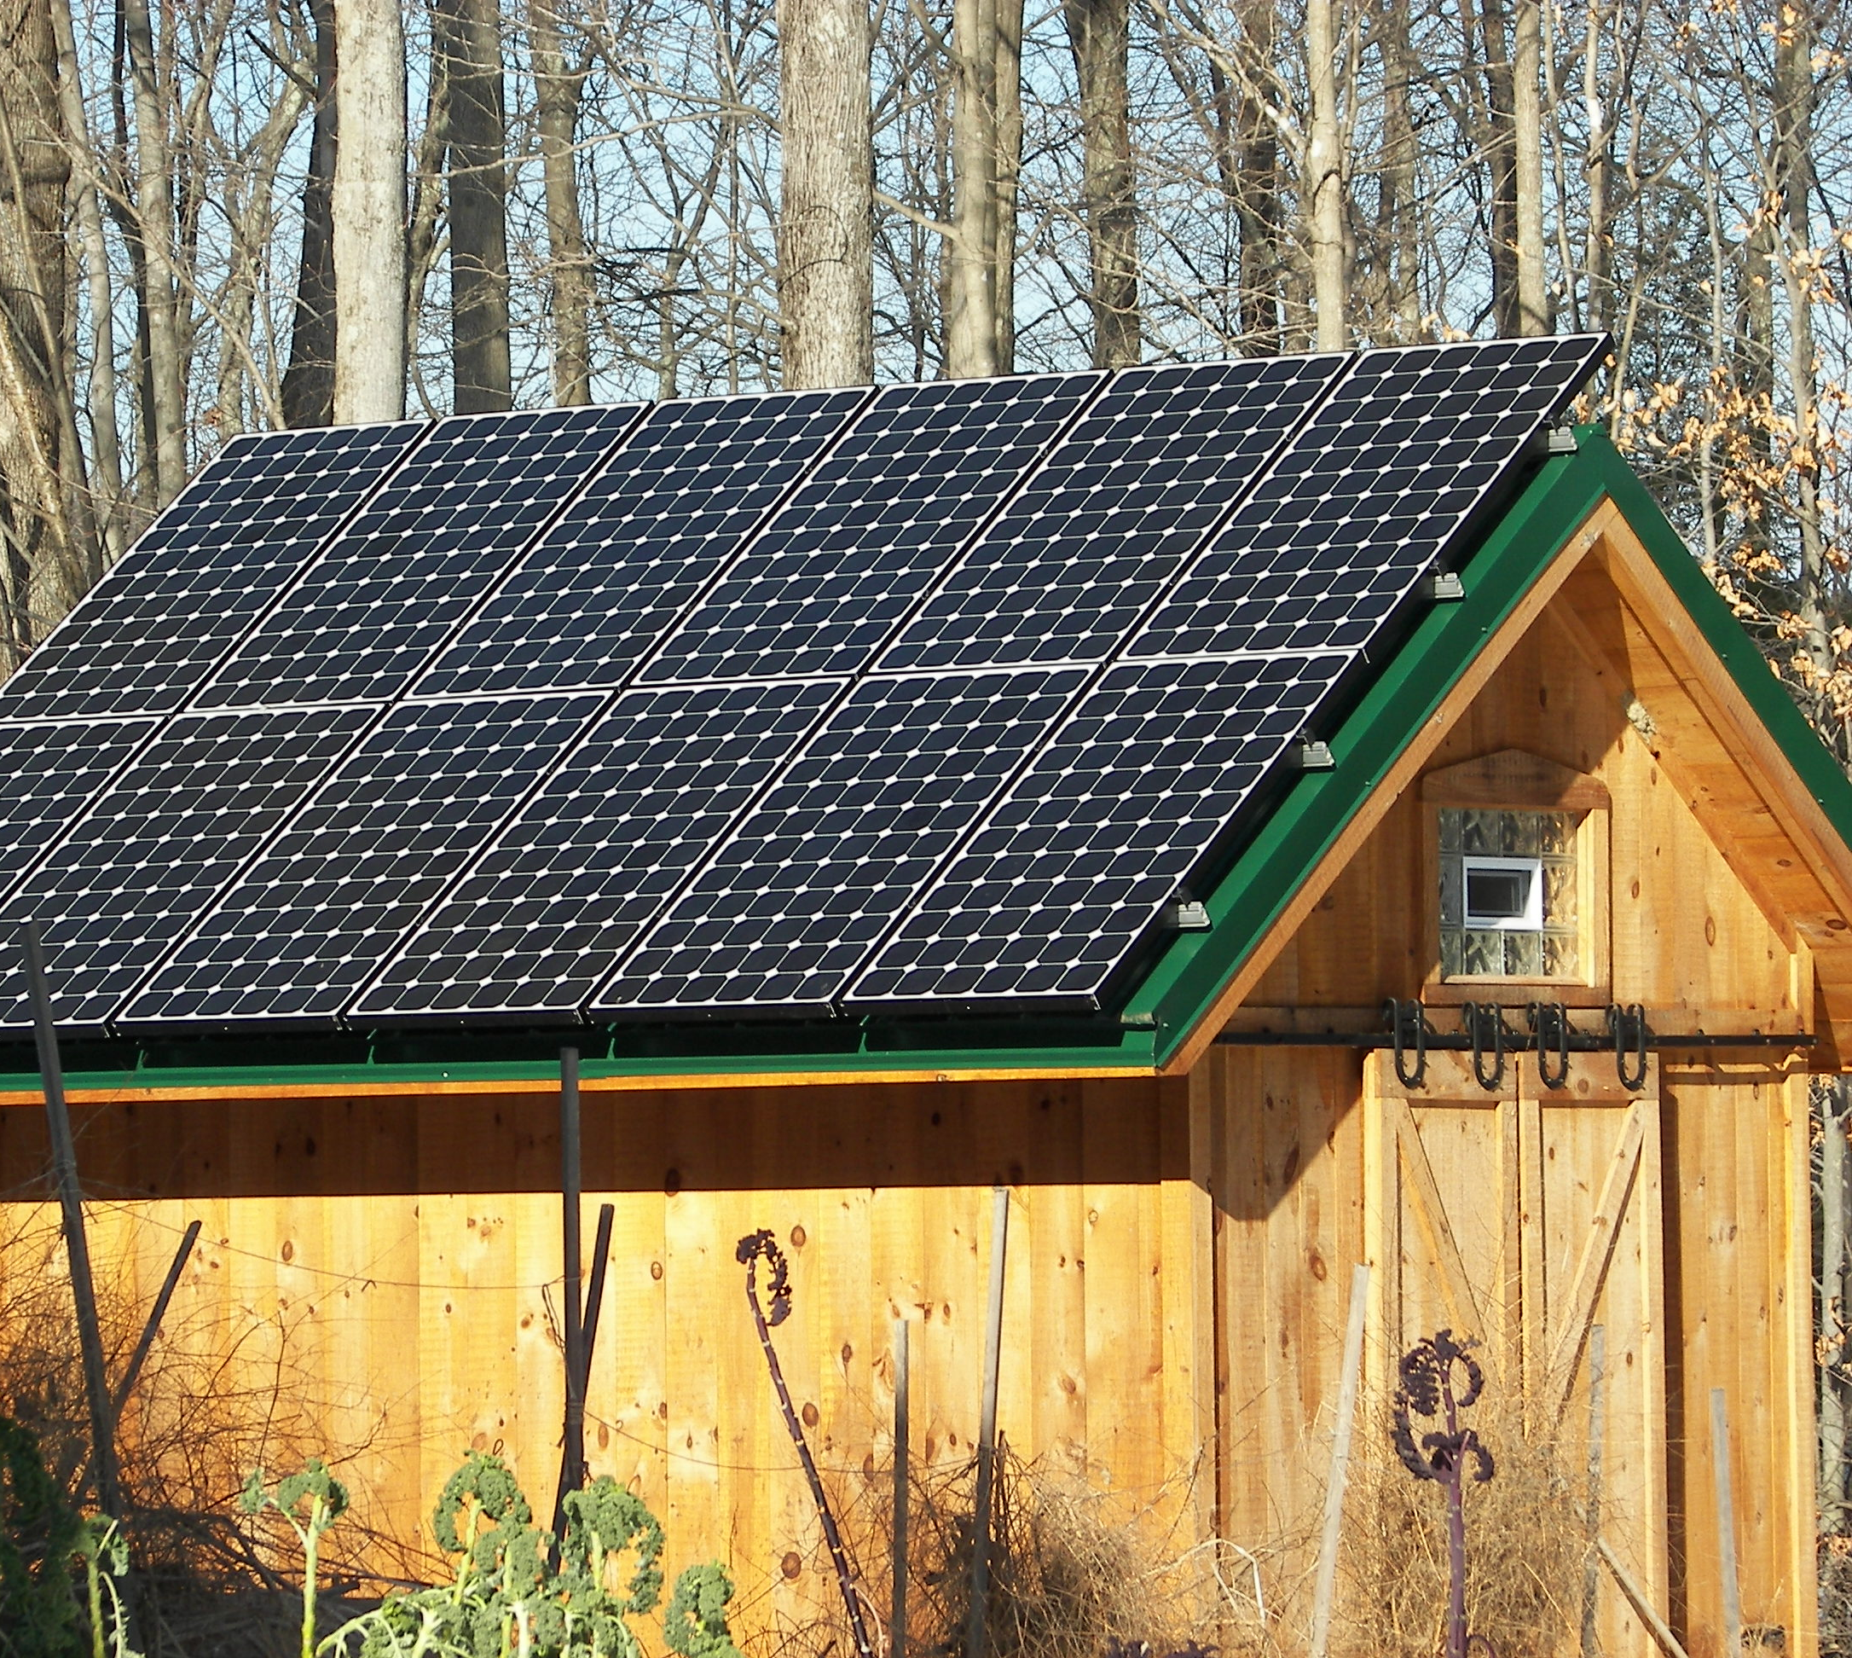
Post & Beam Barn

Slide 10
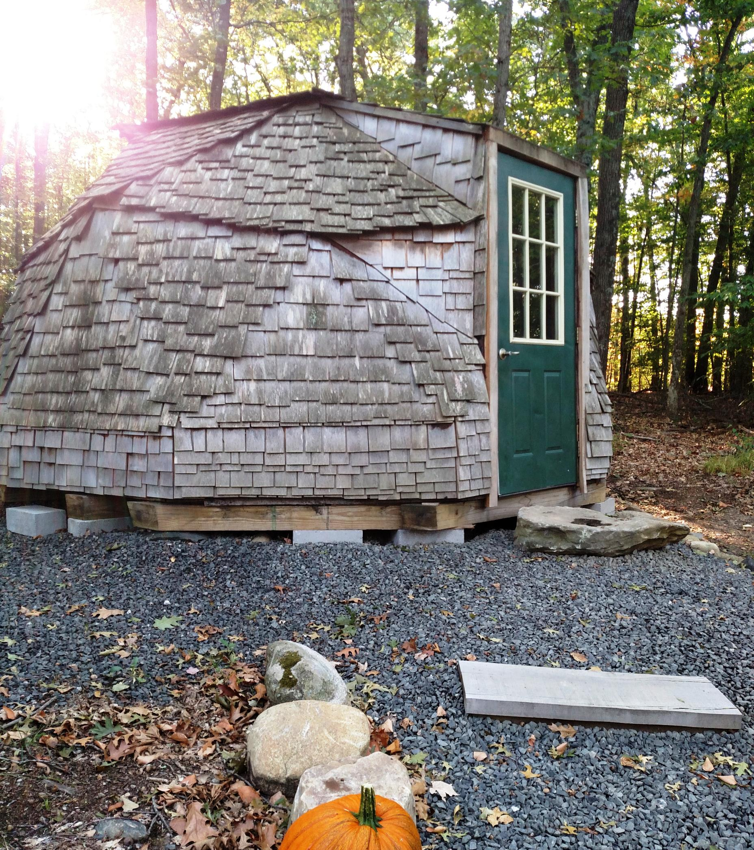
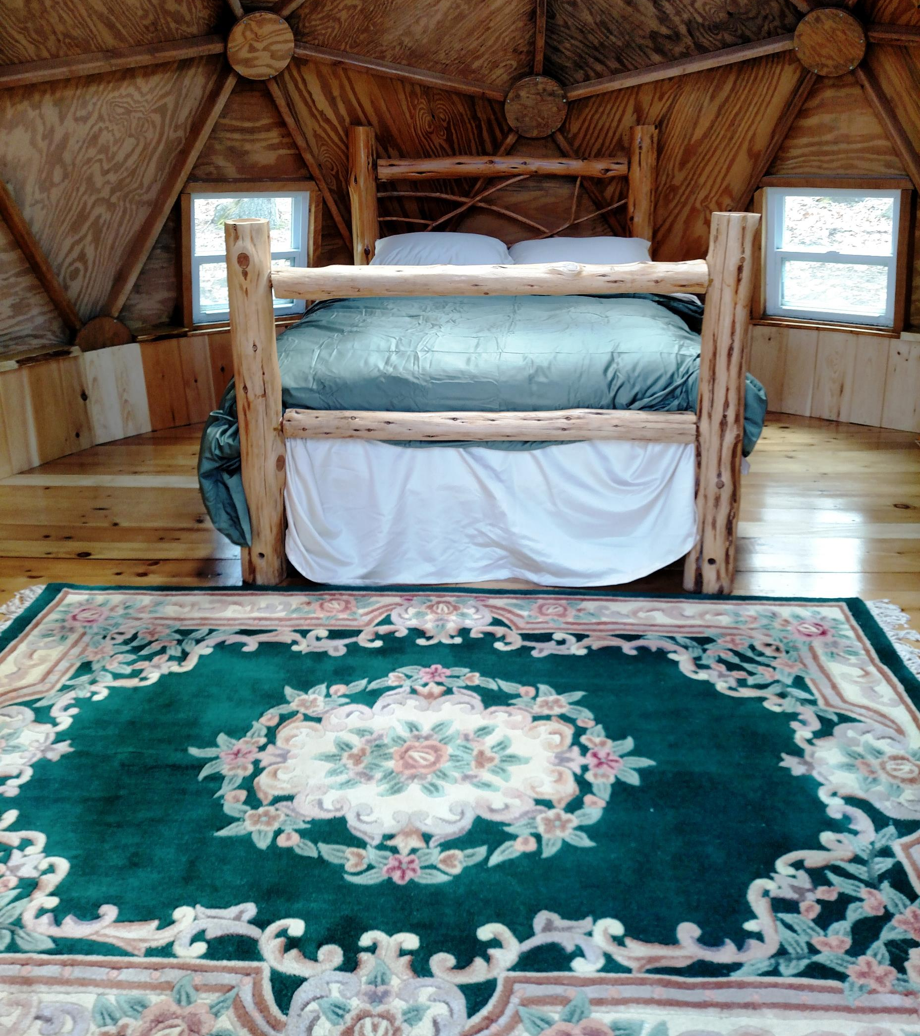
Geodesic Dome

Slide 11
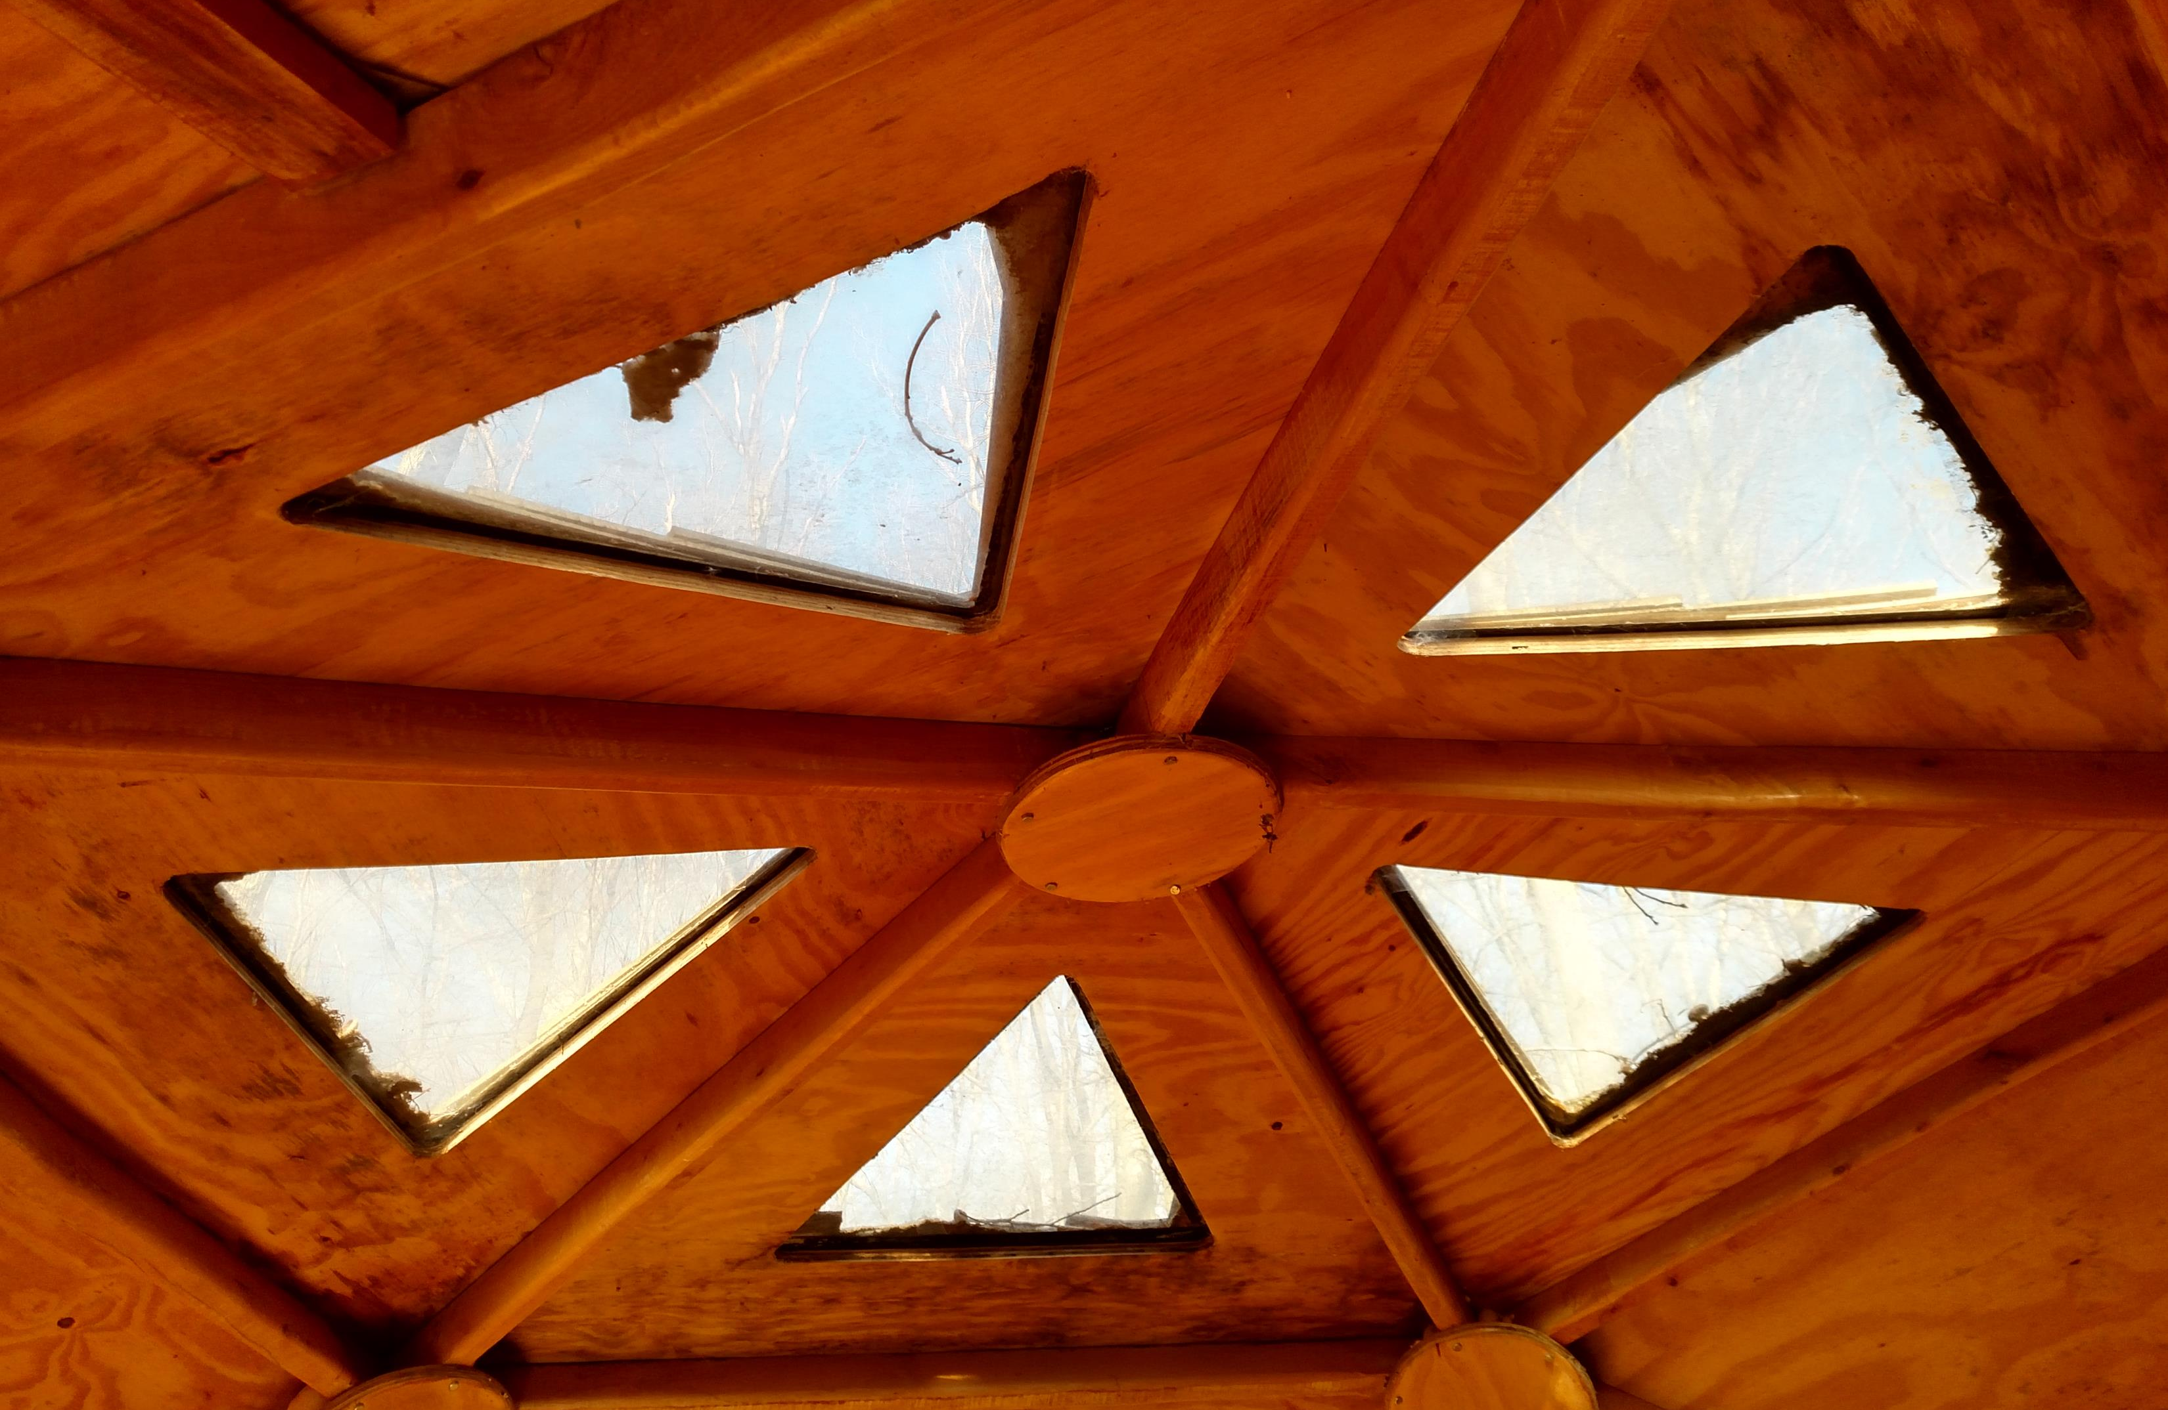
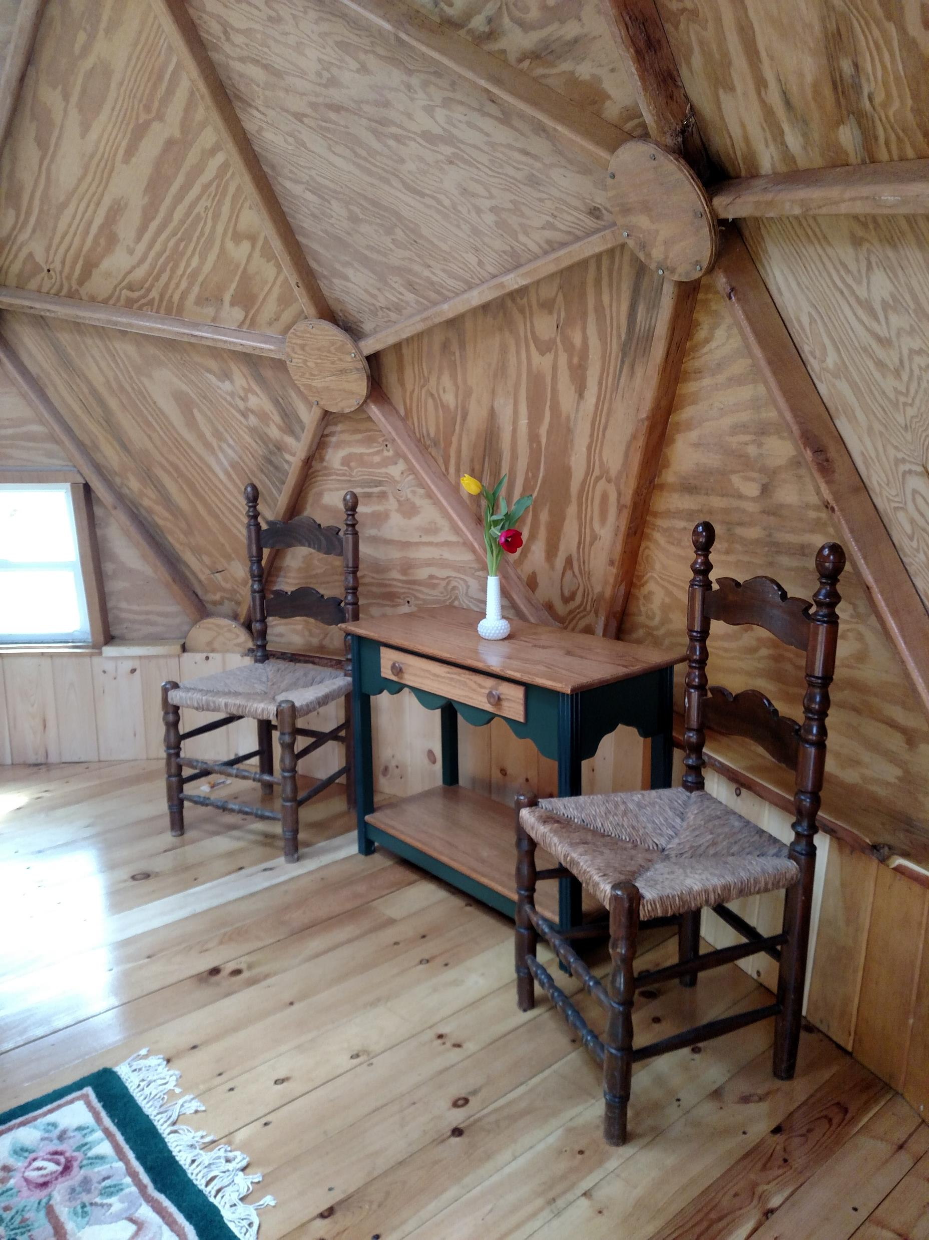
Dome

Slide 12
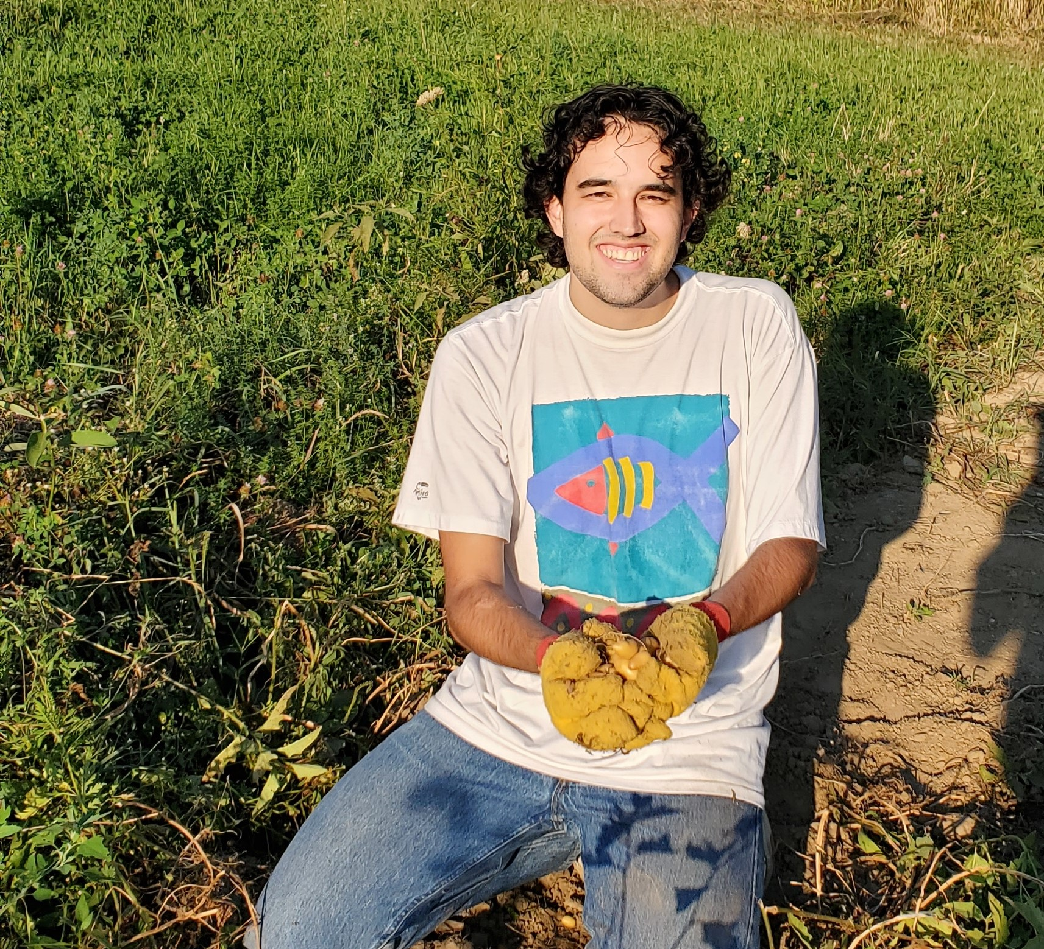
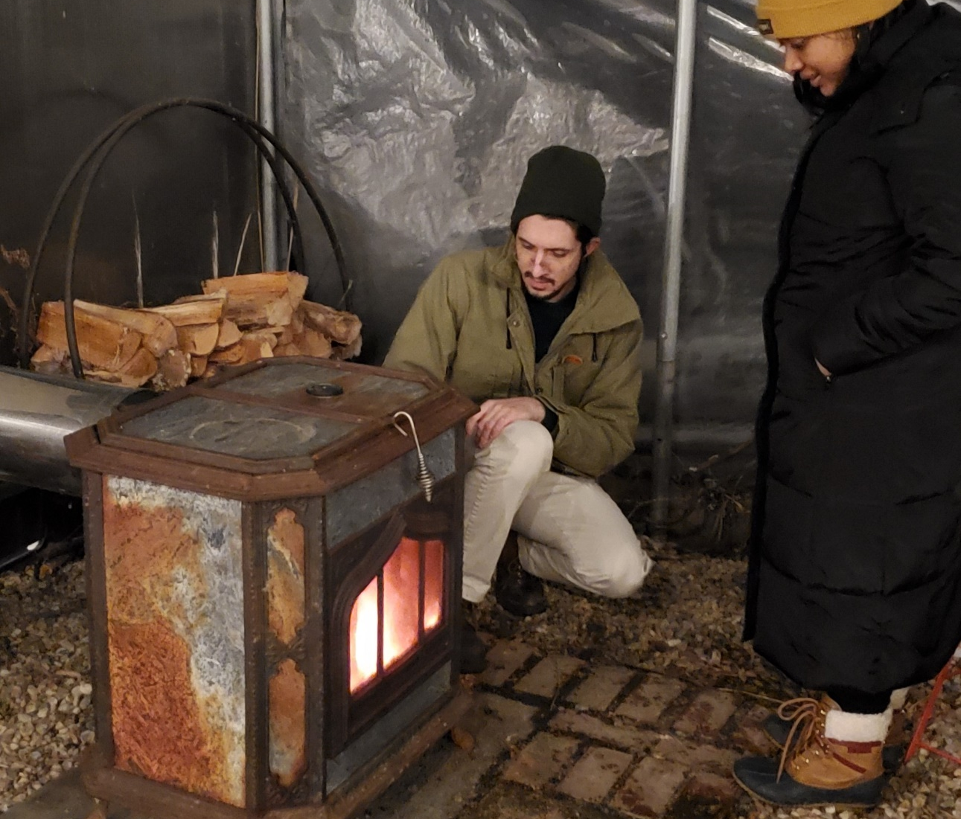
Things to do on the farm

Slide 13
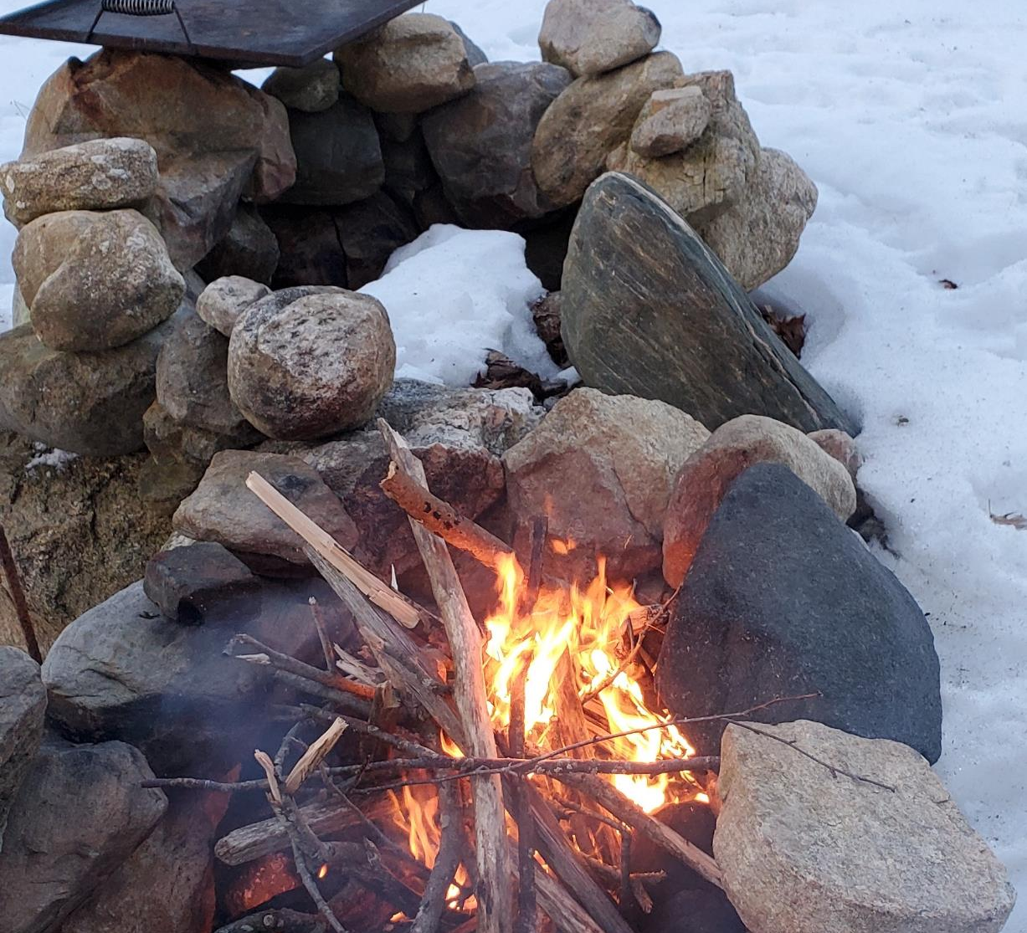
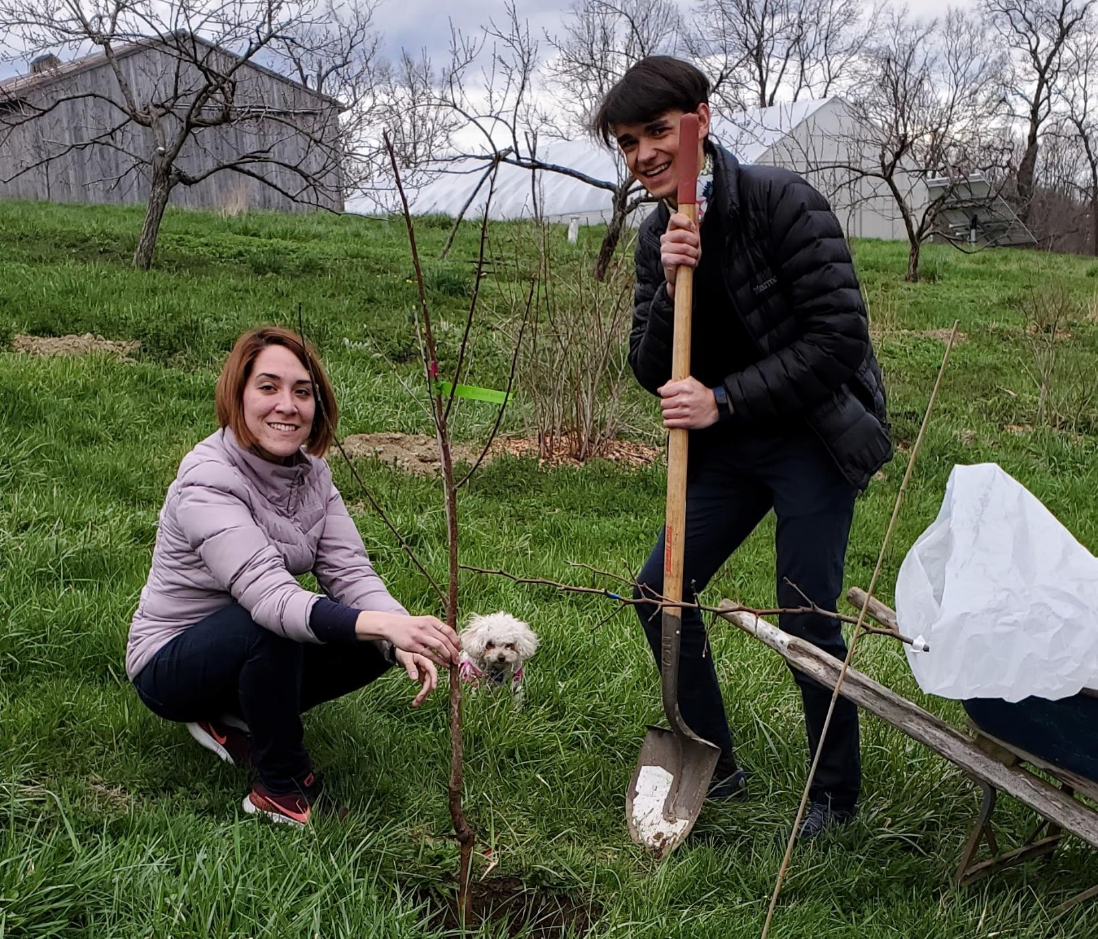
Things to do

Slide 14
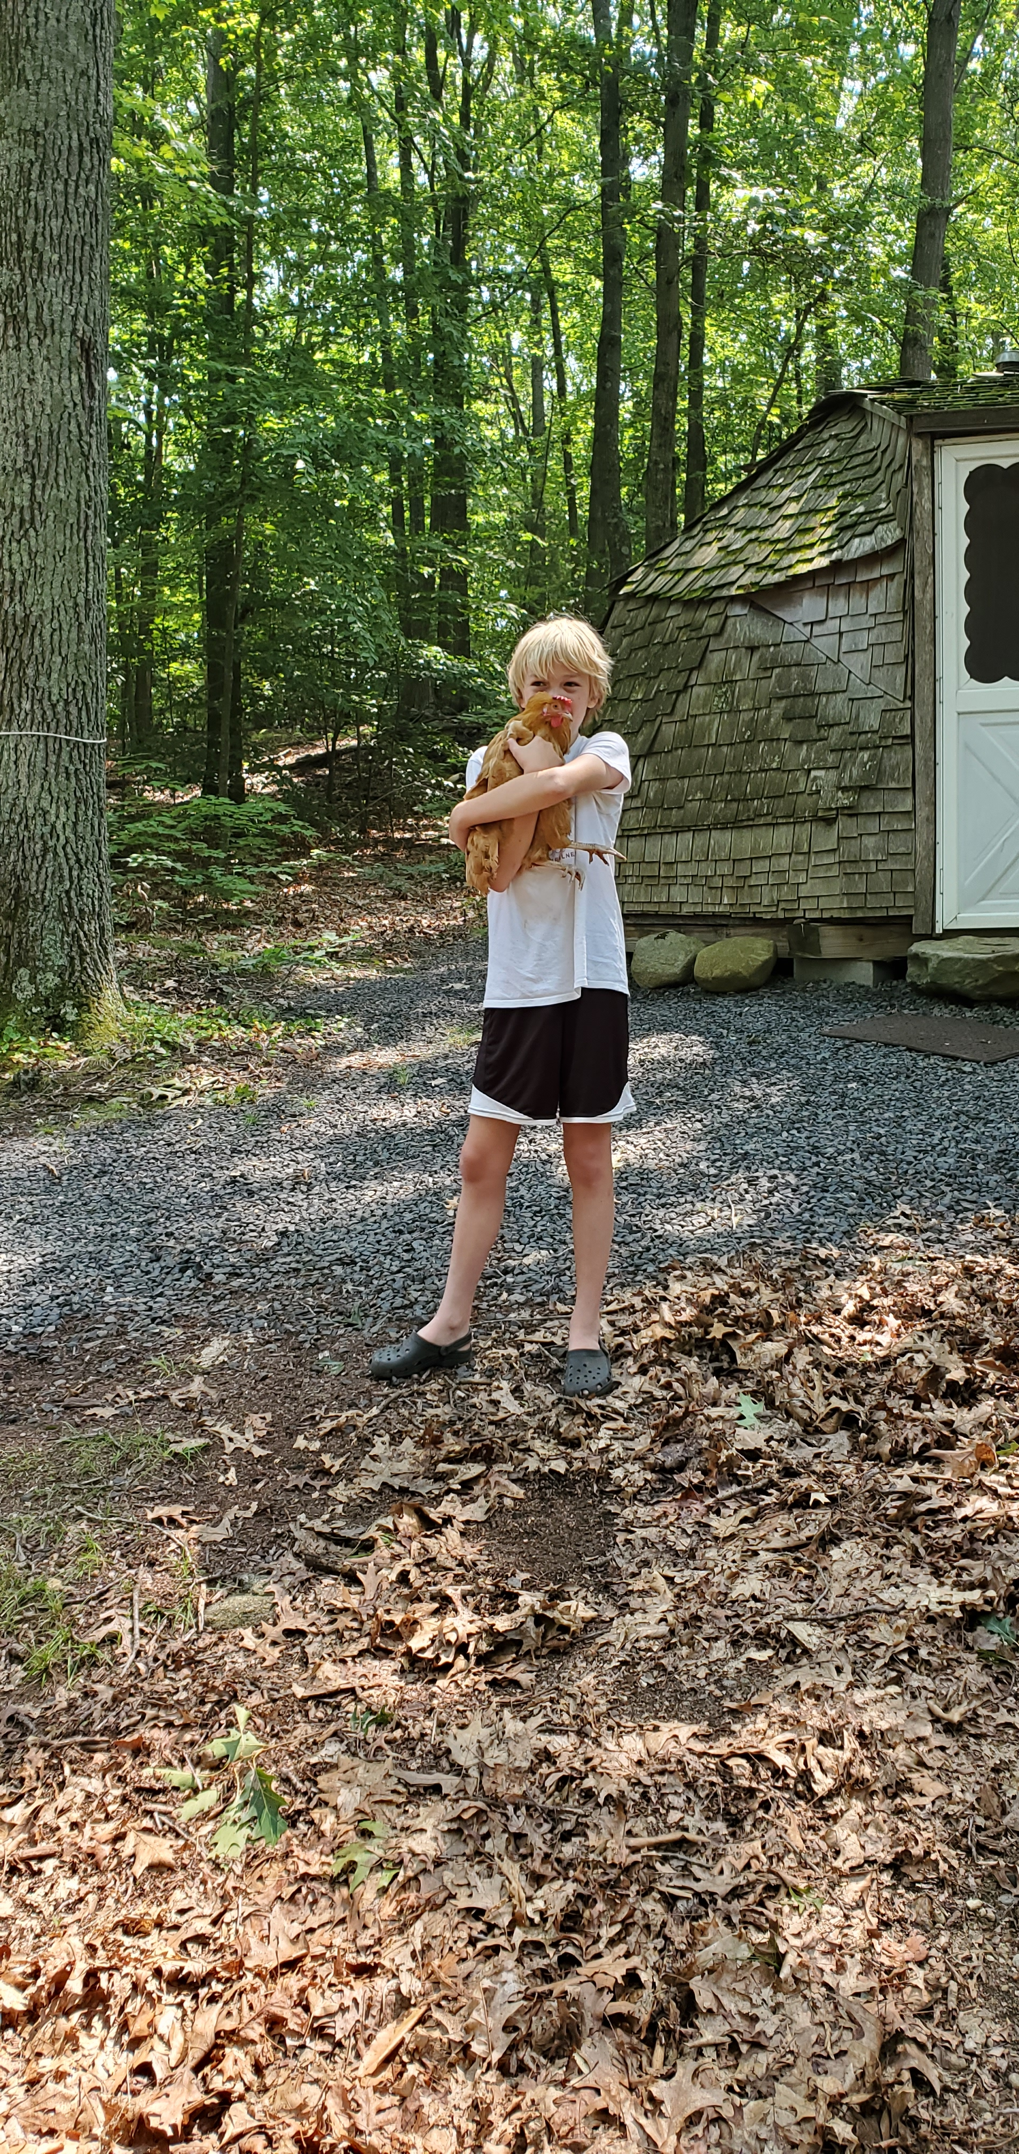
Animals allowed

Slide 15
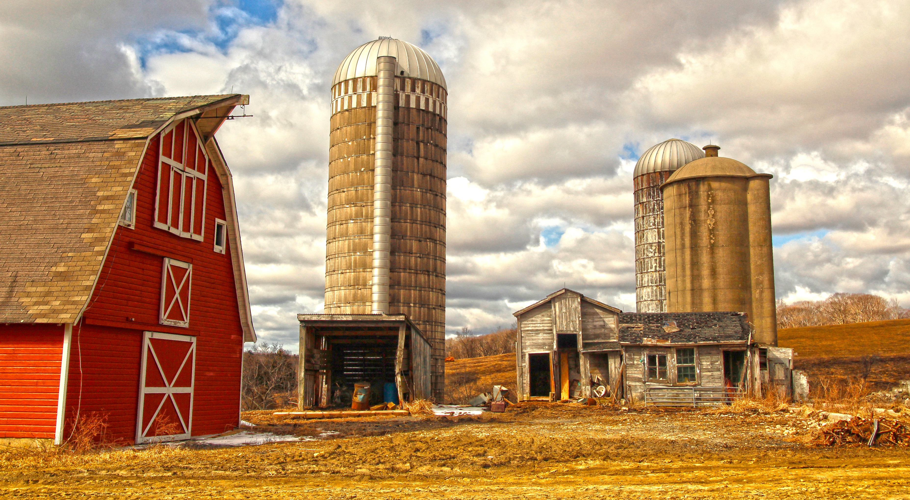
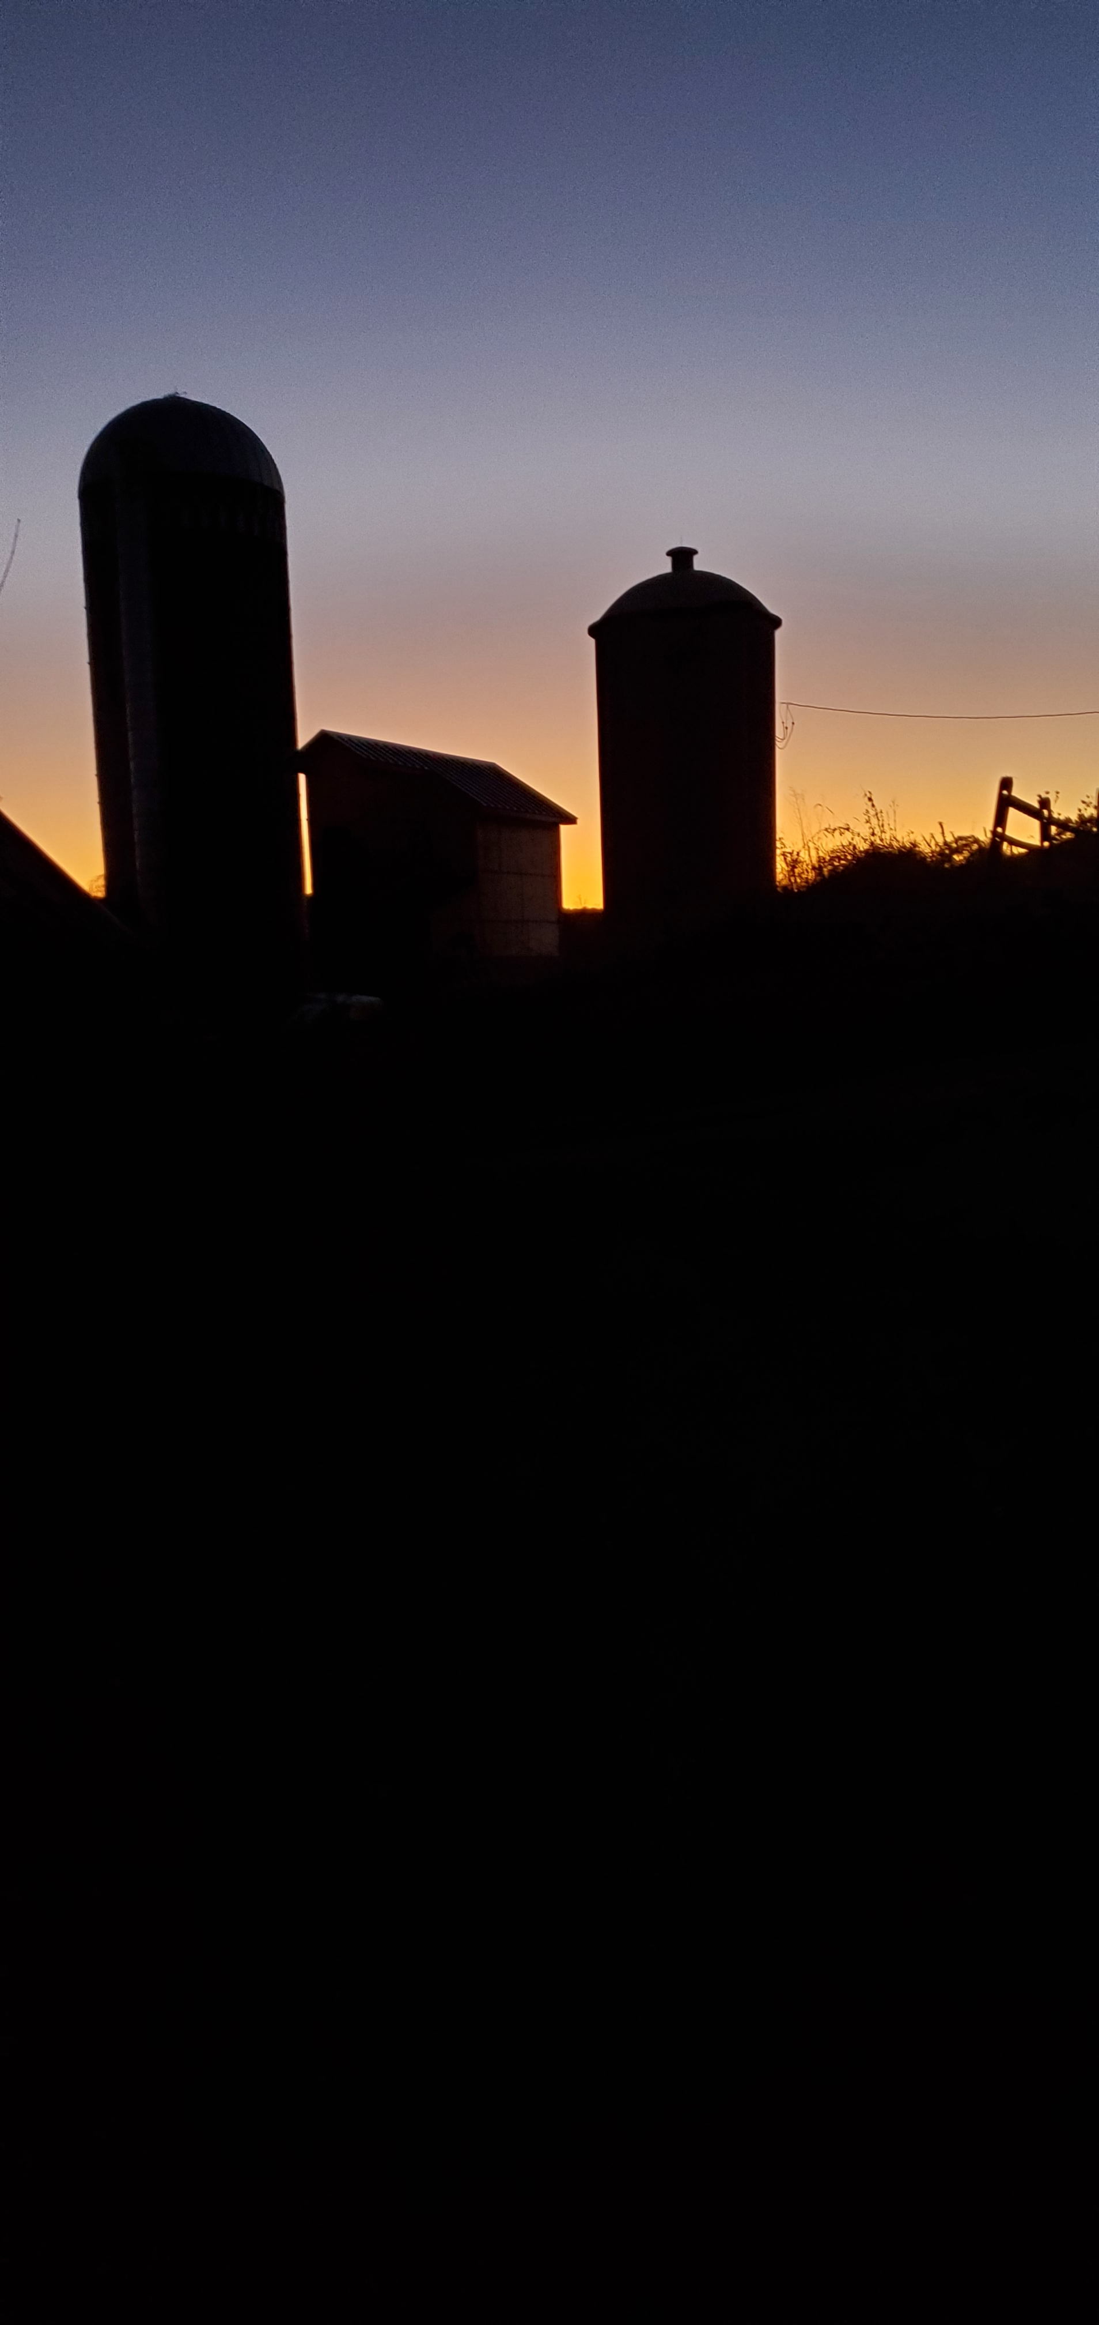
The silo Project

Slide 16
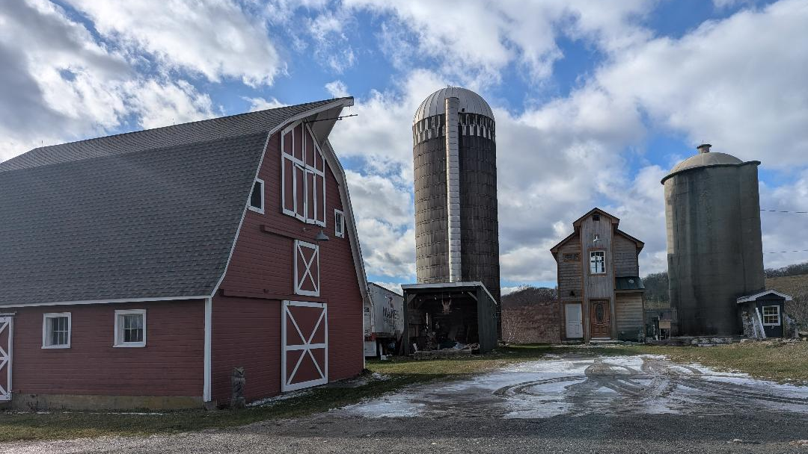

Slide 17
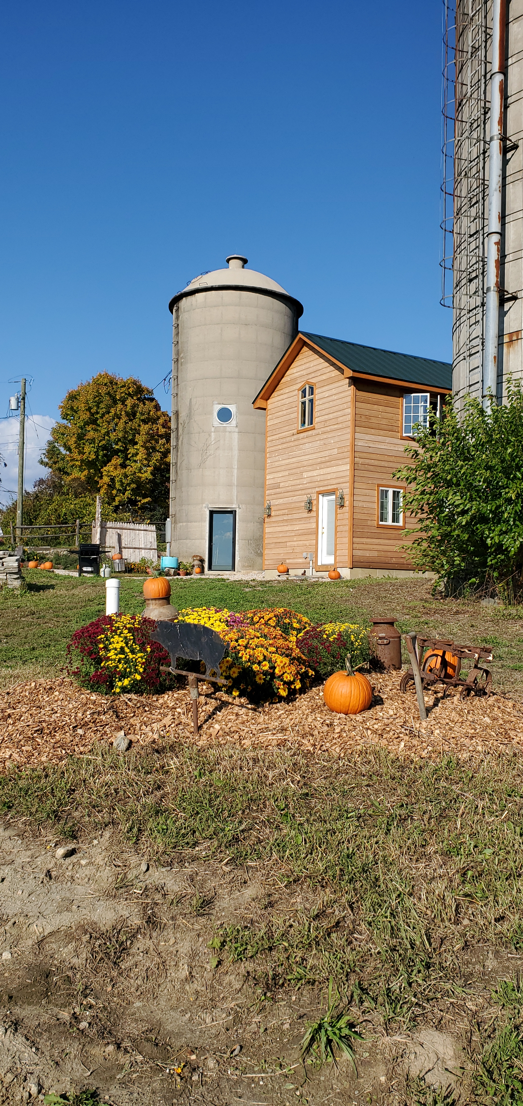
Bathroom/loft & Silo

Slide 18
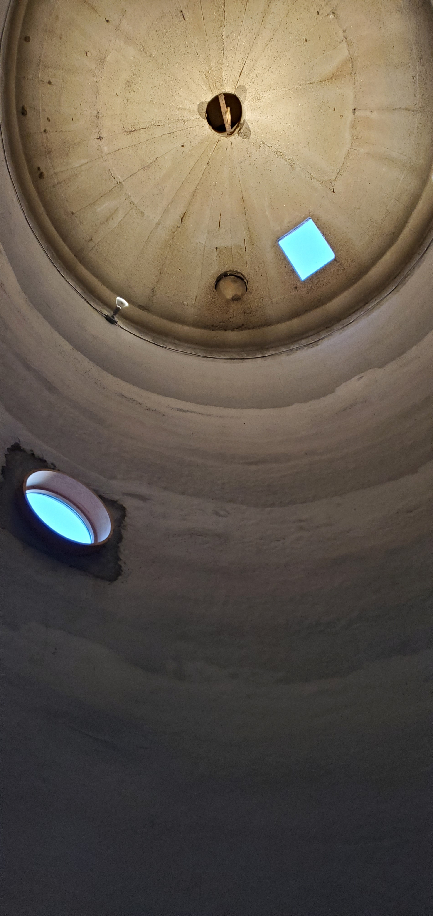
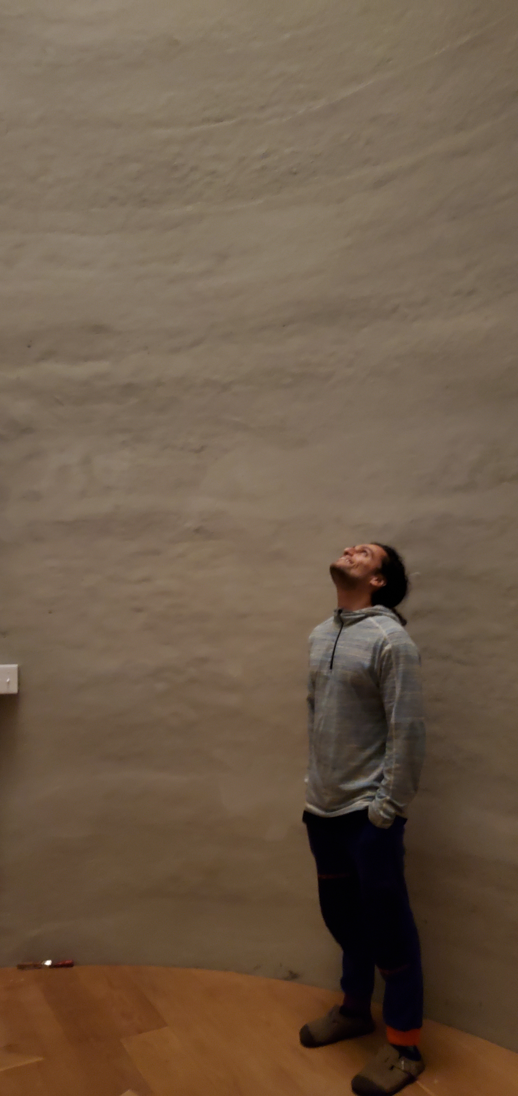
Silo

Slide 19
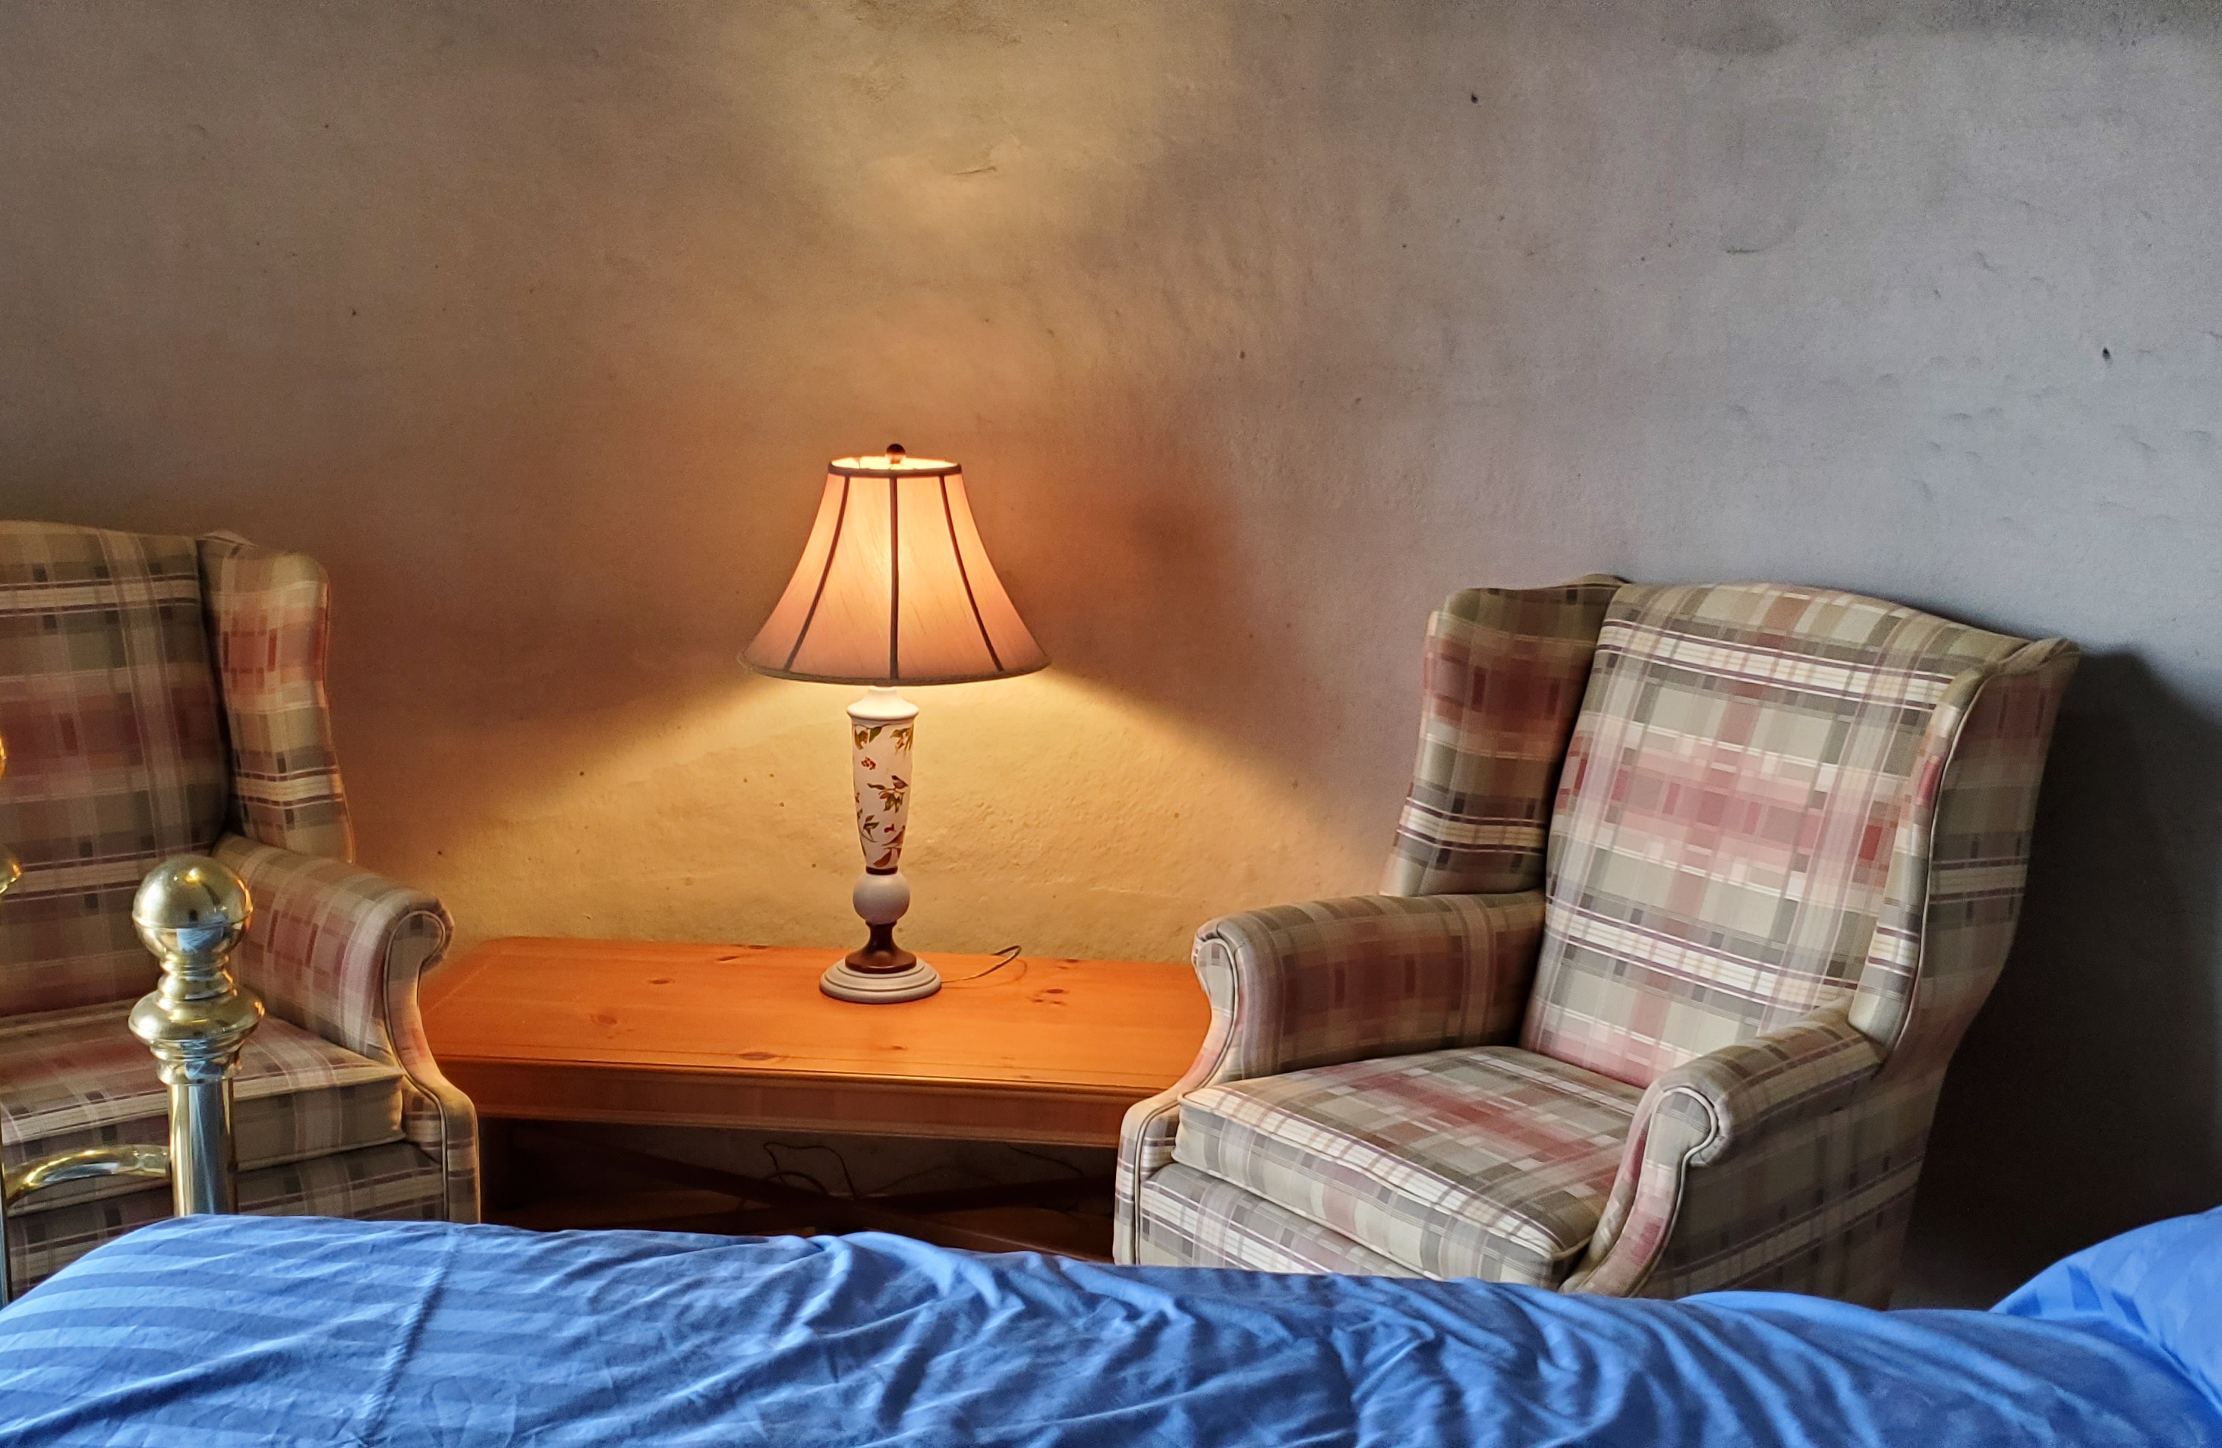
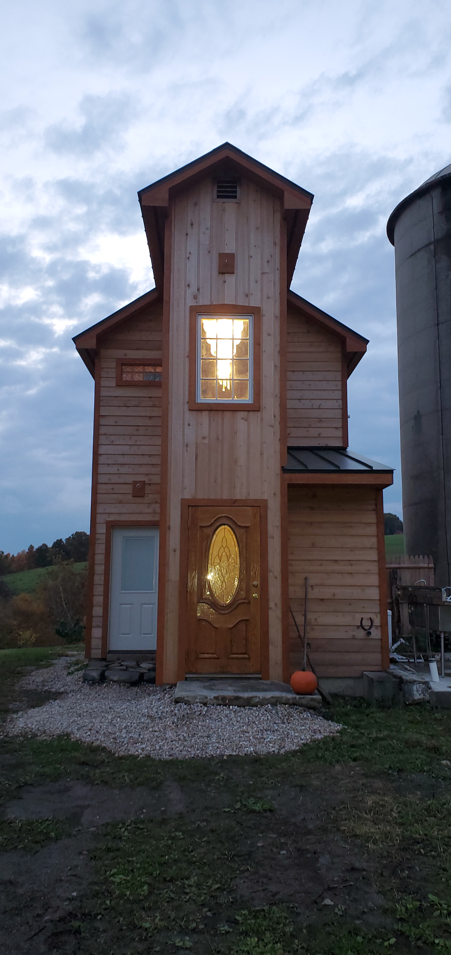
Silo & Loft

Slide 20
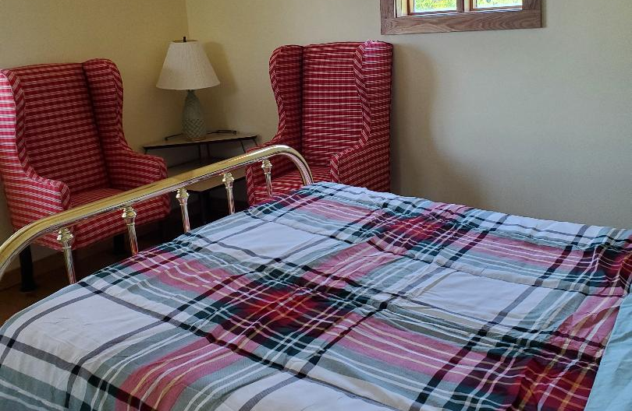
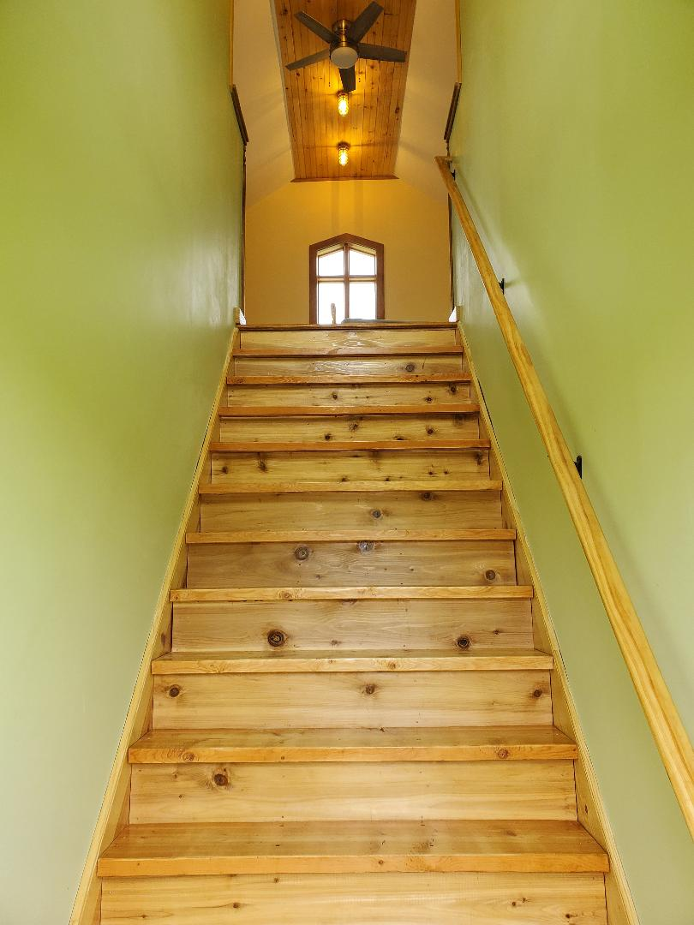
Loft

Slide 21
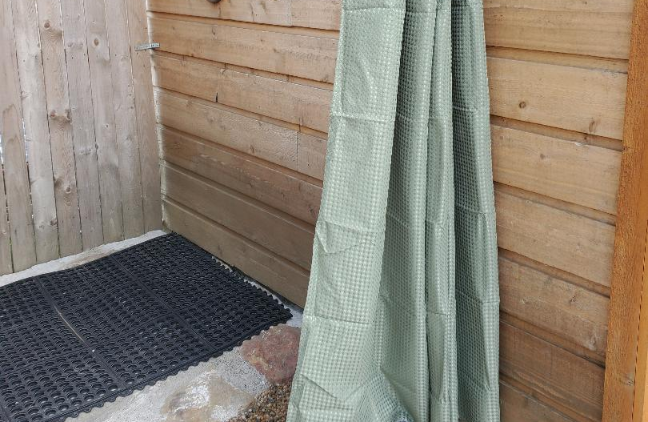
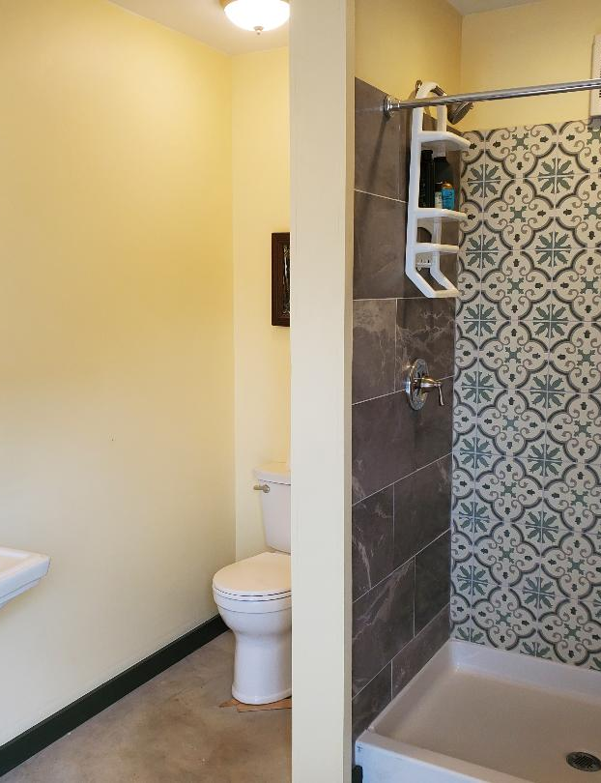
Outdoor shower & Bathroom

Slide 22
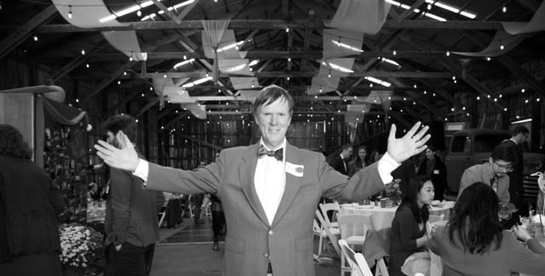
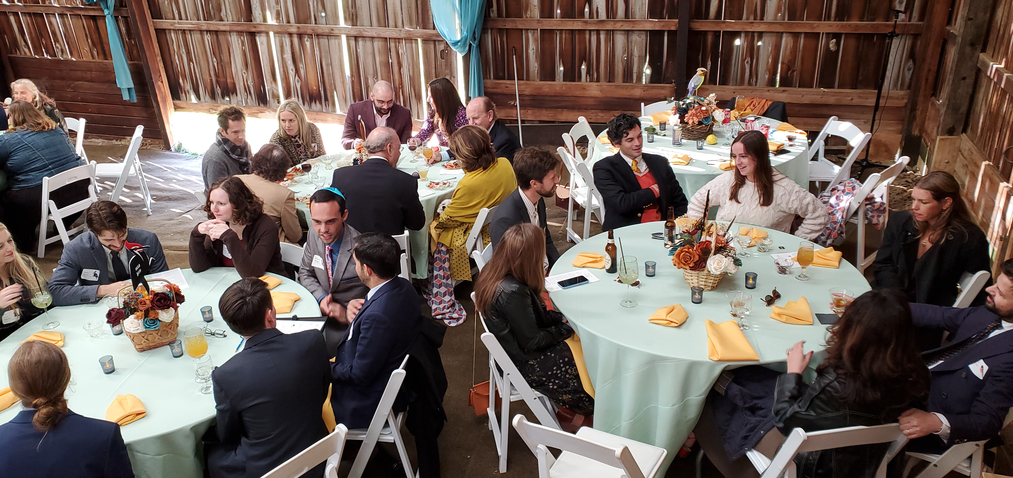
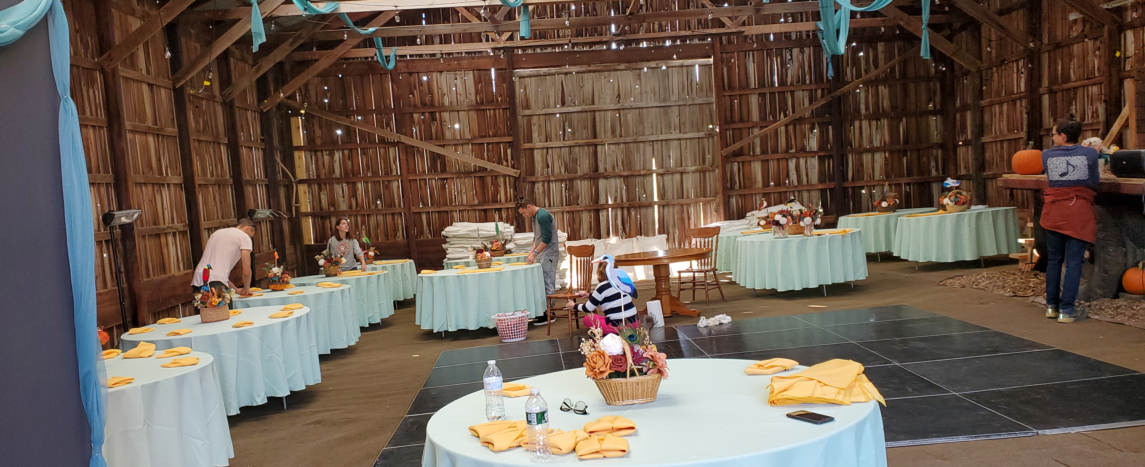
EVENTS

Slide 23
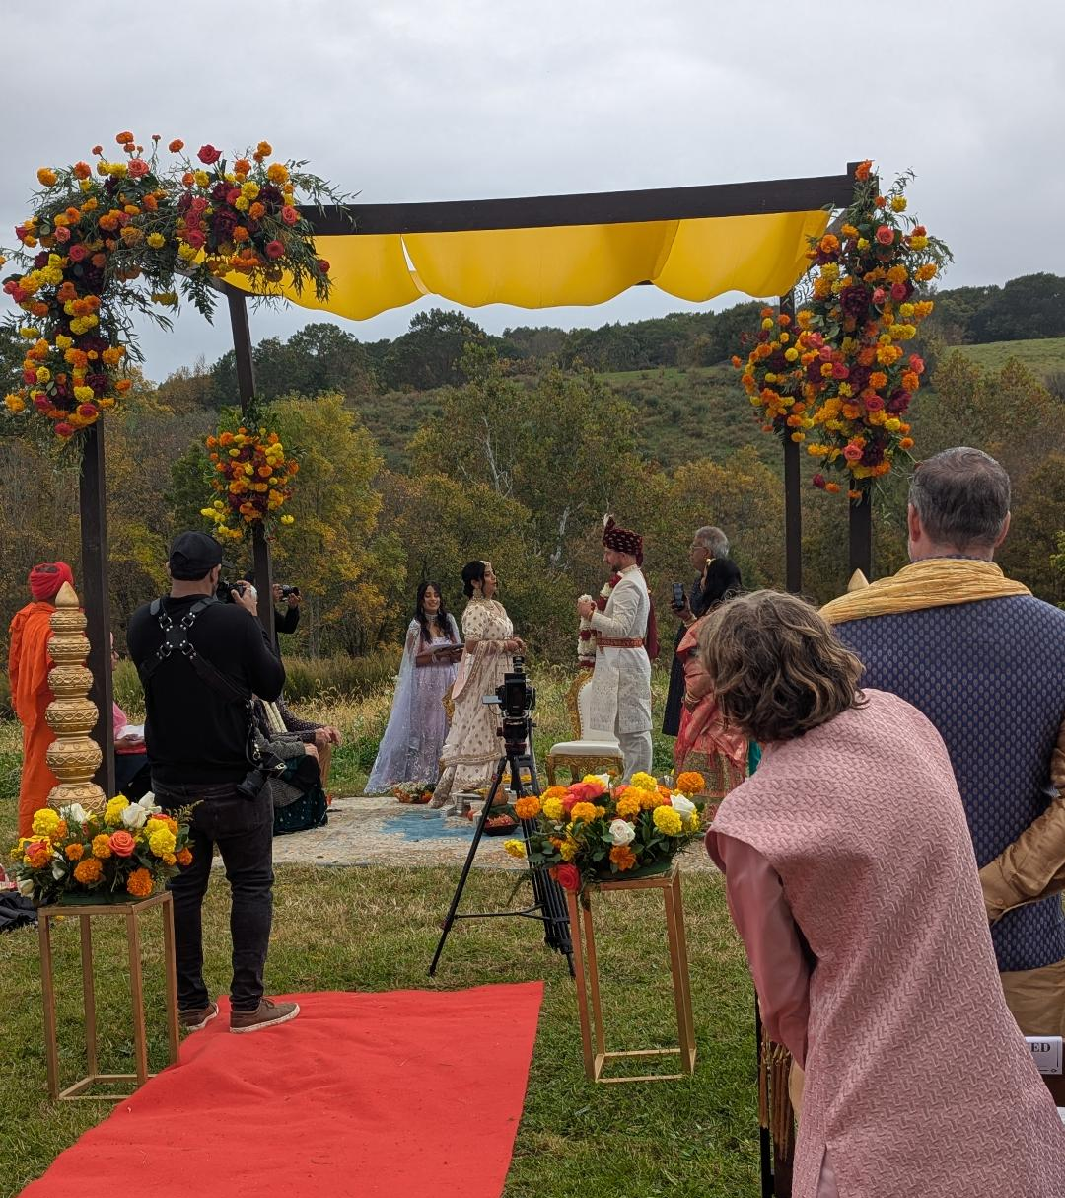
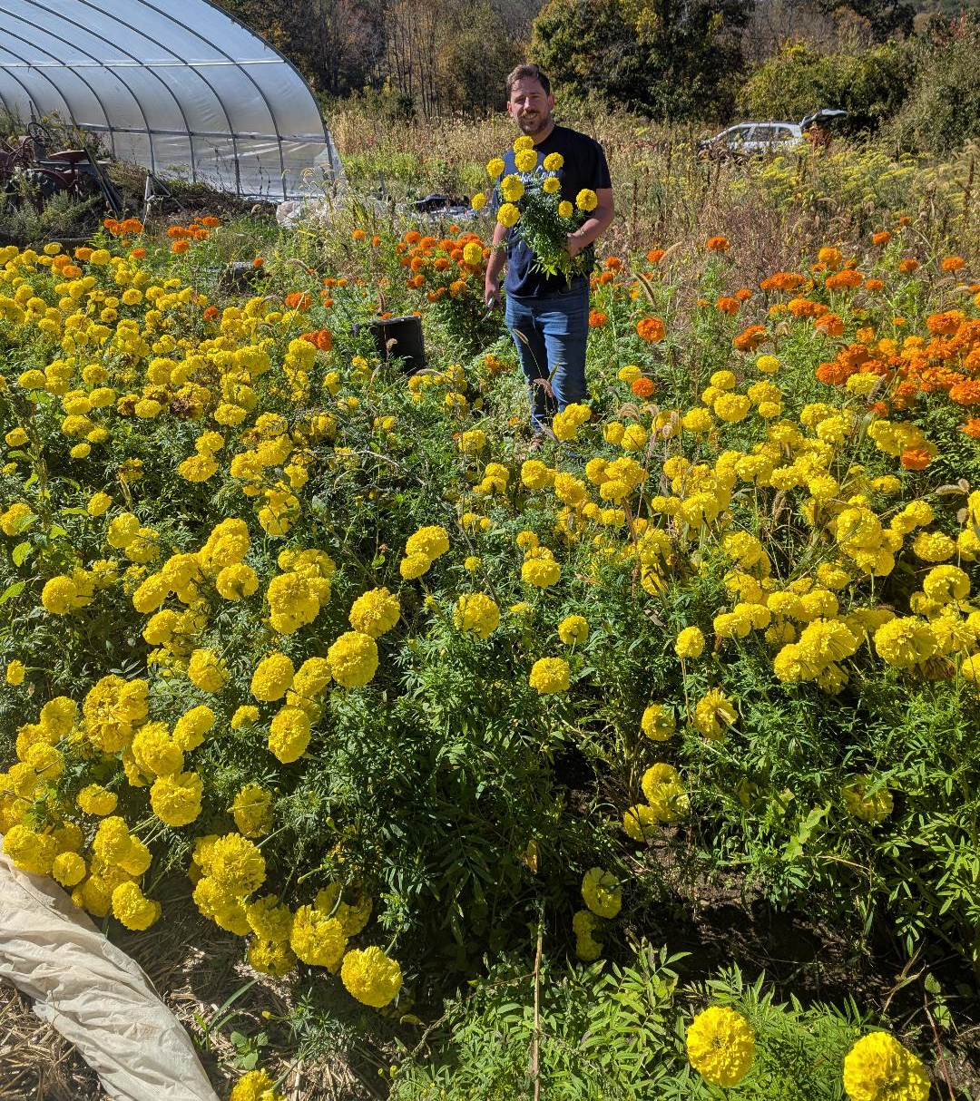
Adding Value

Slide 24
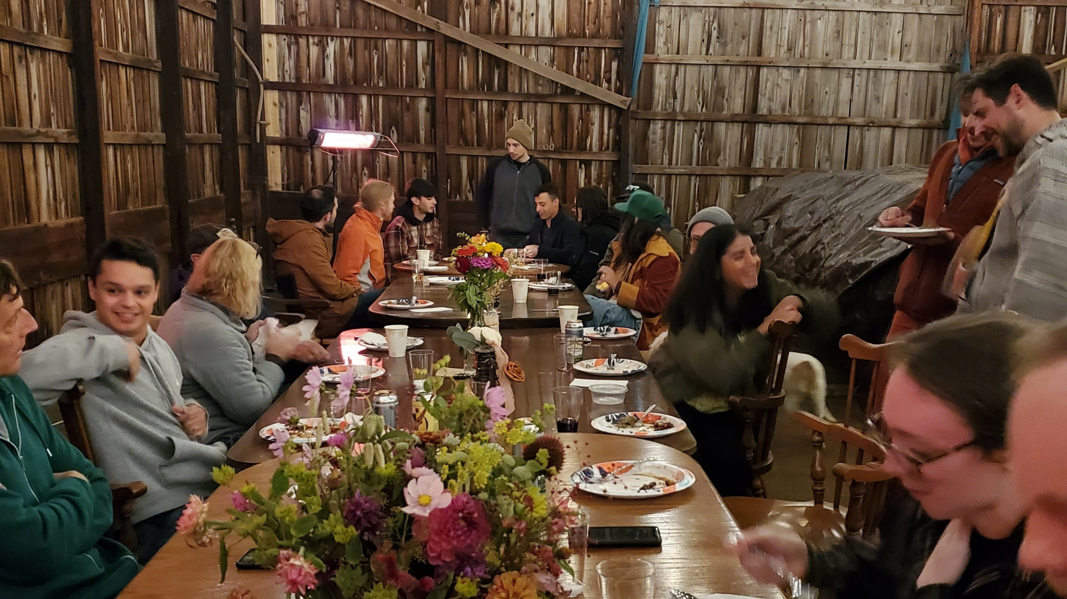

Slide 25
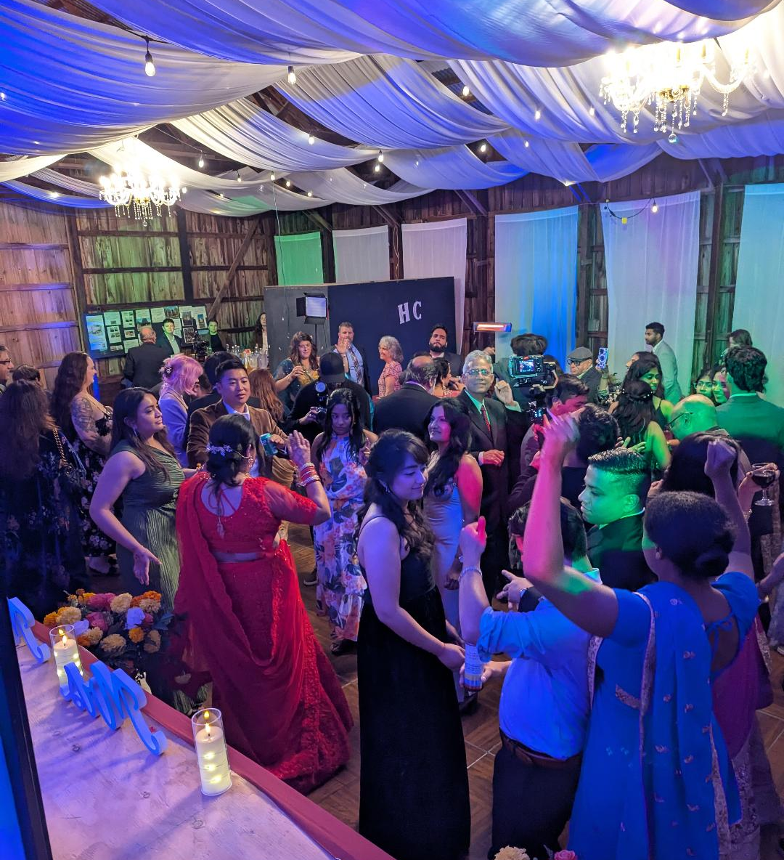

Weddings

Slide 26
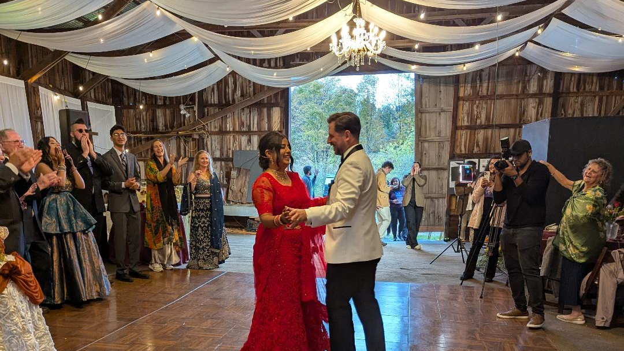

Slide 27
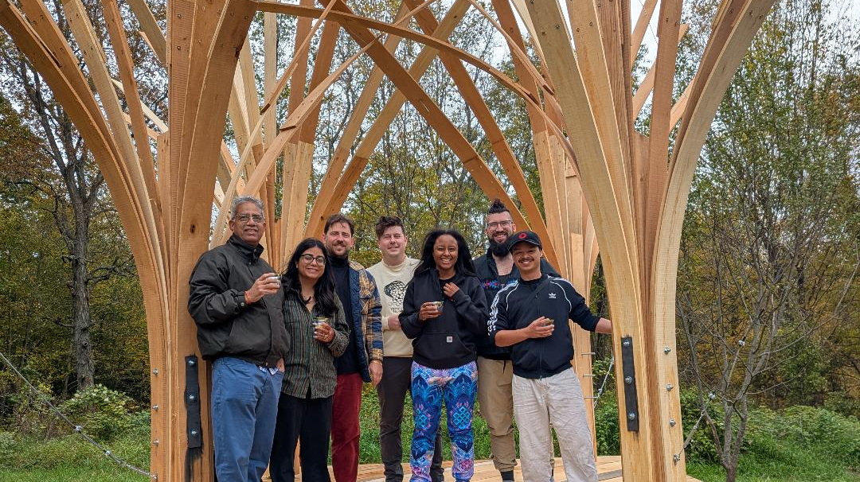

Slide 28
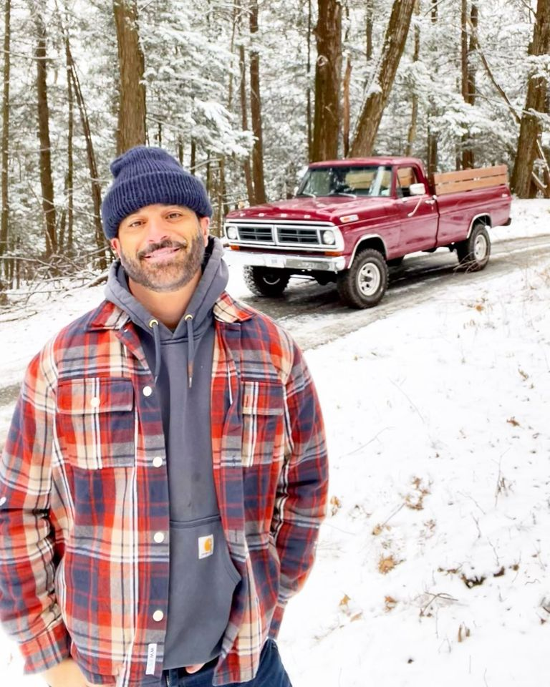
June Farms
West Sand Lake, NY

Slide 29
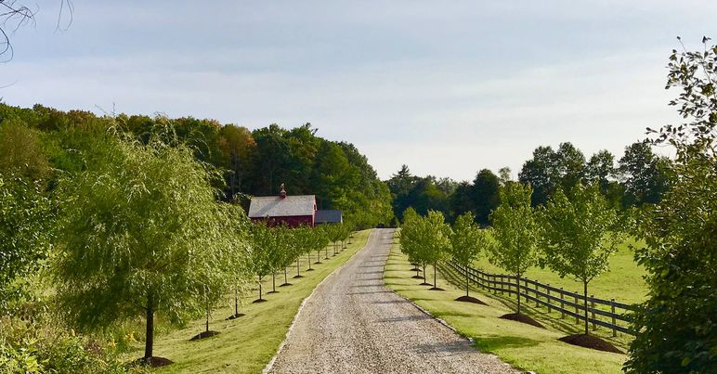
June Farms Goats
June Farms is a small, gentleman’s farm located on 120 acres in New York’s beautiful Hudson Valley. We specialize in working with heritage breeds, traditional livestock breeds that were raised by our ancestors centuries ago. All of our animals are pasture raised, they have access to plenty of fresh grass, and they are treated with love and respect.

Slide 30
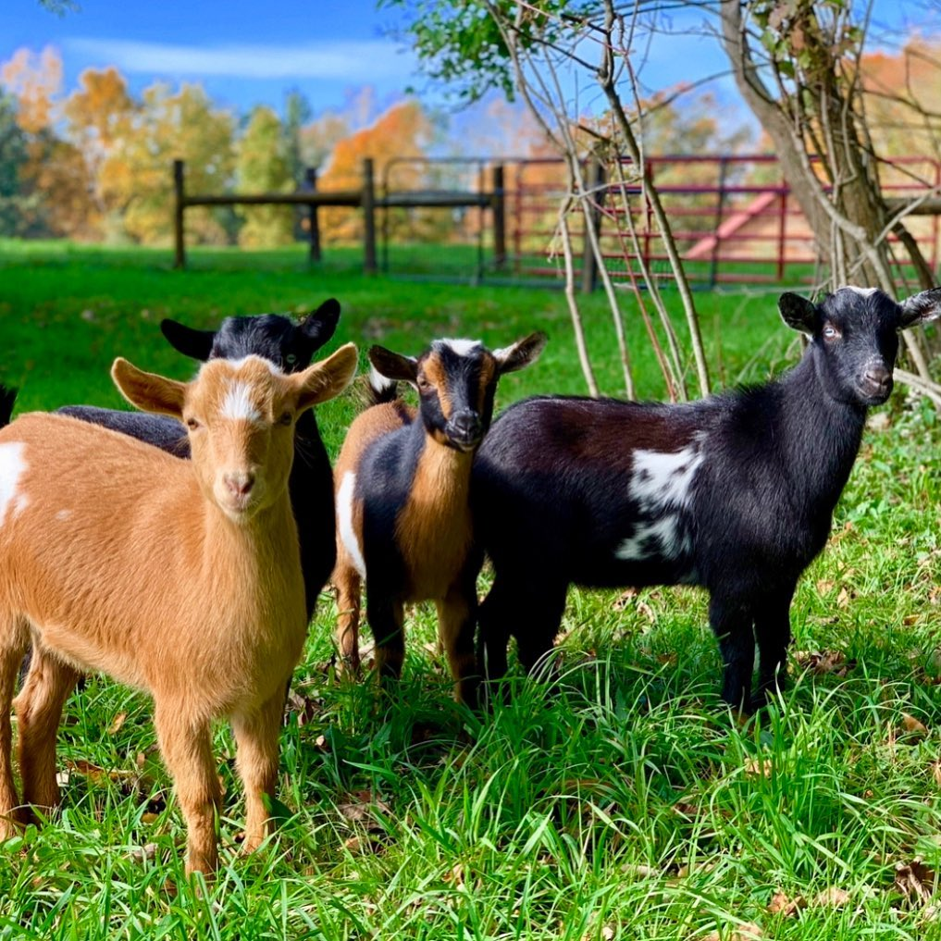
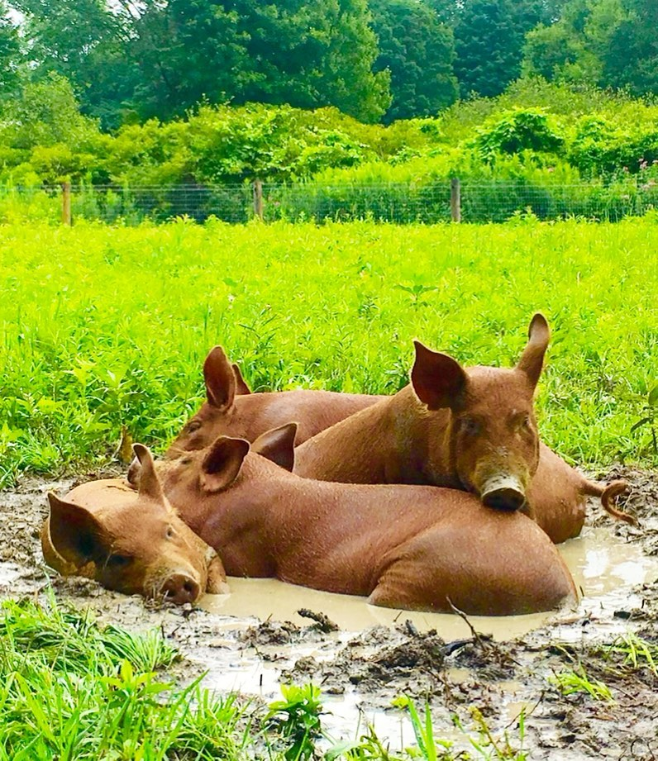
June Farms Animals

Slide 31
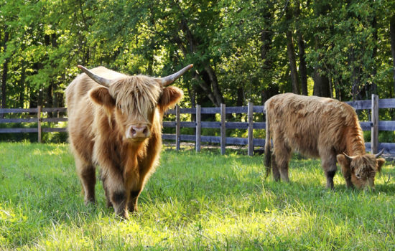
Timber Town Cabins

Slide 32
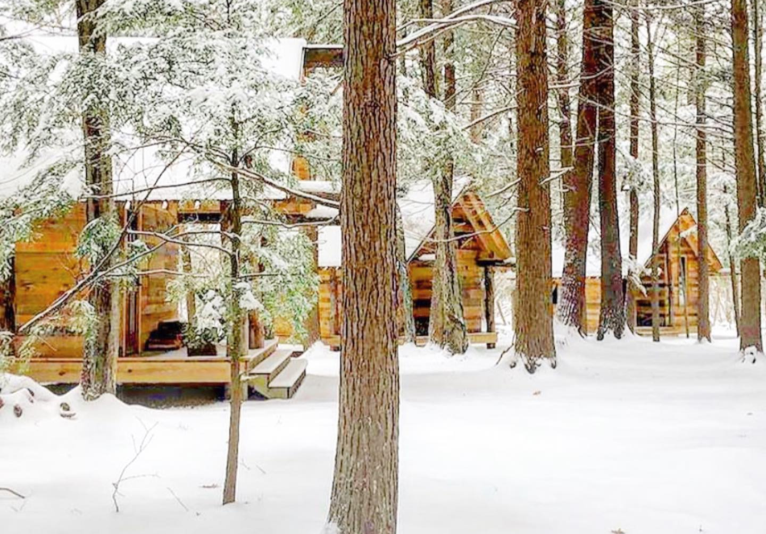
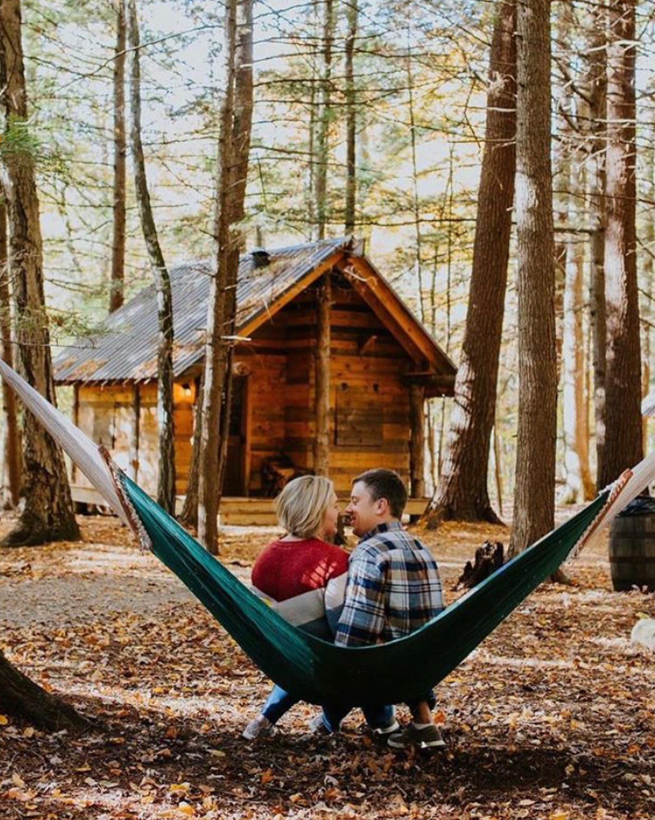
Timber Town

Slide 33
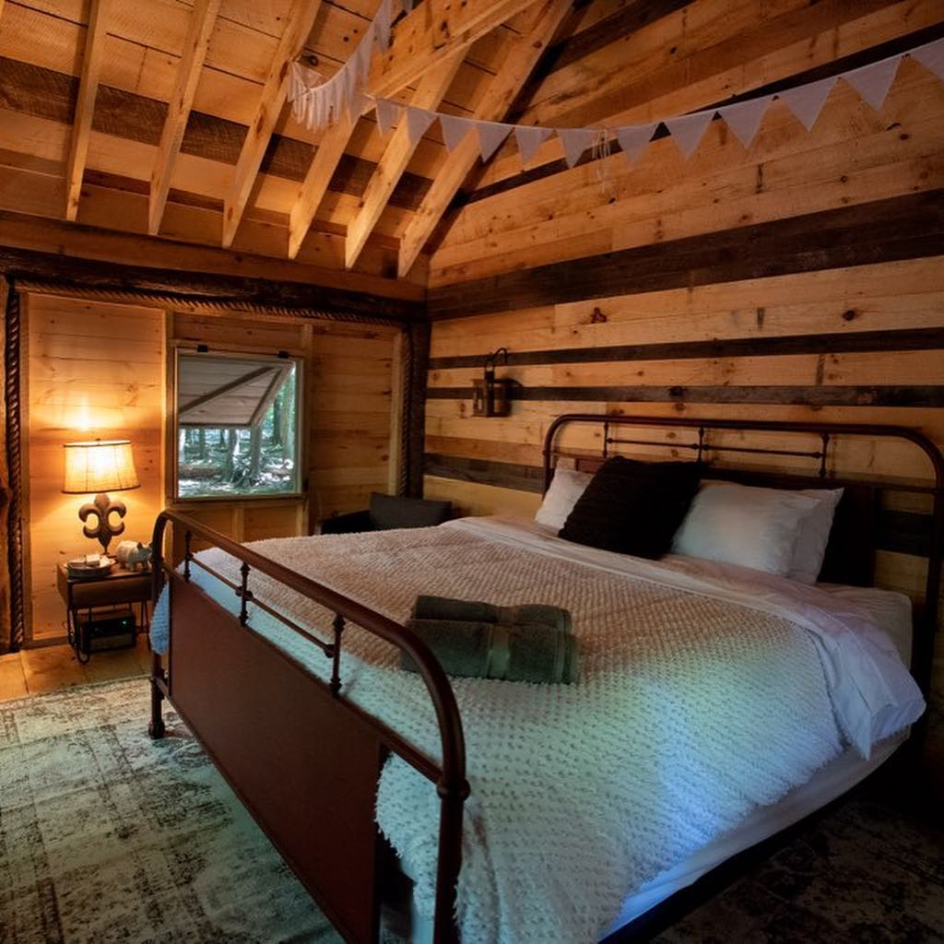
The Lodge

Slide 34
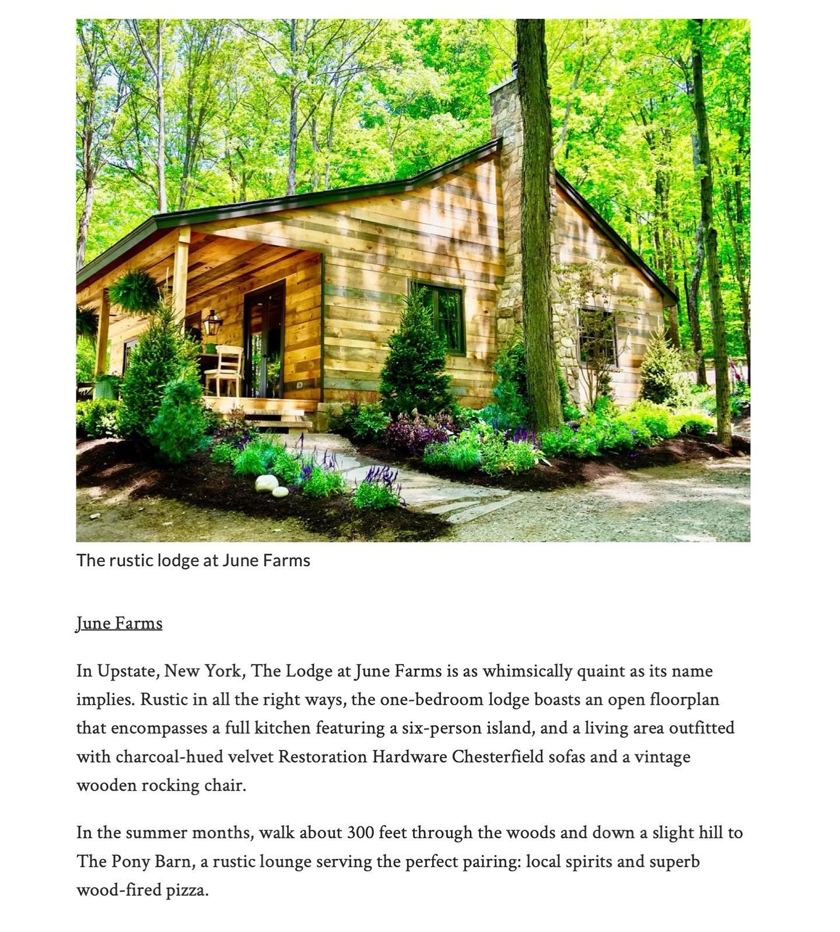
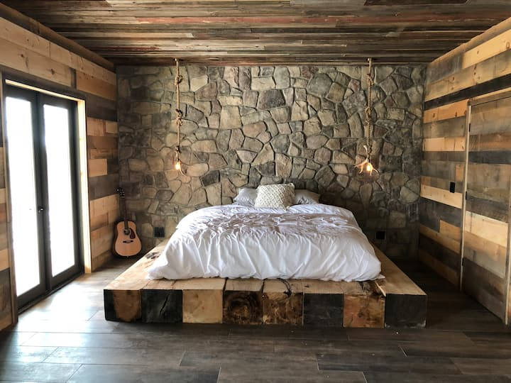
The Lodge Inside

Slide 35
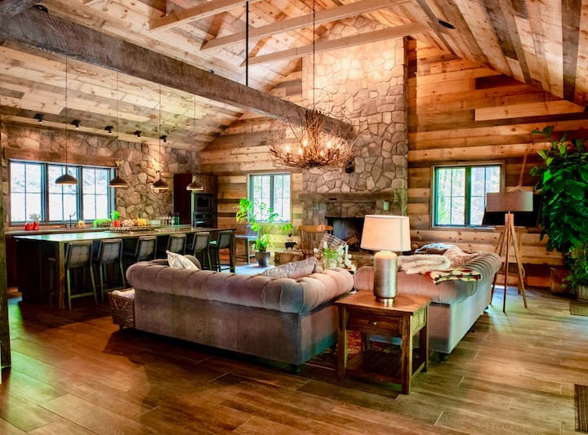
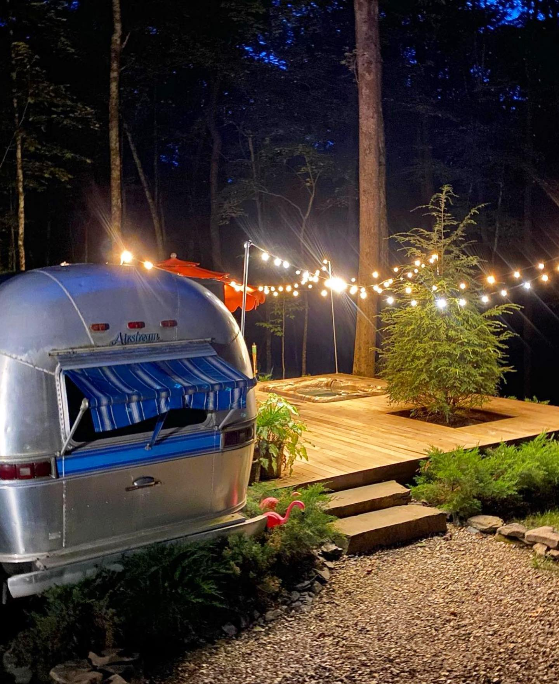
Airstream

Slide 36
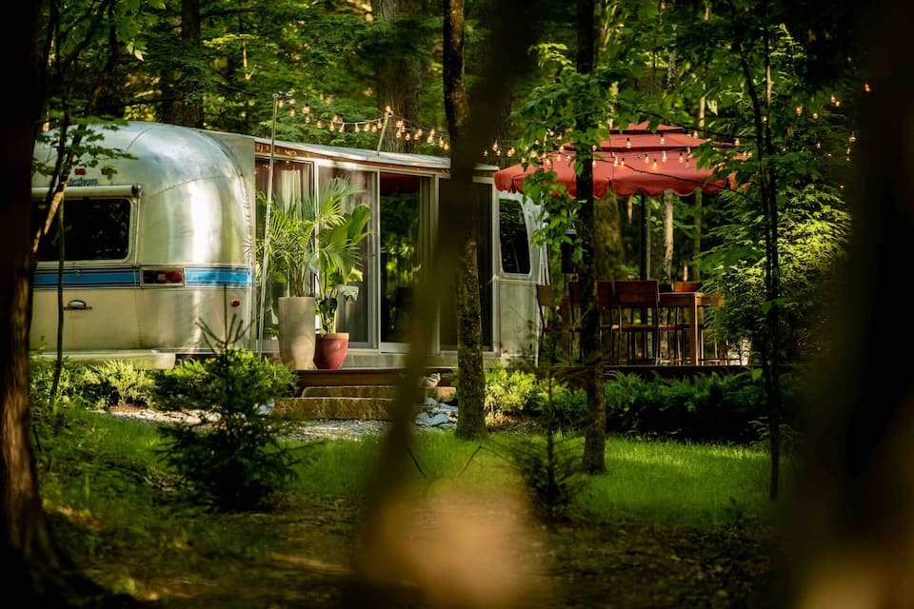
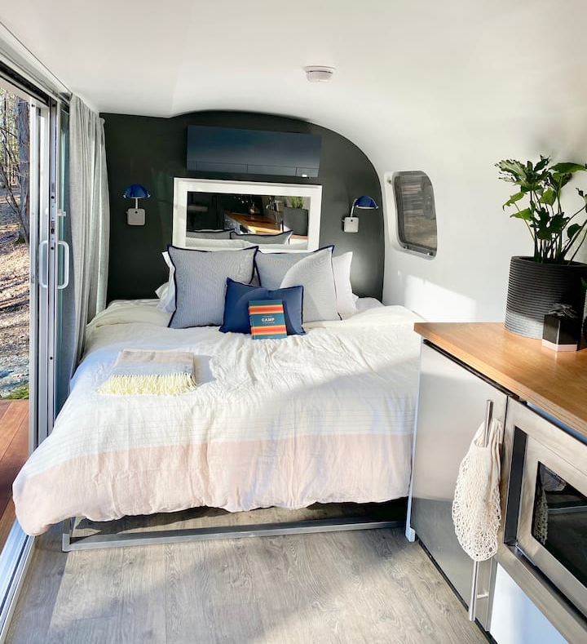
Airstream-Inside

Slide 37


Tipi @ June Farms

Slide 38


The Coop @ June Farms

Slide 39


The Pony Barn

Slide 40


Inside the Pony Barn

Slide 41


June Farm Wedding Venue

Slide 42

Weddings on the farm

Slide 43


June Farms

Slide 44


June Farms Events

Slide 45

Key Take Away Points
An on-farm Airbnb can generate significant additional income
You need to insure it fits you and your operation
You can start small and grow – all levels of accommodation are desired
Always create value for your guests

Slide 46

Questions & Answers

