Slide 1
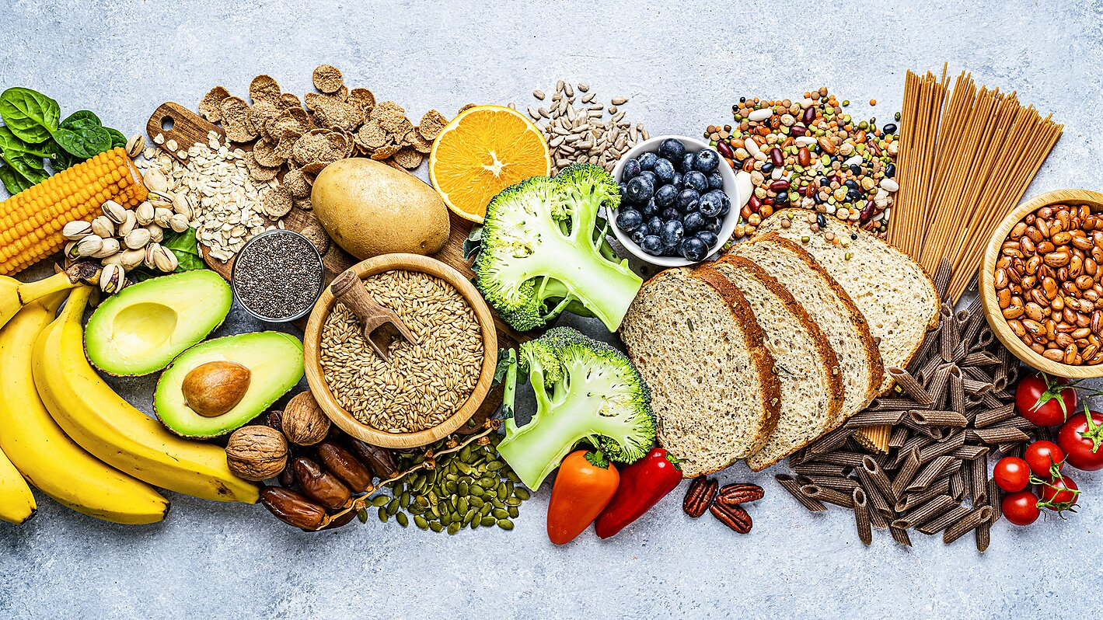
Food Systems Policy: How Local Food Can Help Solve Food Insecurity in Connecticut
Christian Duborg – Food & Nutrition Policy Analyst
Commission on Women, Children, Seniors, Equity, and Opportunity

Slide 2

Report Outline
Introduction
Background: Food and Nutrition Insecurity in CT
The Power of Local Food
Opportunities to Strengthen Connections
Conclusion

Slide 3


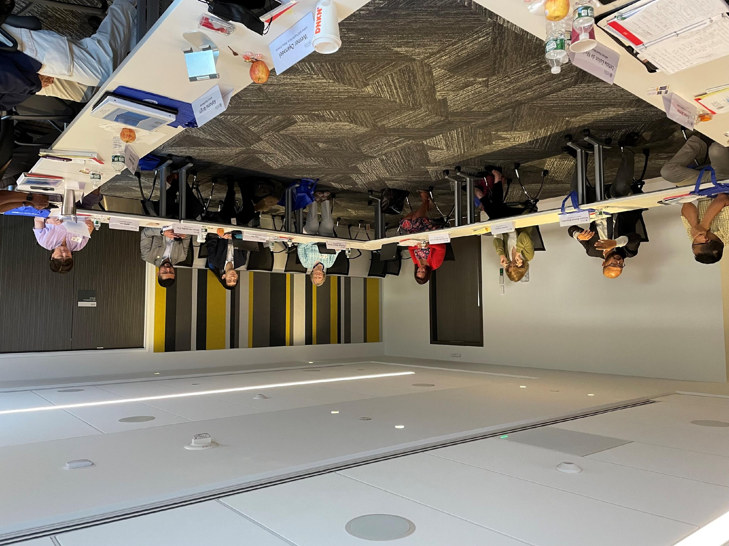
The CWCSEO, is a non-partisan agency within the legislative branch of government in the State of Connecticut.
CWCSEO staff works to eliminate disparities by identifying opportunities, building connections, and promoting equity.
CWCSEO advisors provide feedback via sub-commission chairs to the Executive Board and Executive Director so that both the Executive Board and Executive Director can delineate legislative priorities and action steps on behalf of the Commission.
Most importantly, the Commission staff serves the legislature and the people of the state by promoting best practices and driving sound public policy via data driven research and a cross-cultural approach to policy innovation.
The CWCSEO is driven by a mission to advocate for the rights and welfare of women, children, seniors, and all individuals facing equity barriers. Our vision encompasses a society where every individual, regardless of their background or circumstances, can thrive in an environment of equality, justice, and opportunity.

Slide 4

CWCSEO is operated under the provisions of Title 2, Chapter 23h, sections 2-127 to 2-129, of the General Statutes.
CWCSEO is responsible for focusing on quality-of-life issues, reporting on these issues, making recommendations for enhancing programs or services, commenting on proposed legislation, advising the General Assembly and the Governor concerning the administration of certain programs.
We are responsible for gathering and maintaining current information regarding population changes, providing a liaison to and from governmental entities, and conducting educational and outreach activities

Slide 5
My Job Responsibilities
Food System Map
Food Insecurity Data Map
Food Organizations Database
Annual Report on the State of Food Insecurity in Connecticut (and policy recommendations)
Work group to develop new best practices and initiatives for food security
Public Events and Engagement to Raise Awareness on Food Insecurity and Solutions
Coordination and Collaboration with State and Local Government, non-government groups, and Connecticut residents

Slide 6
Report Outline
Introduction
Background: Food and Nutrition Insecurity in CT
The Power of Local Food
Opportunities to Strengthen Connections
Conclusion

Slide 7
(Some of) The Impacts of Food Insecurity
Worse Physical and Mental Health Outcomes
Worse Education Outcomes for Children
Increased Risk of Housing Insecurity
Increased Risk of Premature Death
Increased Financial Costs to Individuals and the State (ex. $1800 per person per year in excess medical costs)

Slide 8
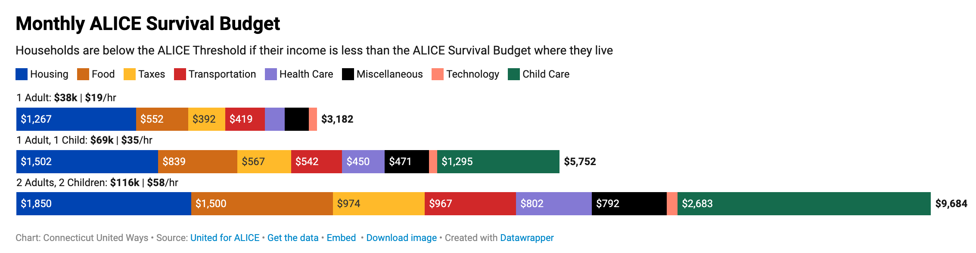
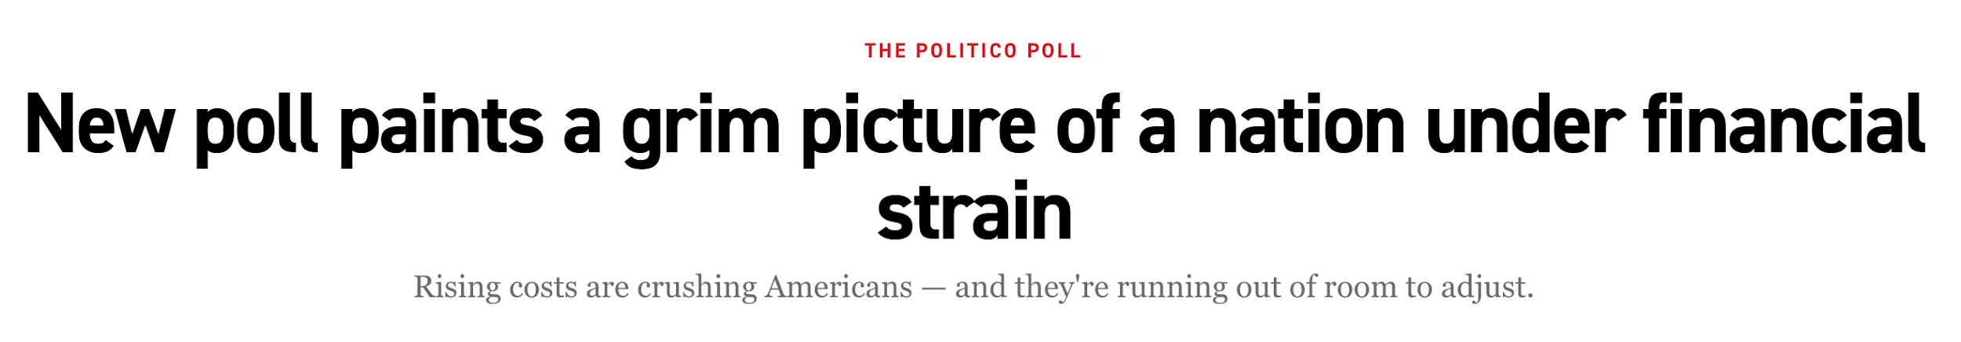
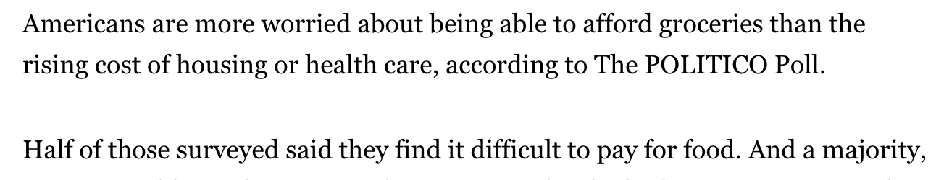
Food & Affordability

Slide 9
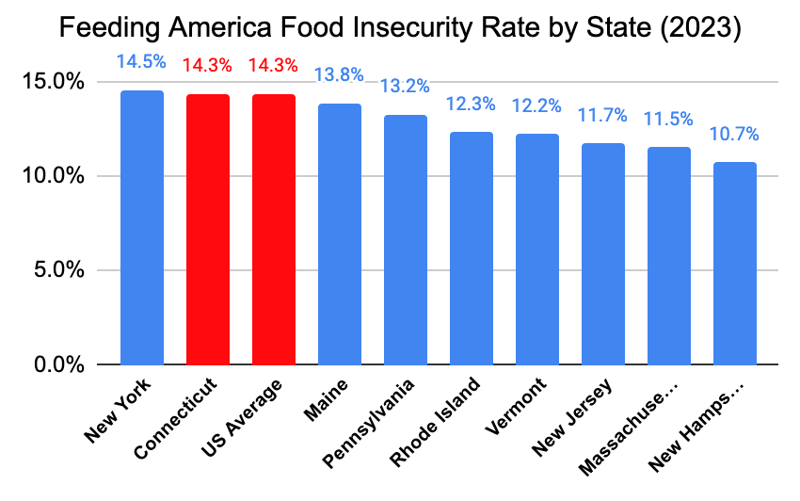

Slide 10
The Big Drivers of Food Insecurity (Oversimplified)
Accessibility
Affordability
Can you easily find a wide variety of healthy food options, get to the food, and bring it home?
Do you have enough money to afford a wide variety of healthy food options without forgoing other basic needs (housing, transportation, etc.)?

Slide 11
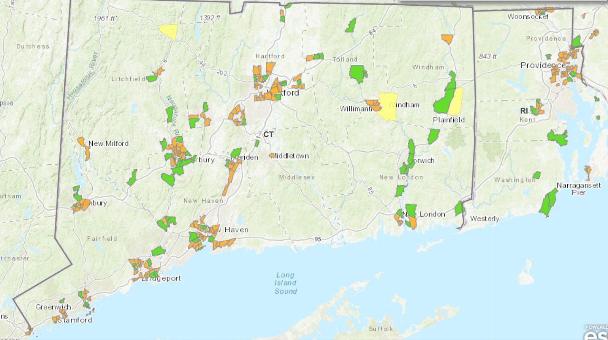

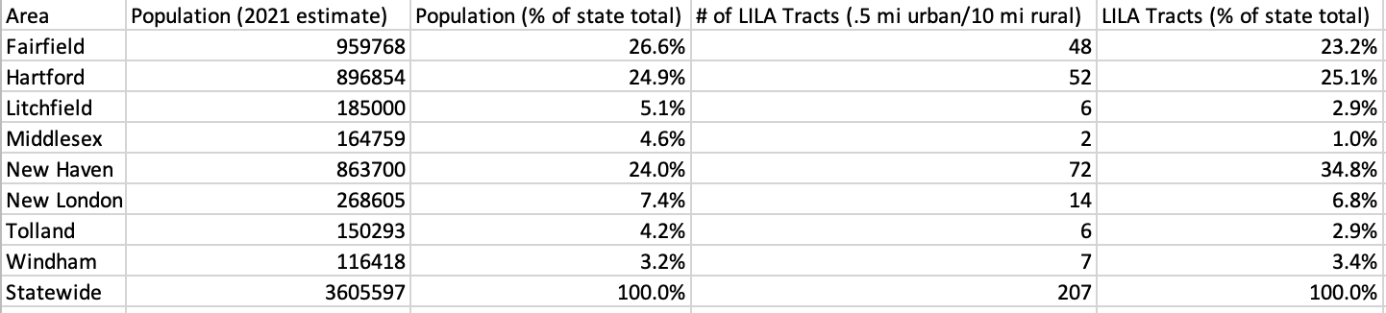
Food Deserts in Connecticut
Low-Income Low-Access Census Tracts (Formerly known as food deserts):

Slide 12
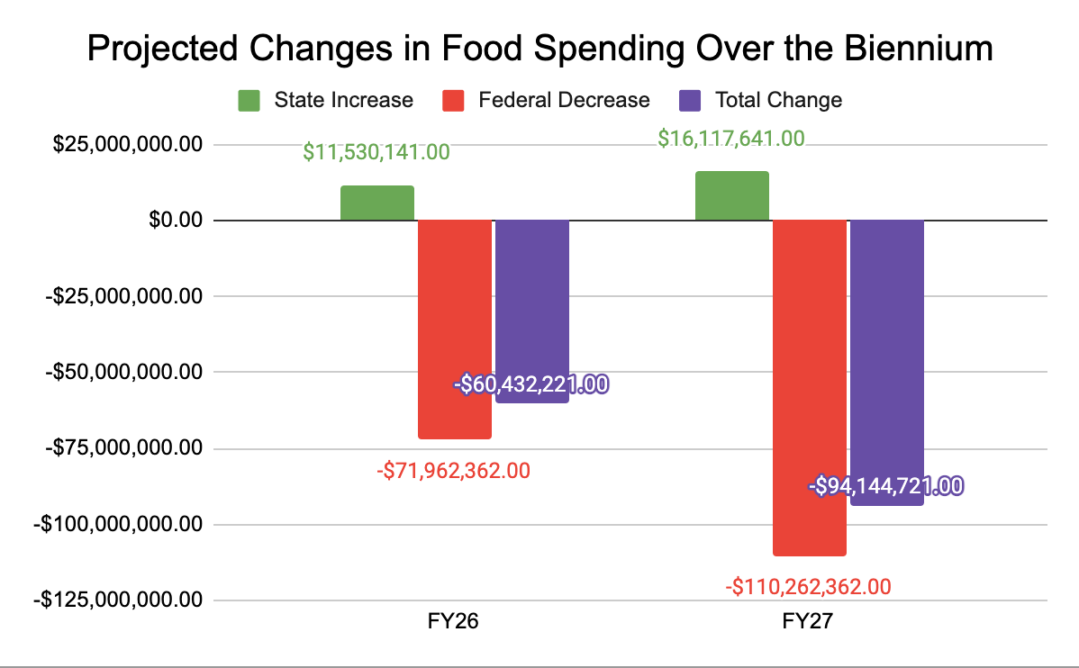

Slide 13
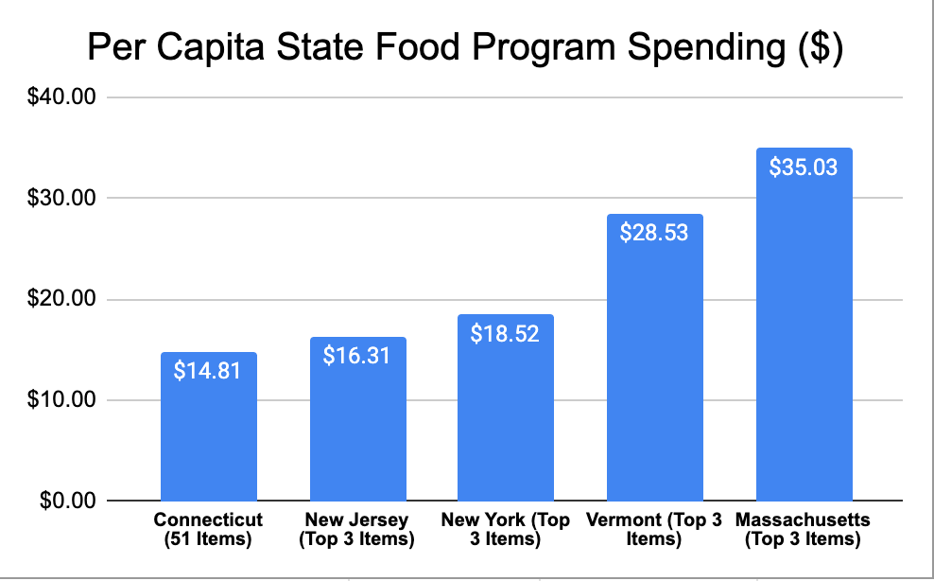

Slide 14
Connecticut Food Spending Compared to Other States
FY 26 Spending Estimates CT
“Core Food Security” (10 items)
$20,102,128
“Broader Food System” (11 items)
$31,919,022
“Food Security Organization Earmarks” (30 items)
$2,418,500
Total (51 items)
$54,439,650
3 Major Policies in Other Northeast States
Massachusetts (HIP, School Meals, Emergency Food)
~$250,000,000
~$128,000,000 (CT adjusted)
New York (School Meals, Emergency Food (HPNAP and Nourish NY)
~$368,000,000
~$68,000,000 (CT adjusted)
New Jersey (State Minimum SNAP Benefit, Food Desert Relief, Emergency Food)
~$155,000,000
~$60,000,000 (CT adjusted)
Vermont (School Meals, Local Food for Schools, Emergency Food)
~$18,500,000
~$104,000,000 (CT adjusted)
Notes:
CT: 3.675
Mass: 7.136
NY: 19.87
NJ: 9.501
VT: 648,943

Slide 15
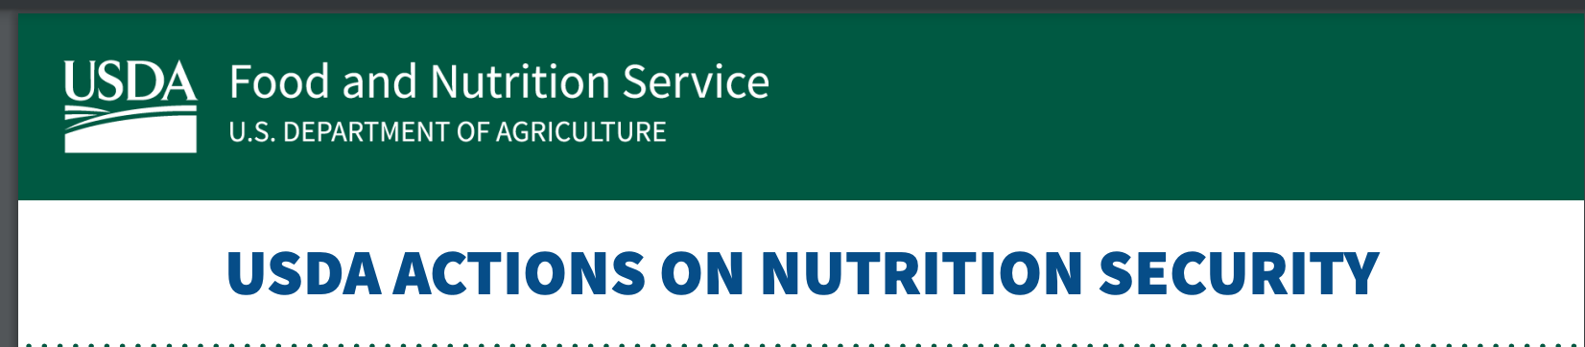
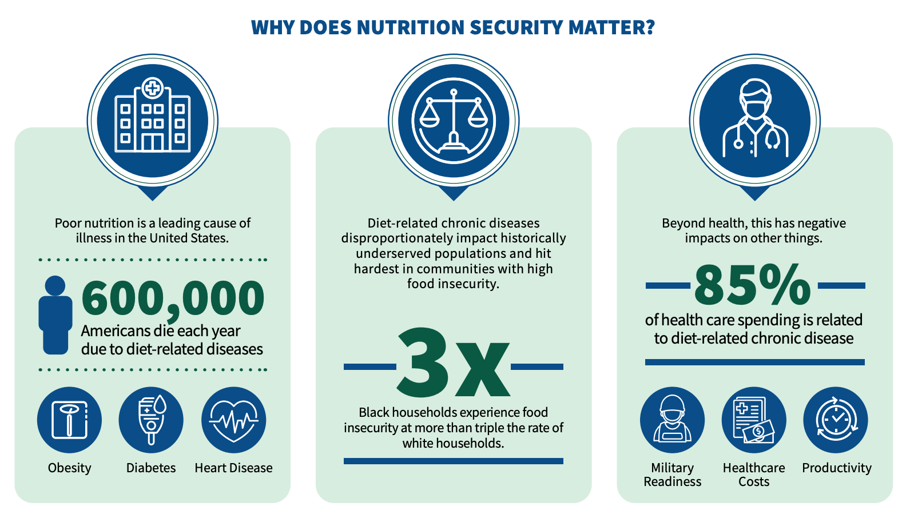
Nutrition and Health Harms
Notes:
Note: This document is from the Biden Administration (future slide contains one from the Trump Administration). This illustrates the growing bi-partisan and scientific consensus on this topic

Slide 16
Challenge to Nutrition Security: Ultra-Processed and Hyper-Palatable Foods
Prevalence of Ultra-Processed and Hyper-Palatable Foods
2019 Study: 62% of food items in the USDA’s Food and Nutrient Database for Dietary Studies are “hyper-palatable”
2023 Study: “over 73% of the US food supply is ultra-processed”
Notes:
Dr. Gombi-Vaca: Identifying cosmetic additives (which are the markers of UPF and are easier for consumers to spot: colors, flavors, and non nutritive sweeteners

Slide 17
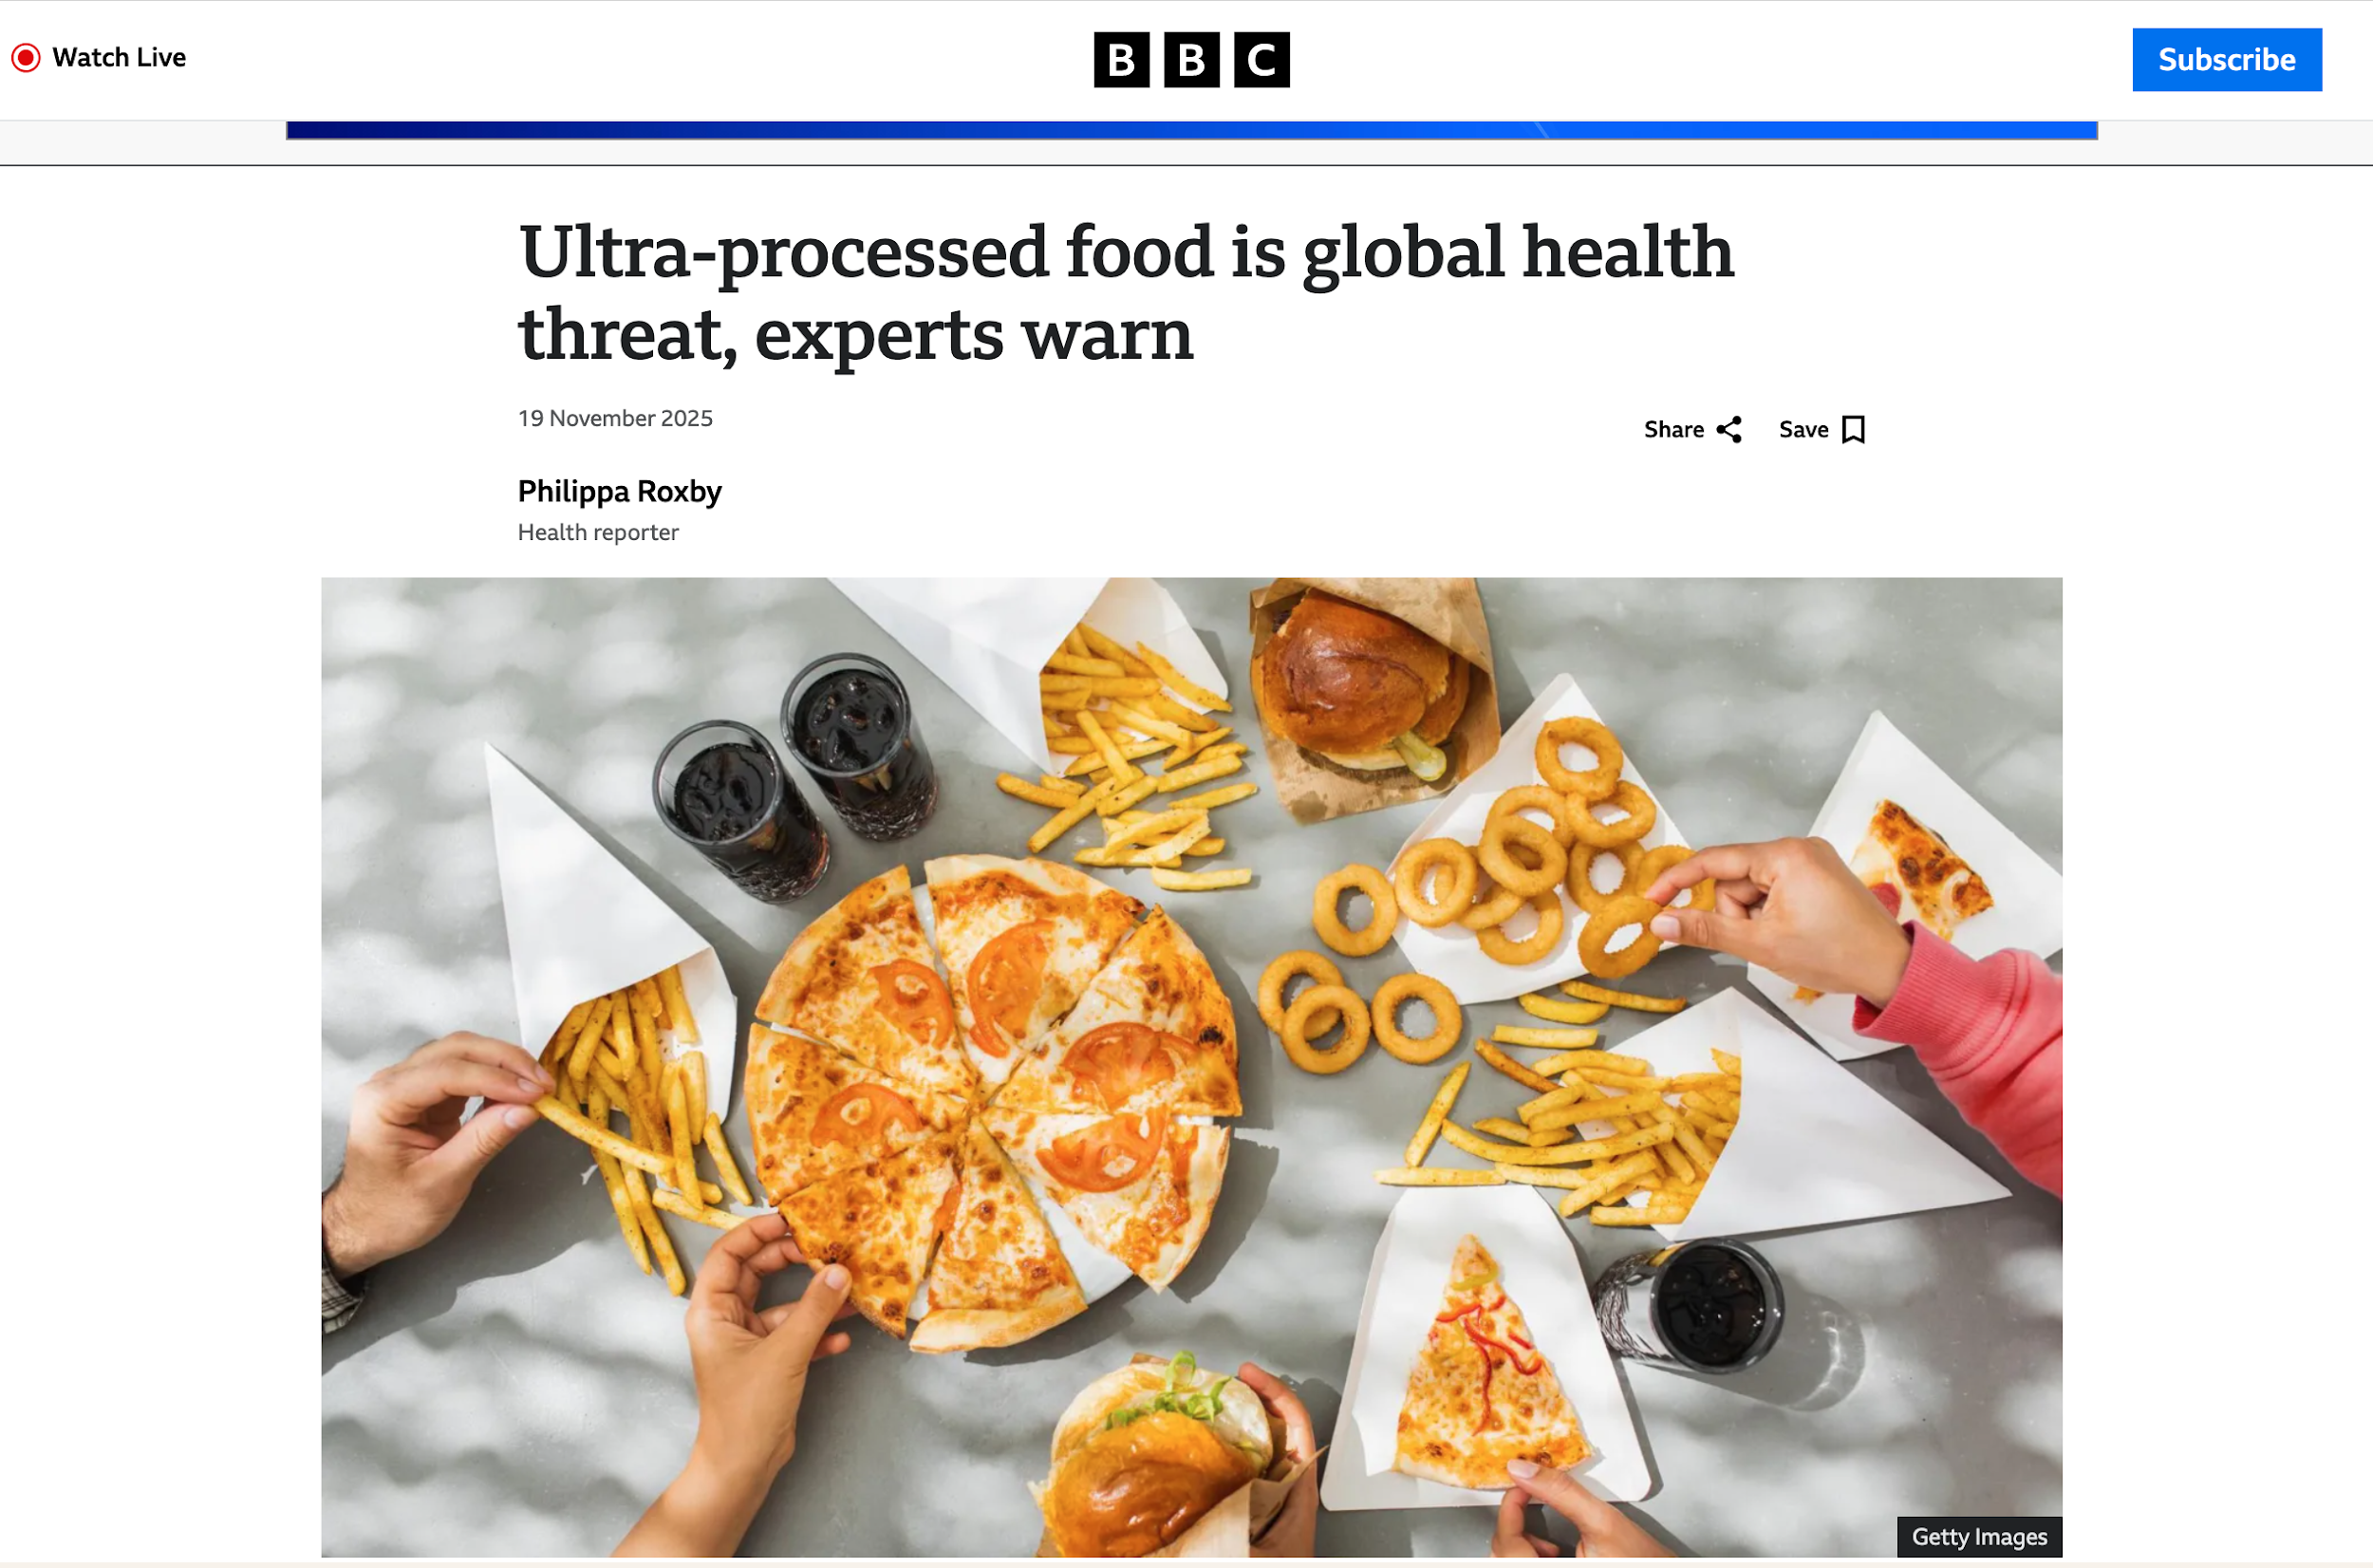
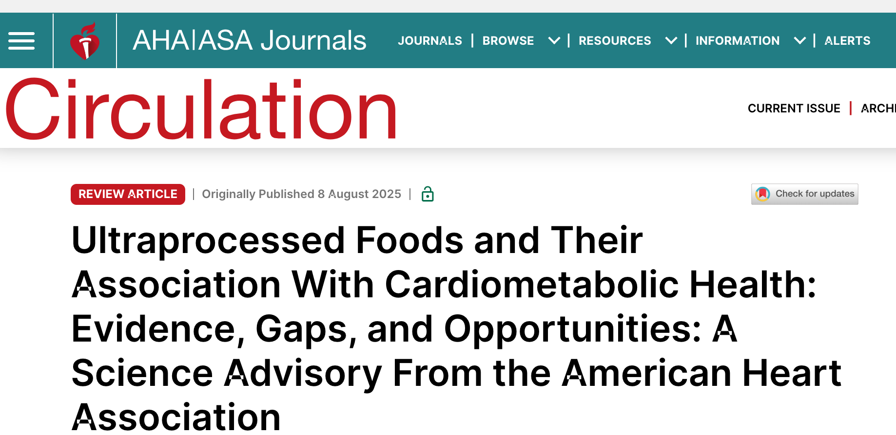
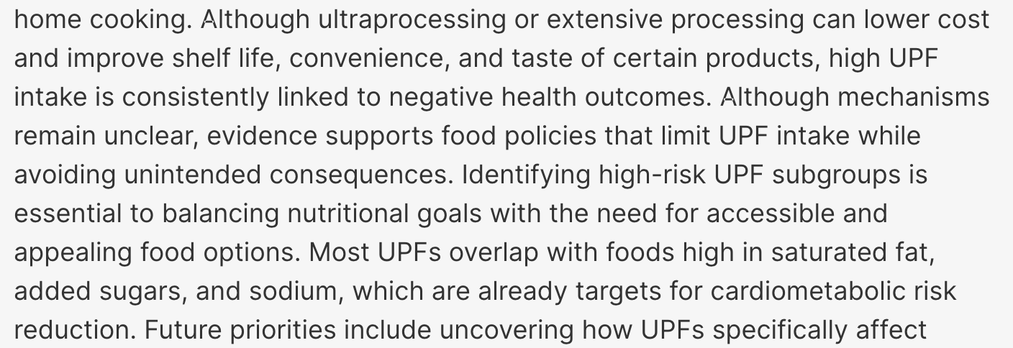
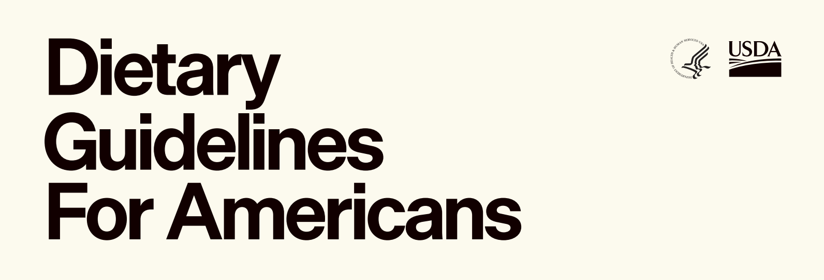
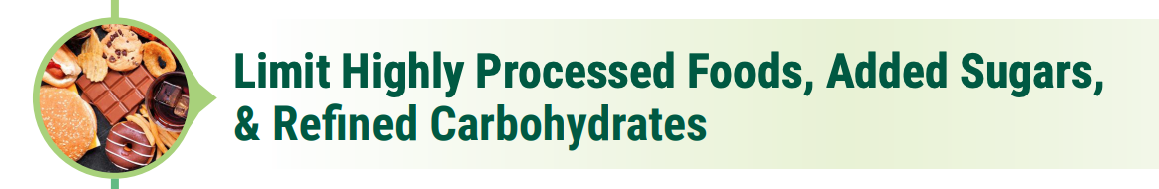
Harms of Ultra-Processed and Hyper-Palatable Food
Notes:
Note: These dietary guidelines came out under the Trump administration (previous slide has a similar document from the Biden Administration). This illustrates the growing bi-partisan and scientific consensus on this topic.

Slide 18
Report Outline
Introduction
Background: Food and Nutrition Insecurity in CT
The Power of Local Food
Opportunities to Strengthen Connections
Conclusion

Slide 19
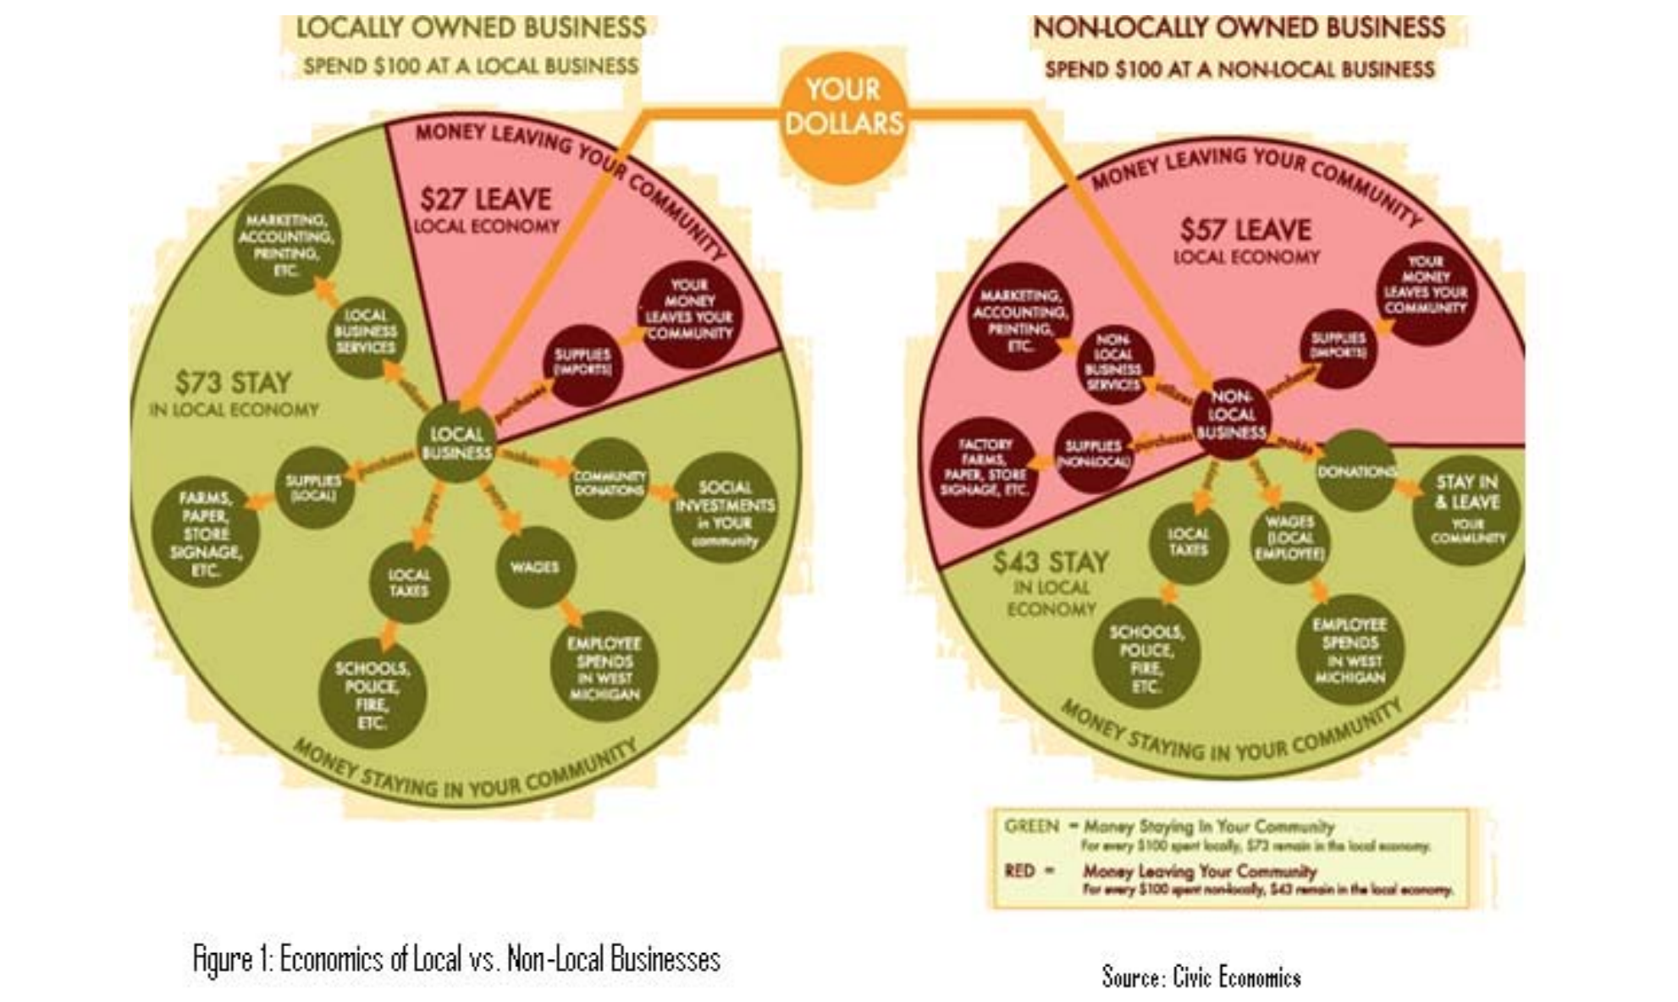
Local Economic Benefits

Slide 20
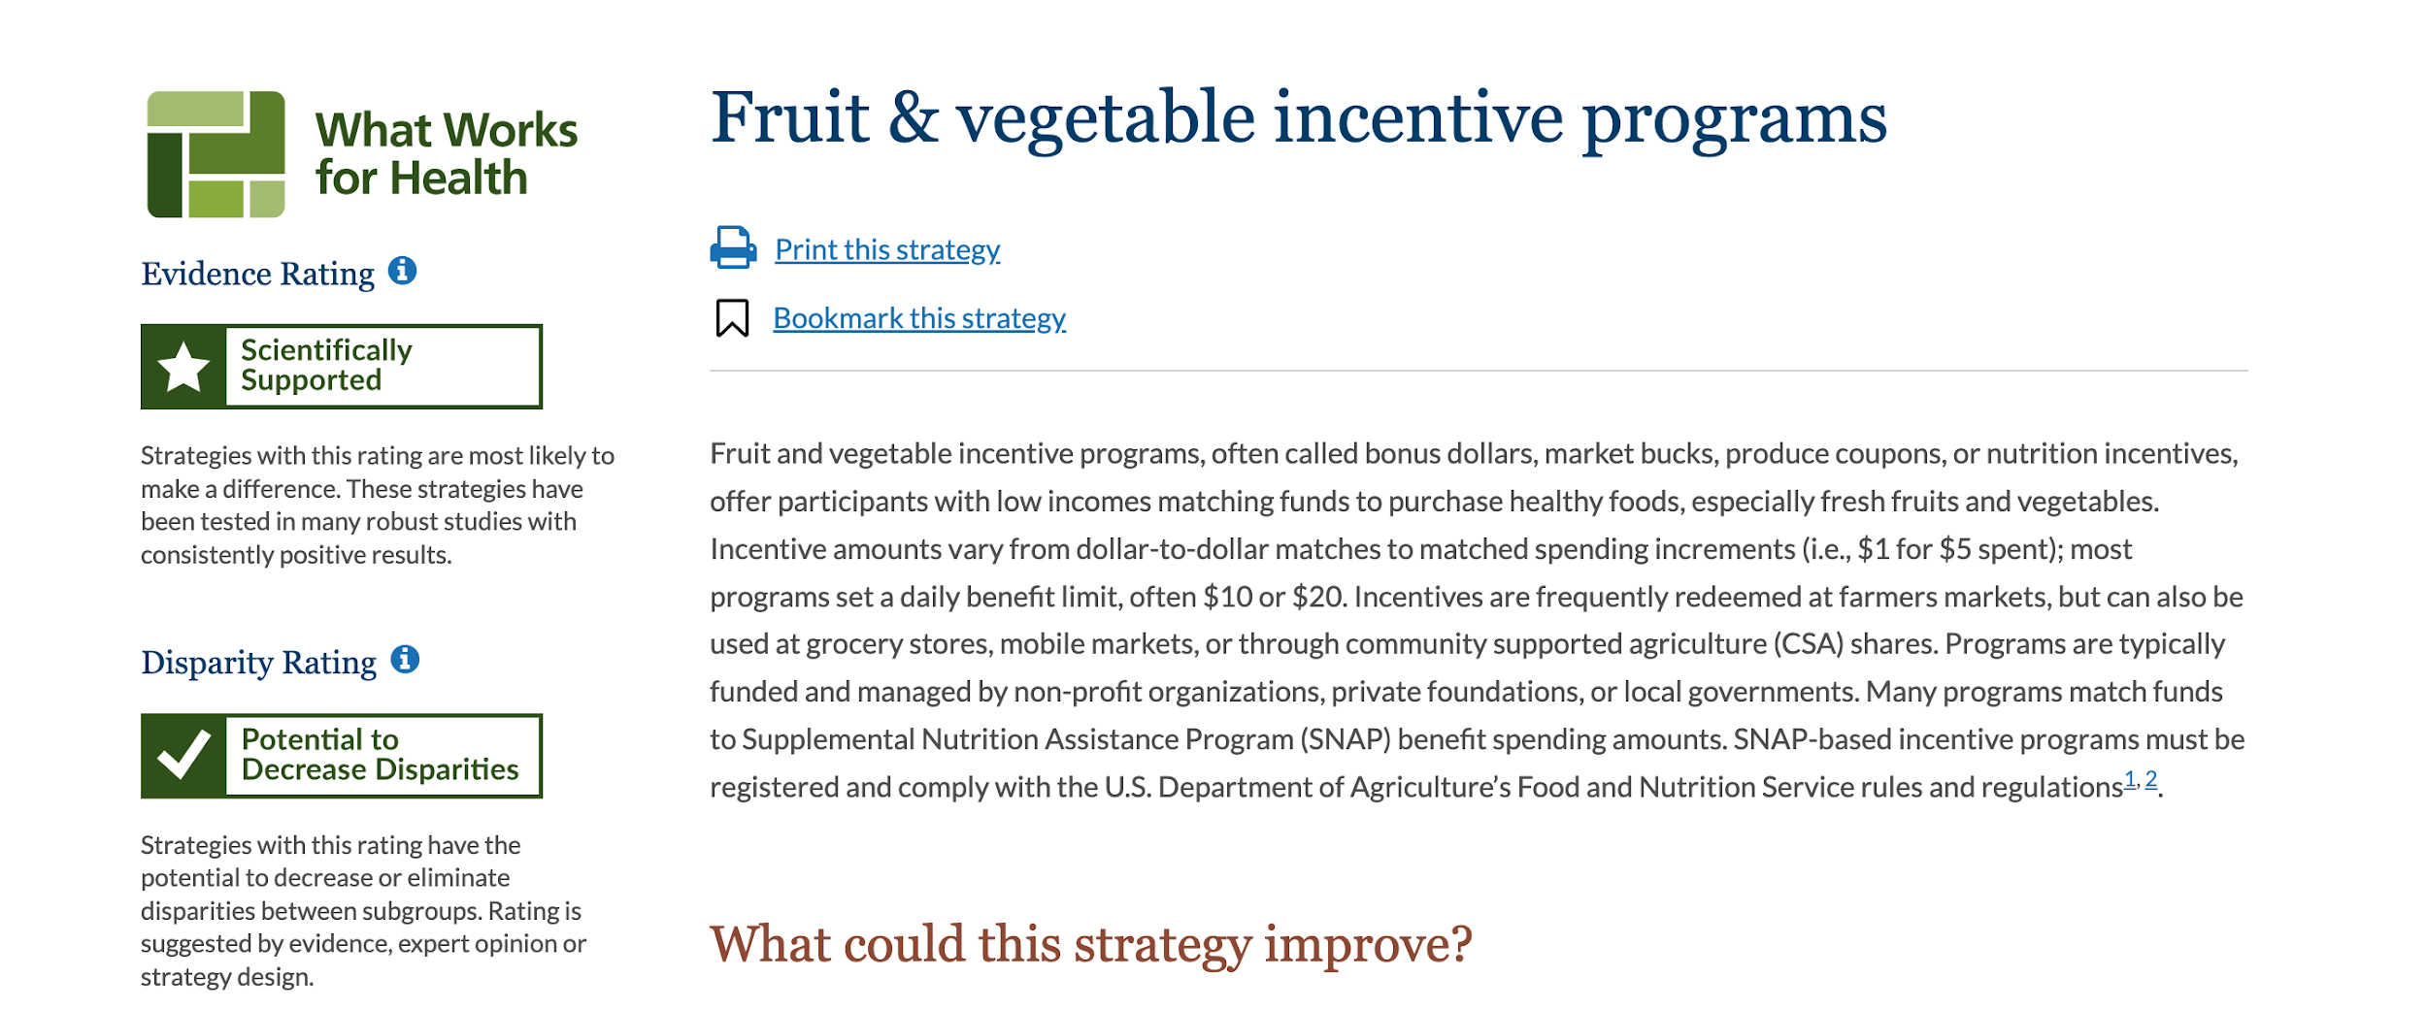
Impact on Nutrition Security

Slide 21

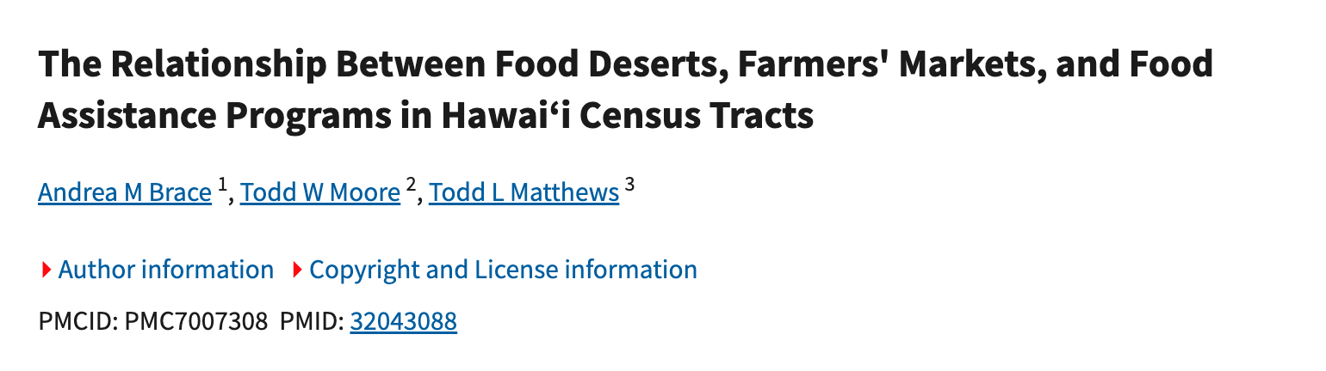
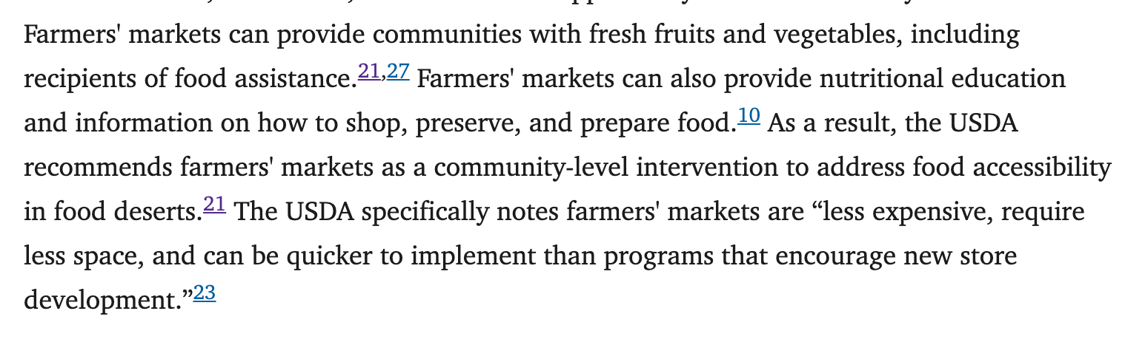
Impact on Food Access

Slide 22
Report Outline
Introduction
Background: Food and Nutrition Insecurity in CT
The Power of Local Food
Opportunities to Strengthen Connections
Conclusion

Slide 23
CWCSEO Food Policy Recommendations
Establish Universal Free School Meals
Mitigate Benefits Cliffs
Establish a State Minimum SNAP Benefit Amount
Apply for Section 1115 Medicaid Waiver for Food as Medicine Initiatives
Create or Expand Regional Community Food Hubs
Establish a State Food Business Incubator Program
Double SNAP Benefits for Connecticut-Grown Produce
Fund Local Food Purchasing Agreement (LFPA) Programs at the State Level
Expand Support for the Food Systems Capacity Building Grant
Partner with Research Institutions to Fill Gaps in the Current Data

Slide 24
Updated Recommendations
Universal Free School Meals
Food Business Incubator Program
Insert a 15% local purchase requirement (phased in as needed)
Initially prioritize residents of LILA Communities (“Food Deserts”)
Option for a need-based grant program (“State CEP”) as an intermediate stage
Allow flexibility on business location to maximize access
Include “business concierge” support to assist bussinesses in permitting process

Slide 25
Outcome of Recommendations
SB 1418: An Act Reducing Barriers to Food Security (died on Senate Floor)
Section 1115 Medicaid Waiver to cover Food as Medicine
State minimum SNAP benefit of $95 a month
Double SNAP at farmers markets
Grants for Regional Food Hubs (deleted by Committee)
HB 6089: An Act Reducing Barriers to Food Security
All 2024 Report Recommendations
HB 7273: An Act Establishing a Working Group to Study Ways to Fund a Universal Free School Meals Program (died on House Floor)
2-cent per fluid ounce excise tax on sugar sweetened beverages (deleted by Committee)
Dedicate revenue to a special fund for universal free school meals (deleted by Committee)
HB 7021: An Act Concerning Funding for Nutrition Assistance (partially folded into the Budget)
$10 million in additional funding (reduced to $3 million in FY 26 and $6 million in FY27
15% local purchasing requirement (deleted by Appropriations but expected to be informally honored)
All Recommendations Renewed for 2026
Primary Issue Identified: Funding Source

Slide 26
Primary Recommendation
Establish a Nonlapsing Food & Nutrition Special Fund within the State Budget
Reasons the fund is needed
Rapid Worsening of Food Insecurity in Connecticut
CT Food Insecurity Spending Below Many Neighboring States
Falling Federal Food Security Funding Since 2022 and subject to uncertainty
Potential for Generating Long-Term Cost Savings
Fragmented Responsibility for Food Issues

Slide 27
Primary Recommendation (Continued)
Establish a Nonlapsing Food & Nutrition Special Fund within the State Budget
“The CWCSEO believes that without significant new state-level investment, it will be extremely difficult to fully address food insecurity, and a special fund is the most practical way to guarantee such investments.”
Possible Funding Sources
Remove the sales tax exemption from ultra-processed, hyper-palatable, and extremely unhealthy foods
Dedicate the Revenue from the Existing “Prepared Meals” Surcharge
Transfers from Other Funds or Private Sources
Expand the Luxury Tax to Cover High-Value Food and Drink Items
Establish an Excise Tax on Sugar-Sweetened Beverages

Slide 28
Report Outline
Introduction
Section 1: Changes 2024-2025
Section 2: Underlying Challenges Spotlight
Section 3: Recommendations
Conclusion

Slide 29
Conclusion
“timely government intervention is needed to prevent this crisis from growing beyond its current level. While the cost of several of the policies recommended in this report would be significant, the unfortunate reality is that the state is likely to spend substantial amounts of money due to food insecurity no matter what. If nothing is done and food insecurity continues to affect hundreds of thousands of residents, the state will be paying substantial amounts of money to deal with the negative impacts of food insecurity on healthcare, housing, education, and more….
Every source of funding, including the five offered in this report, has drawbacks, but few of those drawbacks will be as severe or costly as the ones that come with allowing food insecurity to keep affecting more Connecticut households each year. Addressing food and nutrition insecurity will require the state to make difficult decisions.”

