Slide 1
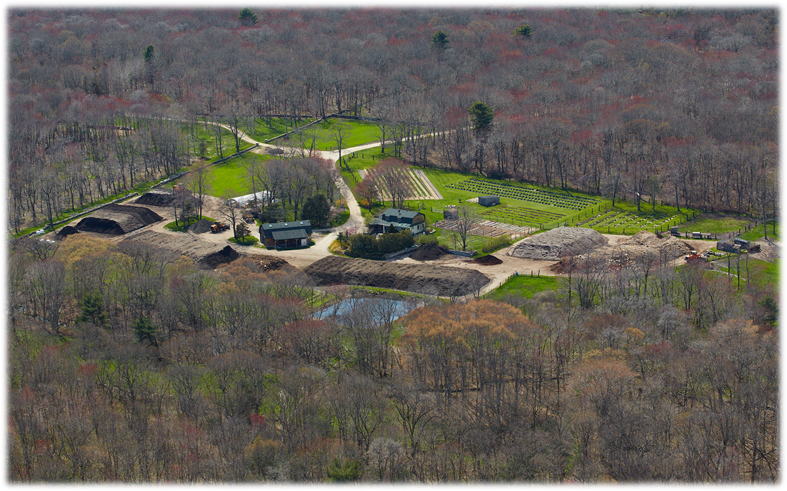
CT NOFA
Compost and The Unseen Soil World
Earth Care Farm
Charlestown, RI
Jayne Merner
March 5, 2026
Notes:
Current 27 acre farm in Charlestown, RI

Slide 2
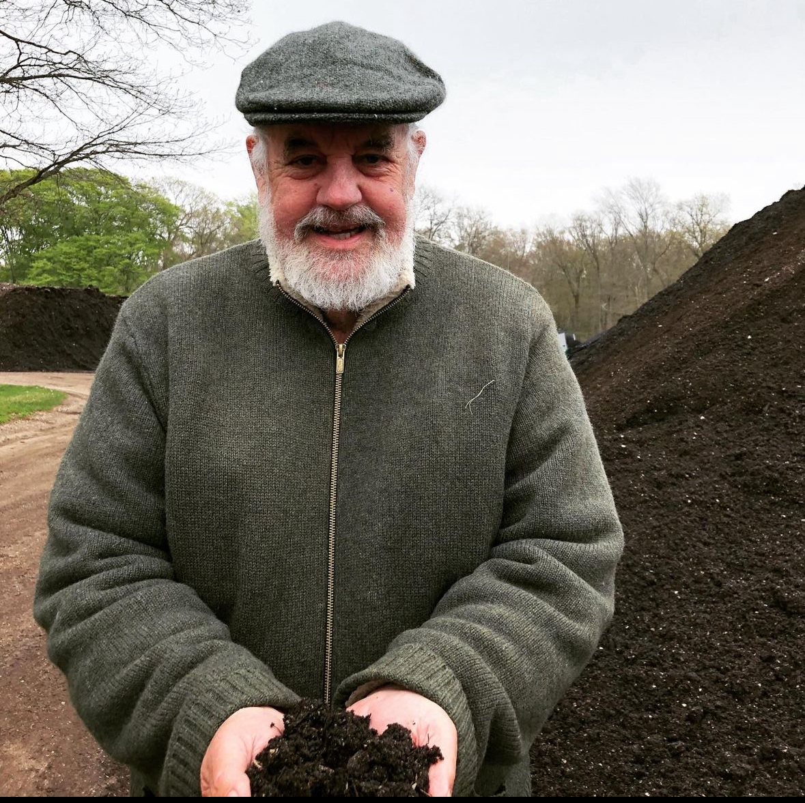

Slide 3
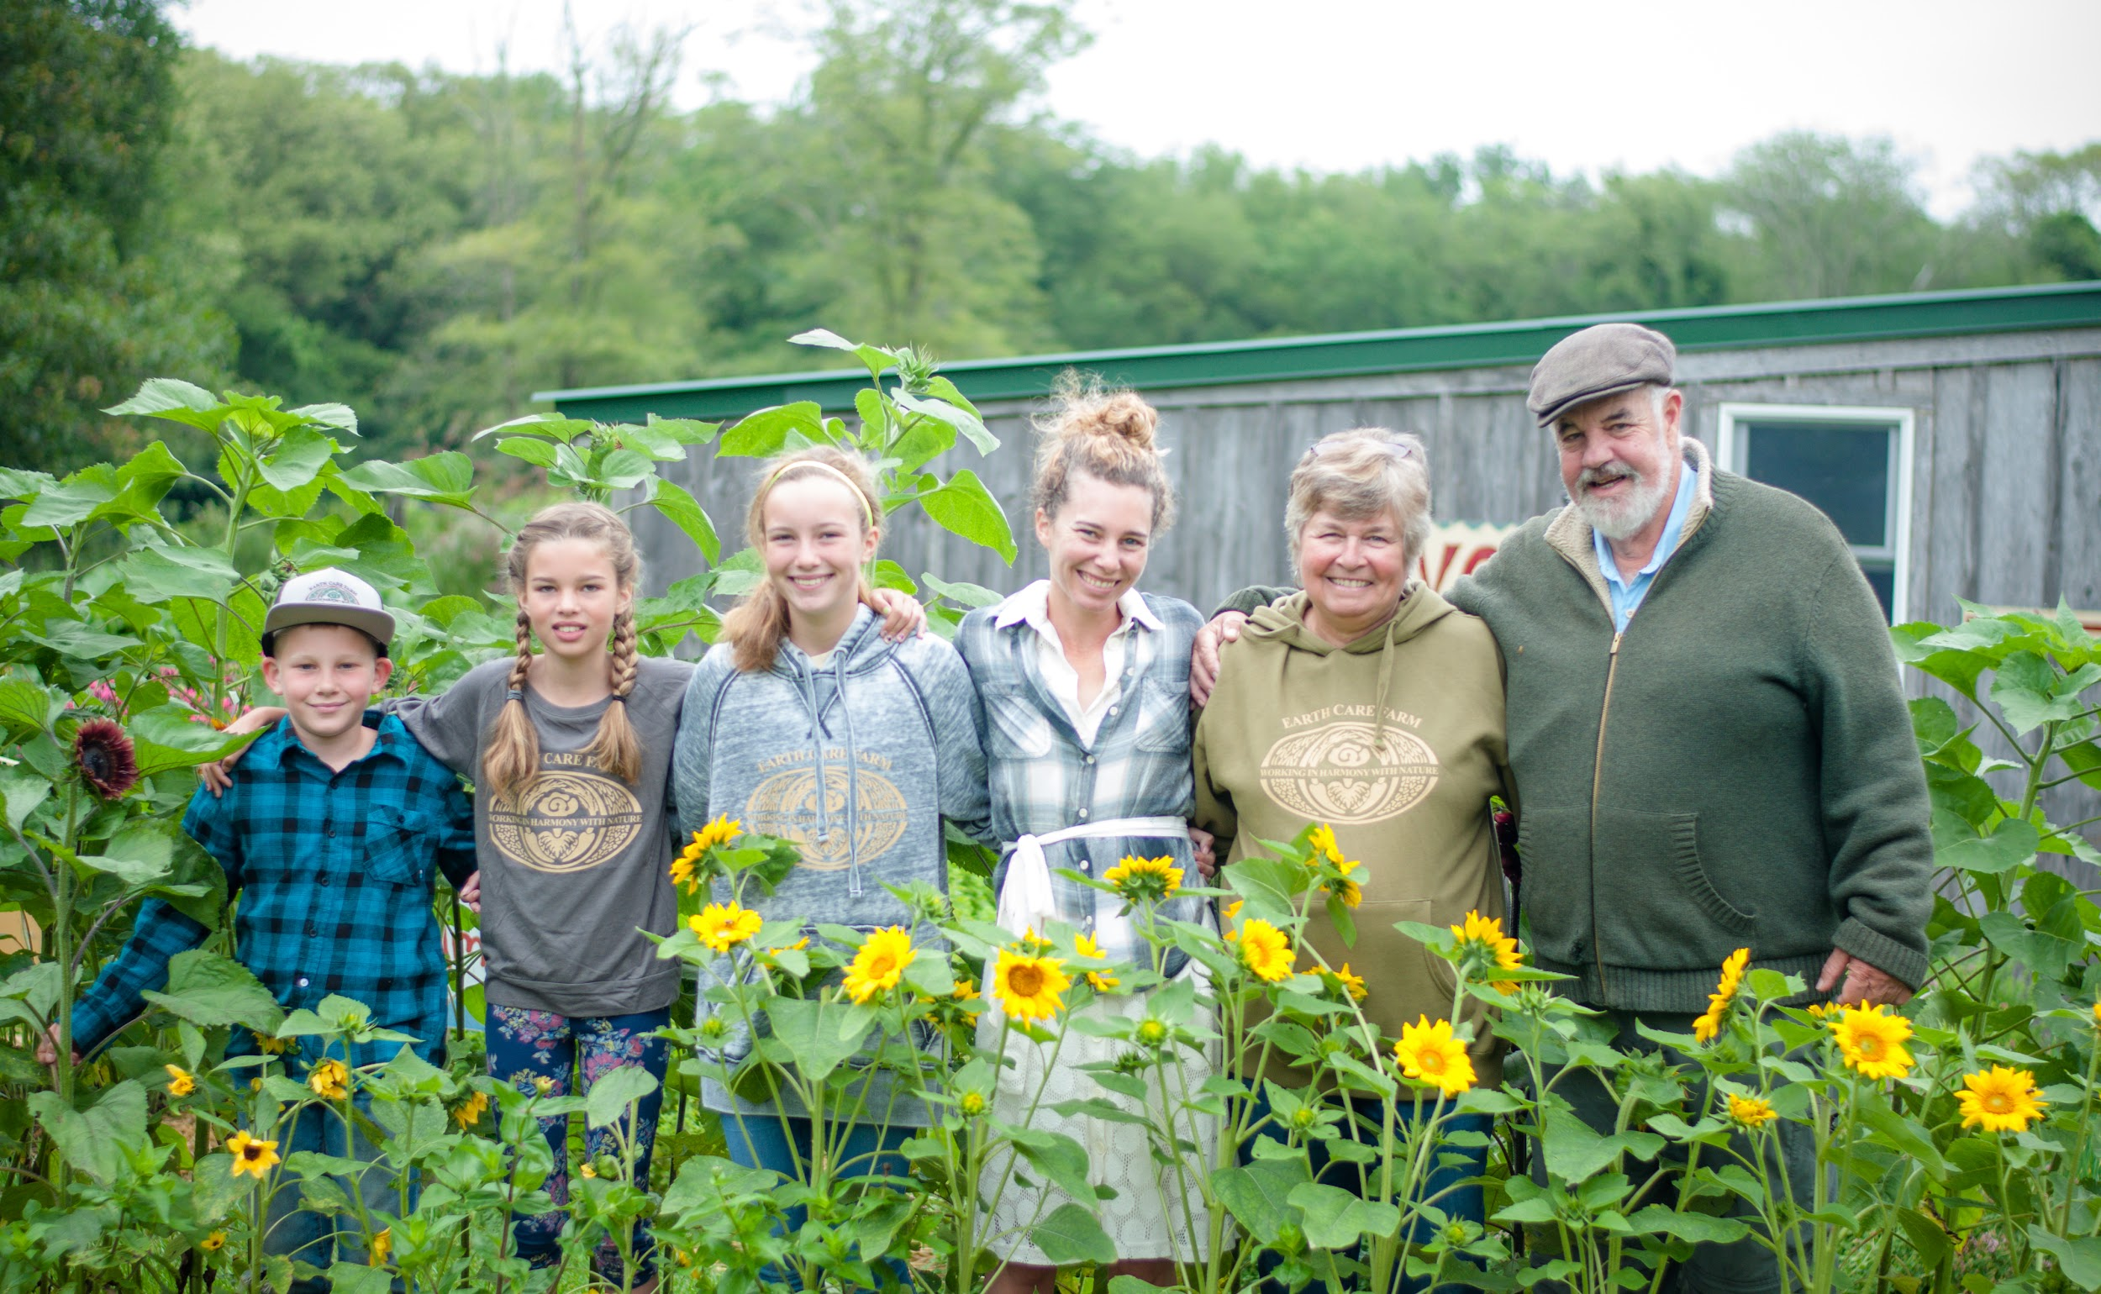
Mike retired in 2016 and passed the torch to Jayne Merner

Slide 4
Notes:
Current 27 acre farm in Charlestown, RI

Slide 5
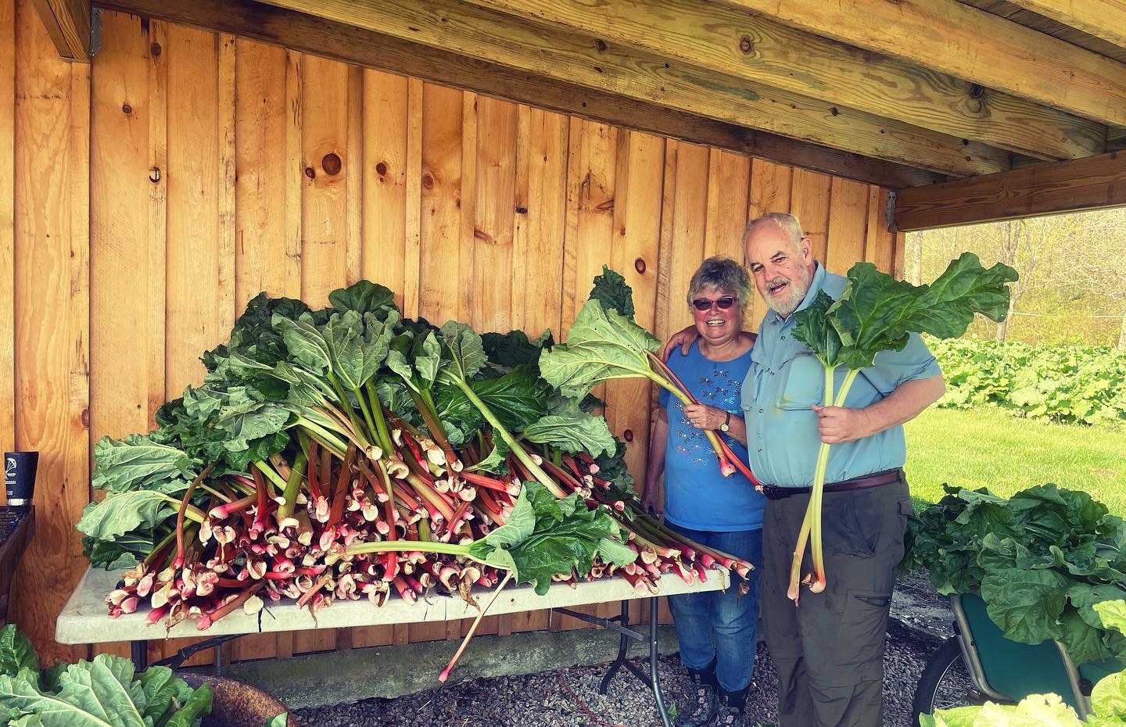
Compost Improves soil structure and stability
Binds particles-acts like glue:
Reduces compaction:
Increases porosity:
Notes:
Show garden soil

Slide 6
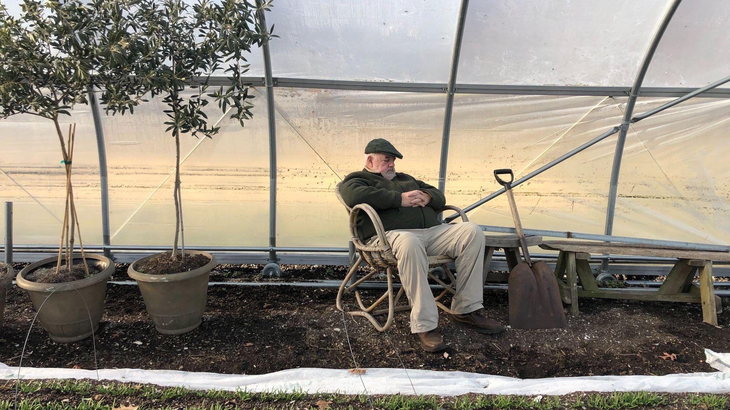
Enhances water management
Increases water-holding capacity:
Improves infiltration:
Reduces erosion:

Slide 7
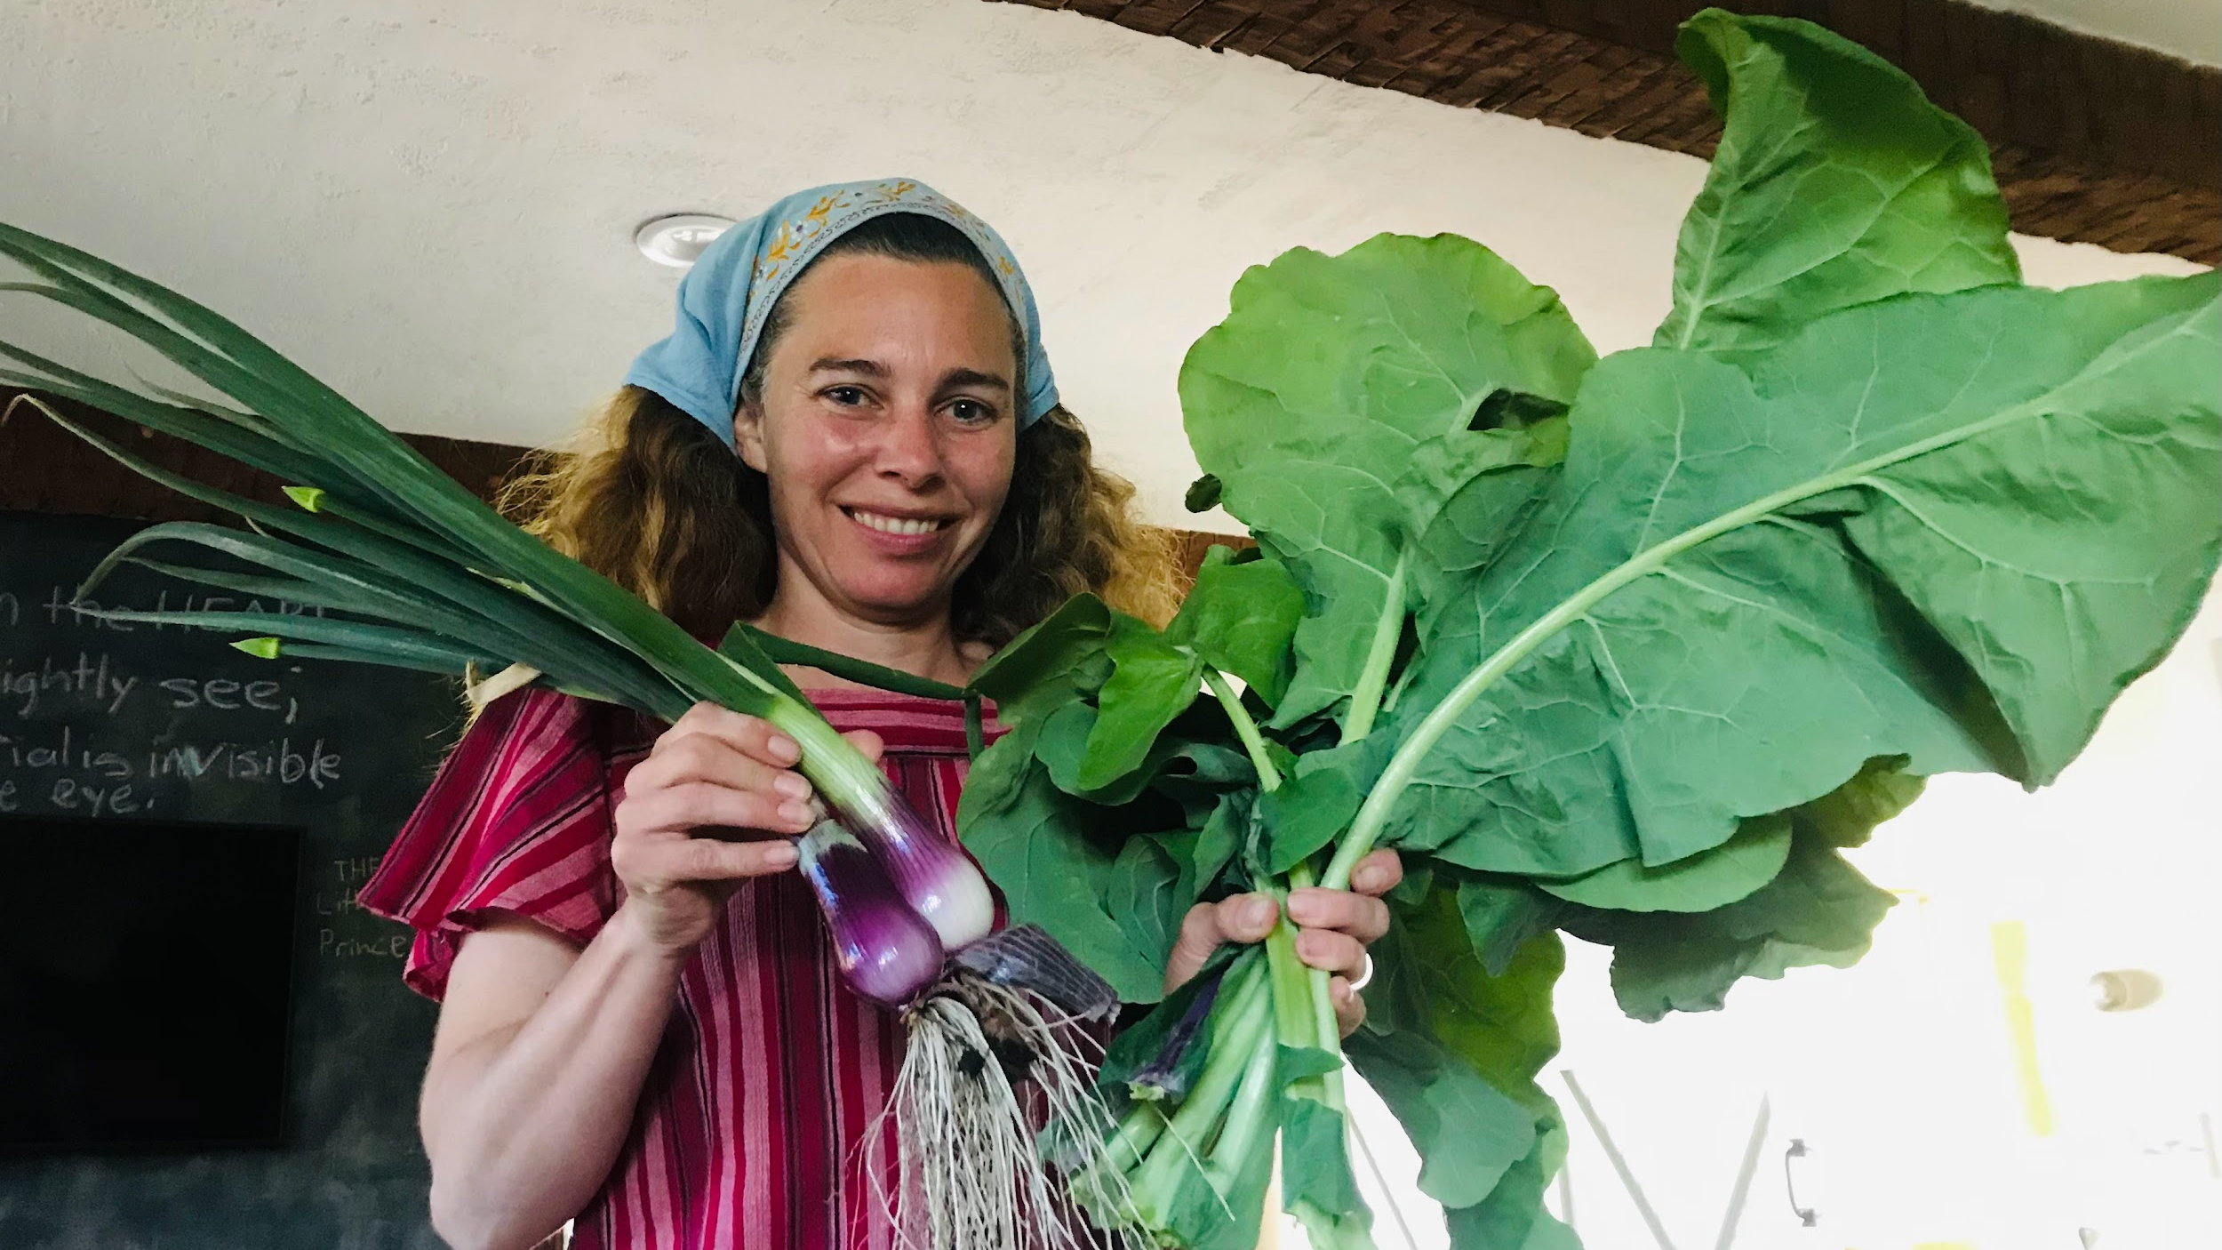
Supports a healthy and active soil ecosystem
Feeds soil life:
Boosts nutrient cycling:
Resists nutrient run off into waterways:
Notes:
Show sweet potato

Slide 8
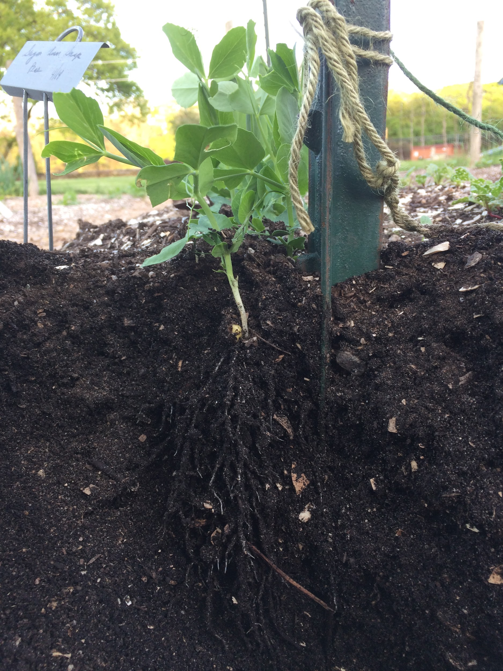
How to Keep Compost and Soil Healthy:
Think like a microbe!
Microbes need oxygen:
  Avoid compaction:
  minimize tilling,
  don’t walk on the planting areas
Microbes need food: (organic matter)
  Add compost
  keep the ground covered with plants as much as possible
  mulch around plants
Microbes need water (but not too much!)
  keep soil moist

Slide 9
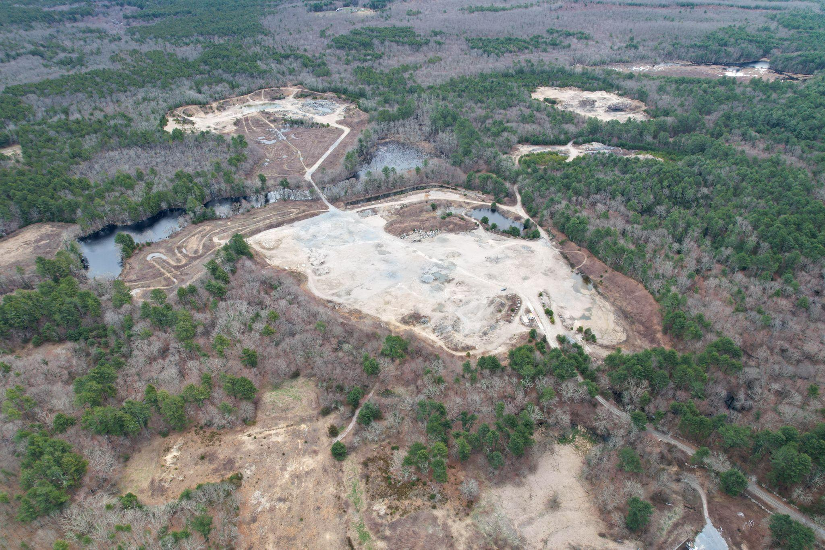
Exciting Expansion News!
Sterling, CT
241 acres
Notes:
New Land in Sterling, CT 241 acres

Slide 10
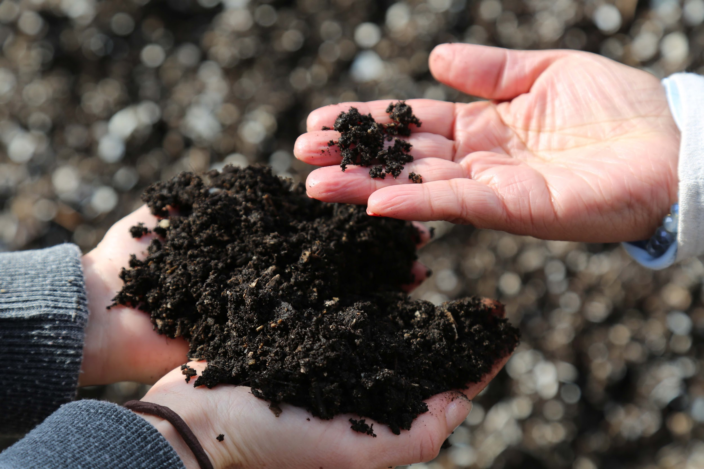
Email: jayne@earthcarefarm.com
Website: earthcarefarm.com

Slide 11

Thank you! Email: jayne@earthcarefarm.com
Website: earthcarefarm.com

