Slide 1

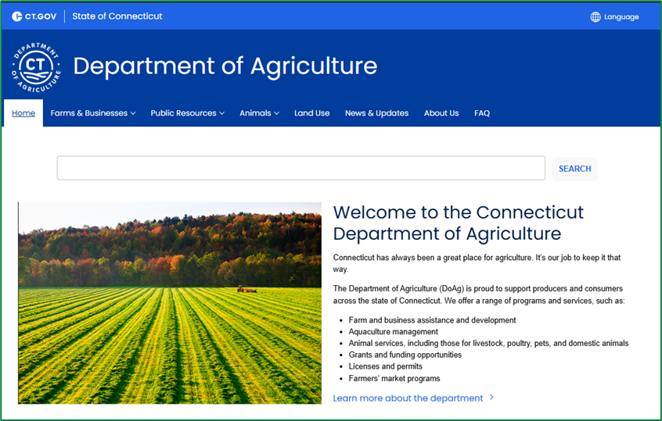
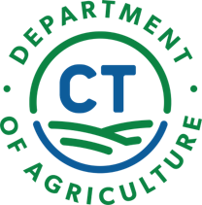
An Overview of CT DoAg’s
Services and Programs
AliRose Grabarz, M.S.
Ag Marketing & Inspection Rep. 2
Alison.Grabarz@ct.gov
www.CTGrown.gov

Slide 2


Who we are
CT DOAG
Ag. Development and Resource Conservation
Regulatory Services
Aquaculture
Grant Programs
Farmland Preservation
Ag Commodities
Dairy and Livestock
Animal Population and Control
State Animal Control
Licensing
Recreational and Commercial Shellfishing
Shellfish Rehabilitation and Enhancement
Shell Recovery and Recycling
Climate Smart
The mission of the Department of Agriculture is to foster a healthy economic, environmental and social climate for agriculture by developing, promoting, and regulating agricultural businesses; protecting agricultural and aquacultural resources; enforcing laws pertaining to domestic animals; and promoting an understanding among the state's citizens of the diversity of Connecticut agriculture, its cultural heritage and its contribution to the state's economy.
CONNECTICUT DEPARTMENT OF AGRICULTURE
450 Columbus Blvd, Suite 703 | Hartford, Connecticut 06103 | 860.713.2500
www.CTGrown.gov
Bureau of Agriculture Development & Resource Conservation
Affirmative Action/Equal Employment Opportunity Employer
Notes:
The State of CT is currently home to 5,058 farms, which keep over 370,000 acres of farmland in active production.
The Bureau of Agricultural Development and Resource Conservation directs programs and activities that assist persons in entering, diversifying, and expanding their agricultural businesses. It administers the Farmland Preservation Program and the Farmers' Market Nutrition Program.
The Bureau of Regulatory Services manages the regulation and inspection of agricultural products and commodities and provides services to ensure food safety. The bureau also enforces the law with regard to the humane treatment of animals and animal diseases.
The Bureau of Aquaculture oversees marine and inland aquaculture production activities, administers the state Shellfish Sanitation Program, and operates the laboratory facility in Milford, leasing, and restoration of shellfish beds and licensing of persons engaged in commercial harvesting of shellfish. The bureau leads an interagency board created by legislation to develop a strategic statewide plan for inland aquaculture.

Slide 3
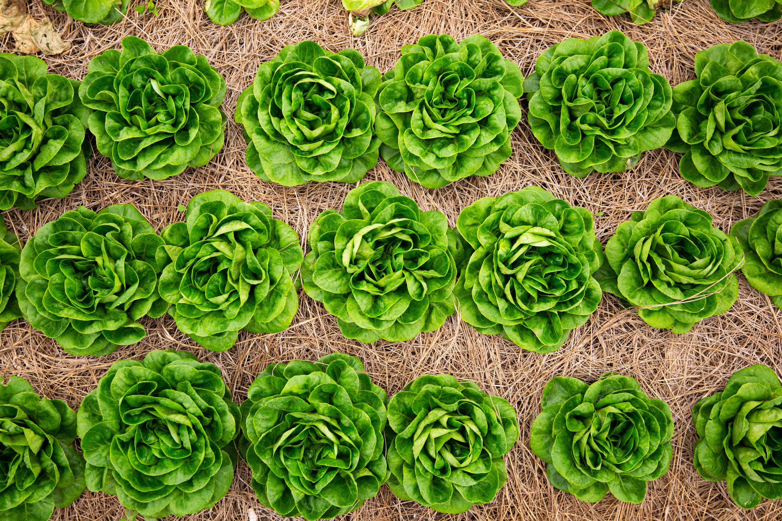


Regulatory Services
Enforces food safety laws relating to:
Dairy safety (fluid milk, fluid milk products, and cheese)
  Inspection, surveillance, and testing of milk producers, milk processors, and cheese manufacturers, advisory, implementation of the Pasteurized Milk Ordinance (PMO)
Ag Commodities
  Produce Safety-Implementation and oversight of Food Safety Modernization Act and CT Good Agricultural Practices
  Honey, maple syrup, shell-eggs
  Small poultry slaughter -CT Small Poultry Processor Inspection Program is available to any poultry producer of not more than five thousand (5,000) turkeys or twenty thousand (20,000) poultry whose products are sold or offered for sale
  Animal feed , Seed, Fertilizer- inspection, sampling and label compliance

Slide 4
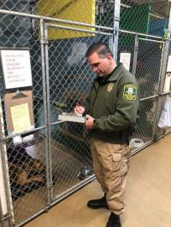
Regulatory Services
Enforces domestic animal laws relating to:
Animal control
  Domestic animals, rabies, animal neglect/abuse investigations.
  Inspections of commercial kennels, pet stores, training, and grooming facilities
Animal population control
  Information on dog and cat spay/neuter programs
  Vaccinations
  Application to license dogs
  The CT vanity plate for vehicles known as the "pet" plate program
  The feral cat grant program
State Veterinarian/animal health
  Livestock, poultry, and animal disease surveillance/traceability
  Poultry or Bird Import permit
  Livestock Importation permit
CONNECTICUT DEPARTMENT OF AGRICULTURE
450 Columbus Blvd, Suite 703 | Hartford, Connecticut 06103 | 860.713.2500
www.CTGrown.gov
Bureau of Agriculture Development & Resource Conservation
Affirmative Action/Equal Employment Opportunity Employer

Slide 5
Regulatory Services
Regulates:
Growing hemp
  Connecticut has an approved state plan by the USDA for hemp producers.
  Under the state plan, is authorized to issue producer licenses, conduct inspections and investigations, issue penalties, promulgate regulations, issue cease and desist orders, issue hold and destroy orders, and other broad powers to regulate the Hemp industry.
Registering seed, fertilizer, soil amendment, and liming materials
  Samples are collected at retailer, wholesaler, and milling operations and delivered to the CT Ag Experiment Station for testing.
  Monitors product labels for compliance with state and federal law.
Licensing:
  From feed, fertilizer, and seed manufacturers, to pet shops and commercial kennels, to milk processors, raw milk producers, and livestock dealers.
CONNECTICUT DEPARTMENT OF AGRICULTURE
450 Columbus Blvd, Suite 703 | Hartford, Connecticut 06103 | 860.713.2500
www.CTGrown.gov
Bureau of Agriculture Development & Resource Conservation
Affirmative Action/Equal Employment Opportunity Employer

Slide 6
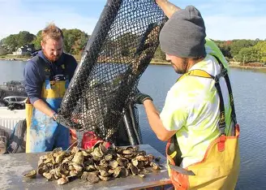
Aquaculture
Oversees the production, harvest, and sale of aquatic plants (seaweed) and animals
  Connecticut shellfishing generated over $16 million in farm-gate sales in 2023
  The Connecticut shellfishing industry provides over 300 jobs statewide
  More than 61,000 acres of shellfish farms are now under cultivation in CT’s coastal waters
Enforces commercial regulations
  Industry meetings
  Shellfish bed types and management
  Direct marketing
Offers training opportunities
  Foundations of Shellfish Farming Training Course, CT Sea Grant through UConn
Distributes shellfish licenses and permits
Provides recreational shell fishing maps and guidance
  Common shellfish species, shellfish size and daily limit restrictions, and permit fees
CONNECTICUT DEPARTMENT OF AGRICULTURE
450 Columbus Blvd, Suite 703 | Hartford, Connecticut 06103 | 860.713.2500
www.CTGrown.gov
Bureau of Agriculture Development & Resource Conservation
Affirmative Action/Equal Employment Opportunity Employer

Slide 7
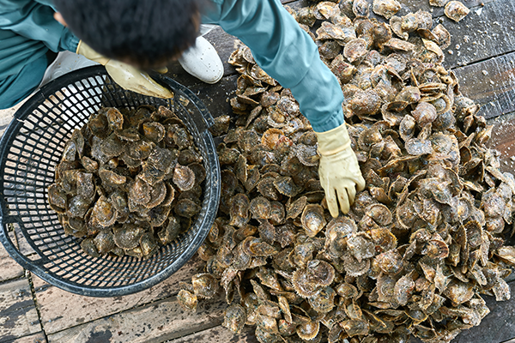
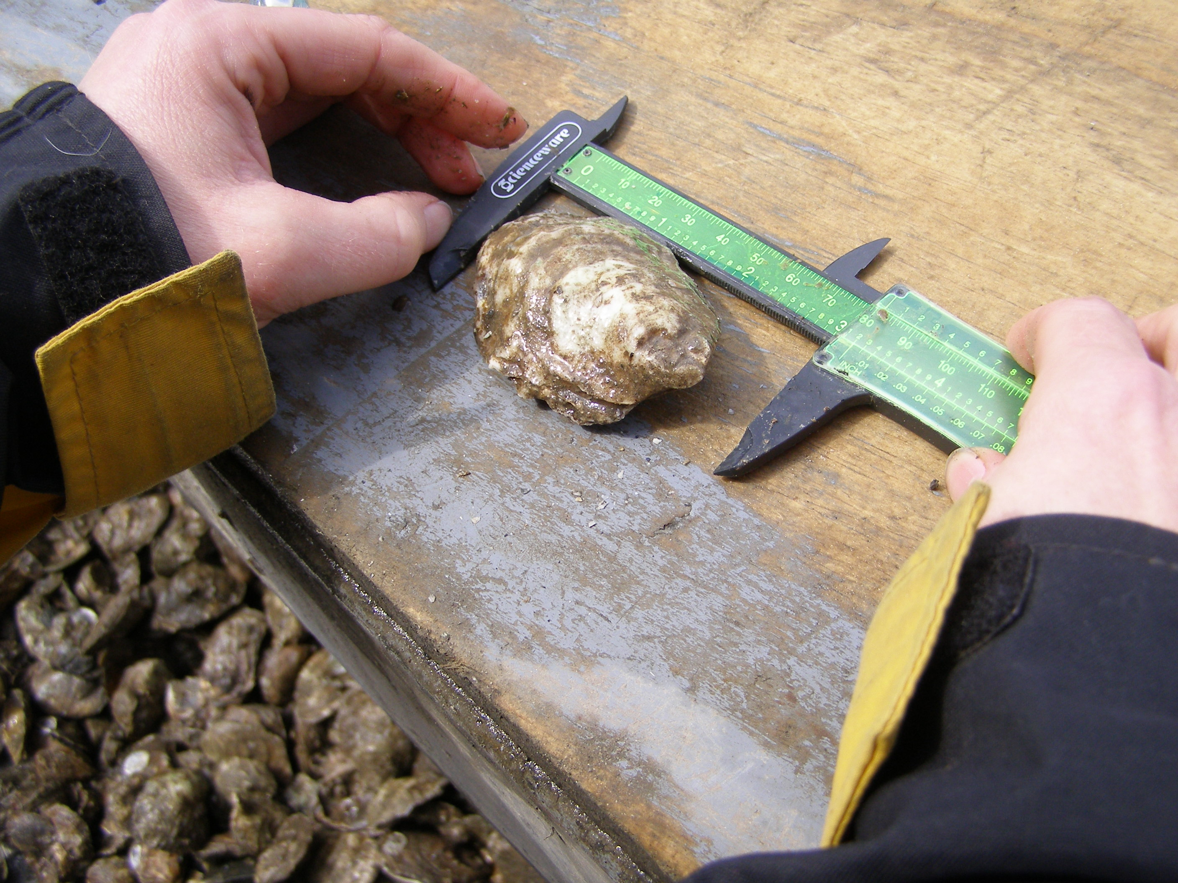
Aquaculture
Laboratory Services
  Conducts seawater and shellfish tissue testing to ensure food safety standards are adhered to
  Viral testing
  Harmful algal bloom and biotoxin testing
  Vibrio testing
Testing especially important after large rainfall events
  Results may result in area closures
Partners with organizations administering shell-recycling programs to rehabilitate shellfish beds and the surrounding ecosystem
CONNECTICUT DEPARTMENT OF AGRICULTURE
450 Columbus Blvd, Suite 703 | Hartford, Connecticut 06103 | 860.713.2500
www.CTGrown.gov
Bureau of Agriculture Development & Resource Conservation
Affirmative Action/Equal Employment Opportunity Employer

Slide 8
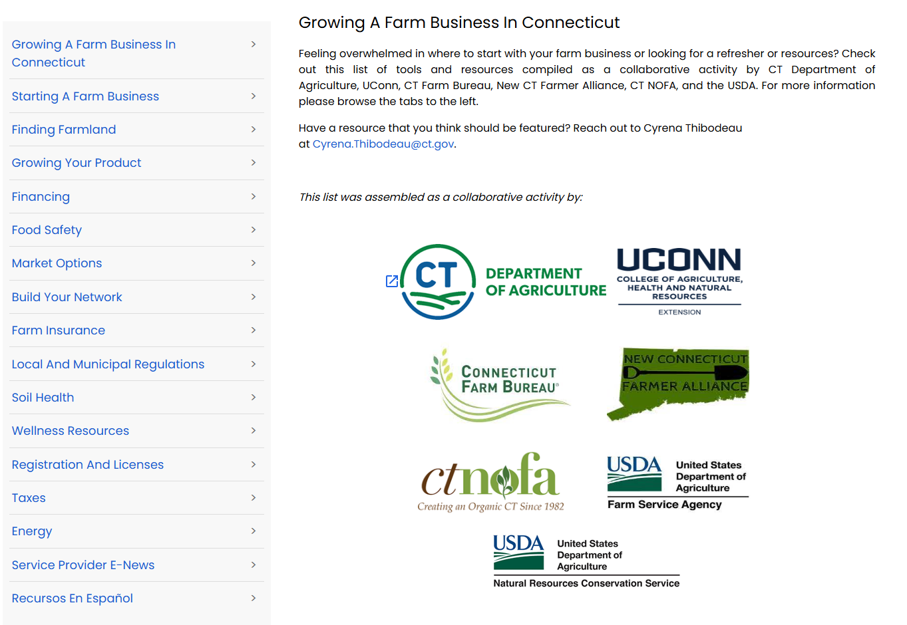
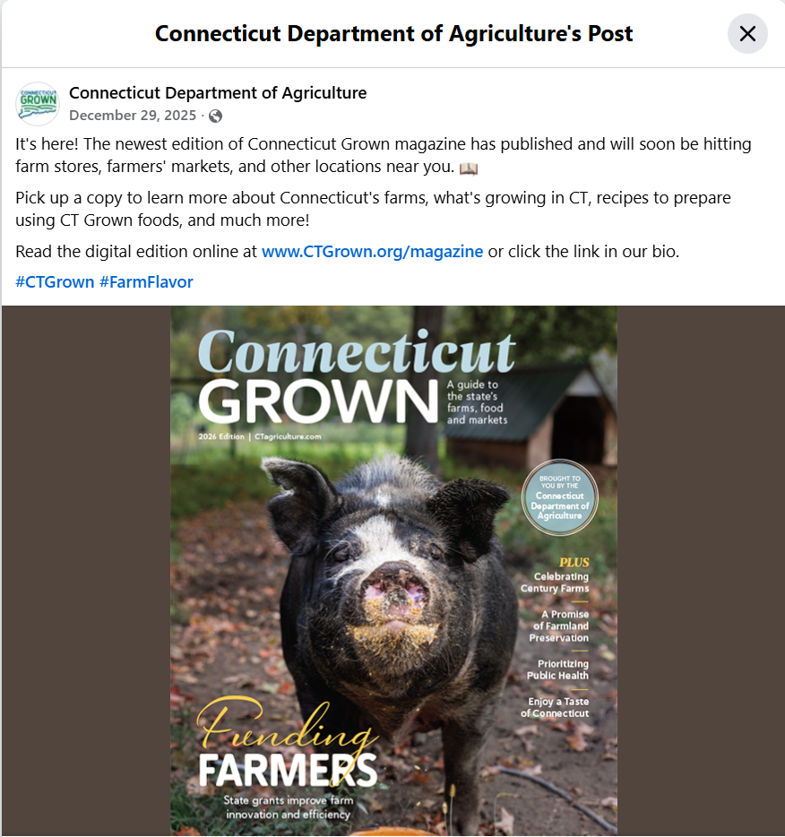

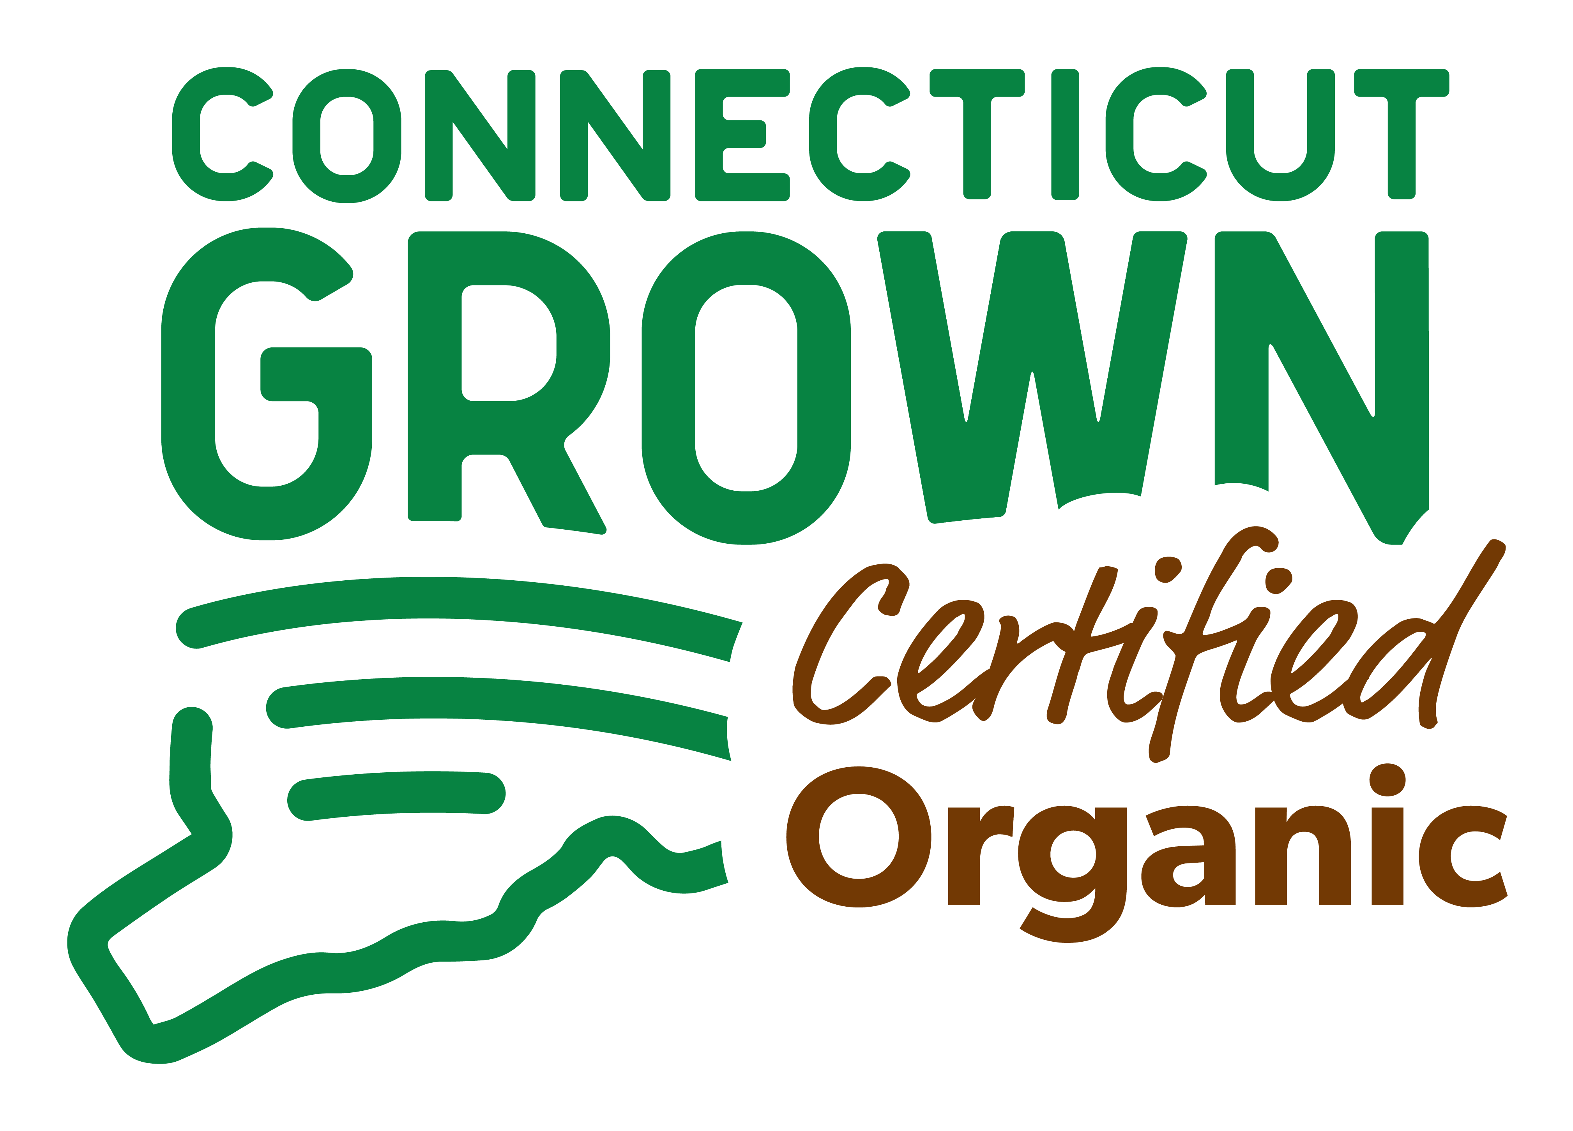
Agricultural Development
Assist persons in entering, diversifying and expanding their agricultural businesses
  Administers various State & Federal grant programs
  Offers educational workshops/trainings related to applying for grants, marketing, and branding
  Technical assistance available
  Growing a Farm Business
Food Export Program
Regulates farmers’ markets
  Farmer certification & Farmers' Market Nutrition program
CT Grown / CT Grown organic
  Branding
  Social media campaign
  Newsletters
  Magazine
  Store
CONNECTICUT DEPARTMENT OF AGRICULTURE
450 Columbus Blvd, Suite 703 | Hartford, Connecticut 06103 | 860.713.2500
www.CTGrown.gov
Bureau of Agriculture Development & Resource Conservation
Affirmative Action/Equal Employment Opportunity Employer

Slide 9


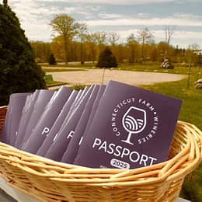
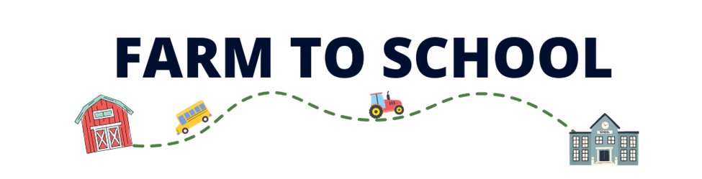
Agricultural Development
Farmland Preservation program
CT Farmlink
  Connecting farmers seeking farmland and farmland owners seeking tenants
Agristress Program
Exhibiting at the Big E
Passport to CT Wine Country
  For licensed farm wineries
Farm-to-School
  In collaboration with UConn’s “Put Local on your Tray”
Food hub / aggregators meetings
Local food purchase agreements
Disaster relief resources
  Farm Recovery & Support Block Grant
CONNECTICUT DEPARTMENT OF AGRICULTURE
450 Columbus Blvd, Suite 703 | Hartford, Connecticut 06103 | 860.713.2500
www.CTGrown.gov
Bureau of Agriculture Development & Resource Conservation
Affirmative Action/Equal Employment Opportunity Employer

Slide 10
Grant Programs--Process
DOAG grants are typically reimbursement grants.
  A portion of the award is received upfront, but the remainder is reimbursed pending project completion and submission of required reporting materials.
Most DOAG grants require a cash and/or in-kind match percentage.
  This percent is based on the project total cost.
  If 50% match is required, a $50,000 project is entitled to receive $25,000, but the other $25,000 must be contributed by the applicant.
Businesses/organizations should be in good standing with the Department of Agriculture, State, and Federal requirements.
Some grants are offered annually; other funding opportunities may become available due to federal or special funding allocations.
All grant applications must be submitted online.

Slide 11
Grant Programs--Eligibility
Farm-Specific Requirements:
  At least one full year of production history
  LLCs & Corps registered with the CT Secretary of State; Sole proprietors & DBAs also eligible
  Farm Tax Exemption permit
  Tenants must have landowner consent for project
Best Practices:
  Maintain & update your website or social media to demonstrate production;
  Connect with State inspectors/regulators (if applicable)
  Work with a local Farm Service Agency (through USDA) office to get your farm number
    Required for federal grant and loan programs
Other requirements for other organization types (nonprofits, municipalities, schools, universities, etc.)
  Each funding opportunity will review eligibility requirements in the comprehensive Guidance document
  Be sure to review this document before applying.

Slide 12
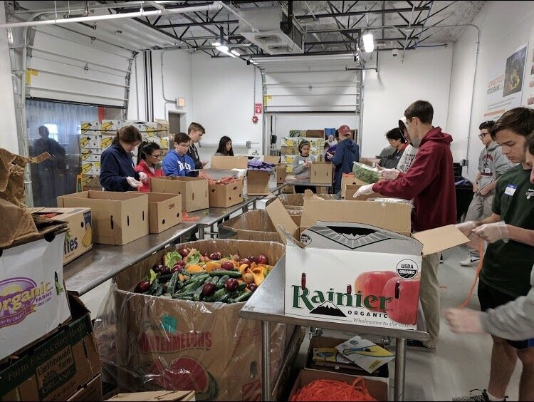
Local Food Purchase Assistance Grant
Open Now Through March 11, 2026
One-Time Allocation
Seeking applications from food hubs, food access organizations, and municipalities with demonstrated capacity to purchase, aggregate, and distribute Connecticut Grown food to underserved communities.
Awards ranging from $100,000 - $310,000
Projects to occur from April 15, 2026, through June 30, 2027
100% of farm products purchased must be grown in Connecticut (CT Grown).
Value-added (pickles, jams, honey, maple syrup, etc.) minimally processed products (frozen and/or cut/chopped,) and prepared meals that are produced in CT and contain predominantly CT Grown ingredients are allowable.
CONNECTICUT DEPARTMENT OF AGRICULTURE
450 Columbus Blvd, Suite 703 | Hartford, Connecticut 06103 | 860.713.2500
www.CTGrown.gov
Bureau of Agriculture Development & Resource Conservation
Affirmative Action/Equal Employment Opportunity Employer

Slide 13
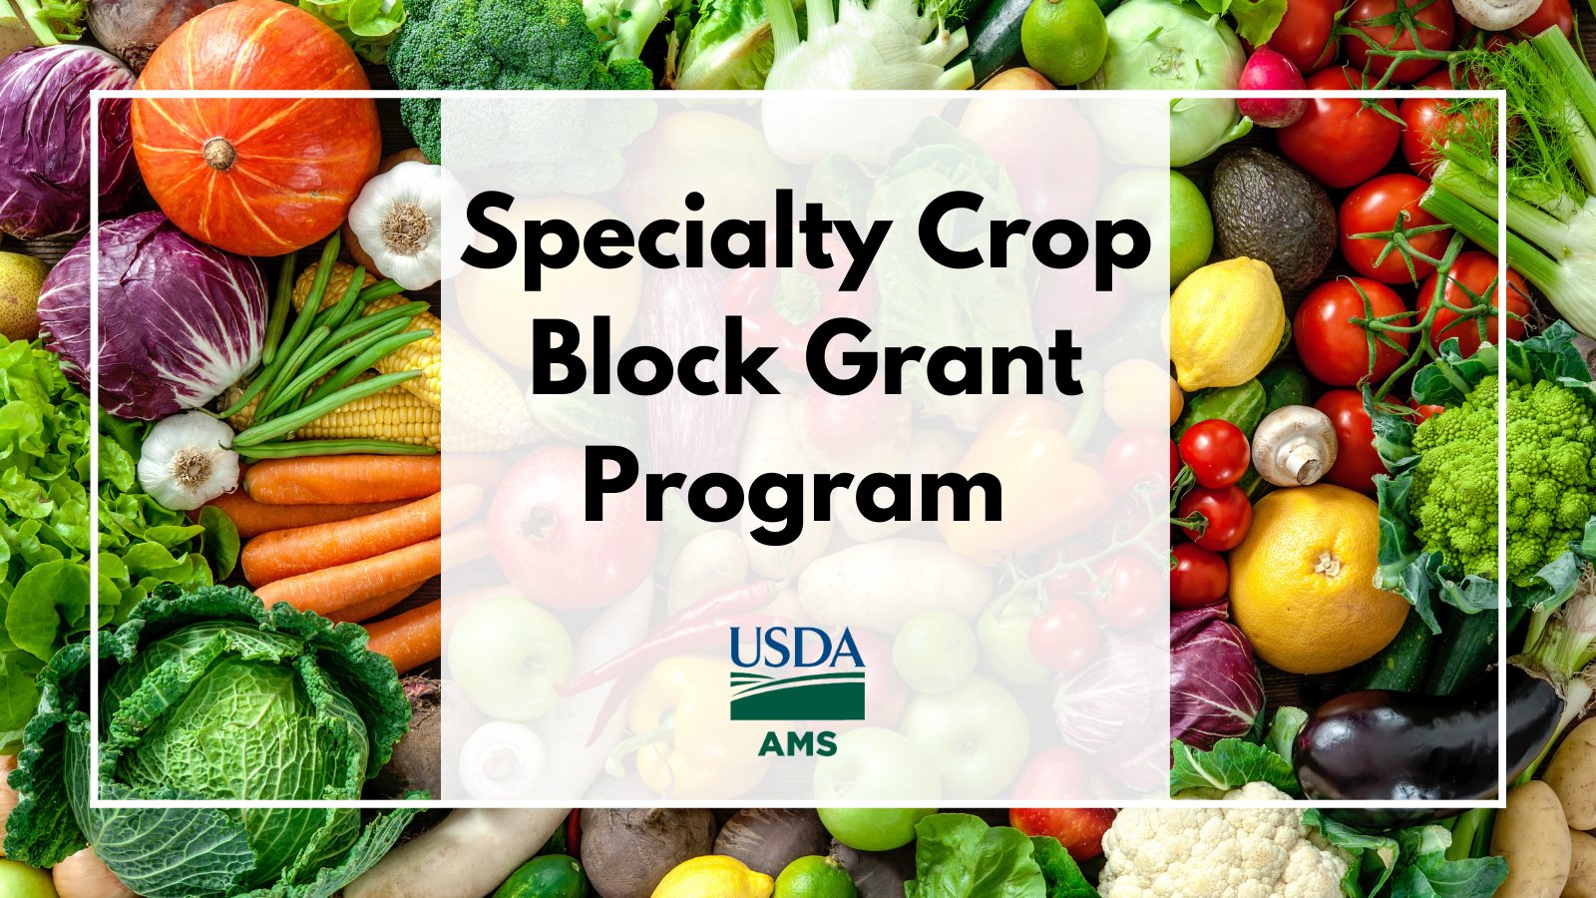
Specialty Crop Block Grant
Open Now Through March 16, 2026
Annual
Seeking applications from universities/colleges, municipalities, registered nonprofits, State agencies, councils of government, and producers to enhance the competitiveness of specialty crops.
Awards up to $100,000
Specialty crops are defined by the USDA as fruits and vegetables, dried fruit, tree nuts, maple syrup, honey, horticulture, and nursery crops.
Projects must impact and produce measurable outcomes for the specialty crop industry and/or the public.
Priorities:
  Research, Innovation, and Knowledge Transfer
  Market Development and Consumer Engagement
  Specialty Crop Producer Education, Development, and Networks
  Integrated Technical Assistance and Capacity Building for Ag Viability
  Food Safety and Regulatory Compliance
CONNECTICUT DEPARTMENT OF AGRICULTURE
450 Columbus Blvd, Suite 703 | Hartford, Connecticut 06103 | 860.713.2500
www.CTGrown.gov
Bureau of Agriculture Development & Resource Conservation
Affirmative Action/Equal Employment Opportunity Employer

Slide 14
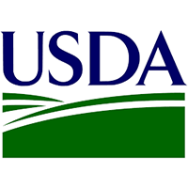
Organic Cost Share Program
Anticipated Spring 2026
Annual
Federal program: Combination of the National Organic Certification Cost Share Program and the Agricultural Management Assistance Organic Certification Cost Share Program
Reimbursement of costs for receiving and maintaining organic certification
  75% of the operation’s total allowable certification costs, up to a maximum of $750 per scope (crops, livestock, wild crops, handling/processing, and State Organic Program fees)
Due to a program pause last year, the 2025 & 2026 rounds are anticipated to be run simultaneously in 2026.
Application release is currently pending USDA instructions and approval to implement.
CONNECTICUT DEPARTMENT OF AGRICULTURE
450 Columbus Blvd, Suite 703 | Hartford, Connecticut 06103 | 860.713.2500
www.CTGrown.gov
Bureau of Agriculture Development & Resource Conservation
Affirmative Action/Equal Employment Opportunity Employer

Slide 15
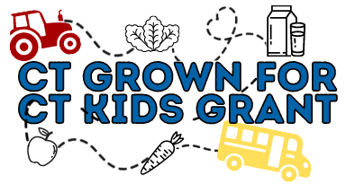
CT Grown for CT Kids Grant
August - October 2026
Annual
This grant category provides financial resources to Connecticut producers for projects and training that must be directly associated with increasing farm sales to schools.
Maximum award: $5,000, no match is required.
Project Examples
  Equipment costs for harvest, wash and pack, sorting, and/or transportation of farm products to schools and ECE buyers.
  Infrastructure such as high tunnels and/or storage to allow for season extension.
  Required trainings and certifications (such as food safety) needed to sell to local schools.
Colleges/universities, schools, school districts, childcare centers, and organizations developing farm-to-school programs or increasing availability of local foods in child nutrition programs are also eligible to apply for up to $50,000.
CONNECTICUT DEPARTMENT OF AGRICULTURE
450 Columbus Blvd, Suite 703 | Hartford, Connecticut 06103 | 860.713.2500
www.CTGrown.gov
Bureau of Agriculture Development & Resource Conservation
Affirmative Action/Equal Employment Opportunity Employer

Slide 16
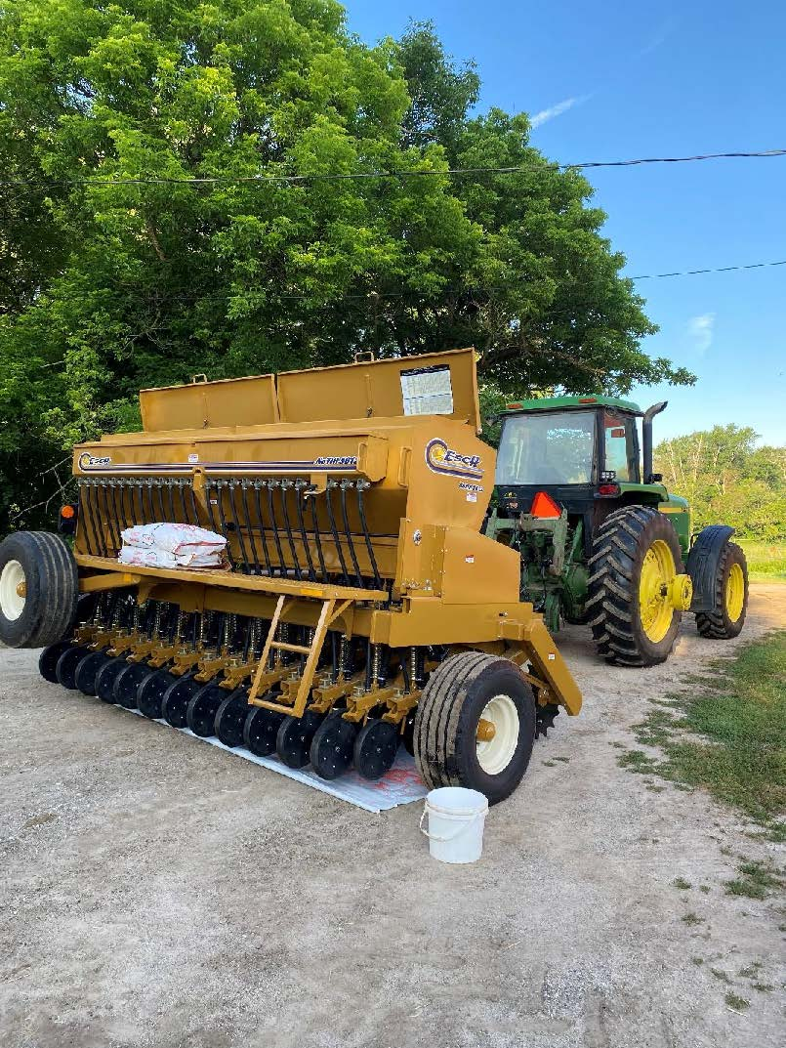
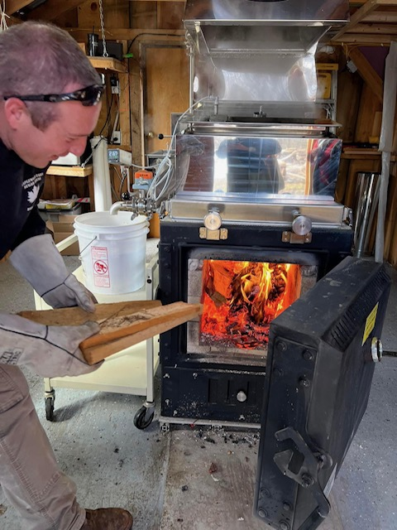
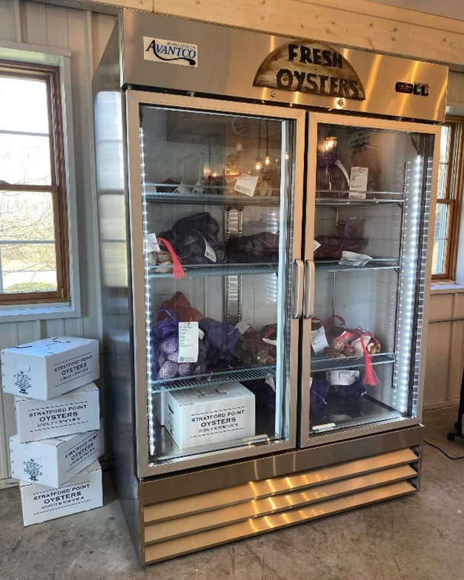
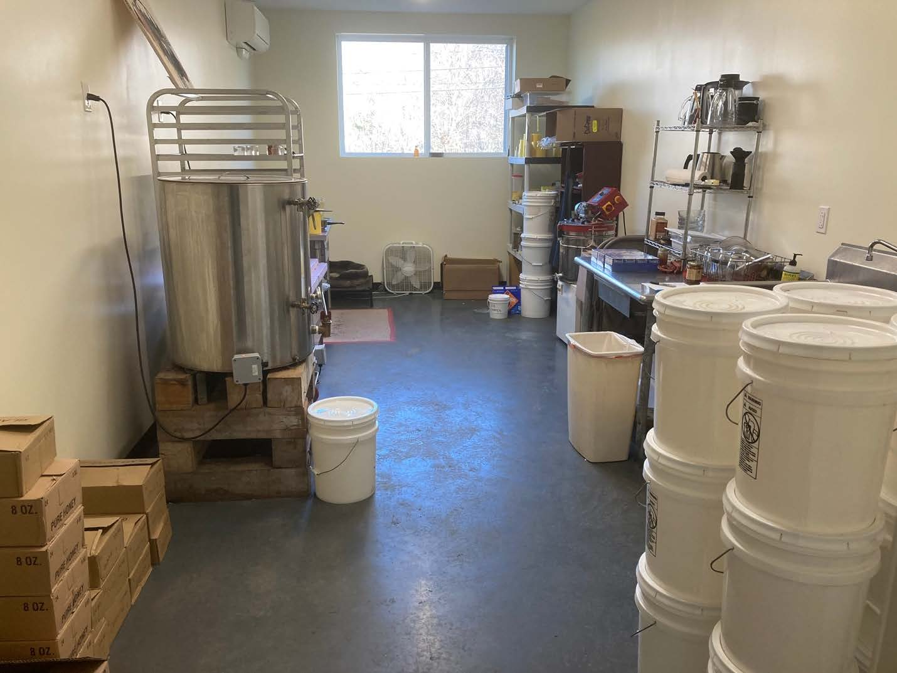
Farm Transition Grant
November 2026 – January 2027
Annual
Provides matching funds to Connecticut farmers and agricultural cooperatives for the diversification of existing farm operations, transitioning to value-added agricultural production and sales.
New Farmer Micro Grant: $5,000 max., 25% match
    Small equipment, buildings, irrigation to increase farm production or efficiency
Infrastructure Investment Grant: $24,999 max., 50% match
    New fencing, barn remodeling/expansion, equipment to increase farm production or efficiency
Research and Development Grant: $24,999 max., 40% match
    Consultant fees, pilot equipment, other expenses related to market evaluation or product development
Innovation and Diversification Grant: $49,999 max., 25% match
    Infrastructure, equipment, software, or consultant fees to produce a new product
CONNECTICUT DEPARTMENT OF AGRICULTURE
450 Columbus Blvd, Suite 703 | Hartford, Connecticut 06103 | 860.713.2500
www.CTGrown.gov
Bureau of Agriculture Development & Resource Conservation
Affirmative Action/Equal Employment Opportunity Employer

Slide 17
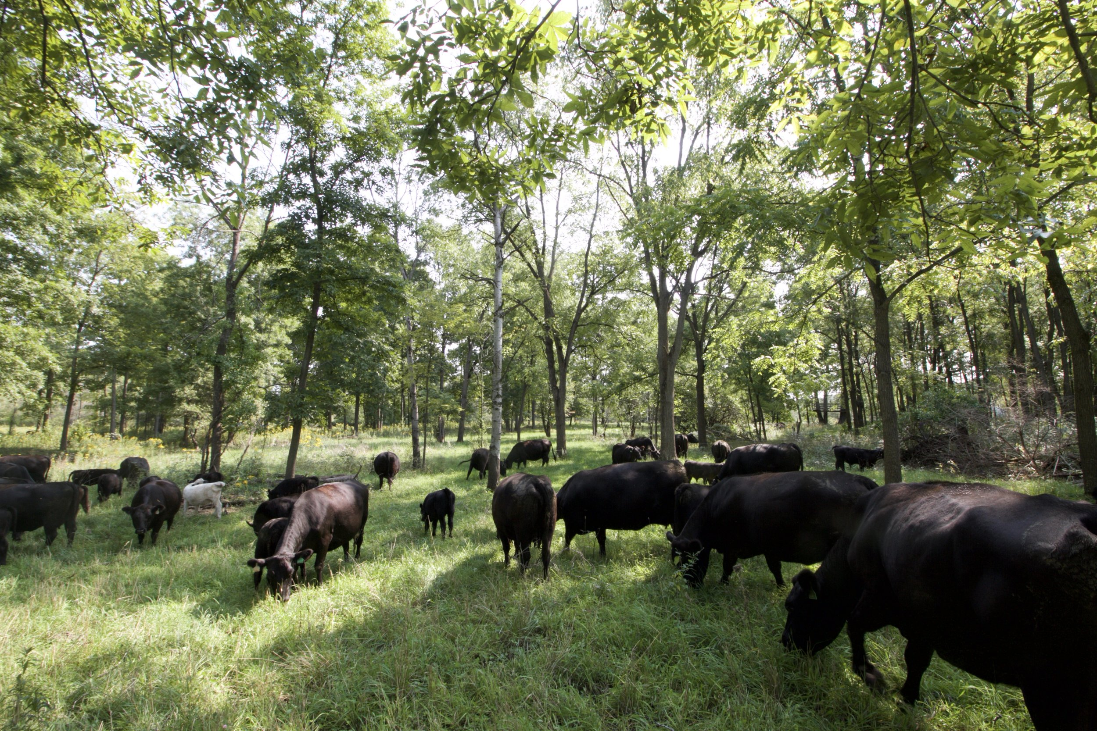
Restoration, Resiliency, and Preparedness Grant
2026 (exact timeline TBD)
Annual
Eligible projects:
Improving soil structure, cover crops, nutrient management
Riparian land management, rainwater collection systems
Agroforestry and silvopasture
Enhanced grazing land management
  Rotational grazing, transitioning crop land to pasture, livestock waste management
Capital Improvements and Purchases
  Rainwater harvesting systems
  Composting systems
  Hydroponics/aquaponics
  Wells
  Fencing
Provides funds to support investments that increase the long-term climate resiliency of farming operations and decrease farm vulnerability to extreme weather events.
Program also involves developing a comprehensive Farmland Restoration and Climate Resiliency Plan (FRCR Plan) for the entire farm.
Awards up to $100,000 with a 10% match requirement.
  Cash and in-kind contributions allowed.
CONNECTICUT DEPARTMENT OF AGRICULTURE
450 Columbus Blvd, Suite 703 | Hartford, Connecticut 06103 | 860.713.2500
www.CTGrown.gov
Bureau of Agriculture Development & Resource Conservation
Affirmative Action/Equal Employment Opportunity Employer

Slide 18
Farm Recovery & Support Grant
2026 (exact timeline TBD)
One-Time Allocation
Federal allocation received “to provide compensation to producers for necessary expenses related to crop, timber, and livestock losses, including on-farm infrastructure, as a consequence of any weather event in 2023 and 2024 that a state, in its sole discretion, determines warrants relief”.
CT DoAg is engaging with USDA weekly to continue negotiations and finalize program parameters.
In January 2026, CT DoAg executed a Statement of Work to contract with SHI International Corp., who is working with Submittable Holdings, Inc. and CohnReznick Advisory LLC., to complete the work plan development and submit to USDA Farm Service Agency for review and approval by March.
It is anticipated that the USDA review and response process will take at least 4-6 weeks, or approximately through mid-April.
Phase 2, which includes creation of the online application portal and deployment of the grant application, can only begin once USDA approves the work plan.
Estimated application acceptance beginning June-July 1, 2026.
CONNECTICUT DEPARTMENT OF AGRICULTURE
450 Columbus Blvd, Suite 703 | Hartford, Connecticut 06103 | 860.713.2500
www.CTGrown.gov
Bureau of Agriculture Development & Resource Conservation
Affirmative Action/Equal Employment Opportunity Employer

Slide 19
Other Upcoming Grant Programs
Application Period: TBD
These new-ish programs were recently funded during the 2025 Legislative Session:
    Shipping Container Farms Grant
    Manure Management Grant
    Crop Loss Reimbursement Grant
Farm Reinvestment Grant
More to come on those in the future!

Slide 20
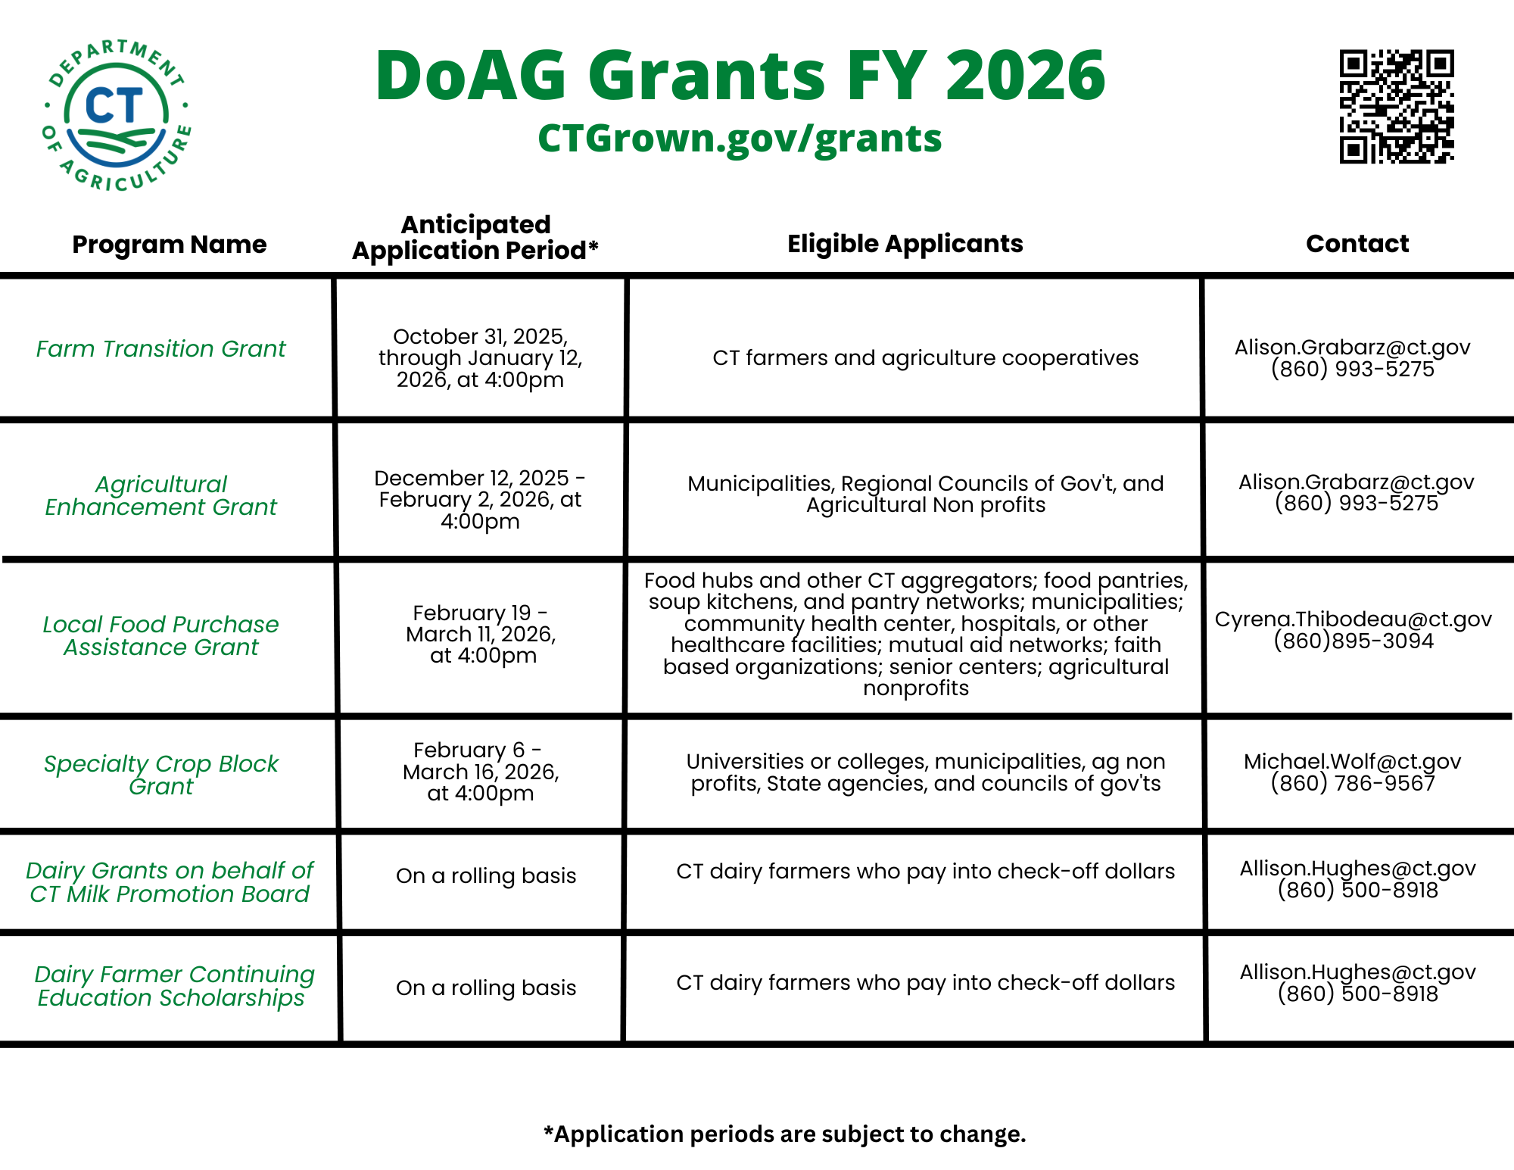
Fiscal Year Timeline for Grants and Programs

Slide 21

Technical Assistance Available
CT Small Business Development Center
Business advising and planning
Grant writing assistance prior to application submissions, focused on DoAg programs
Supporting farm/food system businesses more broadly by providing access to all appropriate CTSBDC services, including:
  Advising in business and product strategy, access to financing, financial management, accessing markets and customers, and other areas as needed
  Providing in-depth assistance to those who are more specifically looking for assistance on the market side of their business (i.e. getting into new markets, creating value added products, assisting producers with a marketing strategy, etc.)
  Leveraging CTSBDC’s proprietary and licensed business management tools and databases
  Assisting clients in strategies to diversify their products and market outlets
  Providing access to CTSBDC’s Business Financial Literacy and Credit Counselling and Immigrant Entrepreneur Assistance programs
Learn more.
To get started, complete the CT SBDC Agricultural intake form.
CONNECTICUT DEPARTMENT OF AGRICULTURE
450 Columbus Blvd, Suite 703 | Hartford, Connecticut 06103 | 860.713.2500
www.CTGrown.gov
Bureau of Agriculture Development & Resource Conservation
Affirmative Action/Equal Employment Opportunity Employer

Slide 22

Technical Assistance Available
The Carrot Project
Supports the financial viability of farm and food businesses by providing information, training, skill-building, and access to capital within a comprehensive support ecosystem.
Prioritizes businesses facing barriers to financial sustainability and is committed to an inclusive food system.
Programs serve start-up, early-stage, expanding, and established farm, food, and fishery businesses—from those accessing land for the first time to those undergoing a farm transition.
Services are free for most clients, with a cost-share for those above asset or income guidelines.
Business Advising & Coaching: personalized, one-on-one advising to help clients meet business goals and improve long-term viability. Their services have a proven record of increasing farm profitability.
Training: Nervous with numbers or have limited experience? Check out their website, calendar, and newsletter to increase your financial know-how! These tools are available nationwide.
Loans & Capital Readiness: The organization offers expert guidance in preparing loan or grant applications, securing loans and loan guarantees, and identifying the most suitable forms of capital for your needs.
Learn more.
To get started, email jcole@thecarrotproject.org
CONNECTICUT DEPARTMENT OF AGRICULTURE
450 Columbus Blvd, Suite 703 | Hartford, Connecticut 06103 | 860.713.2500
www.CTGrown.gov
Bureau of Agriculture Development & Resource Conservation
Affirmative Action/Equal Employment Opportunity Employer

Slide 23

Technical Assistance Available
Tierra Viva Collective
Assist early-stage land-based projects cut through administrative barriers by building alternative systems rooted in community values.
Support land stewards in securing funding, setting up collaborative structures, and building strong, local supply chains.
Helps farmers and producers clarify goals, grow their enterprises, and build sustainable food distribution networks rooted in equity and shared ownership.
Provides tailored mentorship, collaborative research, and capacity-building workshops to support the long-term vision of community-owned land and food systems across the region.
Learn more.
To get started email hello@tierravivacollective.org
CONNECTICUT DEPARTMENT OF AGRICULTURE
450 Columbus Blvd, Suite 703 | Hartford, Connecticut 06103 | 860.713.2500
www.CTGrown.gov
Bureau of Agriculture Development & Resource Conservation
Affirmative Action/Equal Employment Opportunity Employer

Slide 24

Technical Assistance Available
Organic Outreach Specialist, Dave Tschiegg
Available for eligible transitioning and certified organic CT farms
Guidance on participating in the CT Grown certified organic branding and social media campaign
Technical assistance implementing CT Grown certified organic brand and marketing assets
Share insights from organic consumer research report to support market growth and customer engagement
Evaluate current marketing strategies and materials
Make recommendations for enhancing brand messaging and storytelling around certified organic status and products
Assess website and social media presence
Learn more.
To get started request a consultation.
Funding was made possible by the U.S. Department of Agriculture (USDA) Agricultural Marketing Service, Organic Market Development Grant, awarded and administered by the CT Department of Agriculture. Its contents are solely the responsibility of the authors and do not necessarily represent the official views of the USDA.
CONNECTICUT DEPARTMENT OF AGRICULTURE
450 Columbus Blvd, Suite 703 | Hartford, Connecticut 06103 | 860.713.2500
www.CTGrown.gov
Bureau of Agriculture Development & Resource Conservation
Affirmative Action/Equal Employment Opportunity Employer

Slide 25
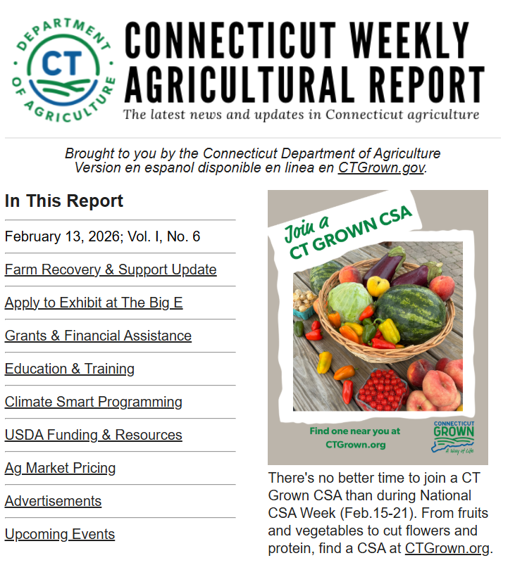
How to stay informed?
Subscribe to the Weekly Agricultural Report.
Check our website often.
Give us a call!

Slide 26
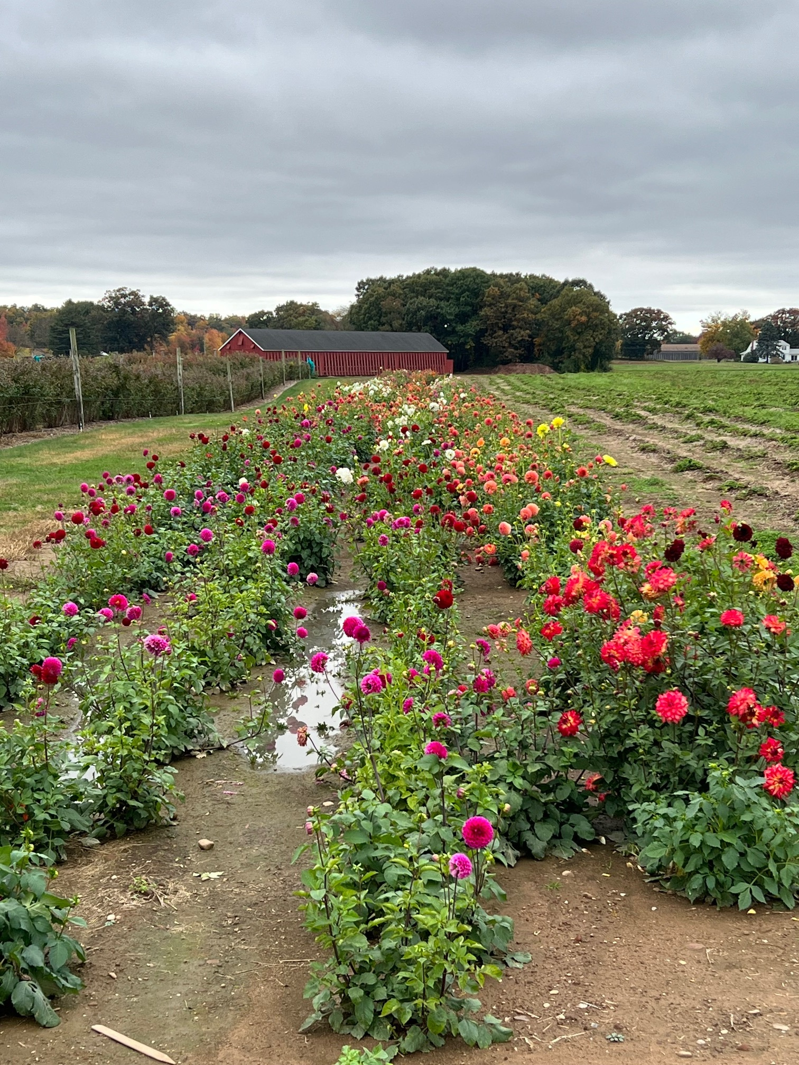
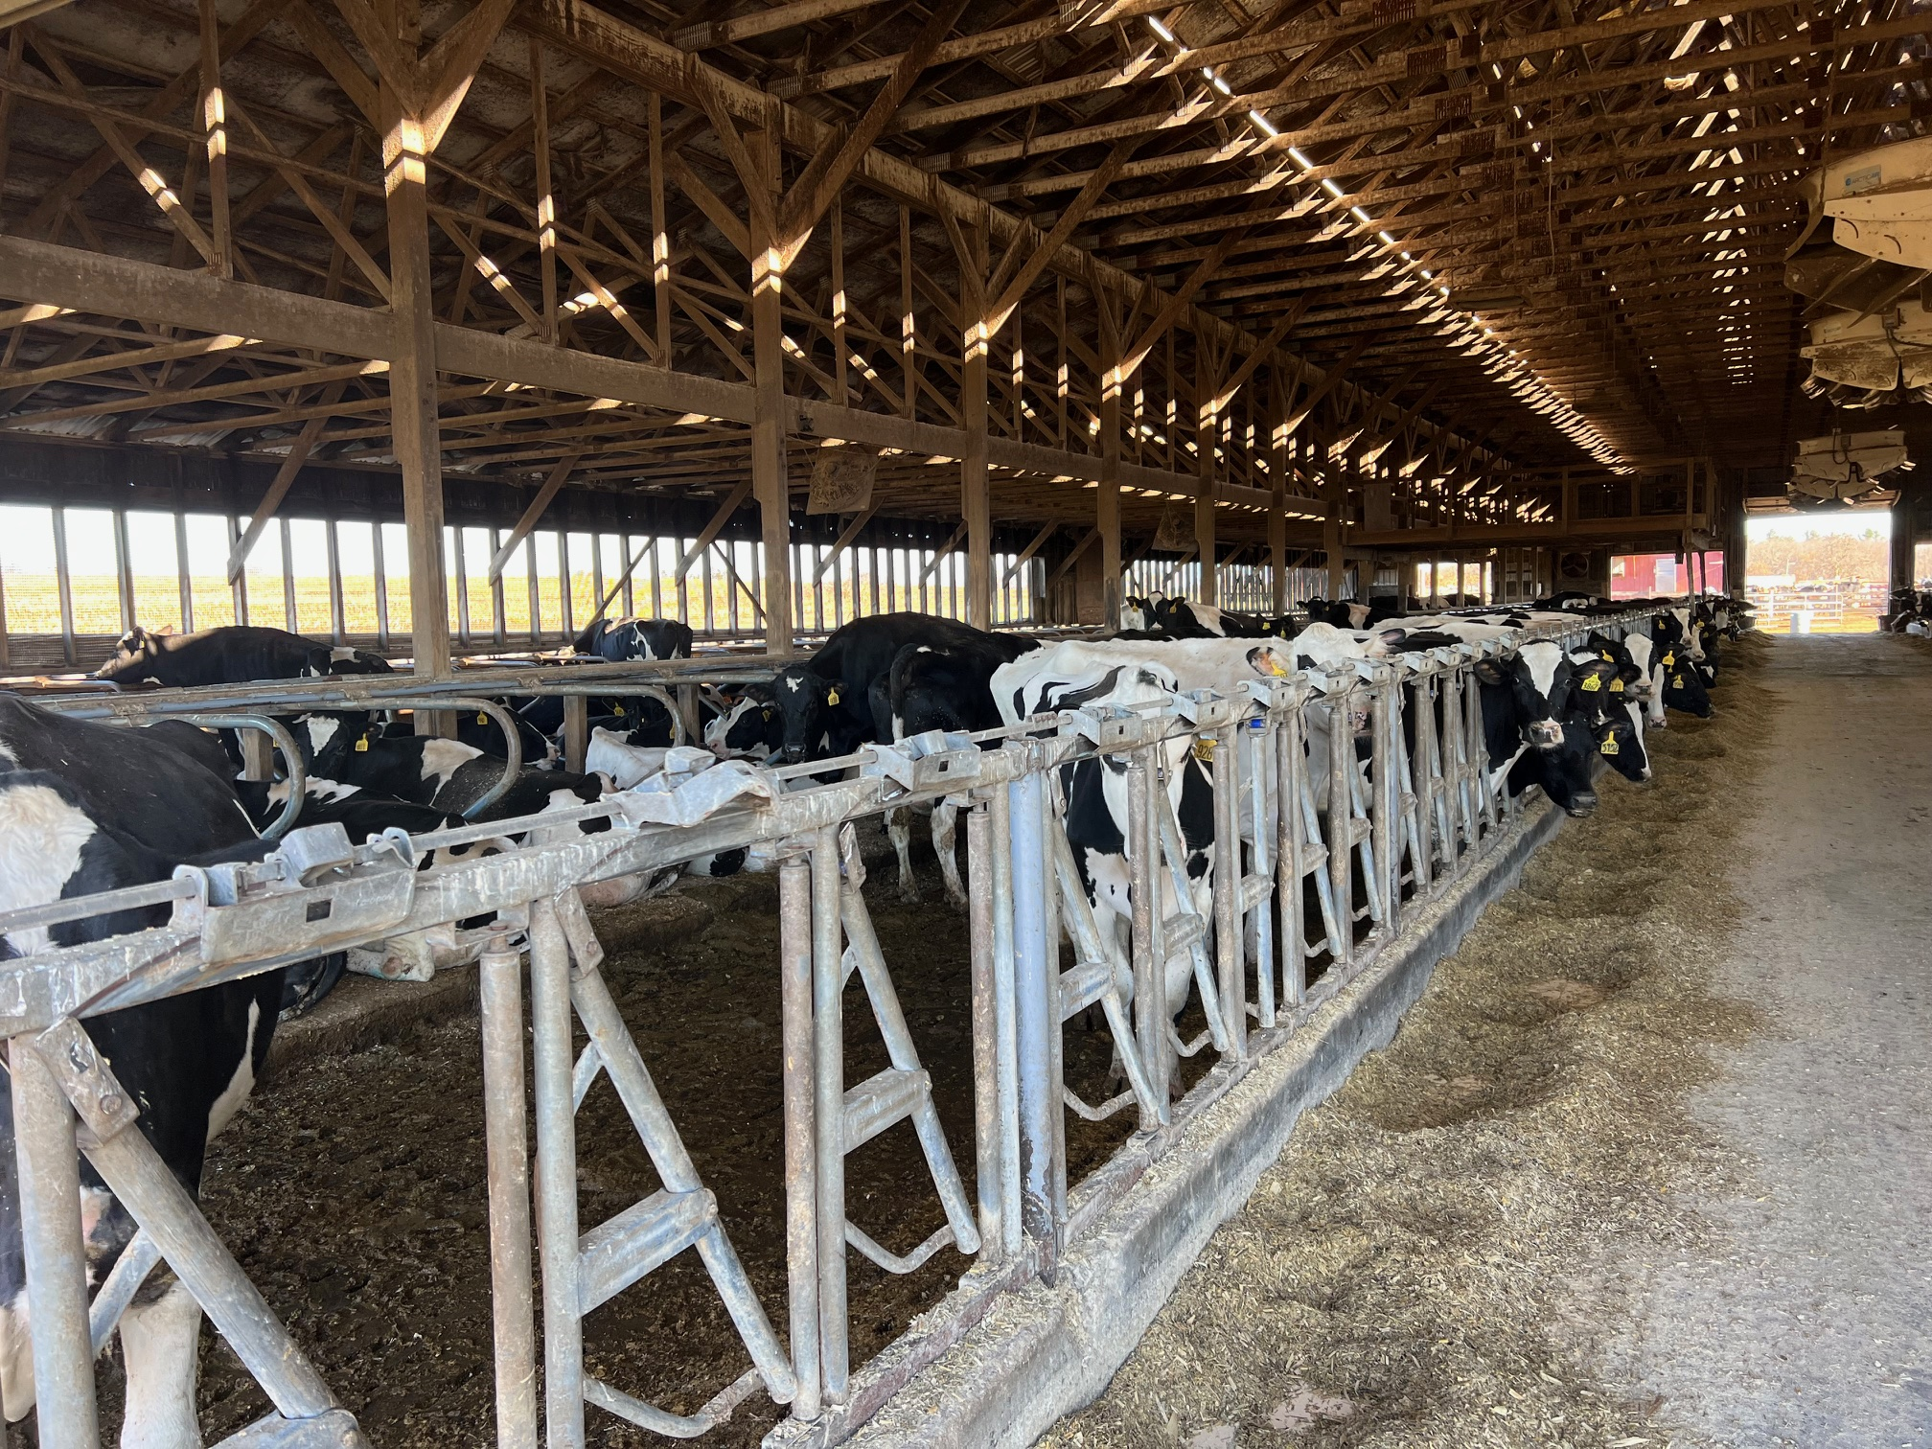
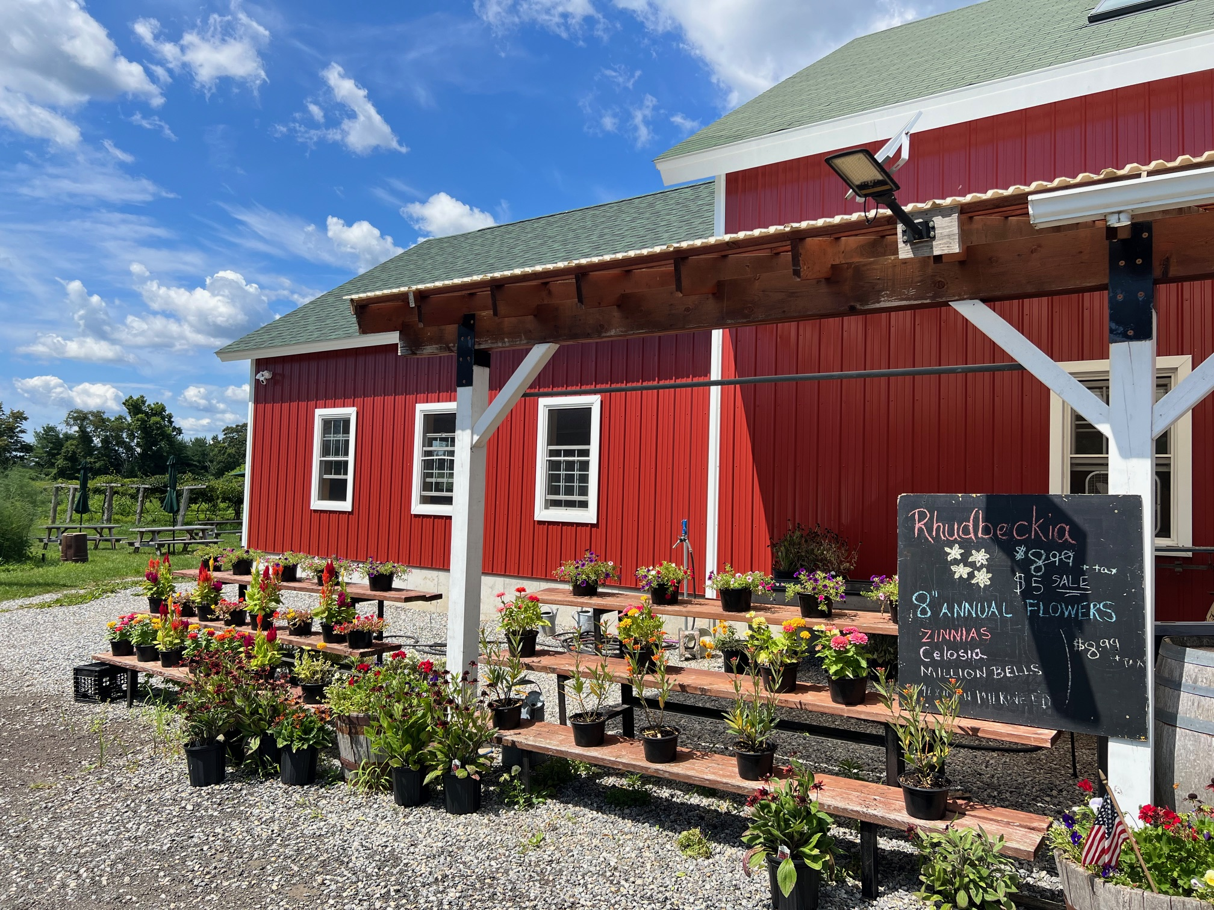
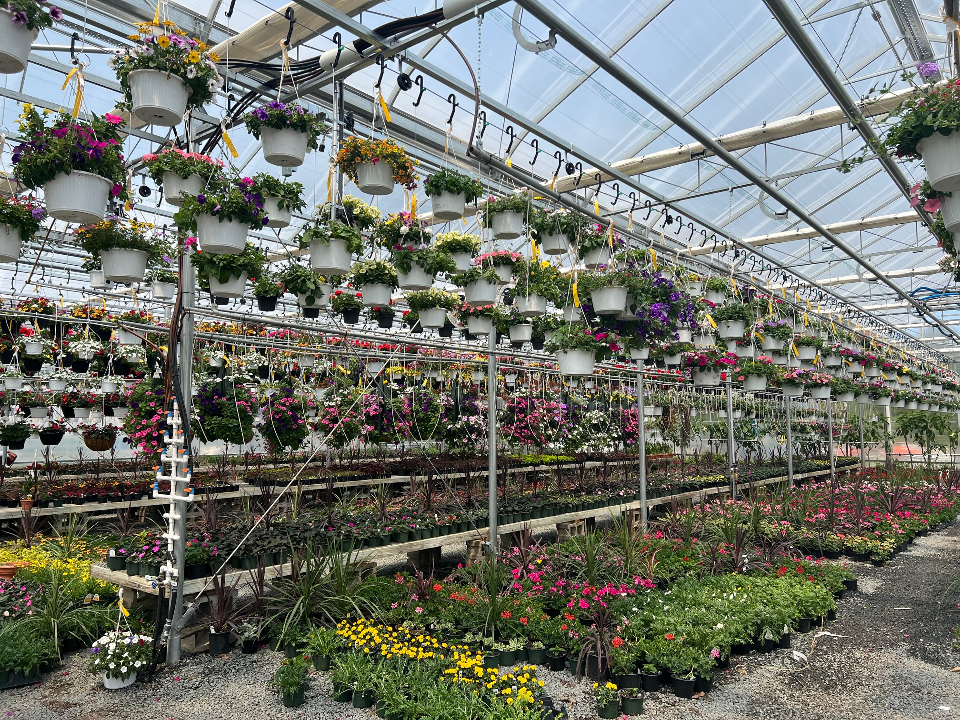
Questions?
You can also reach out after this workshop via:
Alison.Grabarz@ct.gov
(860) 993-5275

